Slide 1
Post-Secondary Financial Aid
2013 - 2014 School Year
www.grasp4virginia.com

Slide 2
What is GRASP?

Slide 3
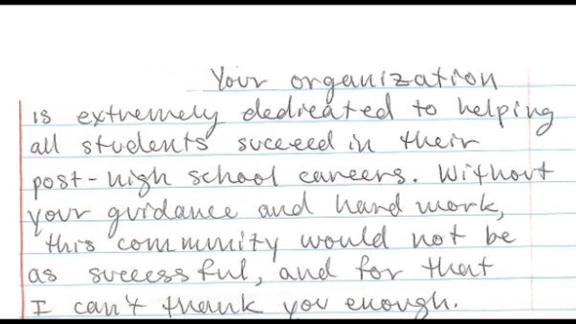
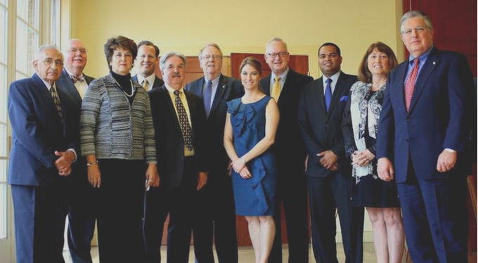
Donors
Who is GRASP?
Students
Advisors
Board of Directors

Slide 4
In 68 Schools, GRASP Advisors …
Appointments through school counseling
On site at least 1 day a week
Confidential and always free
Assist with college financial aid process
Knowledgeable about special circumstances: foster care, adoption, legal guardianship, divorce, financial challenge, layoff
Will help you to not miss opportunities.

Slide 5
Today’s Presentation
As one of GRASP’s community outreach efforts, we present to parents and students outside of the school setting. Typically this is in libraries, but GRASP advisors also present for groups such as the Delta’s who are sponsoring today’s Infinite Scholars program.
Your presenter today is GRASP Advisor Ms. Phenie Golatt. Prior to joining GRASP, Phenie was Director of Financial Aid at Virginia Union University for more than 20 years. She retired from Virginia Union University in October 2006. Mrs. Golatt received her training in financial aid from the U.S. Department of Education and State Council of Higher Education for Virginia. She received additional training from the United Negro College Fund, the College Board, National Association of Financial Aid Administrators (NASFAA), District of Columbia, Washington, D.C., and United Student Aid, Indianapolis, Indiana. She has been a financial aid administrator at colleges in North Carolina and Virginia. She has conducted financial aid workshops for parents and students in the state for more than 20 years. Mrs. Golatt received a B.S. in Business Education from North Carolina Agricultural and Technical State University. She has done post graduate studies at NC Central University, NC State University, and Virginia Tech.

Slide 6
5 Steps to Financial Aid Success
Scour college websites for scholarship dates, priority filing dates for financial aid, application dates
File FAFSA on-time regardless of your perceived financial need
Don’t get “emotionally hooked” on a school if finances matter
Maximize your high school’s resources: meet with your advisor, let your school counselor know about special circumstances
Don’t overlook schools because of affordability issues
Pay attention to emails and college assigned student accounts

Slide 7
In case you forget all that I say, go to www.ecmc.org/student/Opportunitiesbooklet.html available in Spanish and English

Slide 8
Take a Step Now
Before January of your senior year, get preliminary results from:
www.fafsa4caster.ed.gov
Learn estimated federal student aid eligibility
Become familiar with student aid
Some information will pre-populate a FAFSA
Notes:
8

Slide 9
FAFSA in 5 Steps
File on-line at www.fafsa.gov after January 1, 2014.
On the final FAFSA step, after “submit your FAFSA”, note the expected family contribution. This will be labeled EFC . An asterisk (*) by EFC indicates selected for verification (about 30% of applicants).
Check email regularly. Look for a Student Aid Report. Correct errors on-line.
Before the priority filing dates, contact schools to verify receipt of the FAFSA. Schools should have downloaded it from the FAFSA website.
Respond to emails or requests for documentation!

Slide 10
Why Complete the FAFSA?
COA
- EFC need
Cost of Attendance (COA) includes: books, fees, room and board, tuition, personal expenses and transportation.
The FAFSA will tell you your family’s Expected Family Contribution (EFC)
The difference between your EFC and the COA is your financial need

Slide 11
Award Letters
COA: $20,000
EFC: $5,000
Need: $15,000
Fall Spring Total
Federal Subsidized Loan: $2,500 $2,500 $5,000
Federal Unsubsidized Loan: $2,000 $2,000 $4,000
Federal Work Study: $1,000 $1,000 $2,000
School Grant: $2,000 $2,000 $4,000
Total Financial Aid Package: $7,500 $7,500 $15,000

Slide 12
Award Letter Samples
 | Fall | Spring | Total
Grant |  |  | 24,450
VA Grant |  |  | 3,200
Work Study |  |  | 1,200
Fed. Unsub. Staf. Loan |  |  | 5,500
Total Financial Assistance |  |  | $34,350
Fed. Direct Loan – Subsidized | 1,750 | 1,750 | 3,500
Fed Direct Loan – Unsub | 1,000 | 1,000 | 2,000
VGAP Grant | 1,200 | 1,200 | 2,400
Federal Work Study | 1,200 | 1,200 | 2,400
Total |  |  | $10,300
Federal Pell Grant | 2,000 | 2,000 | 4,000
Federal Subsidized Loan | 1,750 | 1,750 | 3,500
Unsubsidized Loan | 1,000 | 1,000 | 2,000
Total Aid | $4,750 | $4,750 | $9,500
$55,000 | Cost of Attendance
20,650 | EFC
$34,350 | Need
$18,000 | Cost of Attendance
7,700 | EFC
$10,300 | Need
$30,000 | Cost of Attendance
1,500 | EFC
$28,500 | Need

Slide 13
“Colleges and universities that claimed to meet 100 percent of demonstrated financial need for full-time undergraduates in fall 2012.”¹
Amherst College | Columbia University | MIT | Trinity College
Barnard College | Connecticut College | Middlebury College | Tufts University
Bates College | Cornell University | Mount Holyoke | University of Chicago
Berea College | Dartmouth College | Northwestern | UNC
Boston College | Davidson College | Oberlin College | Notre Dame
Bowdoin College | Duke University | Occidental College | Univ. of Pennsylvania
Brown University | Franklin and Marshall | Pomona College | University of Richmond
Bryn Mawr College | Franklin W. Olin | Princeton University | USC
Cal Tech | Georgetown University | Rice University | Vanderbilt University
Carleton College | Grinnell College | Scripps College | Vassar College
Carroll University | Hamilton College | Smith College | Washington and Lee
Claremont McKenna | Harvard University | St. Olaf College | Washington University
Colby College | Harvey Mudd College | Stanford University | Wellesley College
Colgate University | Haverford College | Swarthmore College | Wesleyan University
Holy Cross | Macalester College | Thomas Aquinas | Williams College
 |  |  | Yale University
¹US News and World Reports, September 18, 2013

Slide 14
“I will not file -- we will not get anything”
Choosing to not file the FAFSA means that your school will not consider you for financial aid – “free money” grants or loans.

Slide 15
If you miss your school’s priority filing date, file anyway and file soon.
2014 Priority Filing Dates
Community Colleges: vary, check website
CNU: March 1
JMU: March 1
Longwood: March 1
ODU: February 15
Radford: February 15
*UVA: March 1
VCU: March 1
Virginia State: March 31
Virginia Tech: March 1
*William and Mary: March 1
* also require the CSS Profile

Slide 16
More Forms?
Some schools have additional forms. The safest thing to do is to call your school’s financial aid department and/or look closely at their website.
CSS/Financial Aid PROFILE – check your school, some examples: William and Mary, Hampden-Sydney College, Washington & Lee, Princeton, Harvard, Duke, University of Virginia
School specific form: University of Richmond, Elon, University of Virginia
Ask about due dates. You may lose aid if you miss due dates.

Slide 17
Virginia’s Only Junior College
Richard Bland
Tuition, Room and Board about $18,879 / year
The curriculum is intended to allow students to acquire junior status after transferring to a four-year college, or to pursue expanded career opportunities.

Slide 18
Community College Transfer Programs
Attend Community college for two years, followed by a four-year college for another two years. Also, $1,000 to $2,000 in additional state grant money may apply.
See website for details: www.vccs.edu/transfer
For example, pursue a John Tyler + UVA or VT engineering degree:
Requires JT 3.0 GPA
Less expensive
Smaller classes
More info at www.jtcc.edu
Notes:
Here’s a third option for you to consider: a one-to two-year program at a community, junior, or technical college. Some programs award certificates (such as in some computer, technology, or medical fields). Others grant two-year associate’s degrees. Only the degree programs qualify you to transfer to a four-year college or university.
What kinds of jobs are available for students who complete one of these programs?
18

Slide 19
Virginia Wizard
www.vawizard.org
Assistance with:
Your college search
Transferring from Community College to 4 Year School
College Cost Calculator

Slide 20
A Few Schools with Extraordinary Income Dependent Aid
Contact these schools for possible full package opportunities.
University of Richmond
College of William & Mary -- Promise
UVA –UVA Access
Virginia Tech – Presidential
James Madison – Centennial
Washington and Lee

Slide 21
Application Fee Waivers
If you or a family member have free or reduced lunch there may be a fee waiver available for the first time you take the SAT or ACT.
For families struggling financially, colleges will often waive admission fees. But… you have to ask!
A source for application fee waivers: go to the NACAC website http://www.nacacnet.org. In the search field, type waiver.

Slide 22
School-Specific Information
Christopher Newport
Presidential Leadership Program
Submit both application to the University and application to the President's Leadership Program at the same time.
If chosen as a finalist, you will be contacted for a personal interview
Minimum $500 residential scholarship each semester
Eligible to receive $500 - $2,000 for international study
Most students have: 3.5 G.P.A. and 1200 combined SAT or 27 on ACT
Priority given to students who apply for freshman admission by the November 15 Early Decision or the December 1 Early Action deadline
Honors Program
Apply to the University using the Common Application.
Select “Yes” for President’s Leadership Program and/or Honors program in the Member Questions section of the Common Application, then complete the mandatory Writing Supplement.
If you have previously applied to CNU but did not indicate your interest in the Honors Program, complete an Honors Program application.
If you have not completed an admission interview, please schedule as soon as possible. Interviews are mandatory for scholarship consideration.
Learn more about each program through our President's Leadership & Honors Visit Day (invitation only) or an Open House.

Slide 23
School-Specific Information
Old Dominion University
Early Action & Merit Scholarships apply by
December 1
Notice on-line scholarship calculator
VCU
Merit scholarships apply by December 1.
Virginia Tech
Submit the FAFSA and general scholarship application before March 1

Slide 24
Radford
School-Specific Information
Presidential Scholarship Competition (by invitation only)
Several full in-state scholarships and partial scholarships available
Completed admissions materials must be received in the Office of Admissions by January 15
Academic Excellence Scholarships
Priority given to students with persistent academic excellence
Completed admissions materials must be received in the Office of Admissions by January 15

Slide 25
Virginia State
School-Specific Information
Presidential Scholars – minimum 3.2 GPA and an 1100 SAT or 24 ACT score
Provost Scholars – minimum 3.0 GPA and a 1000 SAT or 21 ACT score
These scholars are eligible for a $7,000 or $3,500 renewable scholarship, respectively (with $2,000 waived for room and board)
No special application required

Slide 26
Borrowing Money
Federal loans have fixed interest rates. There is no shortage of loan money for these loans.
Repayment usually begins after education is finished.
FAFSA – required for fixed rate Stafford Subsidized Loan 3.86%, unsubsidized and subsidized.
FAFSA – required for PLUS loan – 6.41%
Notes:
26

Slide 27
Technical School /Apprenticeship
Free education at the Apprentice School www.apprenticeschool.com
UVA Apprentice Program www.fm.virginia.edu/hrt
Check for school certification http://www.schev.edu/higherEd/POPE.asp
Understand costs and programs
Ask about job placement and follow-up services
Ask employers their opinion of the school
Look into local companies on-the-job apprenticeships
On-line apprenticeship resource: www.doli.virginia.gov

Slide 28
Thank You
www.grasp4virginia.com
Supported by school systems, foundations, corporations* and individuals*
*Charitable donations may be eligible for a 65% state income tax credit

