Slide 1
Topics
Tennessee Organization of School Superintendents
Legislative & Learning Conference
Stacy Bassett, College Board
February 4, 2015

Slide 2
About the Advanced Placement Program
The College Board’s Advanced Placement Program has a 60-year history of delivering excellence in education to millions of students across the country.
AP courses (36) are college-level courses offered in high school.
Courses reflect what is taught in top introductory college courses.
Students take AP Exams at the end of the course, measuring their mastery of college-level work.
A score of 3 or higher on an AP Exam can typically earn students college credit and/or placement into advanced courses in college.
17,000 high schools and 3,900 colleges and universities participate in the program.

Slide 3
A Look at AP in Tennessee
In 2013, Tennessee students qualified for $21,370,938 in college credit through their AP scores
The majority of college admissions officers indicate that seeing AP coursework on student transcripts will positively influence admission decisions
64% of Tennessee’s AP students submitted their AP scores to Tennessee colleges and universities; 36% used these scores to gain admission/credit/ placement outside of Tennessee.

Slide 4
Professors from 40+ TN colleges/ universities created and/or scored AP Exams in 2014
Ashford University
Austin Peay State University
Belmont University
Bethel University
Bryan College
Chattanooga State Community College
Christian Brothers University
Cumberland University
DeVry University
East Tennessee State University - Main Campus
Fisk University
Freed-Hardeman University
King College
Knoxville College
Lane College
Lee University
Lincoln Memorial University
Lipscomb University
Maryville College
Memphis College Of Art
Middle Tennessee State University
Motlow State Community College
Nashville State Tech Community College
Northeast State Community College
Pellissippis State Community College
Rhodes College
Roane State Community College
Southern Adventist University
Tennessee Technical University
Tennessee State University
Texas A&M University-Kingsville
Union University
University Of Memphis
University Of Rochester
University Of Tennessee - Martin
University Of Tennessee - Knoxville
University Of The South
University Of Tennessee - Chattanooga
Vanderbilt University
Victory University
Walters St. Community College

Slide 5
Teachers from 100+ TN schools created and/or scored the AP Exams in 2014
Battle Ground Academy
Baylor School
Bearden High School
Blackman High School
Bolton High School
Brentwood High School
Briarcrest Christian High School
Cane Ridge High School
Cannon County High School
Centennial High School
Central High School
Central Magnet School
Christ Presbyterian Academy
Christian Academy Of Knoxville
Cocke County High School
Collierville High School
Columbia Academy
Craigmont High School
Davison Academy
Dobyns Bennett High School
Dyersburg City Schools
East Hamilton School
East High School
East Literature Magnet High School
Ensworth High School
Ezell-Harding Christian School
Fairview High School
Farragut High School
Father Ryan High School
First Assembly Christian School
First Baptist Academy
Franklin High School
Franklin Road Academy
Friendship Christian School
Fulton High School
Giles County High School
Girls Preparatory School
Grace Christian Academy
Hardin Valley Academy
Harding Academy Of Memphis
Heritage High School
Hillsboro High School
Hillwood Comprehensive High School
Houston High School
Howard High School
Hume Fogg Academic High School
Hutchison School
Independence High School
John Overton High School
Karns High School
Knoxville Catholic High School
L & N Stem Academy
Lausanne Collegiate School
Luella High School
Maplewood High School
Margolin Hebrew Academy Feinstone
Marshall County High School
Martin Luther King High School
Maryville High School
McCallie School
McGavock High School
Memphis University School
Metro Nashville Public Schools
Millington Central High School
Montgomery Bell Academy
Morristown West High School
Notre Dame High School
Oak Ridge High School
Ooltewah High School
Pope John Paul II High School
Ravenwood High School
Ridgeway High School
Riverdale High School
Saint Agnes Academy
Saint Benedict At Auburndale
Samuel W. Wolfson High School
Science Hill High School
Siegel High School
Signal Mountain Middle/High School
Smyrna High School
South Doyle High School
St. Cecilia Academy
St. George's Independent School
St. Mary's Episcopal School
Stewarts Creek High School
Stone Memorial
Sullivan South
Sycamore High School
Tennessee High School
The Academy At Old Cockrill
The Harpeth Hall School
Tipton-Rosemark Academy
Tyner Academy
University School Of Jackson
University School Of Nashville
Volunteer High School
Warren County High School
Webb School Of Knoxville
West Creek High School
West High School
White Station High School
Williamson County Schools
Wilson Central High School

Slide 6
The College Board and TOSS
In 2013, TOSS endorsed HB 705, introduced by Chairman Harry Brooks, seeking to establish a Tennessee Advanced Placement Partnership (TAPP)
  Modeled after:
    Florida Partnership for Minority and Underrepresented Students (FLP) – 2000
    North Carolina Advanced Placement Partnership (NCAPP) -- 2013
  Intensive Professional Development (PD) seeking to help schools build their AP programs.
  Additional school supports aimed at removing barriers.
  Diagnostic tools.
  Maintenance essential to the program.

Slide 7
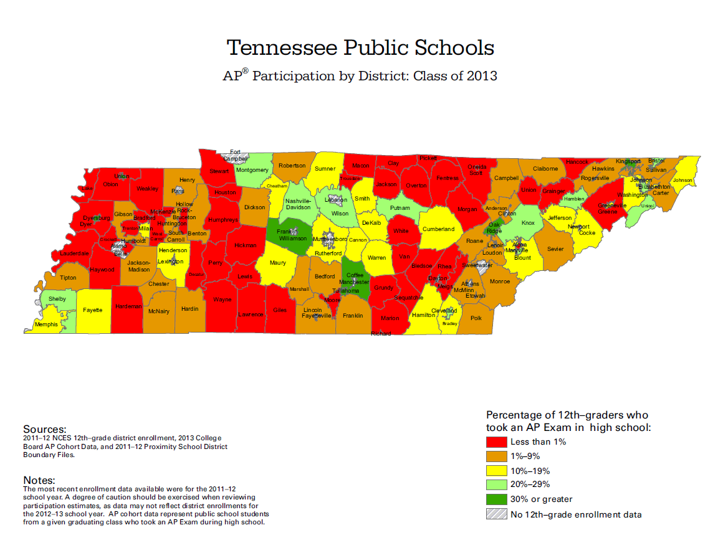
AP Exam Participation

Slide 8
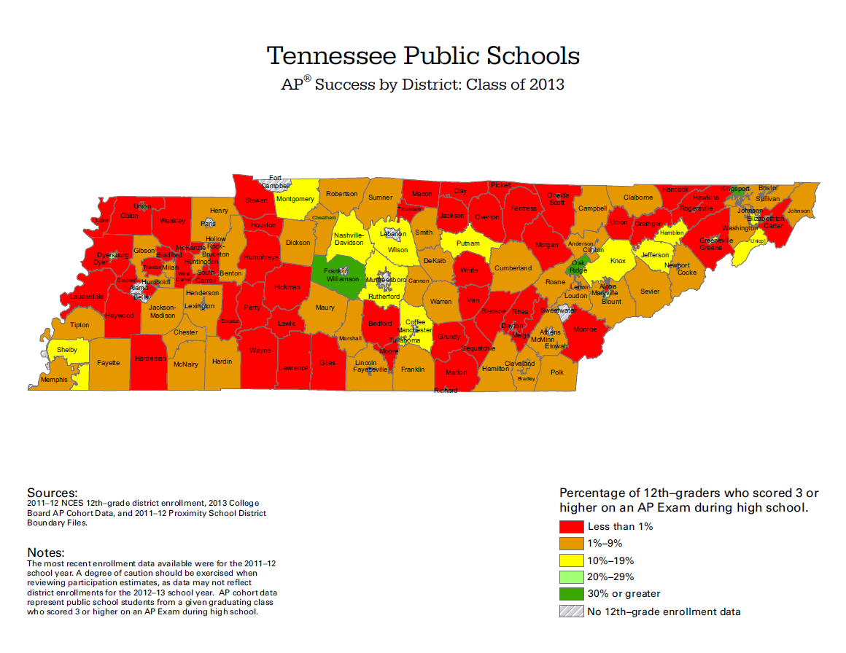
AP Exam Performance

Slide 9
Opportunity for Growth
Nation or State | Percentage of class of 2013 earning 3+ on AP Exam in high school | Ten Year Growth in Students Taking Exams 2003 – 2013 | Ten Year Growth in 3+ Scores 2003-2013
National | 20.1% | 14.3% | 7.9%
Tennessee | 10.1% | 6.2% | 2.4%
Kentucky | 16.3% | 18.0% | 9.3%
Florida | 27.3% | 27.6% | 12.0%

Slide 10
AP Exam Pilot for 2014 & 2015
HB 705
  AP Exam pilot for 2014 & 2015 (22 schools invited – 16 active)
  AP math exams only (Calculus AB, Calculus BC and Statistics)
  Knox County schools all exams
  AP math exams only (Calculus AB, Calculus BC and Statistics)
  Knox County schools all exams
District | High School
Blount | Heritage
Cannon | Cannon County
Jackson-Madison | Madison Academic Magnet
Knox | Carter* (had all AP exams paid for)
Knox | Gibbs* (had all AP exams paid for)
Knox | Halls* (had all AP exams paid for)
Knox | Karns* (had all AP exams paid for)
Knox | South Doyle* (had all AP exams paid for)
McMinn | Central High School
McMinn | McMinn High School
MNPS | Overton
MNPS | McGavock
Roane | Oliver Springs
Rutherford | Smyrna
Sullivan | Sullivan Central
Warren | Warren County

Slide 11
AP Exam Pilot for 2014 & 2015
HB 705 – Exam Pilot Results for 2014
  TDOE
    Providing funds for the cost of the exam fees increased participation.
    Also showed a decrease in AP pass rates for participating students.
    Goal for 2015 - increase participation by economically disadvantaged students as pilot schools have more notice to appropriately schedule students in AP courses and promote this pilot opportunity.
  Results emphasize the importance of the Partnership concept.
  College Board
Subject | Percentage Difference Taken | Percentage Difference Successful Scores
Calculus AB | 102% | 45%
Calculus BC | 20% | 6%
Statistics | 105% | -15%
All exams (Knox only) | 74% | 29%

Slide 12
AP U.S. History Redesign
In 2006, the College Board launched efforts to redesign every AP course
  Ensure alignment with content and rigor of college-level learning
  Respond to feedback from AP teachers
Process (approximately 7 years)
  AP Development Committee for each subject (college faculty & AP teachers including retired AP teacher from Oak Ridge) develops draft curriculum framework
  Validation review of draft framework by history professors and AP teachers from across the country – revisions made based on feedback
  First pilot of redesigned exam
  Publication of framework
  Second pilot of redesigned exam
  AP teacher trainings
  Launch new course

Slide 13
Teachers Support the AP U.S. History Redesign
    Here’s a look at how AP U.S. History teachers feel about the redesigned course, which eliminates the pressure to race through history, cramming every fact that could show up in a multiple-choice question.
Survey Question | Prior AP U.S. History Course | Revised AP U.S. History Course
The course covers too many topics in not enough depth | 72% | 6%
The course has the right balance of breadth and depth | 24% | 81%
The course is appropriately paced | 62% | 91%

Slide 14
What did teachers dislike?
OLD AP US History
Vague, 5-page outline:
    Expanding movements for civil rights
Related AP Exam question:
The National Organization for Women (NOW) was founded in 1966 in order to:
encourage women to believe in the “feminine mystique”
challenge sex discrimination in the workplace
oppose the proposed Equal Rights Amendment
advocate restrictions on access to abortion
Advocate equal access for women to athletic facilities

Slide 15
What has changed?
NEW AP US History
Specific, 50-page outline
    Seeking to fulfill Reconstruction-era promises, civil rights activists and political leaders achieved some legal and political successes in ending segregation, although progress toward equality was slow and halting.
Related AP Exam question:
Briefly explain ONE specific example of civil rights activism that curtailed segregation between 1945-1980.

Slide 16
Myths vs. Facts About AP U.S. History
MYTH: The new concept outline removes or reduces the roles of important figures and heroes like . . .
FACT: In September 2014, the survey of AP teachers reported that the framework encouraged them to increase focus on . . .
John Winthrop John Winthrop
Thomas Paine Thomas Paine
James Madison James Madison
George Washington George Washington
Abraham Lincoln Abraham Lincoln
Booker T. Washington Booker T. Washington
Dwight D. Eisenhower Dwight D. Eisenhower
Martin Luther King, Jr. Martin Luther King, Jr.
Ronald Reagan Ronald Reagan
George W. Bush George W. Bush

Slide 17
Myths vs. Facts About AP U.S. History
MYTH: The new concept outline is negative, eliminating military history and the work of the Founders
FACT: The new concept outline encourages more attention to the Founding and military history than the old one.
No reference to Declaration of Independence
The only battle ever to appear in an AP exam question was Pearl Harbor, a defeat
Declaration of Independence + Constitution are required
Test questions will ask students to discuss locally selected examples of military victories in 18th, 19th, and 20th century

Slide 18
Myths vs. Facts About AP U.S. History
MYTH: The redesign of AP US History is an effort to impose the Common Core.
FACT: The AP US History updates have not had any relationship to the Common Core. This work was conducted by teachers and professors who began in 2006 and released their work to the public in 2012, prior to David Coleman’s arrival at the College Board.
AP US History is a college-level course, designed by colleges nationwide for college credit. The Common Core are high school standards in ELA and math.

Slide 19
The College Board has acted in good faith by making AP US History more transparent
“Old” AP US History
“New” AP US History
Vague, 5-page framework that did not reveal results of college survey to teachers and the public
Exam questions only revealed once every 5-8 years
More multiple-choice, fewer open-ended questions that reward local choices
No process for incorporating public feedback
Clear, 50-page framework that shows teachers and the public the results of college survey
Exam questions revealed every year
Fewer multiple-choice, more open-ended questions that reward local choices
Annual process for incorporating public feedback

Slide 20
College Board Actions
The new AP U.S. History course framework was released to the public in
October 2012, was authored by and has the overwhelming support of, AP
U.S. History teachers and college level U.S. history professors. Since that
time, we have received some thoughtful feedback. To address these concerns the College Board has:
Clarified the instructions in the framework;
Implemented a process for collecting feedback to ensure fidelity to college credit requirements and a balanced view of America’s history. If you wish to propose changes to the AP U.S. History Curriculum Framework, College Board is accepting public comment on the framework from October 1, 2014 through February 28, 2015: http://apcentral.collegeboard.com/apc/members/exam/exam_information/224882.html
Started to rollout the most robust set of supporting materials for AP U.S. History teachers in the AP Program’s 60-year history, including greater access to AP Exams.
Presented to the Tennessee State Board of Education on October 30, 2014. Presentation is archived and can be found on the TBE web page, http://www.tn.gov/sbe/2011VideoStreaming.shtml
Any changes will be announced spring 2015.

Slide 21
American Historical Association
August 20, 2014
The AHA Supports the Revised Framework for the Advanced Placement U.S. History Course and Exam
The American Historical Association (AHA) supports the College Board in its efforts to encourage rigorous history education and ensure that the history classroom is a place of engaged learning and open dialog. The AHA remains confident that the College Board’s Advanced Placement US History Framework will help teachers achieve these goals without introducing partisanship, dictating content, or ignoring important aspects of US history. The AHA objects to mischaracterizations of the framework as anti-American, purposefully incomplete, radical, and/or partisan.
The new framework is not a set of instructions or dictates for teachers; it allows them to decide what content may be taught in the AP history classroom. The framework has been grievously mischaracterized as a curriculum. It is not. The framework offers guidance for teachers on how to connect just about any historical content to the skills that students will need for the AP exam, for college, and for citizenship. The curriculum content remains the province of the teacher, the school district, and the state.

Slide 22
Organization of American Historians
August 29, 2014
The Organization of American Historians supports the Revised Framework for the Advanced Placement and U.S. History Course and Exam.
In response to recent criticism of the College Board, the OAH affirms that expert teachers and scholars of good will designed and conducted the extensive process of revision.
The OAH is proud to be associated with these dedicated and professional teachers and historians.

Slide 23
National Council for History Education
August 26, 2014
NCHE welcomes revision of the APUSH Framework and test in view of the increased emphasis on the teaching and testing of historical thinking.
Multiple-choice questions, often derided as “multiple guess,” will now relate to historical evidence, such as documents, images, and maps, and require students to reason rather than simply recall.
There will be short essays specifically designed to assess proficiency in historical thinking, as well as command of content knowledge.
Longer essays, written in response to Document-Based Questions, will also show students’ ability to understand, interpret, and apply historical evidence. These skills will serve them well in college and throughout their lives.
Of course, historical thinking requires that students have some history to think about, and to that end the APUSH Framework includes a concept outline, but offers teachers considerable latitude in deciding how to flesh it out. Given that latitude, complaints about omissions from, and a political bias in, the Framework seem misplaced. Besides, teaching students how to think for themselves is the best antidote to the dangers cited by APUSH critics.

Slide 24
In Summary
“My sentiments are entirely on the side of the AP History framework. It was put together by teachers and historians who have been working on it for years. It is a sound framework that will help teachers improve the teaching of AP history.”
James McPherson, Pulitzer Prize-winning historian of the Civil War, October 13, 2014
The following slides contain attestations of support from each of the country’s
American history associations.

Slide 25
For Further Information
These attestations and others, as well as the AP US History course materials, are available to the public at:
More information is available collegeboard.org/APUSH

