Slide 1
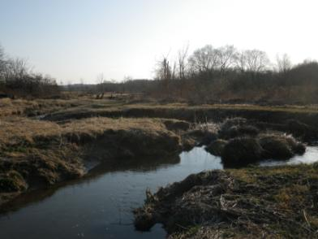
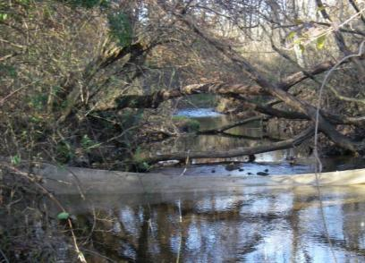
Stream Fish Dispersal and Growth in Wooded and Meadow Reaches of the White Clay Creek
Willy Eldridge
with Laura Borecki, Bill Anderson, Mike Broomall, Roberta Weber, Molly Gabler, Andrew Anderson

Slide 2
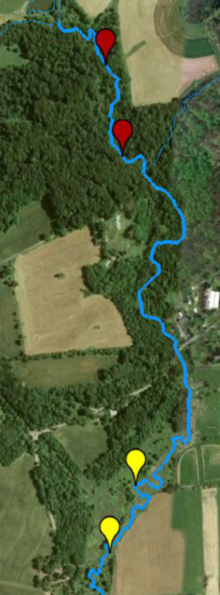
Fish Community Index | Habitat Comparison
Species richness | Grassland > Wooded
Abundance | Grassland > Wooded
Biomass | Grassland > Wooded
Production | Grassland > Wooded

Slide 3
Meadow
Forest
Stream narrow
Higher baseflow velocity
Higher daytime temperature
Less woody debris
Authochthonus basal resources
Lower macroinvertebrate density
Stream wide
Lower baseflow velocity
Shading reduces daytime temperature swing
More woody debris
Higher macroinvertebrate density
Allochthonous inputs
Higher capacity to process matter
and nutrients
Sweeney et al. 2004 PNAS

Slide 4
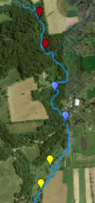
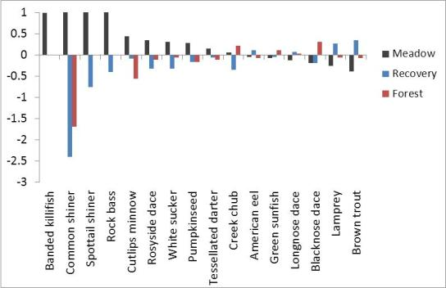
Community comparison in upper east branch White Clay Creek
Forest
June 2011 | Abundance (fish/m) | Biomass (g/m)
Forest | 5.9 | 39.3
Recovery | 5.1 | 32.2
Meadow | 9.0 | 52.5
Recovering
forest
June 2011
Electivity
Habitat electivity
Meadow

Slide 5
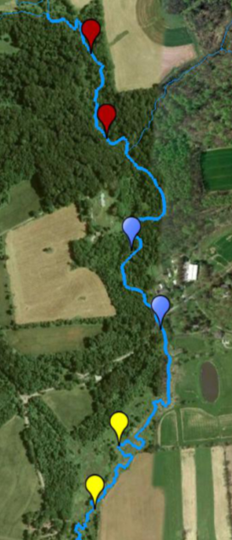
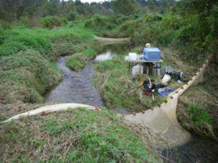
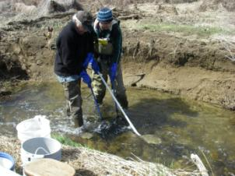
20m
Mechanisms?
Mark (100m):2010 Sep-Oct
Recap. (300m): 2011 Jan|Apr|Jun|Sep
Flow
300m
100m
Forest
550m
20 m “channel unit”
Recovering
forest
300m
Backpack
electrofishing
550m
Elastomer tag
Meadow
300m

Slide 6
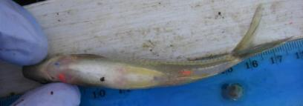
Elastomer mark (> 45mm TL)
4 colors (Blue, Green, Red, Yellow)
6 locations (R & L – Pectoral, Anal, Caudal)
4 tags per individual
3058 possible codes

Slide 7
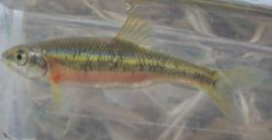
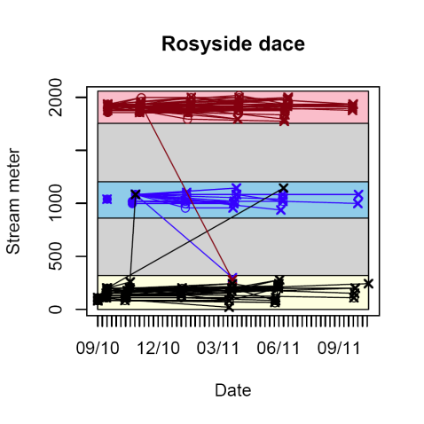
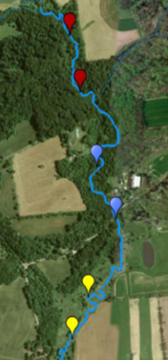
Do fish seek out the meadow?

Slide 8
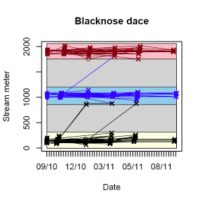
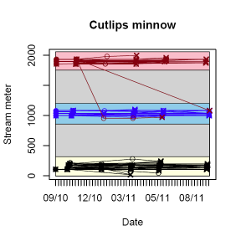
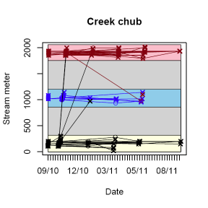
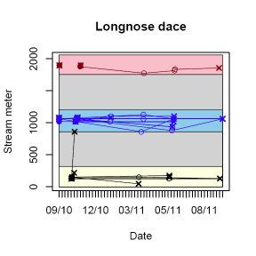
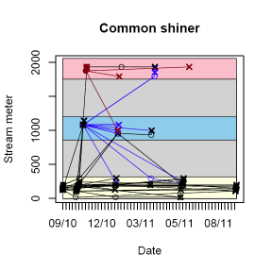
Do fish seek out the meadow?

Slide 9
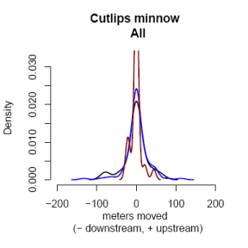
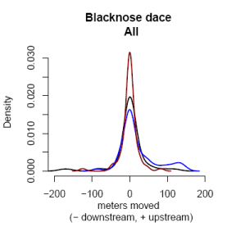
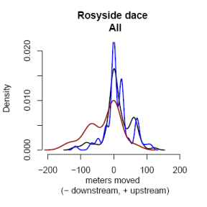
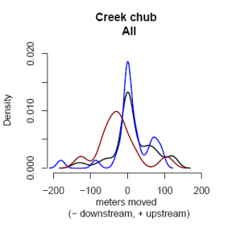
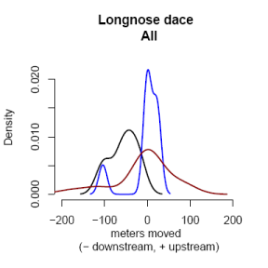
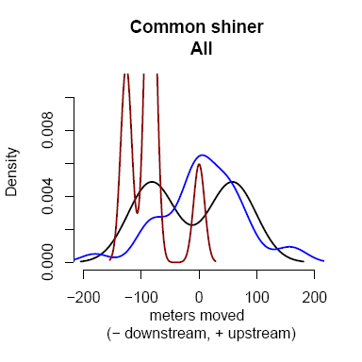
Movement within reach
Forest
Recovery
Meadow
ANOVA p<0.05

Slide 10
What about the habitat?

Slide 11
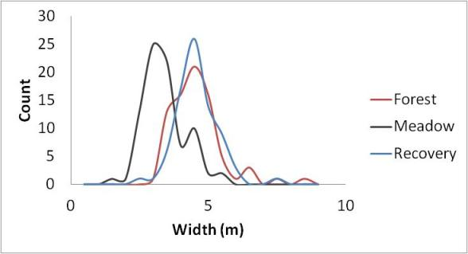
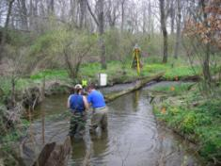
Depth
Count
Width
Depth (m)
 | Forest | Recovery | Meadow
# Transects | 78 | 78 | 83
Average (m) | 4.3 | 4.2 | 3.1
Median (m) | 4.3 | 4.2 | 3.0
 | Forest | Recovery | Meadow
# Points | 749 | 614 | 742
Average (m) | 0.12 | 0.13 | 0.17
Median (m) | 0.10 | 0.10 | 0.16

Slide 12
The meadow is deeper, so how does that happen and could that affect fish?
Are there more pools in the meadow?
Are the pools deeper?
Are the riffles shorter?

Slide 13
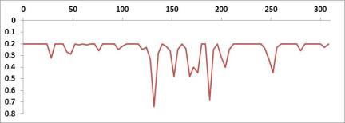
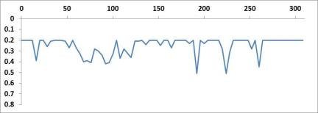
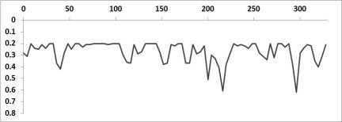
Riffles, Runs & Pools
Depth of thalweg
 |  | Forest | Recovery | Meadow
Riffles | Number | 15 | 15 | 13
(<0.2m) | Length Riffles | 184 | 168 | 104
 | % Riffle | 60% | 55% | 32%
 | Mean length | 12.3 | 11.2 | 8.0
 | Max. length | 32 | 36 | 16
Runs | Number | 18 | 16 | 19
(0.2-0.4m) | Length | 96 | 104 | 204
 | % Run | 31% | 34% | 62%
 | Mean length | 5.3 | 6.5 | 10.7
 | Max. length | 12 | 24 | 24
Pools | Number | 6 | 6 | 5
(>0.4cm) | Total length | 24 | 24 | 20
 | % Pool | 8% | 8% | 6%
 | Mean length | 4.0 | 4.0 | 4.0
 | Max. length | 4 | 4 | 4
Stream meter (m)
Depth of thalweg (m)

Slide 14
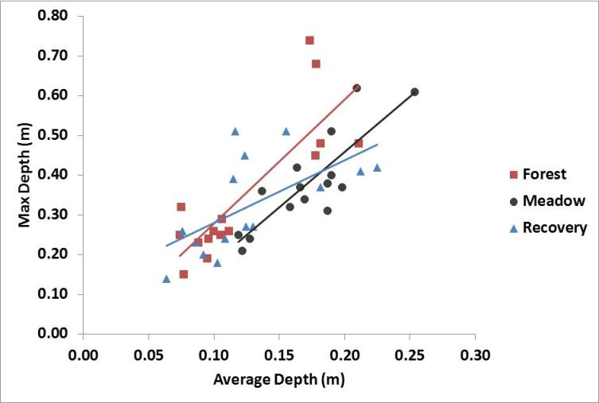
The pools in the meadow are not deeper but there are fewer shallow areas in the meadow
NB: Each point is a 20m
“channel unit”
Does increased depth in meadow explain the increased fish abundance and biomass?

Slide 15
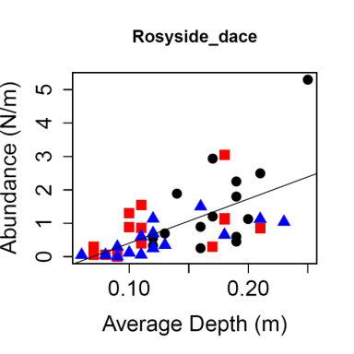
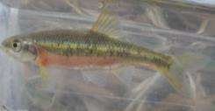
Average depth and species abundance in each 20m “channel unit”
Pool species
June 2011

Slide 16
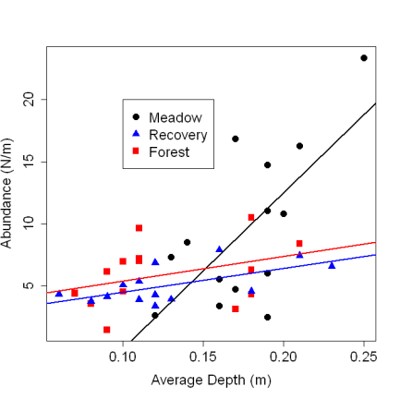
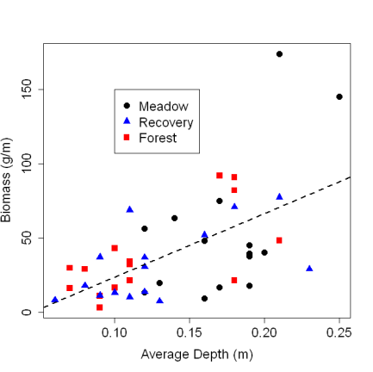
Abundance Biomass
All species
All species
ANCOVA p<0.05
ANCOVA p>0.1
Depth

Slide 17
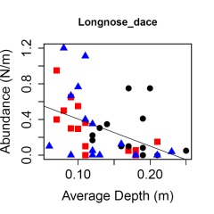
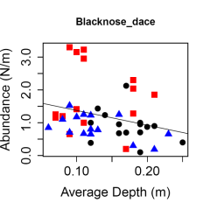
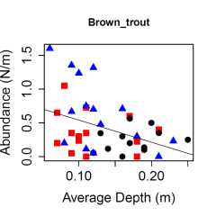
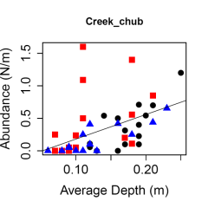
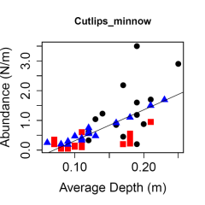
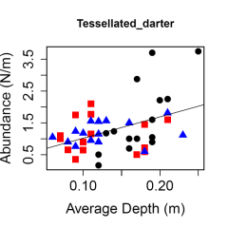
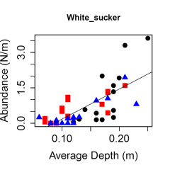
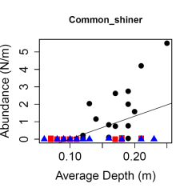
ABUNDANCE
Forest
Recovery
Meadow
ANCOVA p<0.05

Slide 18
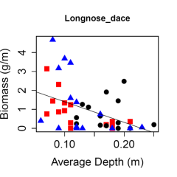
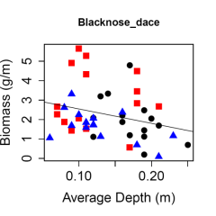
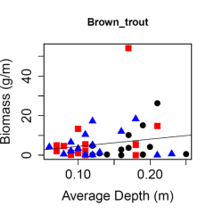
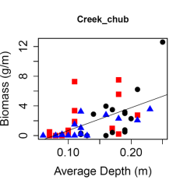
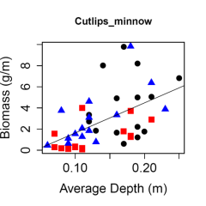
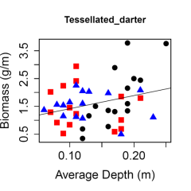
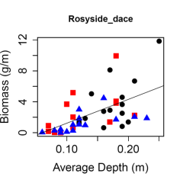
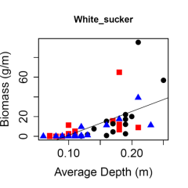
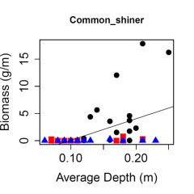
Forest
Recovery
Meadow
ANCOVA p<0.05
BIOMASS

Slide 19
Diet June 2011 - Stomach contents
% wet weight

Slide 20
Growth Cutlips minnow 120110

Slide 21
Growth & Production
Growth rate
Production
Biomass (g/m)
Production
 | Creek chub | Common shiner | Longnose dace | Cutlips minnow | Rosyside dace | Blacknose dace
Forest | 2.2 | 0.2 | 0.9 | 1.2 | 2.6 | 3.1
Recovery | 1.2 | 0.0 | 1.2 | 3.0 | 1.4 | 1.7
Meadow | 2.8 | 5.1 | 0.8 | 4.5 | 3.8 | 2.1
 | g/m/yr
Forest | 11.5
Recovery | 8.6
Meadow | 23.1

Slide 22
Refuge from high flows?
When individuals move are they displaced (e.g. competition or high flow) or seeking preferred habitat?
A large storm occurred one week before Mar. sampling
LWD > 30cm dia. per 300m
Forest | 29
Recovery | 24
Meadow | 5

Slide 23
Dispersal after storm
Forest
Recovery
Meadow
Flow refuge in meadow –
Undercut banks? Overhanging vegetation?

Slide 24
Summary
Fish species richness, abundance, biomass and production higher in meadow than forested reaches
Increased abundance in meadow not due to immigration from forest
Increased average depth in meadow responsible for increased abundance and biomass of some but not species
Growth rates are generally higher in Forested habitat but due to low standing stock biomass total production is lower.
Most species are limited dispersers suggesting that reaches +500m apart are largely separate
No evidence that high flows affects fish in meadow differently than in forested reaches

Slide 25
The End

