Slide 1
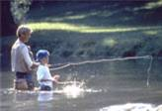
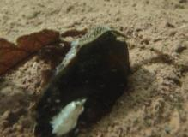

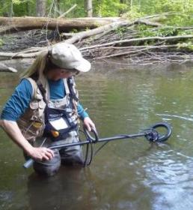
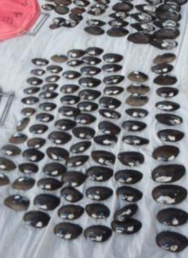


Conservation and Potential Restoration of Freshwater Mussels in the Delaware Estuary Watershed
Danielle Kreeger
Partnership for the Delaware Estuary
Drexel University
White Clay Summit
September 25, 2012
Notes:
-The goal of this presentation is to summarize some of the environmental challenges in the Delaware River Basin that will result from, or at least be affected by, climate change.
-My focus is on water resources, since I represent the Partnership for the Delaware Estuary which is 1 of 28 congressionally approved National Estuary Programs.
- I will only touch on some of the major issues, using a few examples.

Slide 2
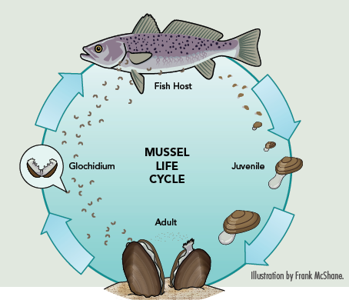
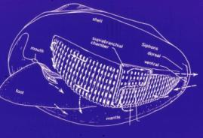
Freshwater Mussels – What Are They?
Filter-feeding Bivalves
Diverse
300 species
Elegant Life History
use fish to reproduce
Long –Lived
up to 100 years

Slide 3
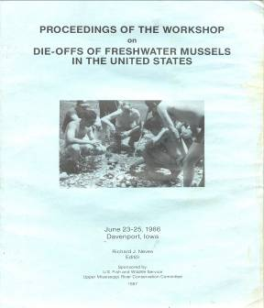
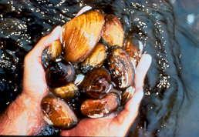
Status and Trends – A Taxa in Decline
Biodiversity
Population
Biomass

Slide 4
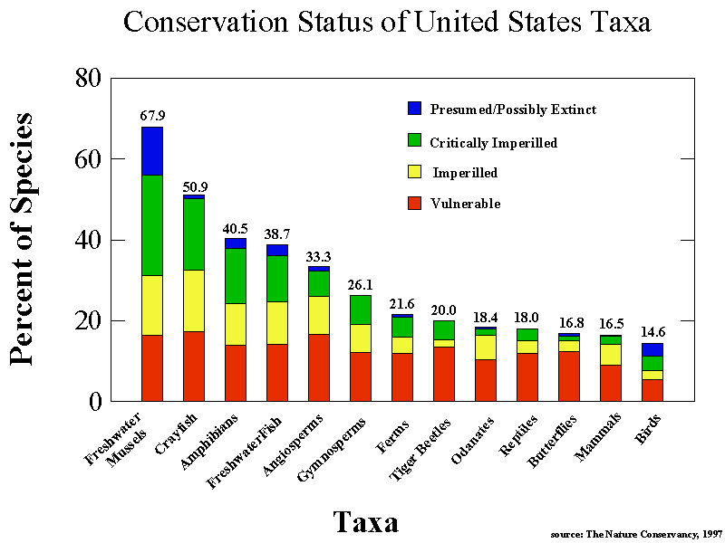

Slide 5
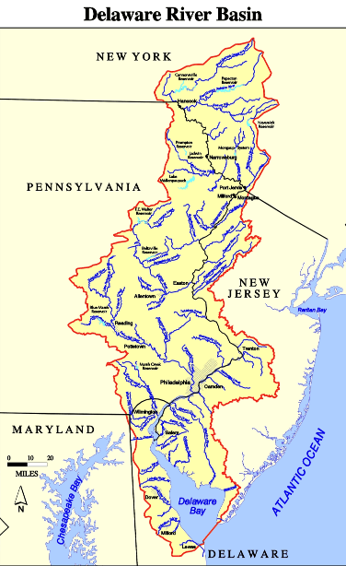

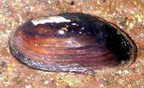


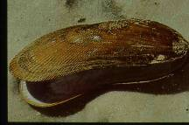


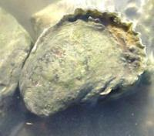

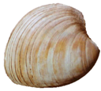
>60 Species of Bivalves in the Delaware Estuary Watershed
11 Other Species of Freshwater Unionid Mussels
Corbicula fluminea
Elliptio complanata
Rangia cuneata
Mya arenaria
Geukensia demissa
Mytilus edulis
Ensis directus
Mercenaria mercenaria
DRBC
Crassostrea virginica

Slide 6
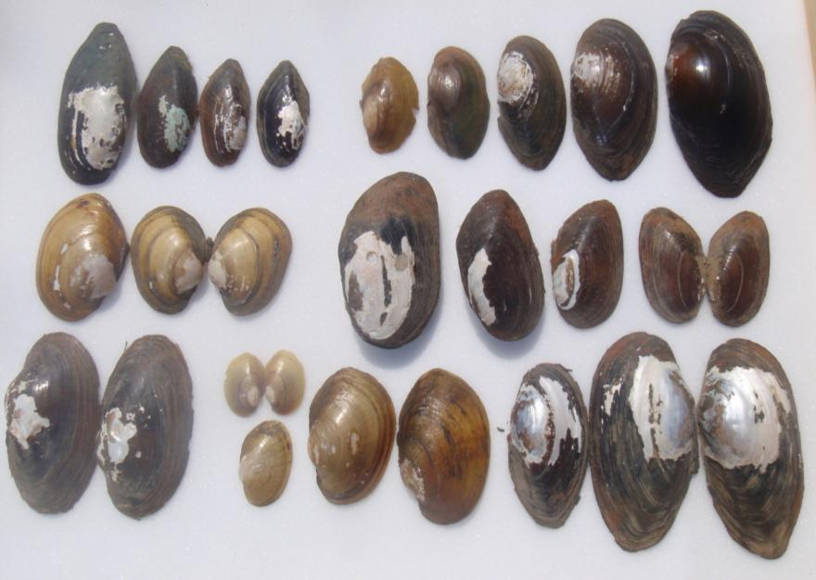
Freshwater Mussels of the Delaware

Slide 7

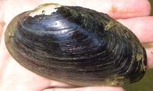
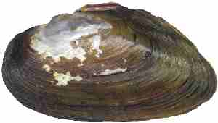
Delaware River Basin
Patchy, Impaired
Rare
Extirpated

Slide 8
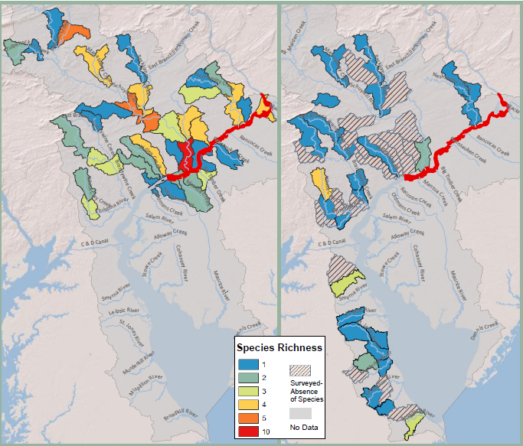
Since
1996
1919
Kreeger

Slide 9
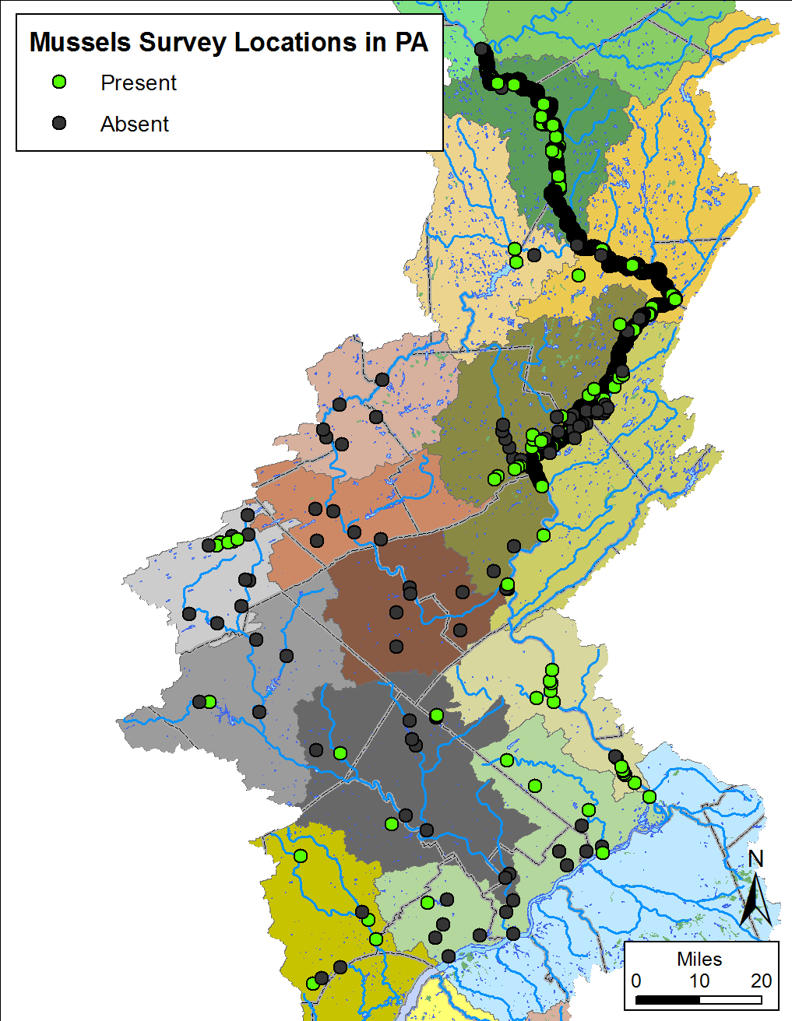
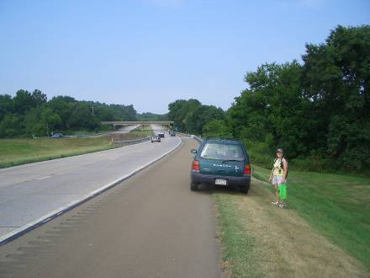
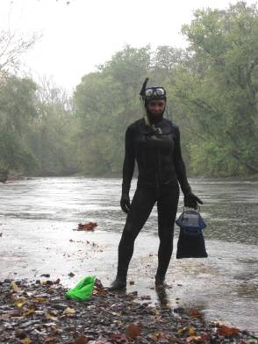
Kreeger

Slide 10
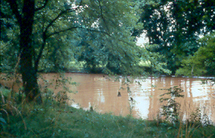
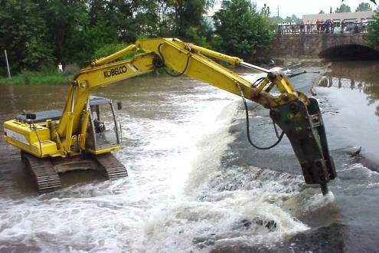
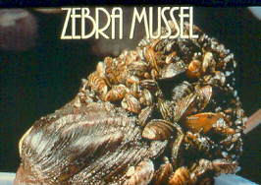
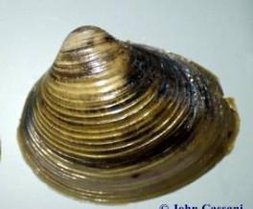
Culprits
Water
Quality
Habitat Loss and Degradation
Exotic Species
Photo by D. Kreeger

Slide 11
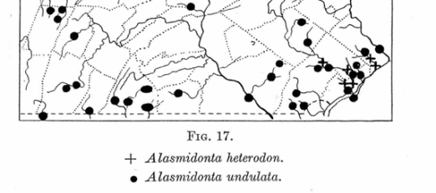
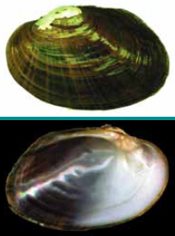
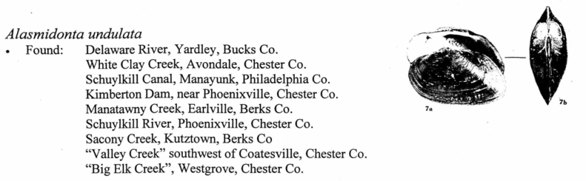
Mussels of White Clay - Historical
Triangle Floater
Alasmidonta undulata
Art Bogan also reported it in 1996
Ortmann, A.E. 1909. A preliminary list of the Unionidae of Western Pennsylvania, with new localities for species from Eastern Pennsylvania. Anals of the Carnegie Museum 5 (2/3): 178-210.

Slide 12
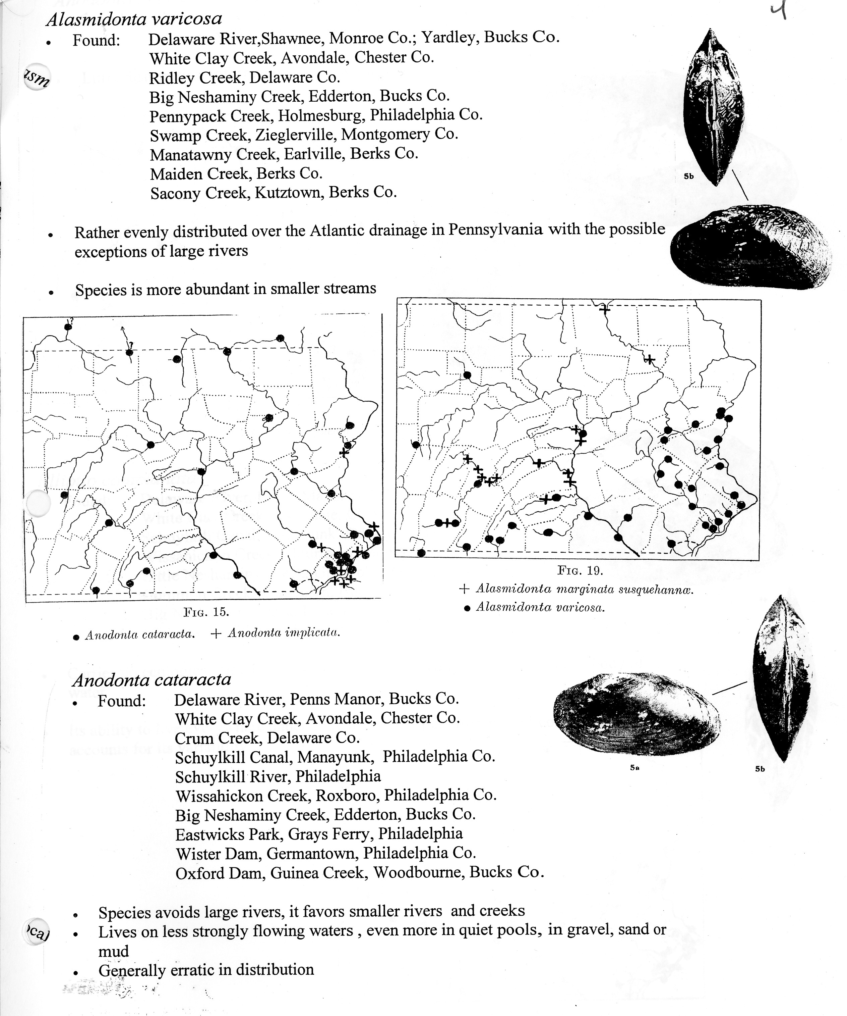
Mussels of White Clay - Historical
Brook Floater
Alasmidonta varicosa
Ortmann, A.E. 1909. A preliminary list of the Unionidae of Western Pennsylvania, with new localities for species from Eastern Pennsylvania. Anals of the Carnegie Museum 5 (2/3): 178-210.

Slide 13
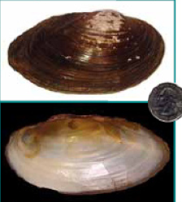
Mussels of White Clay - Historical
Eastern Floater
Pyganodon cataracta
Ortmann, A.E. 1909. A preliminary list of the Unionidae of Western Pennsylvania, with new localities for species from Eastern Pennsylvania. Anals of the Carnegie Museum 5 (2/3): 178-210.

Slide 14
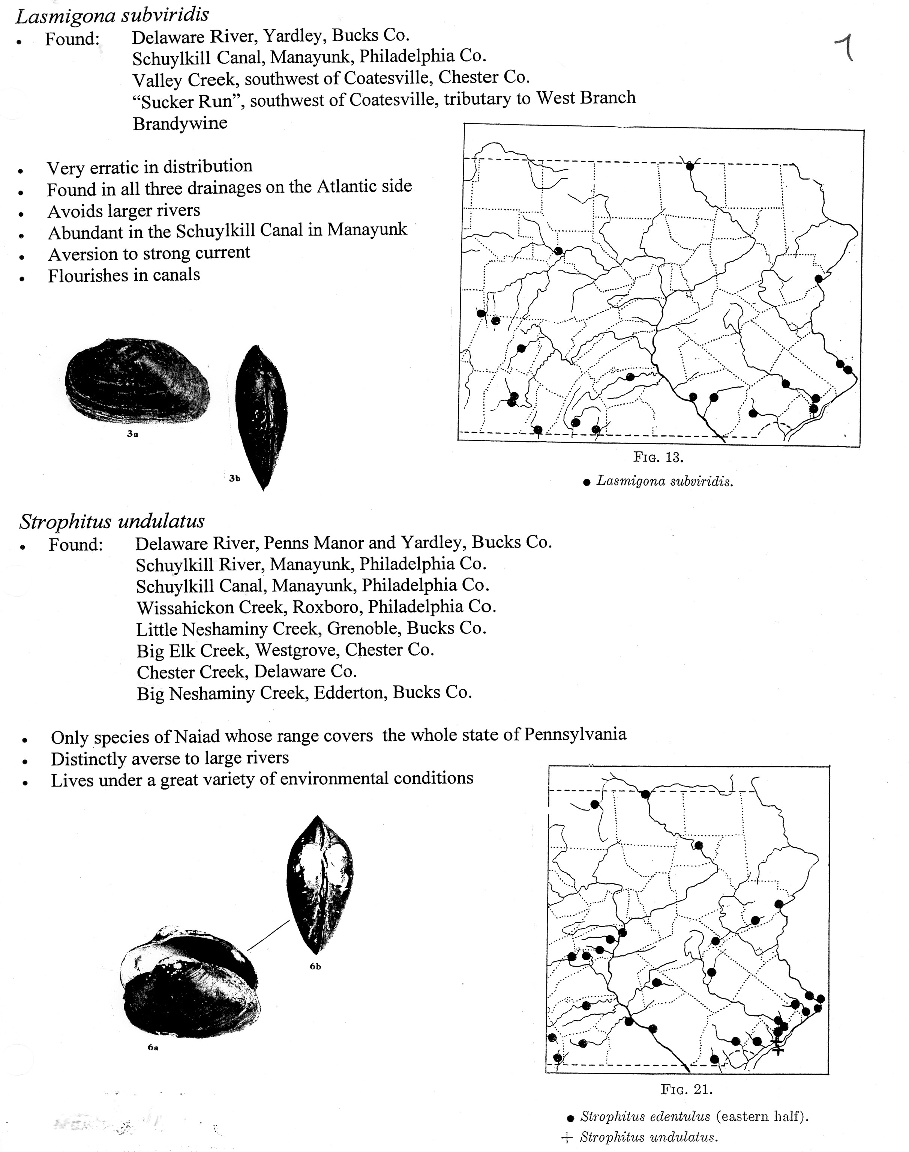
Mussels of White Clay – Historical
Creeper
Strophitus undulatus
Ortmann found it nearby
Kreeger and Gatenby found one live creeper in 2000 in East Branch
Ortmann, A.E. 1909. A preliminary list of the Unionidae of Western Pennsylvania, with new localities for species from Eastern Pennsylvania. Anals of the Carnegie Museum 5 (2/3): 178-210.

Slide 15
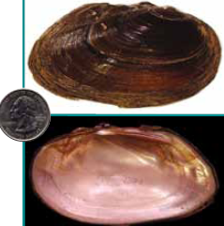
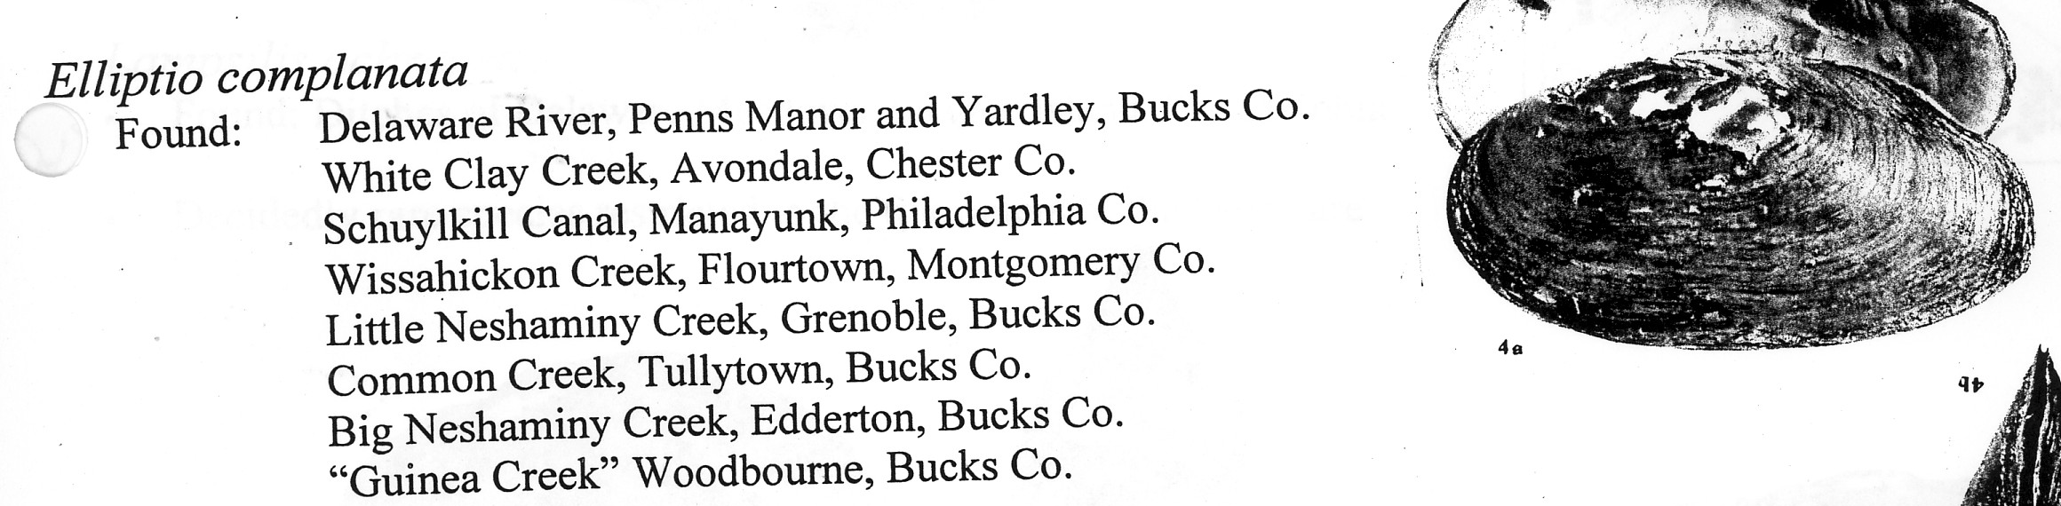
Mussels of White Clay - Historical
Eastern Elliptio
Elliptio complanata
Listed as present by Ortmann
Art Bogan reported it in Middle Branch in 1996
Kreeger and Gatenby found a few live near Avondale up until 2002
Ortmann, A.E. 1909. A preliminary list of the Unionidae of Western Pennsylvania, with new localities for species from Eastern Pennsylvania. Anals of the Carnegie Museum 5 (2/3): 178-210.

Slide 16
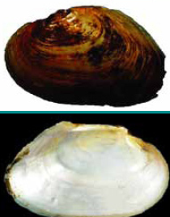
Mussels of White Clay – Historical ?
Green Floater
Lasmigona subviridis
Ortmann found it nearby
Ortmann, A.E. 1909. A preliminary list of the Unionidae of Western Pennsylvania, with new localities for species from Eastern Pennsylvania. Anals of the Carnegie Museum 5 (2/3): 178-210.

Slide 17
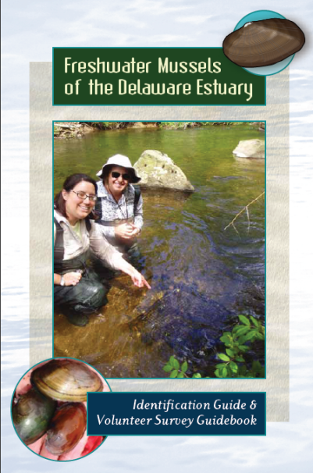
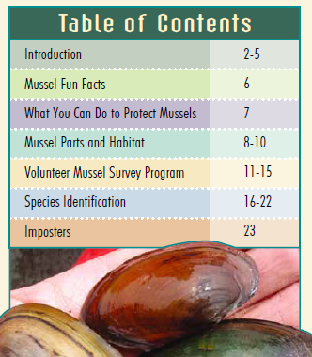
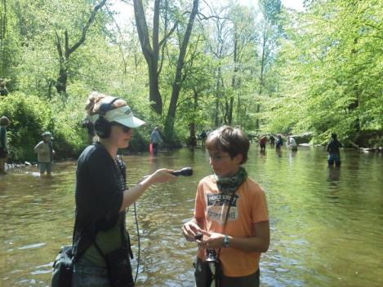
Freshwater Mussels – Educational ID Guide
In Development
Draft Available:
http://delawareestuary.org/activities_volunteer_mussels.asp

Slide 18
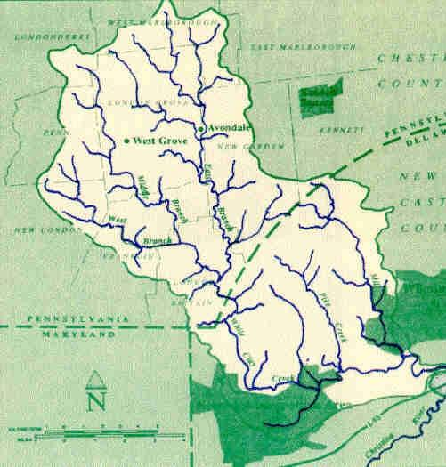
Mussels of White Clay
Historical:
  5-6 species
  (maybe more)
  Abundance uncertain
Current:
  No mussels seen since 2002
http://www.newgarden.org/whiteclay.htm

Slide 19
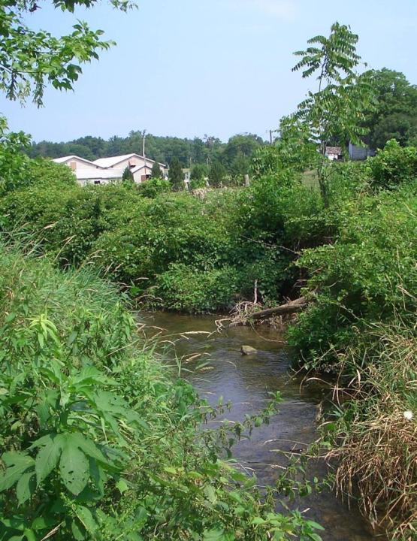
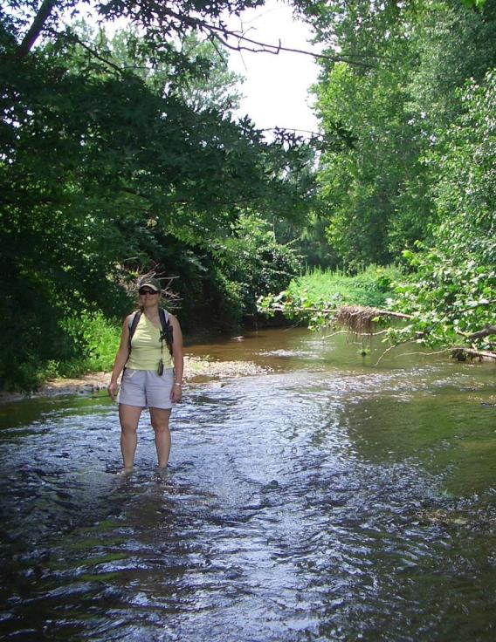
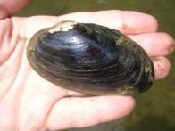

Mussel Surveys
X
White Clay
Big Elk

Slide 20

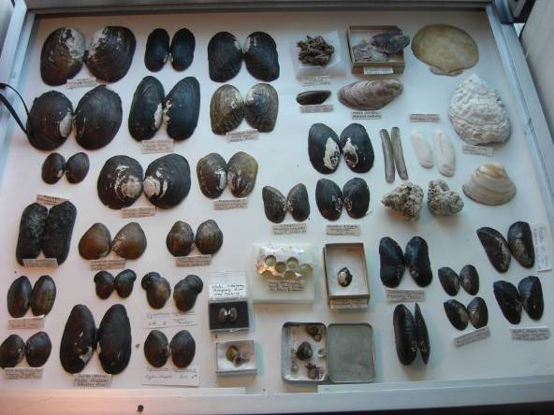
Freshwater Mussels – Why Important?
Biodiversity
↓ Intrinsic Losses
↓ Niches Filled
↓ Human Health
Notes:
This covers some of the same topics as the last slide so I would not use both.

Slide 21
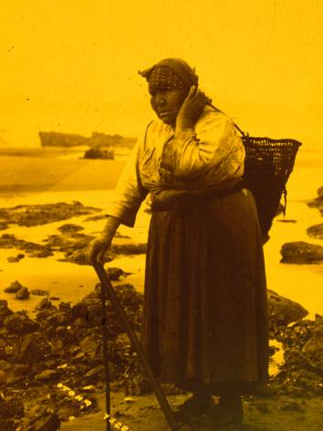

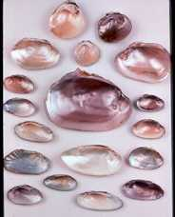
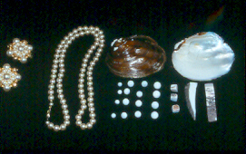
Freshwater Mussels – Why Important?
Cultural-Historical
Native American Uses
Pearl button history
Notes:
This covers some of the same topics as the last slide so I would not use both.

Slide 22
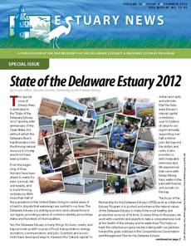
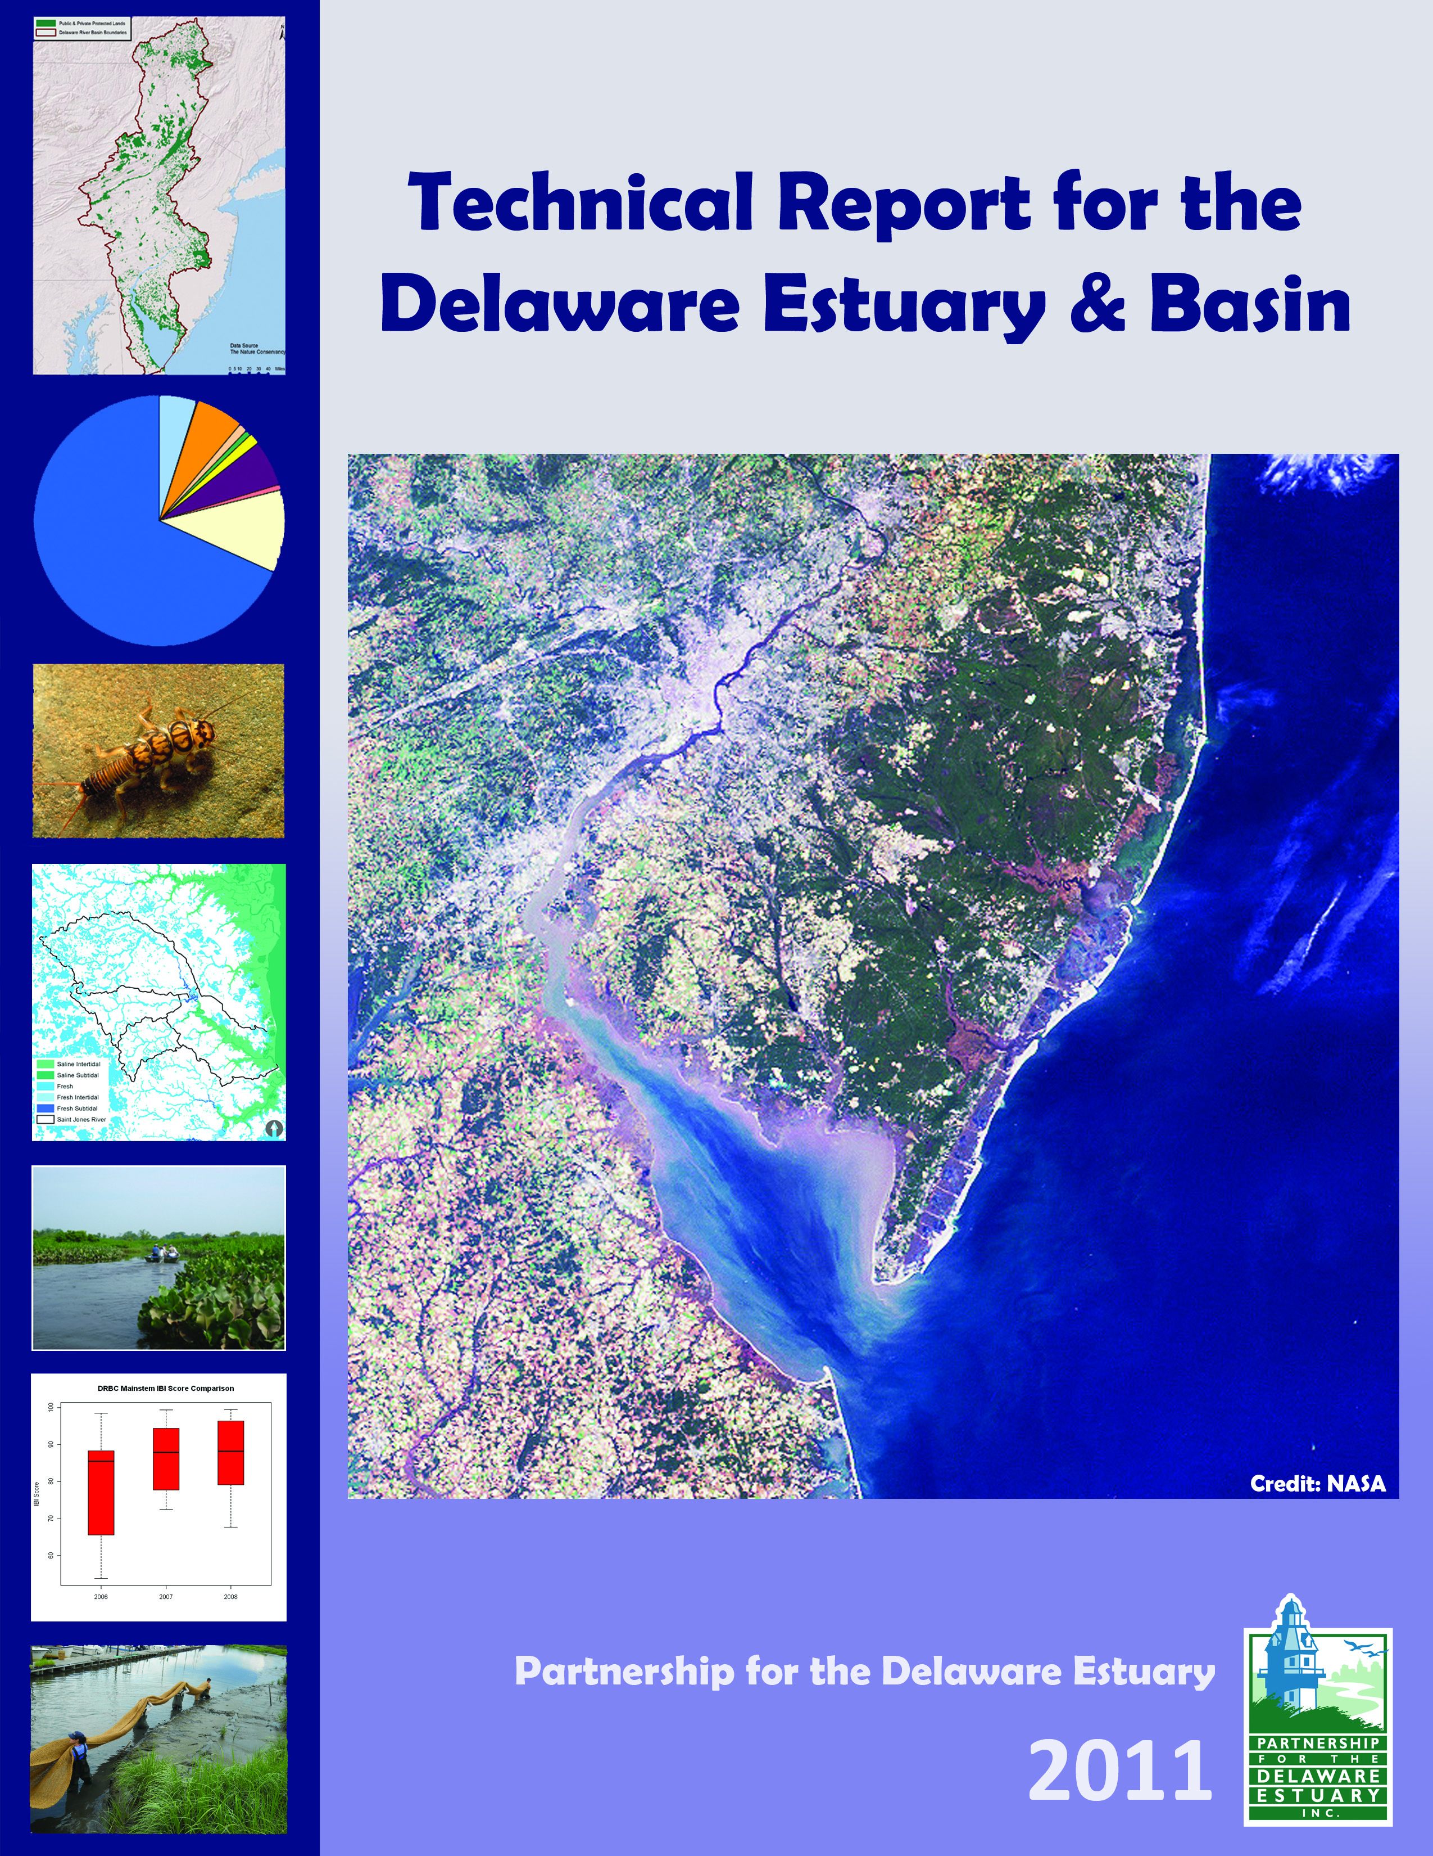
Freshwater Mussels – Why Important?
Bioassessment Value
International Mussel Watch
Effluent Testing, Contaminant Monitoring
Natural Resource Damage Assessment
Tributary and Regional Bioassessment
2012
Notes:
This covers some of the same topics as the last slide so I would not use both.

Slide 23
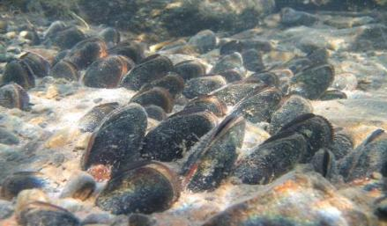
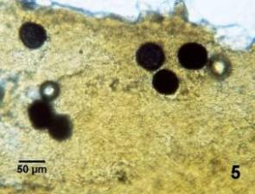
Freshwater Mussels – Why Important?
Ecosystem Services
(Benefits to People And the Environment)
Examples:
Pathogen Removal - may filter and digest harmful bacteria and protists
Model Organisms for medical sciences (e.g. cancer research)
Bed Stabilization
Water Quality - potential TMDL applications
CTUIR Freshwater Mussel Project
Notes:
This covers some of the same topics as the last slide so I would not use both.

Slide 24
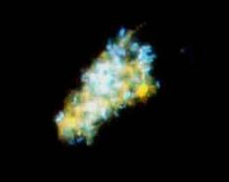


Freshwater Mussels – Why Important?
1. Structure
↑ Habitat Complexity
Bind Bottom
Stabilize Shorelines
↑ Bottom Turbulence
2. Function
↓ Suspended Particulates
↓ Particulate N, P
↑ Light reaching bottom
↑ Sediment Enrichment
↑ Dissolved Nutrients
Notes:
This covers some of the same topics as the last slide so I would not use both.

Slide 25


Biofiltration Potential
Start
No mussels
8 adult mussels
Slide from Dick Neves, VA Tech

Slide 26


Biofiltration Potential
Later
No mussels
8 adult mussels
Slide from Dick Neves, VA Tech

Slide 27


Nature’s Benefits
Bivalve Shellfish are “Ecosystem Engineers”
Mussel Beds
CTUIR Freshwater Mussel Project
Oyster Reefs
Kreeger

Slide 28

Nature’s Benefits (Natural Capital)
Livelihoods
Lives
Health
Livelihoods
Health

Slide 29



Brandywine River
Studied 2000 - present
Elliptio complanata
→
Map from The Brandywine River Conservancy
Notes:
For my first case study, I’ll show some data from a study I’ve had in the Brandywine River, near the PA/DE line.
Although we think there were once seven species of native unionid mussels in these smaller rivers of the upper estuary, I’ve only been able to find one left in the Brandywine, which is the common Elliptio complanata.

Slide 30

One Mussel Bed in a
6 mile reach of the Brandywine River
Filters >25 metric tons dry suspended solids per year
→
Estimated Removal = 7.1 %
Data from Kreeger, 2006
Map from The Brandywine River Conservancy
Notes:
For my first case study, I’ll show some data from a study I’ve had in the Brandywine River, near the PA/DE line.
Although we think there were once seven species of native unionid mussels in these smaller rivers of the upper estuary, I’ve only been able to find one left in the Brandywine, which is the common Elliptio complanata.

Slide 31




Water Processing Estimate
Elliptio complanata
4.3 Billion Elliptio (DK estimate)
2.9 Million Kilos Dry Tissue Weight (DK)
= 9.8 Billion Liters per Hour
Kreeger

Slide 32







Delaware Freshwater Mussels
Susquehanna
Brandywine River, PA
Elliptio complanata
Delaware Estuary Marsh mussels
Geukensia demissa
Delaware Bay Oysters
Crassostrea virginica
Kreeger
Notes:
Let’s contrast an example non-tidal, intertidal and tidal species, picking examples of ecologically significant ones potentially capable of processing large water volumes…

Slide 33




Ribbed Mussels in Salt Marshes
Geukensia demissa
208,000 per hectare on average
10.5 Billion Geukensia
Clearance Rate = 5.1 L h-1 g-1 (DK data)
11.7 Million Kilos Dry Tissue Weight (DK)
= 59.0 Billion Liters per Hour

Slide 34


Oysters on Seed Bed Reefs
2.0 Billion Crassostrea (Powell, 2003 data)
Mean size = 0.87 g dry tissue weight (DK data)
Clearance Rate = 6.5 L h-1 g-1(Newell et al 2005)
= 11.2 Billion Liters per Hour
Kreeger

Slide 35



Bio-filtration
= 80 Billion L/h
Freshwater Mussel
Marsh
Mussel
Oyster
Notes:
Potential
Space and

Slide 36
Considerations
    Total filtration capacity for one fw mussel species (~10 billion L/hr) is >250X freshwater inflow from the Delaware River and other tributaries (not total volume)
    Total filtration capacity of oysters and ribbed mussels in Delaware Bay (~70 billion L/hr) is ~8% of tidal volume per day (100% in 11.5 days)
    Water processing potential is estimated with current abundances
    Although historical abundances can be informative, current and future carrying capacities are poorly understood
Notes:
300 billion gallons in system
70 billion L/h ~= 17.5 billion gal/h
17.5 / 300 = 5.83 % of volume per hr
Volume processed (potentially) every 17 hr.

Slide 37






What Can We Do?
Propagate and Reintroduce Mussels
Shellplanting for Oysters
Monitoring & Research
Water Quality & Flow Management
Riparian Restoration
Living Shorelines
Fish Passage Restoration
Notes:
Predictions serve as common group of “drivers” to workgroups considering vulnerabilities, impacts to future conditions.

Slide 38





Freshwater Mussel Recovery Program
http://www.delawareestuary.org/science_projects_mussel_restoration.asp

Slide 39
Freshwater Mussel Recovery Program
Surveys
  Establish current range and density for historically present species
  Identify candidate areas to be conserved and/or restored
  Qualitative (rapid) and Quantitative (intensive)
  Delineate critical habitat to be protected
Restoration Suitability Tests
  Assess if candidate restoration sites can sustain healthy mussel assemblages
Reintroduction
  Transplant gravid broodstock from healthy extant populations nearby
  Monitor success
Propagation
  Produce genetically appropriate seed mussels in hatcheries for restocking
Education
  Build awareness for mussel conservation and holistic restoration
Promote Habitat and Water Quality Improvement (e.g. dam removal)

Slide 40




Surveys to Fill Data Gaps
PDE, ANSP, PWD

Slide 41


Freshwater Mussel Discoveries
Tidal Delaware River:
Millions of animals
7 Species
Genetically Appropriate

Slide 42


Freshwater Mussel Discoveries
Tidal Christina – 9/20/12
Pyganodon cataracta

Slide 43


Freshwater Mussels – Restoration Suitability?
Mussels Held in Cages in Stream Bottom 1 Year
Monitor Fitness Compared to Controls in Source Streams
(Brandywine and Ridley Creeks)
2007-2008
Elliptio complanata

Slide 44

Important for Overwintering →
Matt Gray thesis research (Drexel)

Slide 45

← Important for Reproduction
Matt Gray thesis research (Drexel)

Slide 46





Reintroduction - Tagged Mussels
PIT Tagging
Collect
Size Sorting
Tagged Mussel
Release

Slide 47



Pyganodon cataracta
Elliptio complanata

Slide 48
Reintroduction - Tagged Mussels
Mussels of two species transplanted in June 2011
Retention of live mussels within immediate
release locations in Chester and Ridley Creeks
Hurricane Irene
T.S. Lee

Slide 49
Reintroduction - Tagged Mussels
Change in Shell Length over 15 months
(June 2011 – Sept. 2012)
Mussel source may affect “hardiness” of transplanted mussels

Slide 50



Propagation and Reintroduction
USFWS & Cheyney Hatcheries

Slide 51




Fish Infestation
Fish from USGS, Academy of Natural Sciences

Slide 52



Larval Transformation Into Juveniles

Slide 53


Propagation and Reintroduction
Propagated Juveniles
Photos, R. Neves, VA Tech

Slide 54
Freshwater Mussel Recovery Program
Goals Based on Ecosystem Services
Not including progeny

Slide 55

Freshwater Mussel – Future Challenges
Temp. has warmed by 1ºC in the past century, mainly in past 30 yrs.
Winter Temperature (Anomoly)
http://delawareestuary.org/science_programs_state_of_the_estuary_treb.asp

Slide 56


Freshwater Mussel – Future Challenges
Precip. has increased >10%
Trend over past 30 years > 5 times trend over last 100 years
Fall Precipitation (Anomoly)
http://delawareestuary.org/science_programs_state_of_the_estuary_treb.asp

Slide 57
Bivalve Projections – FW Mussels
Shifting Species Ranges, But No Dispersal
Patchy, Impaired
Rare
Extirpated
Elliptio complanata
Strophitus undulatus
Alasmidonta heterodon
✗
✗
✗
✗
✗

Slide 58

Summary
Freshwater mussels are the most imperiled animals nationally and locally
Current populations help sustain water quality, and they deserve protection
Populations of many species are below carrying capacity and could be augmented
Protection and restoration of diverse species in different areas can promote positive feedbacks via ecosystem linkages
Although future challenges await, the greatest hurdle at present is investment
Notes:
I did not mention the whole “where do we get the bivalves” issue; it seems that regardless of where we get them (natural irruption, hatchery, or translocation), their populations have to be sustainable to have any long-term benefits. Clearly for dark false mussels in Ches. Bay in 2004, they were not sustainable.

Slide 59

Investment in Delaware Valley Lags
Despite Tough Times,…
High Potential for Beneficial Outcomes from Natural Infrastructure Investment
http://delawareestuary.org/science_programs_state_of_the_estuary_treb.asp

Slide 60









Desired Watershed Condition:
A diverse and robust assemblage of native bivalves living in abundance in all available tidal and non-tidal ecological niches and providing maximum possible natural benefits.
Kreeger
DRBC
Notes:
I like this but not sure it fits

Slide 61

Conceptual model:
Three-pronged approach to bivalve restoration to improve water quality
1. Non-tidal
2. Intertidal
3. Subtidal
1
2
3
Notes:
I like this as a simple visual of what we are proposing.
Fw mussels in non-tidal tribs
Ribbed mussels along intertidal fringe
Oysters subtidal

Slide 62






Delaware Estuary Pilot
www.DelawareEstuary.org
Notes:
We have much more info on our website.

Slide 63

(Not) Freshwater Mussels – Asian Clams

Slide 64






To Understand EcoServices, Need…
Physiology
Ecology
Monitoring, Variability
Population
Surveys
Kreeger
Notes:
To understand the quantitative importance of bivalve populations in any of these aquatic habitats, we know to know quite a bit about them.
For example, we need to know some things about their life history strategy and how they interact with their environment, their ecology - as I just described.
But to assess their functional importance, say for water processing capabilities, we also need to know quite a bit about their physiology. For example, per unit biomass or per adult animal, how much water is filtered per day? How variable is this during the year, with changing food regimes and temperatures? How does this vary among system type and species?
And of course, once you know what a given species in a given system does per unit body weight, then we need to know how much biomass exists in that system for the whole population, and this requires surveys and monitoring data.

Slide 65


Physiology Measurements
e.g., Clearance Rate
In Lab
In Field
Kreeger
Notes:
So how do we measure clearance and water processing?
There are several approaches but they basically all measure the rate of removal of particles over time by known weights of bivalves.
Clearance is expressed as a volume of water that is “cleared” of particles per unit time.
It can be measured in the lab, or in the field. . . Many ref rates are from lab but these don’t always mirror nature

Slide 66


Population Measurements
Size Class Structure
Body Size
Abundance (# m⁻², # mile⁻¹)
Total Area (m², river miles)
Kreeger
Notes:
Turning to the second series of measurements needed, we need population abundance.
This isn’t easy either, because they don’t just all have the same size, and physiology scales to body size.
In addition, there is always tremendous variation in spatial abundance. Bivalves live aggregated usually, in reefs or beds.
Therefore, to estimate total numbers in an ecosystem, you need a good understanding of this spatial variability so you can calculate total overall numbers.

