Slide 1
Incentivised Ads in 2015

Slide 2


A Few Facts
Compass Point West is Next Games first release, launched globally March 2015
75% of our players watch an ad every day
$0.06 per player from ad revenue Daily

Slide 3

Things We Learned From The Best
Integrate With Core Loops
We aren’t the only ones who are doing this well, a few inspirational decisions...
Don’t Overload Inventory
Work With Multiple Partners

Slide 4
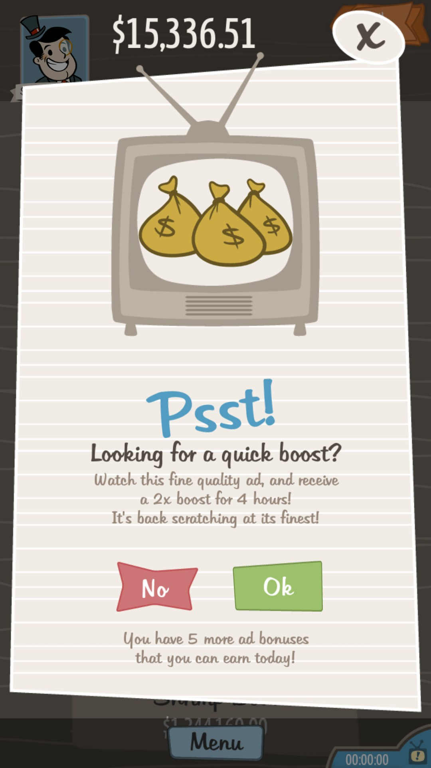
Integrate With Core Loops
This means don’t put it in your shop for soft currency and call it a day
Give the player a purchase worthy item
Put the ad front and center, as you would a shop button, and go straight to the ad
See: Adventure Capitalist, Crossy Road

Slide 5
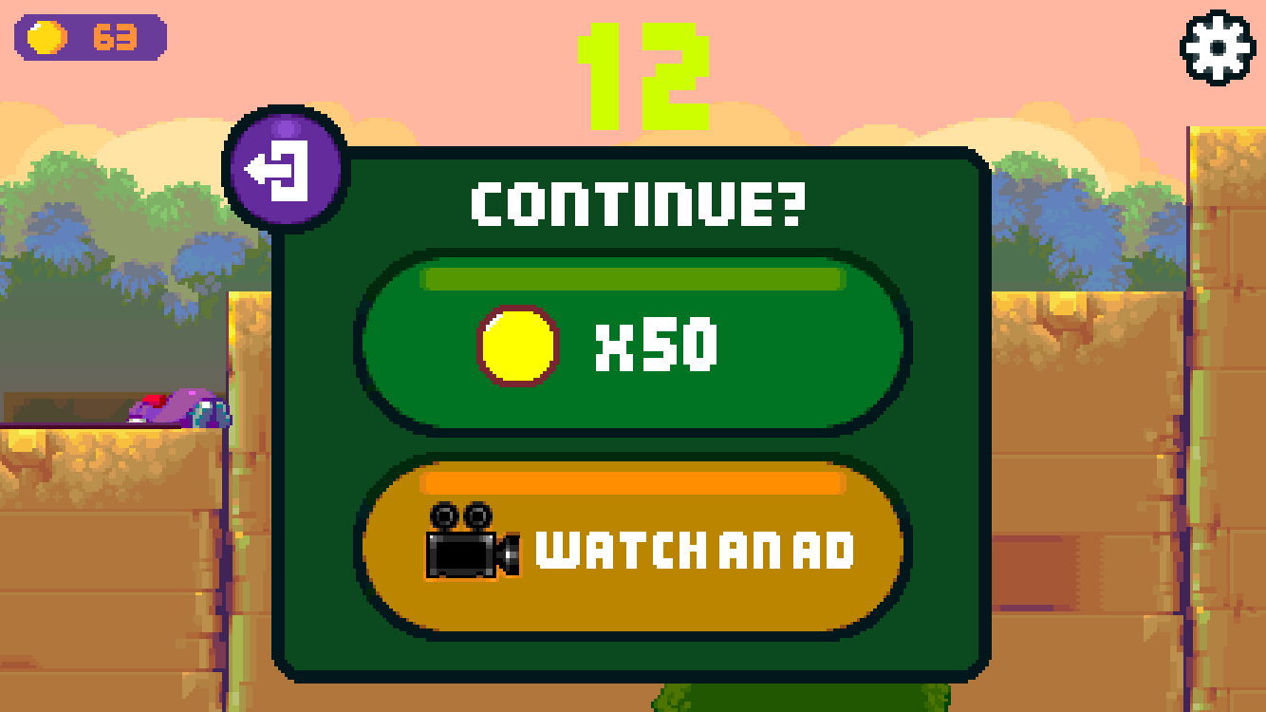
Don’t Overload Inventory
Avoid the temptation to allow players to burn through as many ads as you can show
Remember, you actually want them to click on these!
Ad providers give lower prices eCPM for partners who provide “empty” clicks
See: Vault

Slide 6

Work with Multiple Partners
A single partner puts your revenue at the whim of large client shifts and that partner’s regional reach
Multiple partners allow you to take advantage of big purchases and reach broader audience at the right time
See: Kiloo

Slide 7
Things We Did Differently
Implemented In Non-Proven Genre
We took a few risks on Compass Point West’s Ad implementation, a few examples we’ll go over. ...
Ads Are An Awesome Feature
Ads Are An Important Piece of Our Economy

Slide 8



Non Proven Genre for Ads
Ads/Release
Ratio =
Really freaking high!

Slide 9
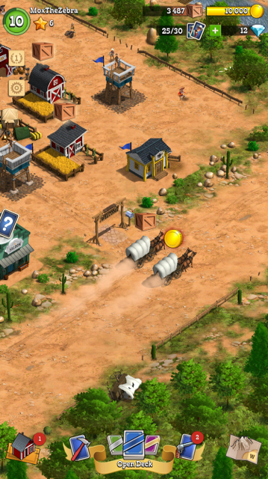
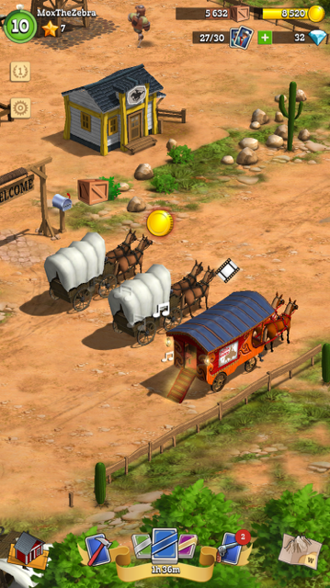
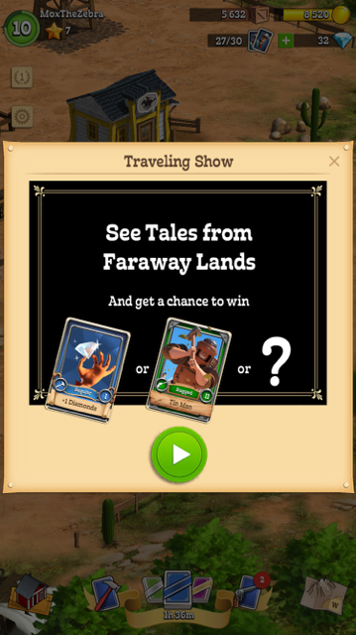
Dedicated Ad Experience

Slide 10

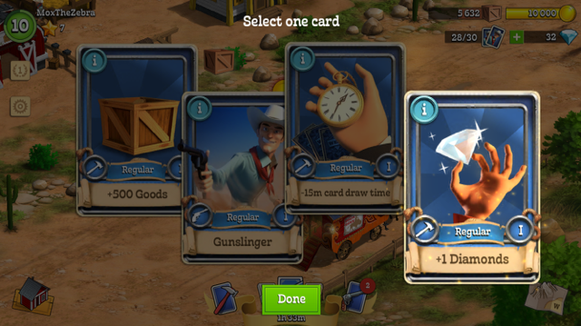
Dedicated Ad Experience

Slide 11
The Ad Economy
Valued the reward at the equivalent of a $0.30 IAP, the reward must be sizable.
This replaced what would be our “teaser” period for IAPs, giving players a piece of the premium experience.
Made liberal use of speed ups, the late part of the loop meant this could extend play sessions and engagement.

Slide 12
The A/B Tests!
We tried showing 3 Ads as Control, 1 Ad and 5 Ads over an 8 hour refresh period as a test
1 Ad: 19% ARPDAU More than Control, 4% Less ARPPU, 15% Higher conversion
5 Ads: 16% less ARPDAU and 18% Less ARPPU
However, when we looked at the overall net revenue generated, the control group actually won out!

Slide 13
The Next A/B Test…
So then we tried a test with ZERO ads:
20% More repeat purchases in group
15% Higher Conversion Rate
50% Higher ARDAU on IAPs
Take away: Ads increase the games value to spenders, but spenders are keenly aware of IAP value and will make best use of rewards

Slide 14
Lower amounts of valuable rewards on voluntary ads used consistently by the a large majority of players in the early purchase price range was the key to our ad revenue success

Slide 15
Thanks, partners!
Twitter: @Dirty_Mitchell
Mitchell.Smallman@nextgames.com

