Slide 1
Mobile Gaming Monetization Trends - 2016
Sohan Maheshwar - Developer Evangelist, InMobi
@soganMageshwar

Slide 2
REACH: 1.2 BN UNIQUES GLOBALLY
DEEP AUDIENCE INSIGHTS
200 Mn
250 Mn
390 Mn
160 Mn
Custom and Seasonal Audience Segments
TRUSTED PARTNER
HIGHLY ENGAGING AD FORMATS
Native
Rich Media
40,000+
Apps
Video
Full Screen
Banner

Slide 3
inDecode.inmobi.com

Slide 4
2015

Slide 5
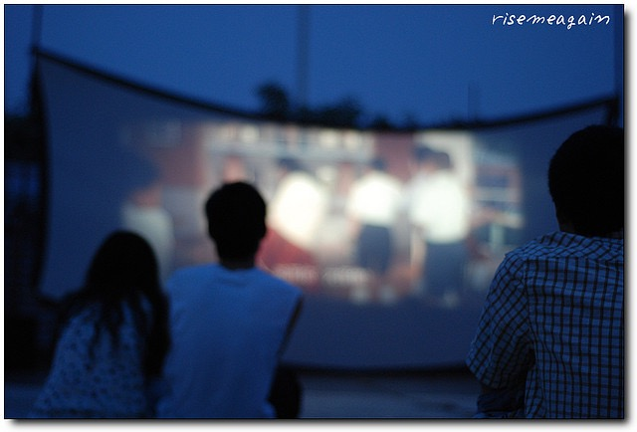
1. Video Ads
Mobile Video Ad Spend went up 70% in 2015. Total of $2.62 billion dollars spent.
Notes:
-Video Ads have better app install conversions, are high-engagement and mean more money for the developer.

Slide 6
1. Video Ads
Crossy Road made $3m from Rewarded Video Ads alone.
Notes:
-Rewarded Video Ads have seen an increase in popularity thanks to its opt-in format.
-Crossy Road made $3m from Rewarded Video Ads alone. A total of $10m in 2015.

Slide 7
2. Apple TV Games
Latest Apple TV supports 3D games through its tvOS.
Notes:
-These games are supported using Siri Remote as well as separately sold ‘traditional’ consoles.
-SpotX, AppLovin have already announced launches of ad SDKs for tvOS.
-It will take away from console sales. Further the divide between serious and casual gamers. New paradigm of gaming from your mobile phone into the living room.
-Apple TV and Google Chromecast are slightly different in their approaches. But fundamentally in the same ecosystem.

Slide 8
3. Game Studios As Publishers
Easier to invest money in user acquisition, paid marketing and localization.
Notes:
-Companies like Sega, Ubisoft etc have invested in getting their games localized for Eastern markets, given the size of the markets there.
-This works vice versa as well. For instance Neko Atsume, a japanese app about cats saw some traction in foreign markets. so they localized it for the west and released it.

Slide 9
2016

Slide 10
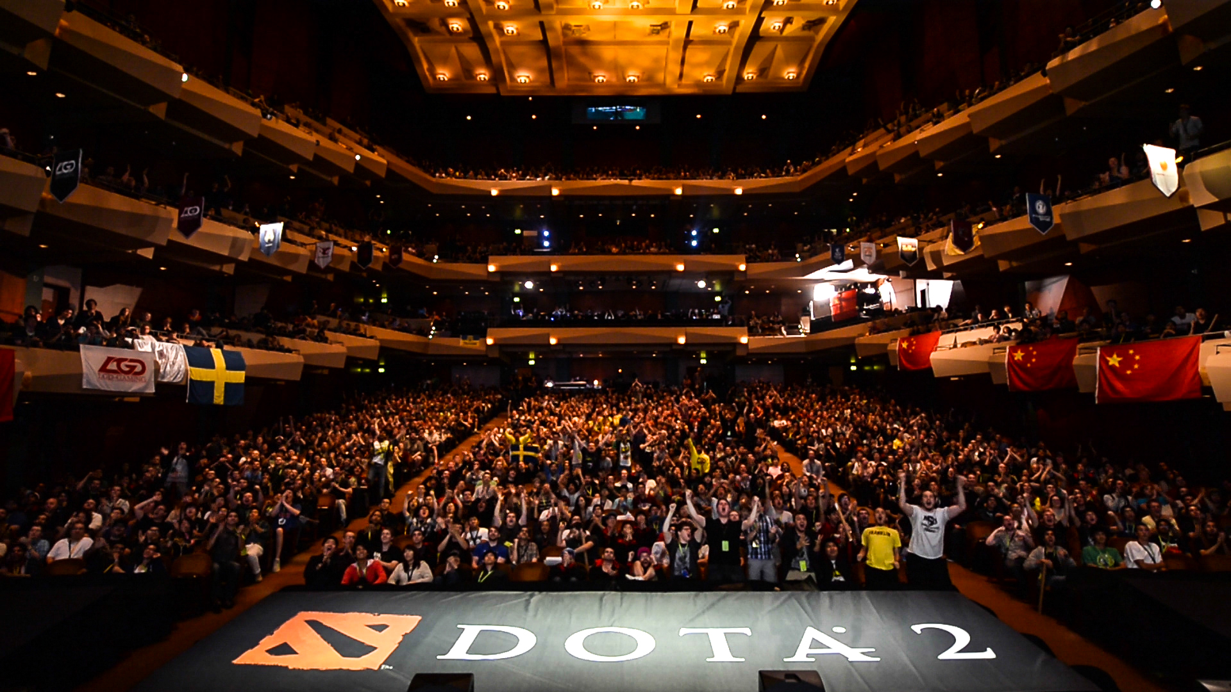
1. Live Streaming Mobile Games
Twitch has 120 million users a month. YouTube Gaming, MobCrush, Shou.tv offer live mobile streaming.
Notes:
Twitch was bought by amazon for ~$1 billion.
Even SDKs ilke Everyplay which record gameplay on mobile are quite popular.

Slide 11
2. Playable Ads
App-install Ads that let users ‘play’ a game within the ad.
Notes:
-InMobi in partnership with Voxel launched Playable Ads.
-The technology allows users to ‘stream’ an app inside an ad through virtualization.
-Didn’t work because of tech difficulties and publishers weren’t too keen on taking time away from their games. But market is evolving.
-Google just launched their version of Playable ads and it might see a resurgence.
- Can work for non-game ads as well.

Slide 12
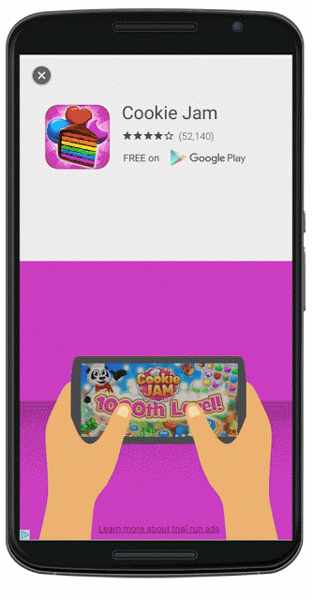

Slide 13
3. In-Game Branded Assets
Branded in-game assets that are ‘native’ to the game.
Notes:
Static and non static assets are branded with a company’s name. Sometimes these assets are interactive ,as in the case of the Idea power up in this ad in Angry Birds.
In countries like India it is tough to monetize through IAPs thanks to low credit card penetration and high entry point of IAPs. So game dev focus on a mixture of ad revenue and branding opportunities. For example: Amazon presents XYZ game.

Slide 14
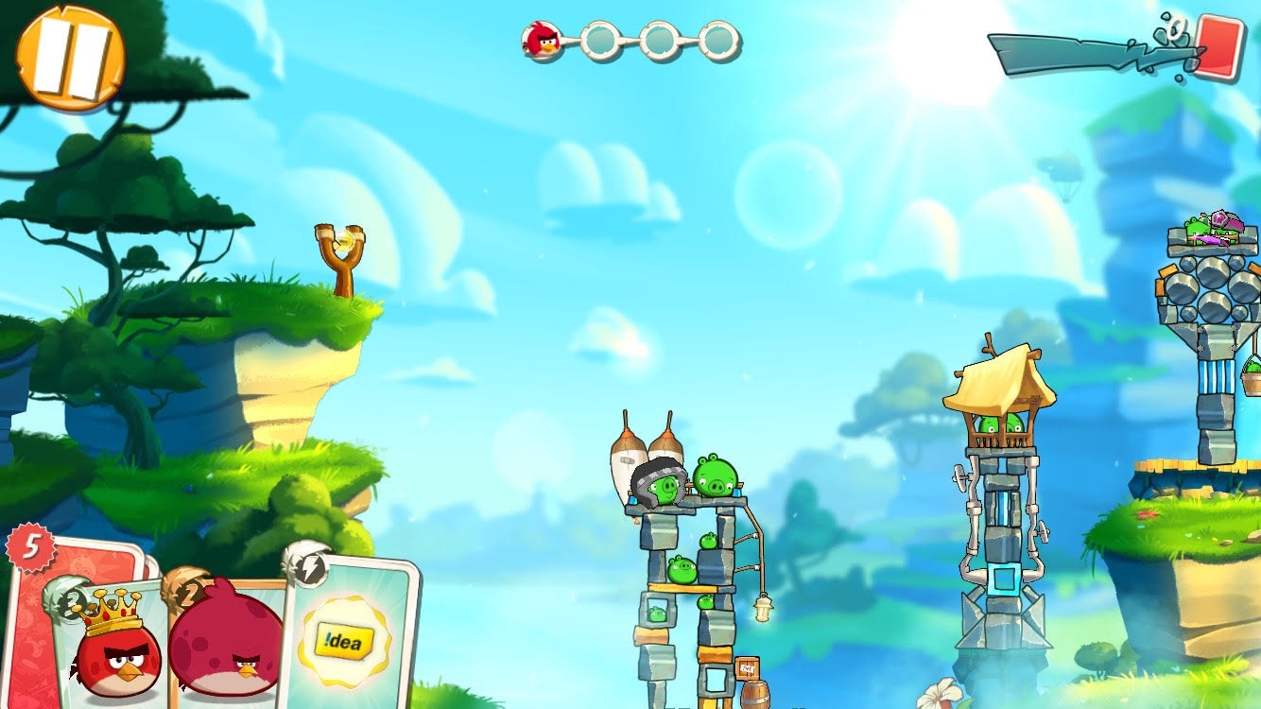

Slide 16
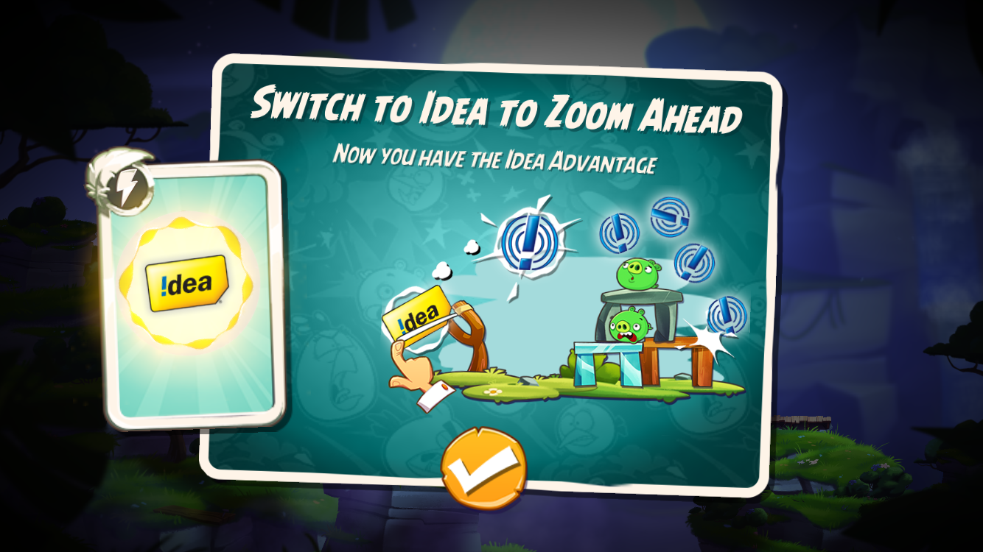

Slide 17
4. Offline Rewards
Companies like kiip.me or Frapee that offer incentives based on in-app progress.
Notes:
-PikPok for instance shows kiip ads in their games. Kiip is more verstatile as it can be used in non-game apps as well.
-Frapee has their own games hosted on the Play Store. Essentially they target very casual gamers and give them incentives to play simple, arcade style games. Again, this works in a market like SE Asia.

Slide 18
5. Netflix-ication
Subscription based services for apps and games. Eg: Amazon Underground
Notes:
-Amazon is offering hundred of games for free (including all IAPs) currently. Plans are to move to a monthly subscription sort of model
-Even Humble Bundle now has a monthly subscription model.
-Clear that monthly subscriptions are a better model for companies in the long run as there are repeat customers. Spotify, Apple Music and Amazon’s Kindle subscription are examples of this.

Slide 19
6. Look East
Google Play to re-launch in China.
India to overtake US in number of smartphones sold, in 2017.
Notes:
-Rovio office in Delhi
-china and japan themed angry birds

Slide 20
RECAP.
Live Streaming Mobile Games
Playable Ads
In-Game Branded Assets
Offline Rewards
Netflix-ication
Look East

Slide 21
Photo Credits
https://www.flickr.com/photos/barrentrees/8079590996/
https://www.flickr.com/photos/risemeagain/2639315654/
http://www.develop-online.net/analysis/region-focus-hamburg/0117537
https://www.flickr.com/photos/lostdogphoto/6793426696/
http://media.steampowered.com/apps/dota2/images/blogfiles/crowd_end_of_da.jpg
https://www.flickr.com/photos/zeeyolqpictures/14371703182
https://www.flickr.com/photos/101295317@N06/15083805494
https://www.flickr.com/photos/29233640@N07/3745368402
https://www.flickr.com/photos/62693815@N03/6276688407
https://www.flickr.com/photos/24958117@N07/18416891492
https://www.flickr.com/photos/fotonormann/8602226743

Slide 22
THE END
Questions?

