Slide 1
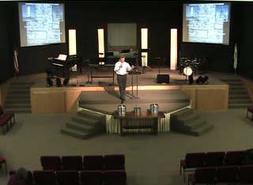
Evangelistic Priorities
as a Senior Minister
Make the message clearly known
Call to a valid decision
Foster a persistence in faith
Notes:
Make the message clearly known - Are they hearing what you are saying?, are they seeing what you are saying? Are they doing what you are saying?
Call to a valid decision – what will be left behind, changed, embraced, forgotten and remembered?
Foster a persistence in faith - a valid decision is not made because of life circumstances, it is made into life circumstances. The circumstances may not change, but the life will!

Slide 2
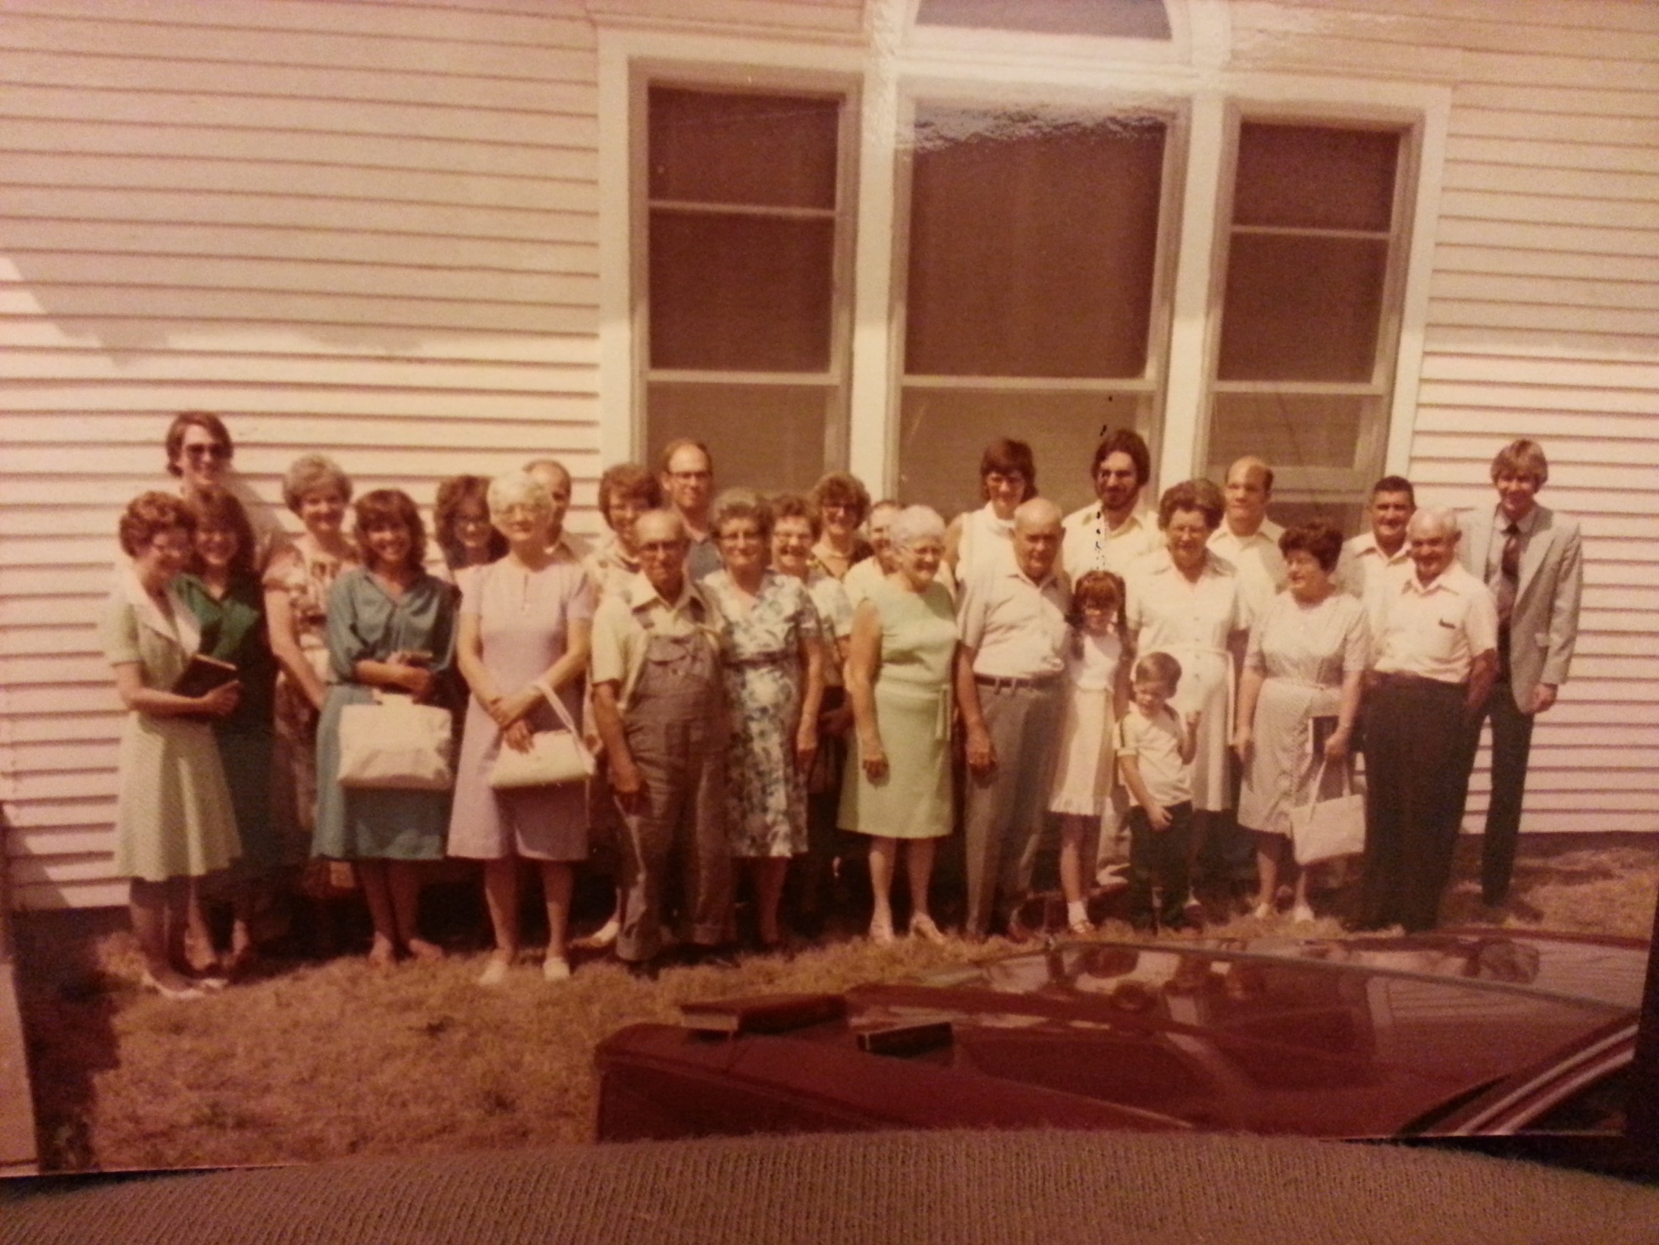
Evangelistic Priorities as a Senior Minister
Be a positive example
Communicate first by listening (60/40 principle)
Speak to them with love
Go with them to their friends
Small Church
Notes:
Be a positive example
Communicate first by listening (60/40 principle)
Speak to them with love (you attract more flies with honey than you do vinegar)
Go with them to their friends (bring your friends to church so that I [the preacher] can win them)

Slide 3

http://dougdelp.files.wordpress.com/2011/01/english-standard-version-bible-personalized.pdf
Notes:
“One of the key factors that led me to take Jesus Christ as my Lord and Savior was…
“Becoming a Christian has caused me to…”
Then I posted on PowerPoint and challenged them to write the following information within the first
two blank pages:
“God’s word answers the question, ‘What must I do to be saved?’”
The Bible contains God’s will for us - Ps 19:7-8, pg. 391
All disobedience to God is sin -1 Jn. 3:4, pg. 878
We’ve all sinned - Ro. 3:23, pg. 806
Wages of sin is death - Ro. 6:23, pg. 808
Jesus is God in the flesh - Jn. 1:14, pg. 758
Jesus paid the debt of our sin - Ro. 5:6-9, 807
Man must respond to God’s grace - Jn. 1:12-13, 758
The Bible says to BELIEVE— John 8:24, 765
The Bible says to REPENT— Luke 13:3, 745
The Bible says to CONFESS— Ro. 10:9, 810
The Bible says to be BAPTIZED—Ac. 2:38, 779
The Bible says to be FAITHFUL— Re. 2:10, 884

Slide 4
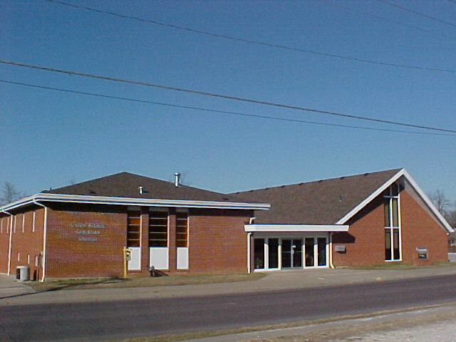
Evangelistic Priorities as a Senior Minister
Be a positive example
Learn to say I’m sorry
Learn to evaluate & reevaluate
Discern their culture & pick your battles wisely
Not as
Small of Church

Slide 5
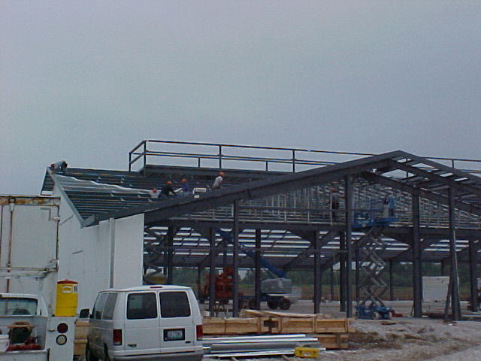
Evangelistic Priorities as a Senior Minister
Be a positive example
Equip the believers
Get to know the unbelievers (Building God’s Way)
Study and promote the big picture (W.I.T.N.E.S.S.)
Medium Size Church

Slide 6
Evangelistic Priorities
as a Senior Minister
Major events in the church
Major events within the next two years
Current community/cultural events
When did you preach last on “Sin,” “Salvation,” “Family,” “Evangelism,” “Stewardship,” “Leadership.”
What holidays need addressing?
What books of the Bible have you not preached from?
What are the current best sellers?
What are the current top headlines?
Notes:
Evangelistic Priorities
Make the message clearly known - Are they hearing what you are saying?, are they seeing what you are saying? Are they doing what you are saying?
Call to a valid decision – what will be left behind, changed, embraced, forgotten and remembered?
Foster a persistence in faith - a valid decision is not made because of life circumstances, it is made into life circumstances. The circumstances may not change, but the life will!
Evangelistic Priorities as a Senior Minister
Small Church
Evangelistic Priorities as a Senior Minister
Not as
Small of Church
Evangelistic Priorities as a Senior Minister
Medium Size Church
Evangelistic Priorities
Major events in the church
Major events within the next two years
Current community/cultural events
When did you preach last on “Sin,” “Salvation,” “Family,” “Evangelism,” “Stewardship,” “Leadership.”

Slide 7
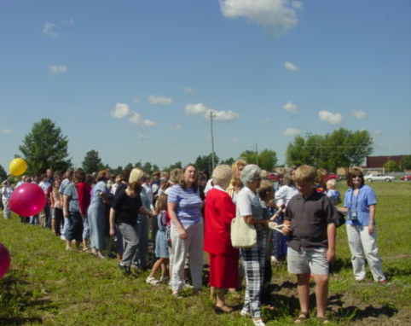
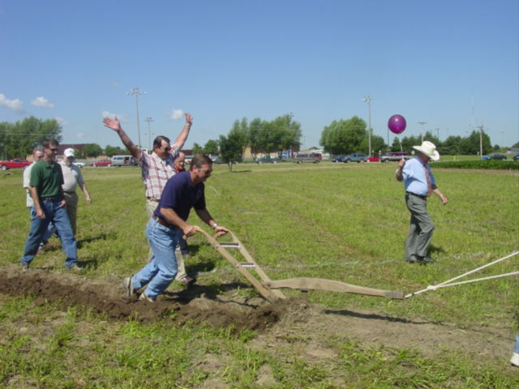
Evangelistic Priorities as a Senior Minister
Equip leaders to evangelize, self-feed and disciple
Manage conflict biblically (cooperation, not manipulation)
Balance the priorities prayerfully
Avoid the “Maverick” mentality

Slide 8


