Slide 1



The importance of engineering, systems & quality for Charleston’s future
Jim Thompson
266 Meeting Street - Suite B | Charleston, SC 29401
Direct: 843.469.8279 | acommoncenter.com
RABQSA Lead Auditor | ASQ Charleston Chair Elect & Quality Conference Chair | ASQ TC Chair Future & Innovation | Member of Society of Manufacturing Engineers | Member of Charleston Metro Chamber of Commerce | Member Charleston Young Professionals | Charleston Running Club
con•cen•tric (ken-sĕn’trĭk) adjective - Having a common center.

Slide 2
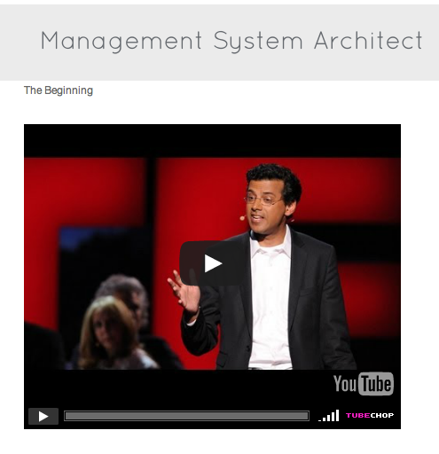
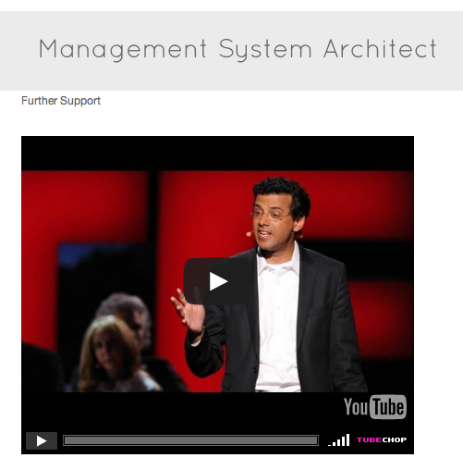
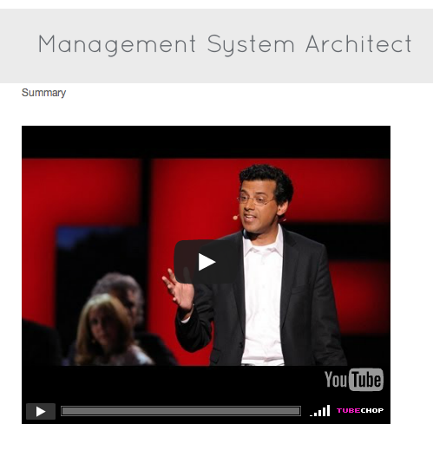
Dr. Atul Gawande
TedTalks – April 2012
Click to watch short video segments regarding importance of systems or watch the full video here: https://www.youtube.com/watch?v=L3QkaS249Bc
Notes:
Examples from the audience
Traditional architect vs. management system architect
10:20-11:33
13:48 – 14:35
18:13 – 19:00

Slide 3
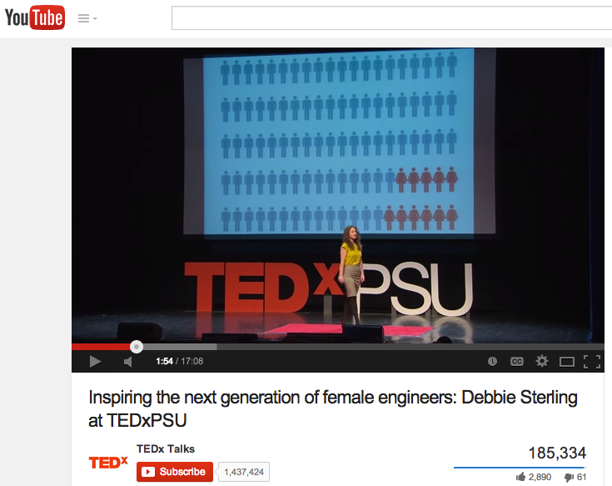
Debbie Sterling
TedxPSU – April 2013
Close your eyes and picture and engineer. You probably weren't envisioning Debbie Sterling. Debbie Sterling is an engineer and founder of GoldieBlox, a toy company out to inspire the next generation of female engineers. She has made it her mission in life to tackle the gender gap in science, technology, engineering and math.
Full Video: https://www.youtube.com/watch?v=FEeTLopLkEo

Slide 4
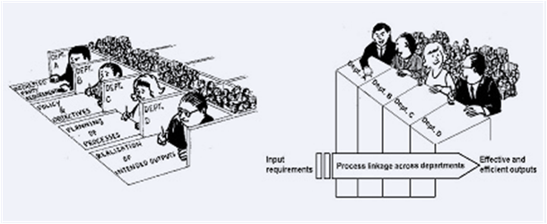
Notes:
The process approach is taking any activity, or set of activities, that uses resources to transform input to outputs. For example, every day a restaurant transforms a certain amount of energy and materials into creating a meal for it’s customers.
The output of the process —> the quality and efficiency of the meal + facility cleanliness + the dining experience + appropriate cost + other expected elements = meeting the desired results of the customers.
The systematic identification and management of the processes employed within an organization, and particularly the interactions between such processes, is referred to as the “process approach”.
Effective operations depend on:
identification and management of numerous interrelated processes
clear understanding for how processes interact
clear expectation of output from one process equals an input into another
clear communication of roles and responsibilities
an overall understanding of the big pictures (goals & objectives)
The automotive process approach is a requirement from the IATF Rules documents (ref. Rules for Achieving IATF Recognition: 3rd edition for ISO/TS 16949). Automotive organizations must ensure that priority is given to:
questioning processes, the sequence and interactions, and performance against the measures defined focus on processes which directly impact the customer questioning the process objectives/targets, with focus on where targets are not being met focus on issues that have the greatest impact on the customer questioning what plans are in place to ensure targets are met corrective action plans where objectives are not being met following audit trails to linkages between customer concerns, performance against objectives and relevant process documents (e.g. control plan, FMEA, etc.), questioning the clients’ process for gathering, communicating and implementing customer-specific requirements
Focus on the customer. Is the customer satisfied with their dining experience? How can we do better tomorrow?
Focus on organizational performance. Did we achieve, as a business, our organizational goals (i.e. make a profit, retain valued staff, satisfy regulatory requirements, etc.)?

Slide 5
“Making systems work is the great task of my generation of physicians and scientists. But I would go further and say making systems work - whether in healthcare, education, climate change, making a pathway out of poverty - is the task of our generation as a whole.”
- Dr. Atul Gawande

Slide 6
Charleston Area Key Links

Slide 7

Charlestonejc.org
American Institute of Chemical Engineers (AIChE) (section 124) www.aiche.org
American Society of Civil Engineers (ASCE) www.ascesceasternbranch.org
American Society of Heating, Refrigeration and Air Conditioning Engineers (ASHRAE) www.ashrae.org
American Society of Mechanical Engineers (ASME) www.asme.org
American Society for Quality (ASQ Charleston) www.asqcharleston.org
Institute of Electrical and Electronic Engineers (Coastal SC Section R30383) www.ieee.org
National Society of Black Engineers NSBE www.nbse.org www.nsbecharleston.org
Society of American Military Engineers (SAME) www.same.org
South Carolina Society of Professional Engineers (SCSPE) www.scspe.org
Society of Manufacturing Engineers (SME 430) www.sme.org
Society of Women Engineers (Lowcountry Section D023) www.swelowcountry.org www.swe.org
The CITADEL School of Engineering http://www.citadel.edu/root/engineering

Slide 8
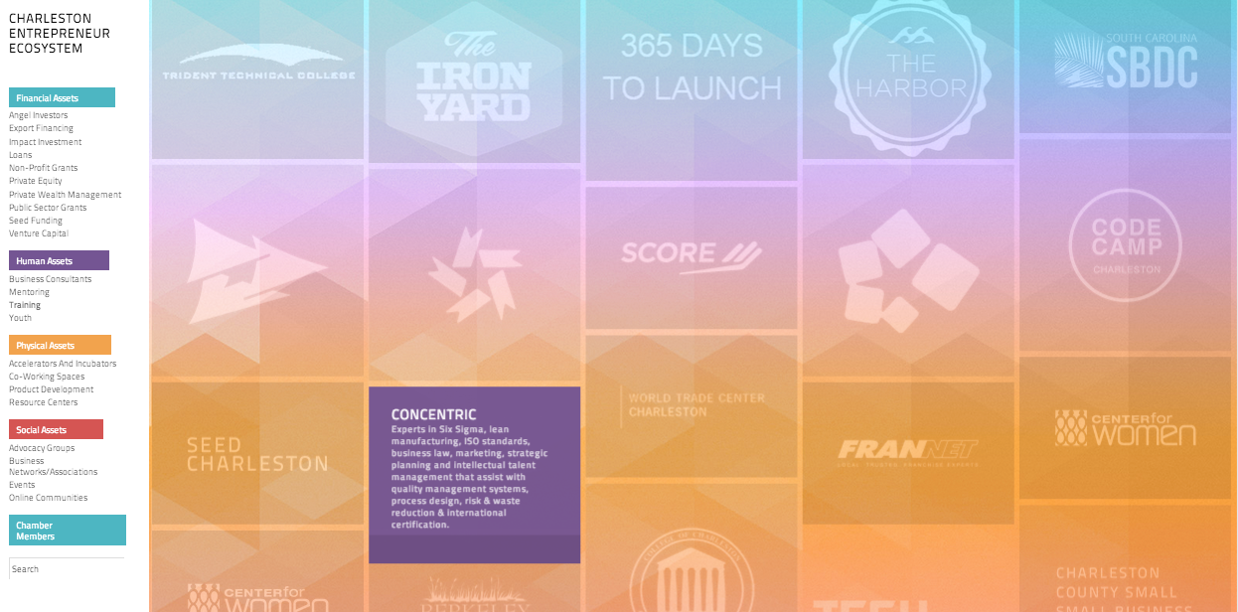
Charleston
Entrepreneur
Ecosystem
charlestonee.com

Slide 9

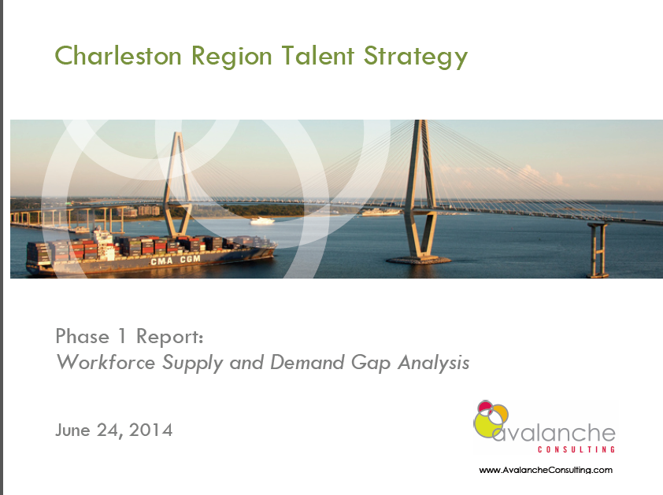
DegreesOfChangeChs.com

Slide 10
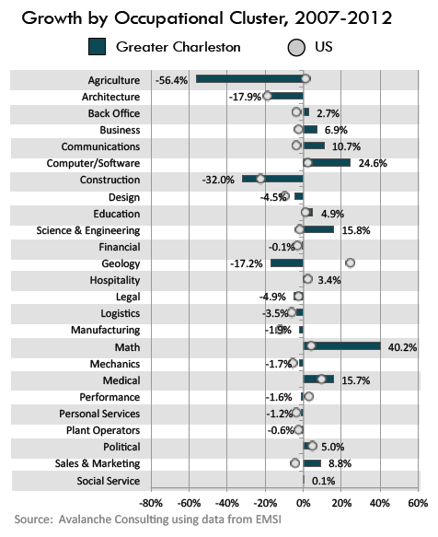
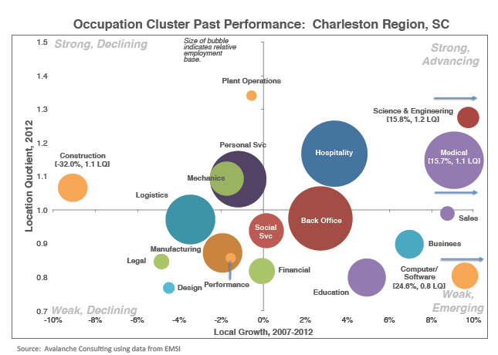

Slide 11
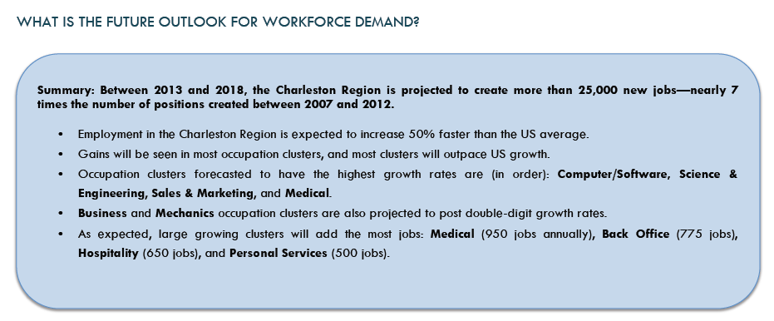

Slide 12
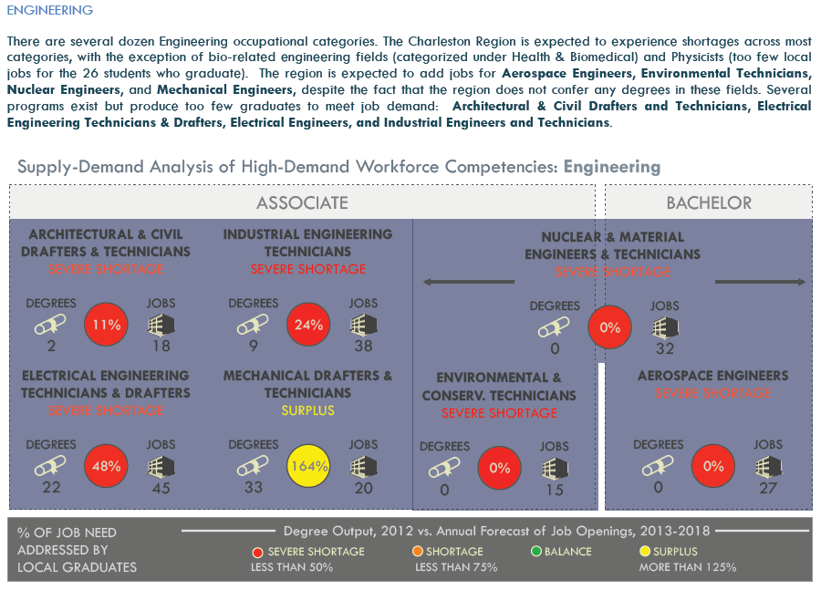

Slide 13
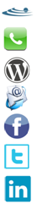
Contact Information
Jim Thompson | Contact Information
Concentric – 266 Meeting St, Charleston, SC
843.469.8279
acommoncenter.com
Jim.thompson@cmsicharleston.com
facebook.com/CMSiCharleston
twitter.com/acommoncenter
linkedin.com/in/jimthompson2001

