Slide 1
OD, Diversity and Inclusion Yesterday Today and Looking Around the Corner
Frederick A. Miller
Judith H. Katz
The Kaleel Jamison Consulting Group, Inc.

Slide 2
WELCOME

Slide 3
TWEETING AS YOU LEARN?
Use the conference hashtag:
#ODNIODA2015
And our Twitter handle:
@kjcginc

Slide 4
Learning Objectives
Explore how issues of Diversity and Inclusion have changed over the years
Examine the changing relationship of OD and Diversity and Inclusion
Discuss what we as OD practitioners can do to influence organizational change with respect to Inclusion and Diversity

Slide 5
Poll Question
Have we as practitioners been aggressive enough in addressing diversity and inclusion?
Not at all To a great extent
0 | 1 | 2 | 3 | 4 | 5 | 6 | 7 | 8 | 9 | 10

Slide 6
Shifts in the Workplace
COMPLIANCE
Affirmative Action
Open Doors
DIVERSITY
Recognizing the reality and business case
Open Minds
INCLUSION
ALL people
Open Systems

Slide 7
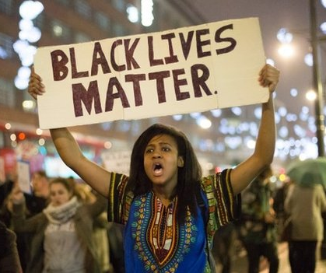
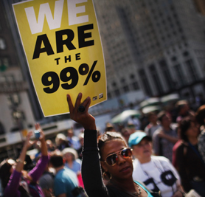
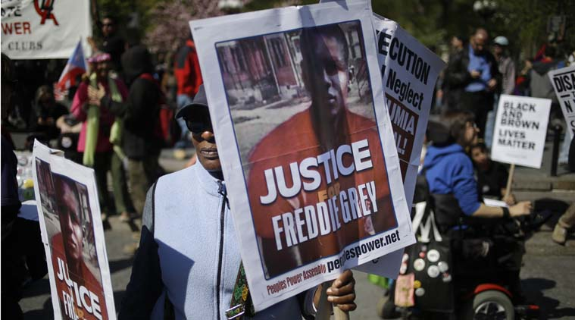

Slide 8
Diversity & Inclusion over the Years
1970s-1980s
1990s
Newly passed Affirmative Action (race and gender)
Focus on
Compliance
“Right thing to do”
Focus on business case.
Beginning to include issues gays and lesbians face in the workplace
2010-Present
2000s
Impact of society on workplace—marriage equality, minimum wage policies, transgender issues, Ferguson, Baltimore
Focus on fabric of the organization
Expanding definition of people of color;
domestic partner benefits for gays/lesbians
Beginning to focus on Inclusion

Slide 9
What’s ahead for Diversity & Inclusion
Sustainability
Marriage
Equality
Technology
Millenials
Polarization
Generation Z
Silver Tsunami
Healthcare
Religious bias

Slide 10
Questions for Discussion
Group 1:
In looking at the poll results and from your own perception, discuss how we as practitioners have/have not taken on diversity and inclusion in the field and in our practices?
Group 2:
To what extent are you bringing issues of diversity and inclusion up in your practice?
Group 3:
To what degree are issues of diversity and inclusion impacting the performance of your organization/client organization? and How?
Everybody:
As you think about your practice and skills, what is a growth/learning edge for you related to diversity and inclusion.

Slide 11
Copyright © 1998, 2001, 2002 The Kaleel Jamison Consulting Group, Inc. All rights reserved. No duplication without the written permission of The Kaleel Jamison Consulting Group, Inc. 518.271.7000. www.kjcg.com.

Slide 13
Privilege

Slide 14
Changing OD Methodologies
Diagnostic OD | Dialogic OD
Assume move to stability | Assume unknowns and unknowables
Unfreezing—Changing—Refreezing | Create disruptions and shift ongoing patterns of communication/interaction to lead to emergence of new possibilities
Organization change: envisioned, planned and managed | Organization transformation: emergent, dynamic, intervene in organization to accelerate, deflect, punctuate or disrupt to enable a leap
Change structures and systems | Change the conversation (change the interaction, change the experiences, change the result
Hierarchical Top-down | Heterarchical Start anywhere – spread out – peer-to-peer
Based on Gervase R. Bushe and Robert J. Marshak (Eds.). (2015), Dialogic Organization Development: The Theory and Practice of Transformational Change. Oakland, CA: Berrett-Koehler (adapted by Judith H. Katz)

Slide 15
The Big Question
Are we individually and collectively doing enough to address diversity and inclusion in our organizations and our lives?
If not…

Slide 16
Please Complete a Survey Before You Leave!
Your feedback is greatly appreciated.
Thank You!

