Slide 1
Thank You!

Slide 2
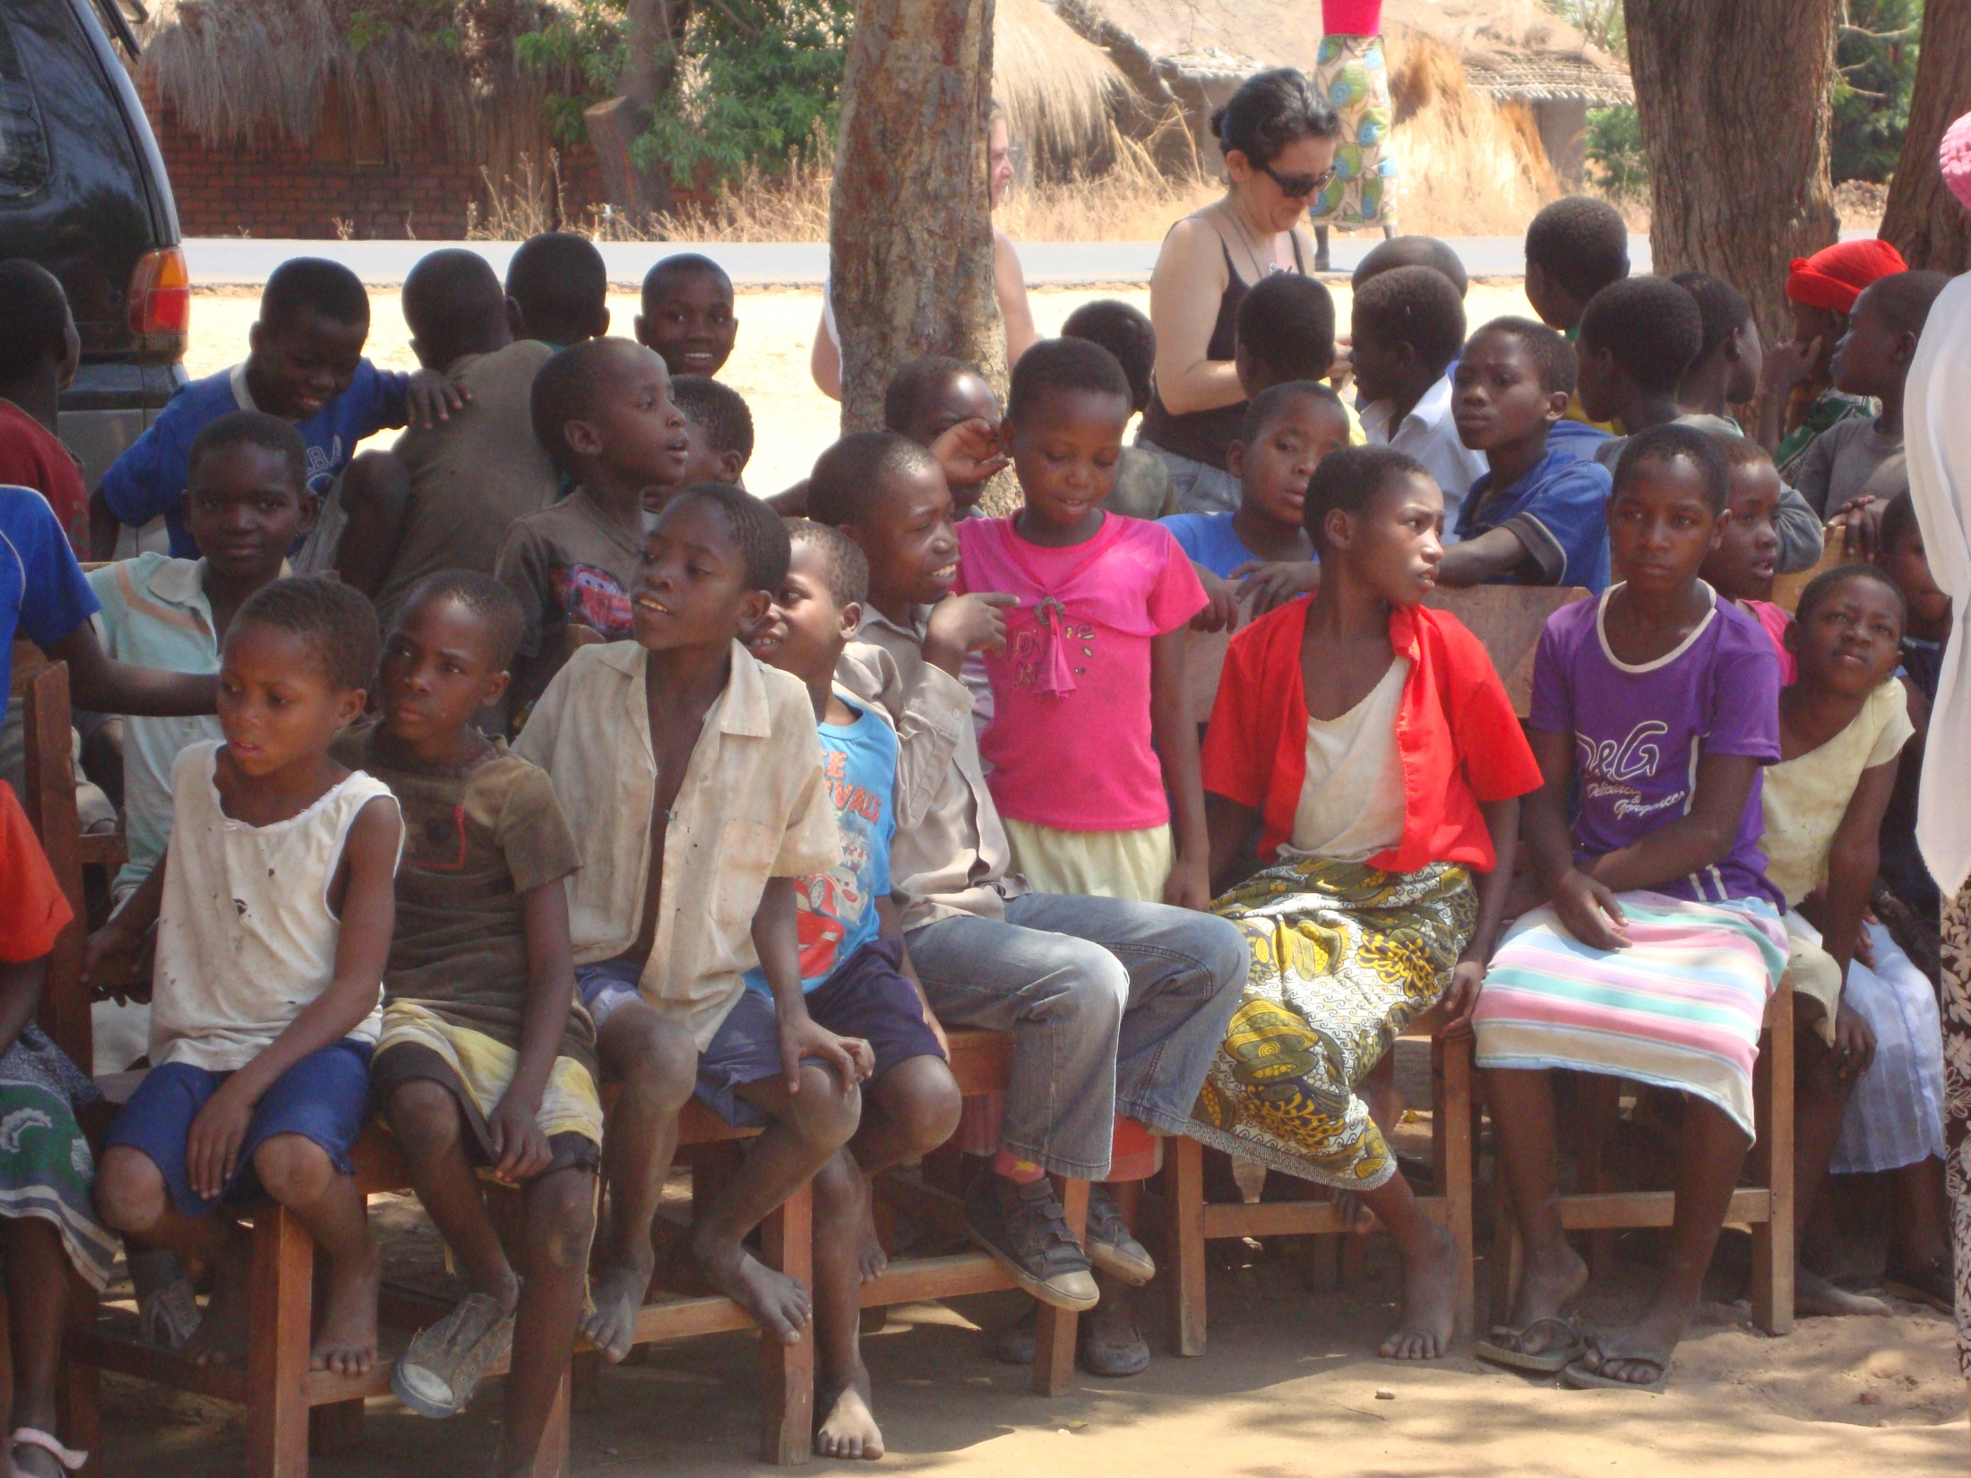
These are the orphans that visit ‘Glad Tidings’ (a charity run orphanage). This was where the underwear was delivered to and was so gratefully received by both children and the volunteers who go every day to cook and care for the children.

Slide 3
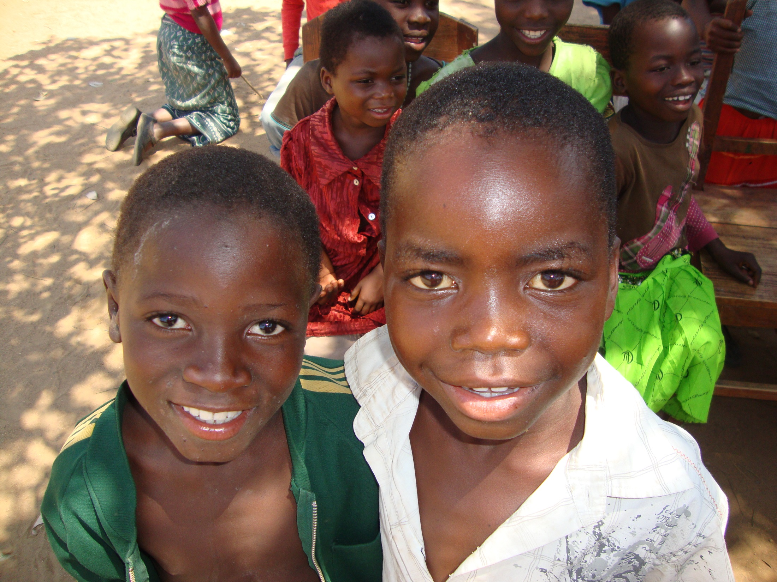

Slide 4
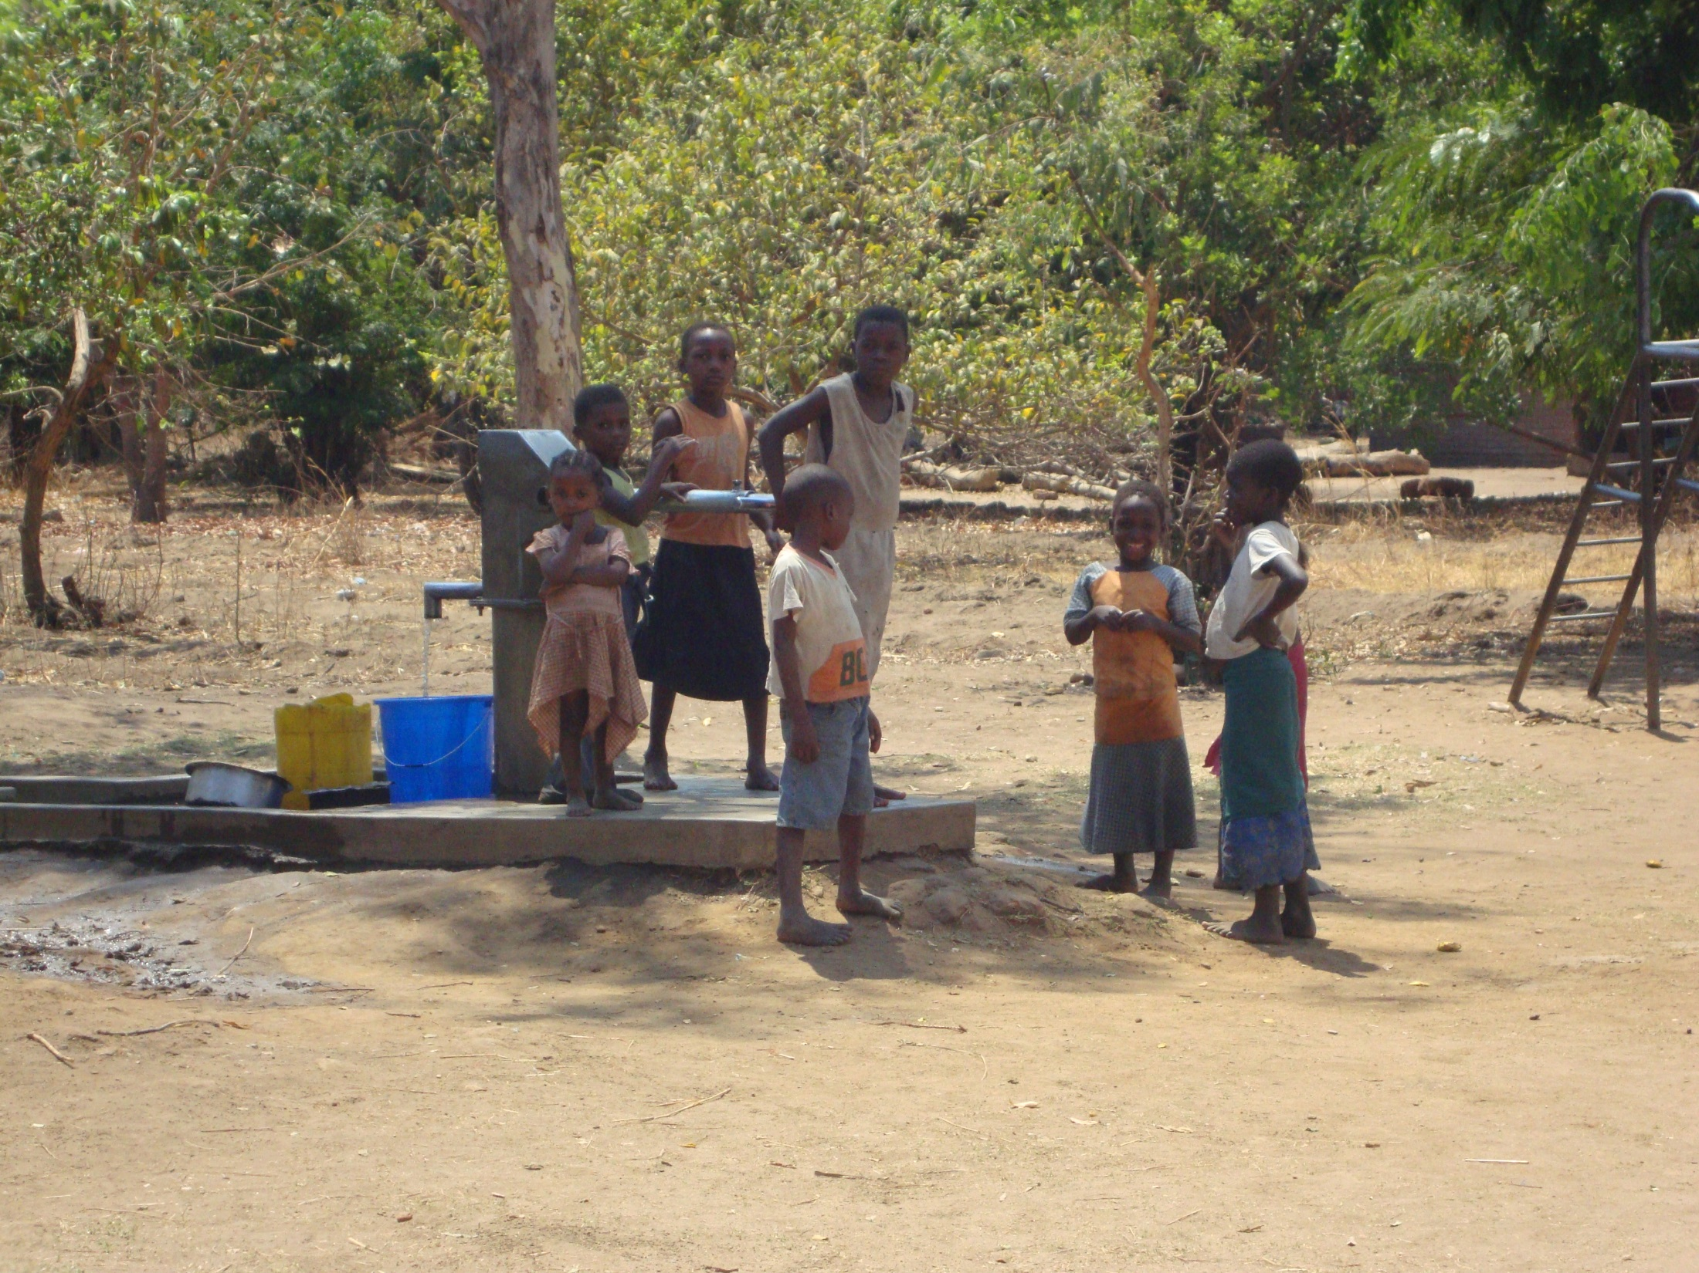

Slide 5
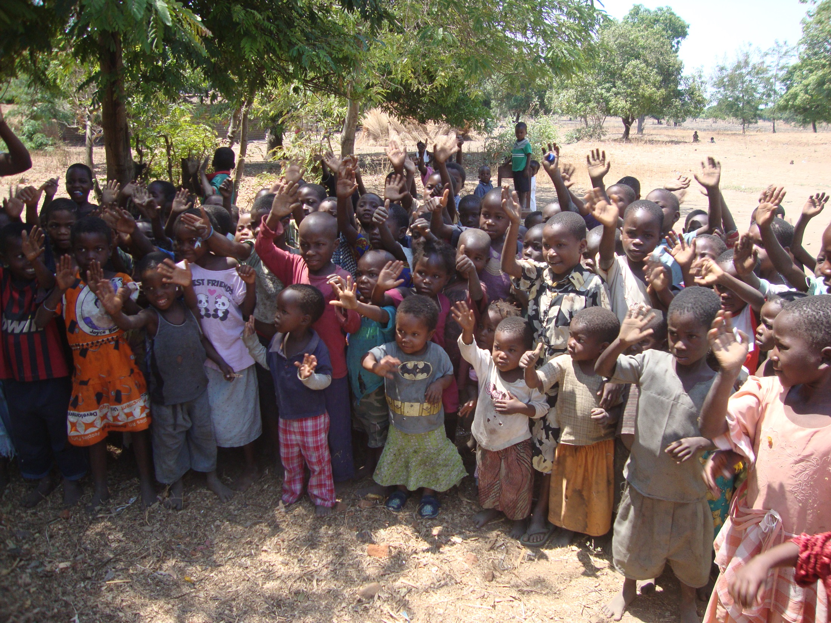
The children were keen to sing to us in English!

Slide 6
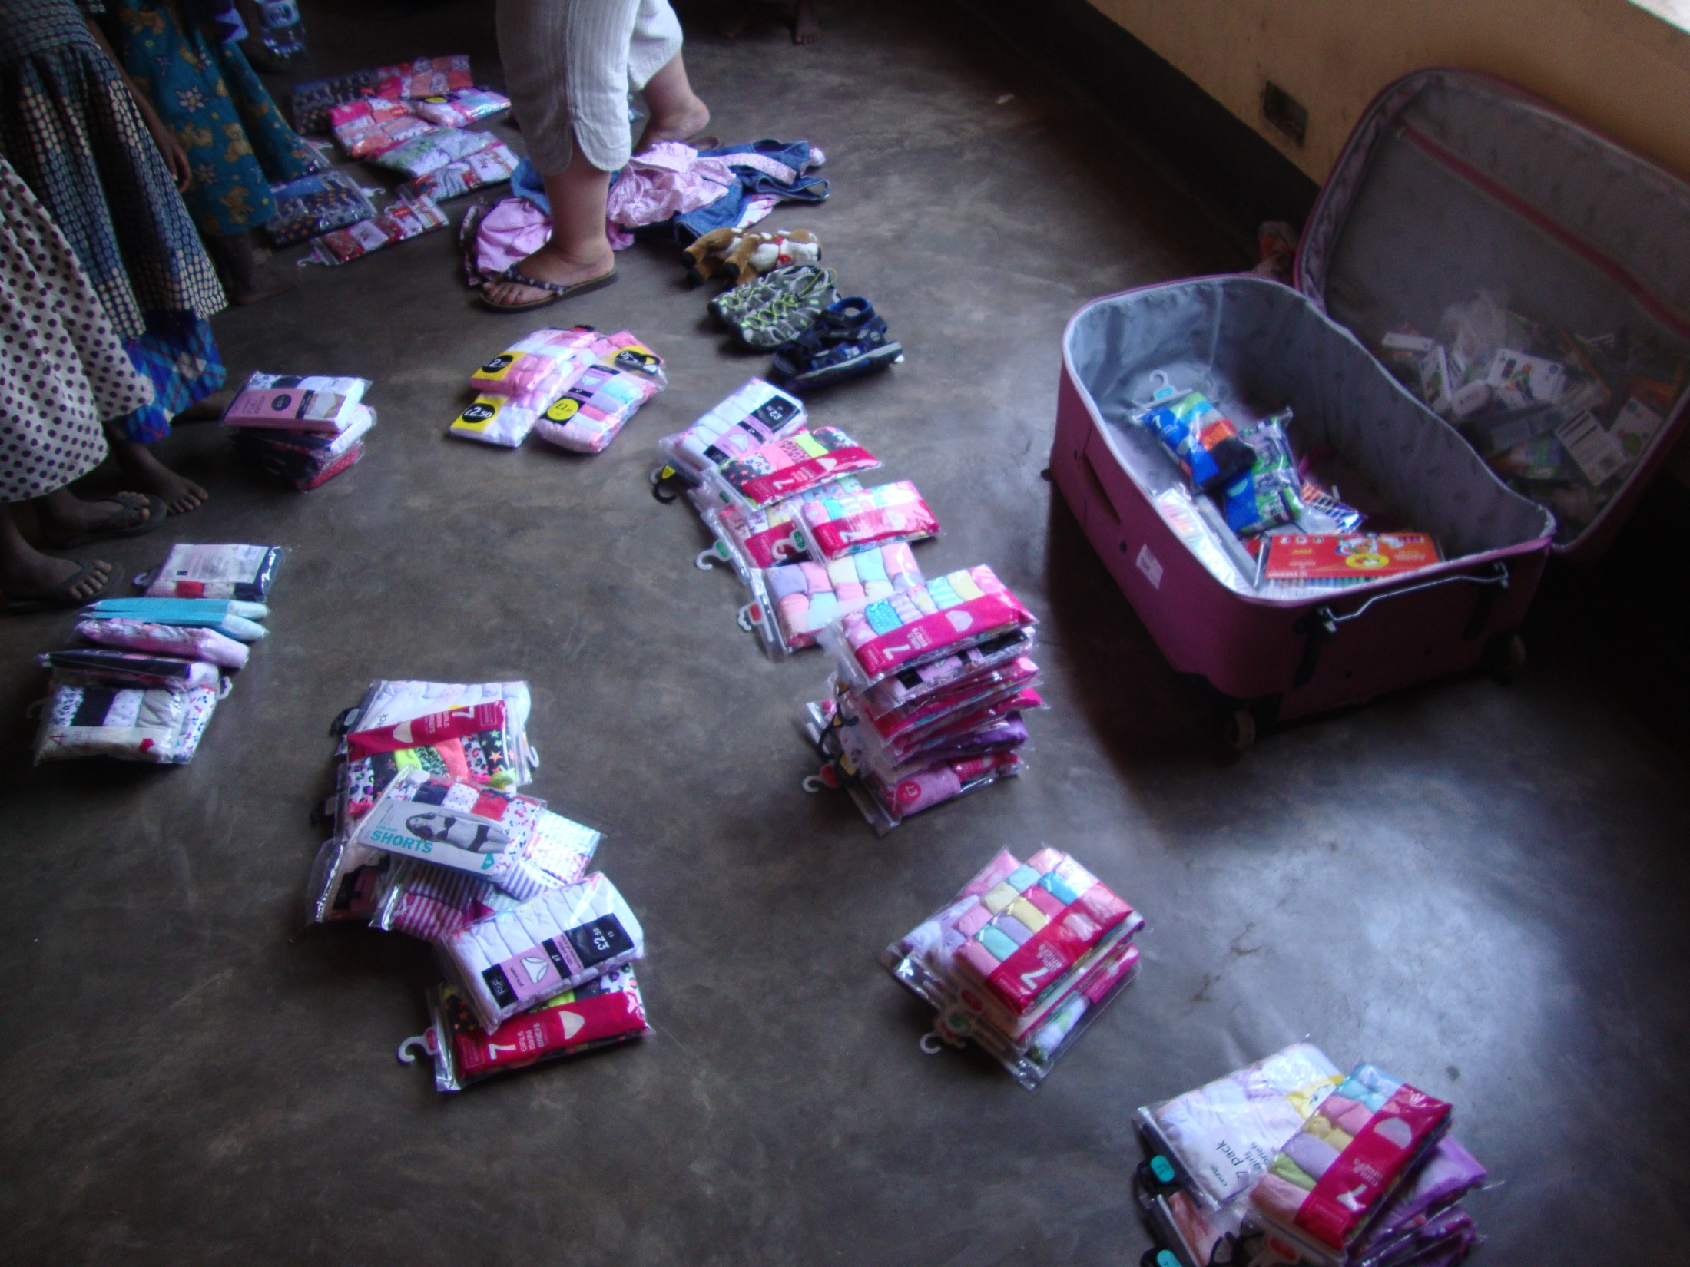
The start of the underwear delivery! Overall you donated 397 pairs of pants! This allowed every child to receive at least one pair.

Slide 7
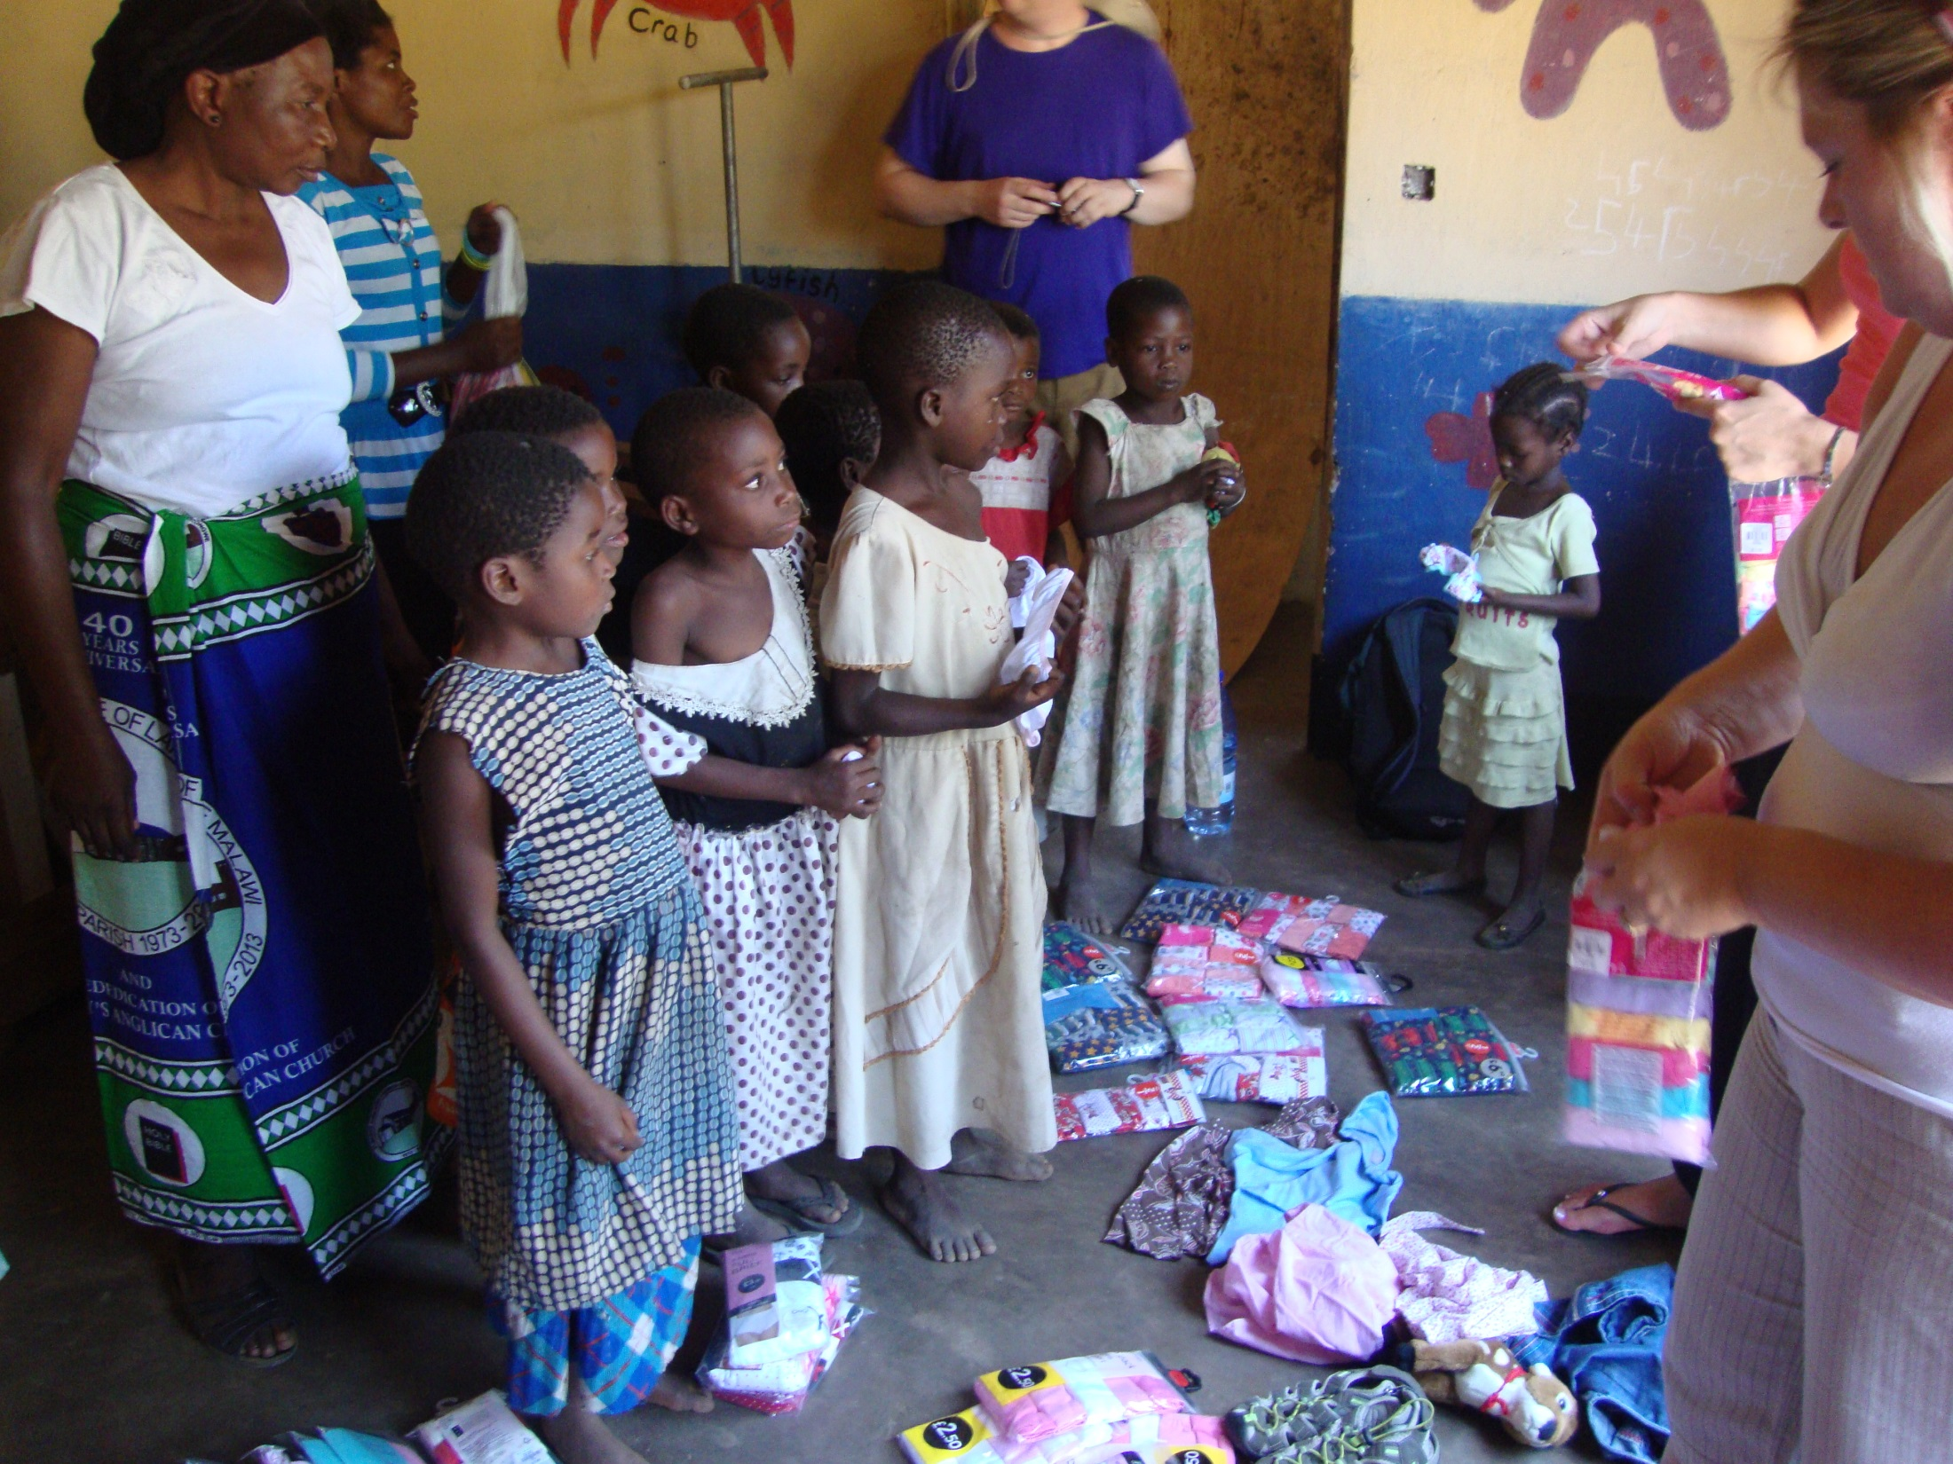

Slide 8
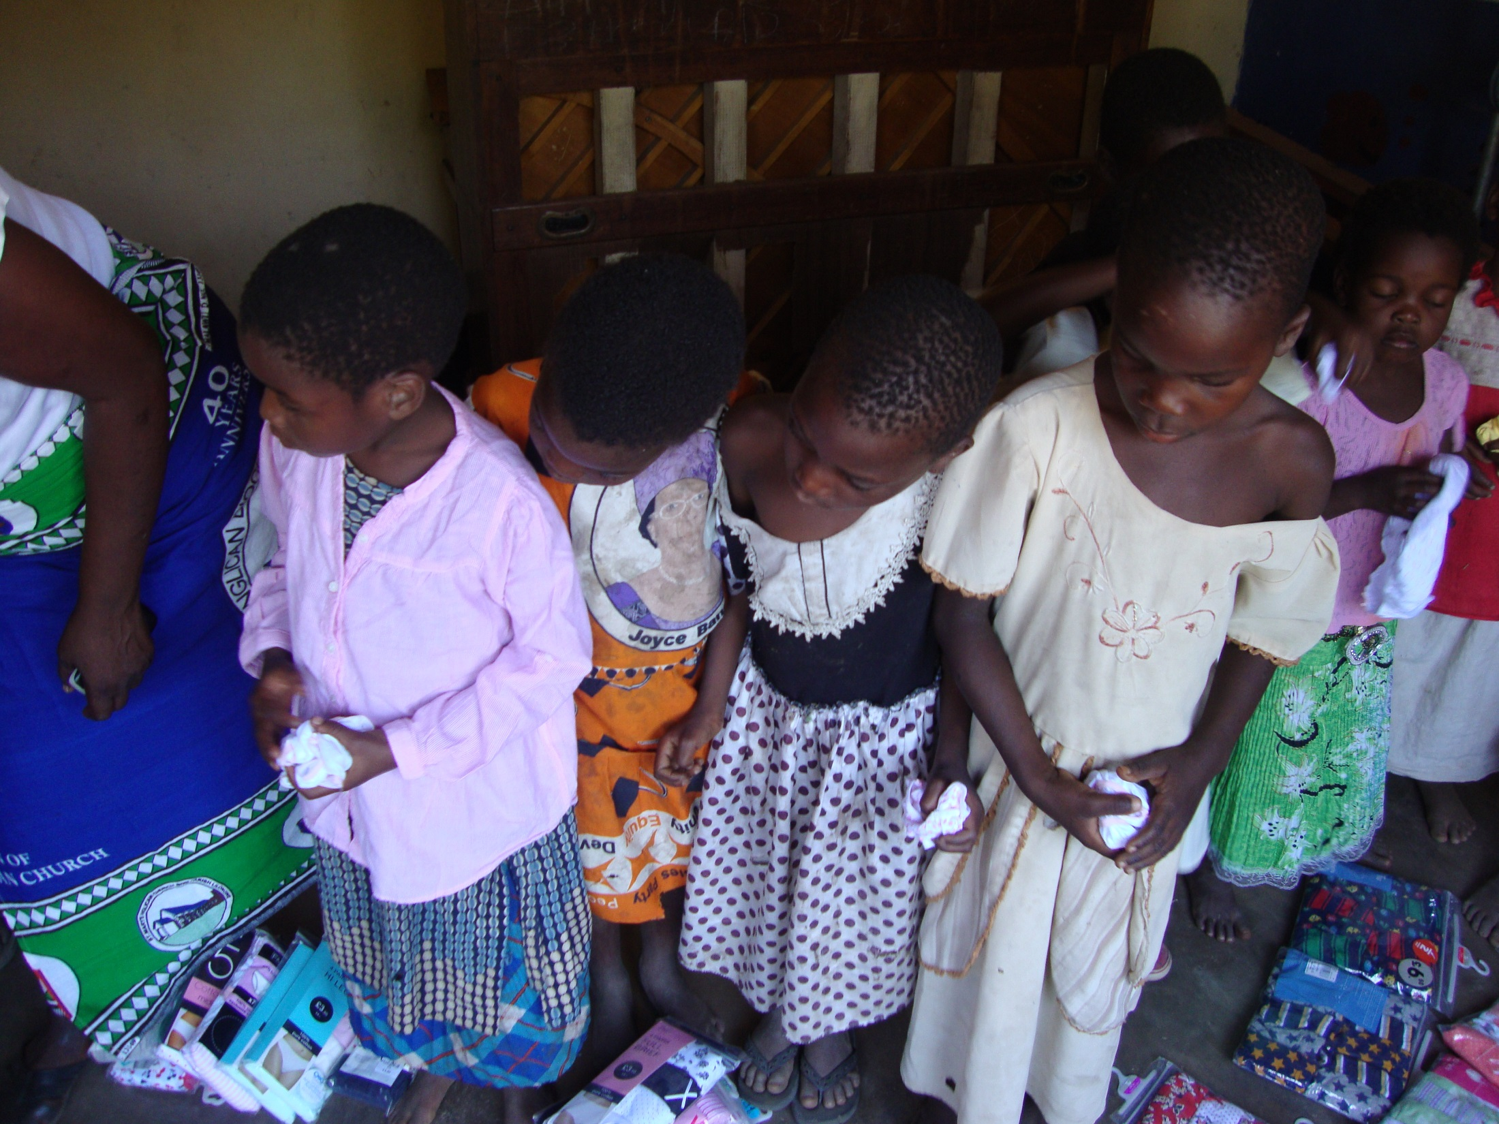

Slide 9
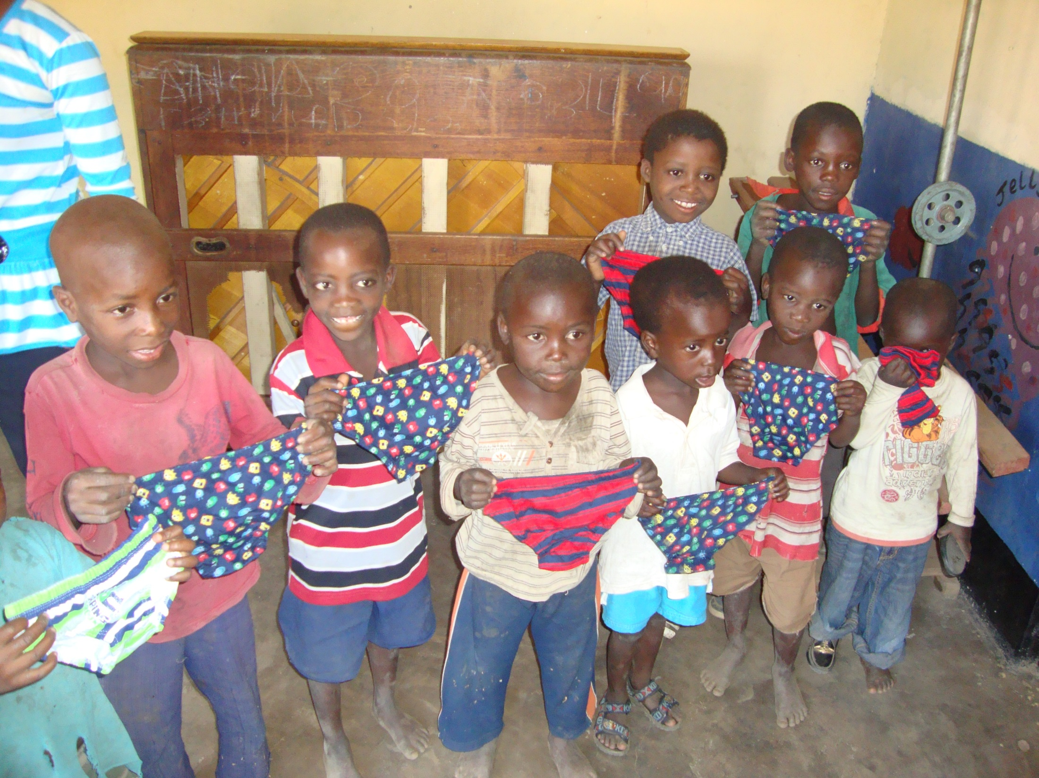
The boys were overjoyed too!

Slide 10
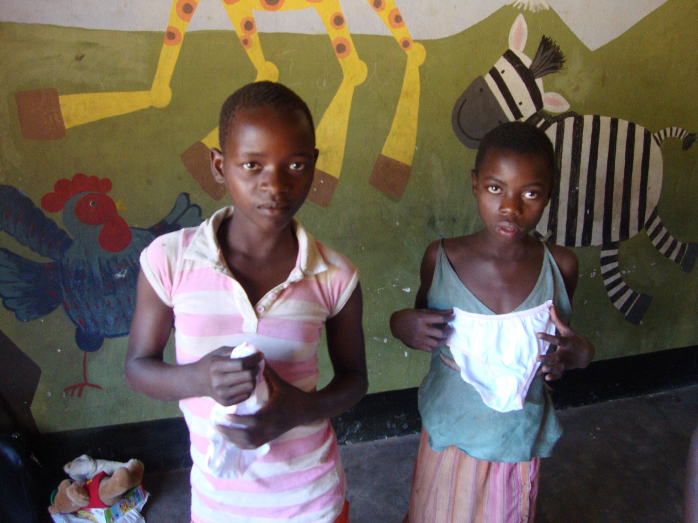
At first the girls were quite bemused and unsure what to do but as soon as they went outside the older girls were helping the younger children find the right size, one girl tried 8 pairs against her!!

Slide 11
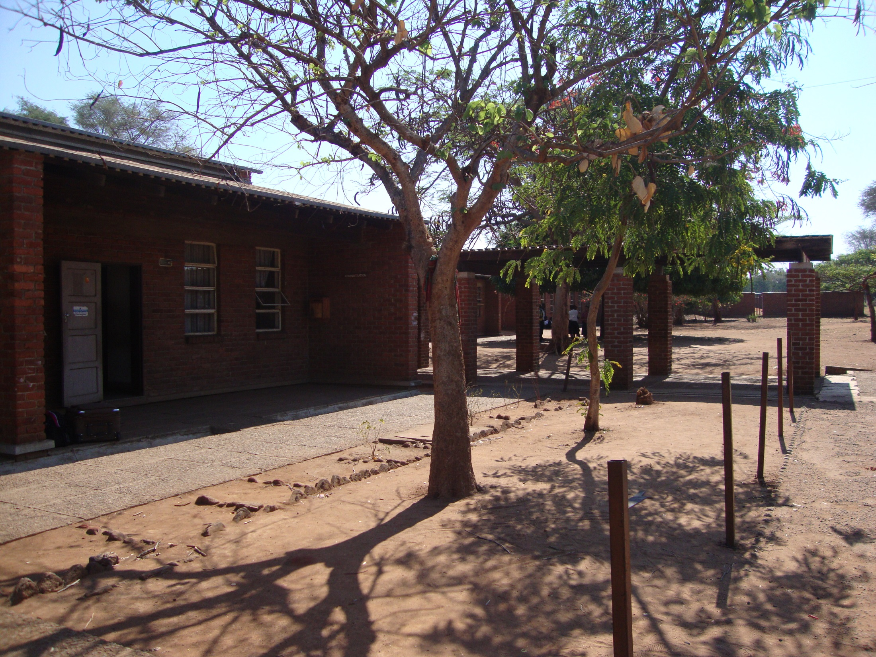
This is Salima Secondary School where all the stationery that was kindly donated was taken to. This school is lucky in terms of having buildings to learn in but resources are in short supply and the pupils and staff were delighted with what they were given.

Slide 12
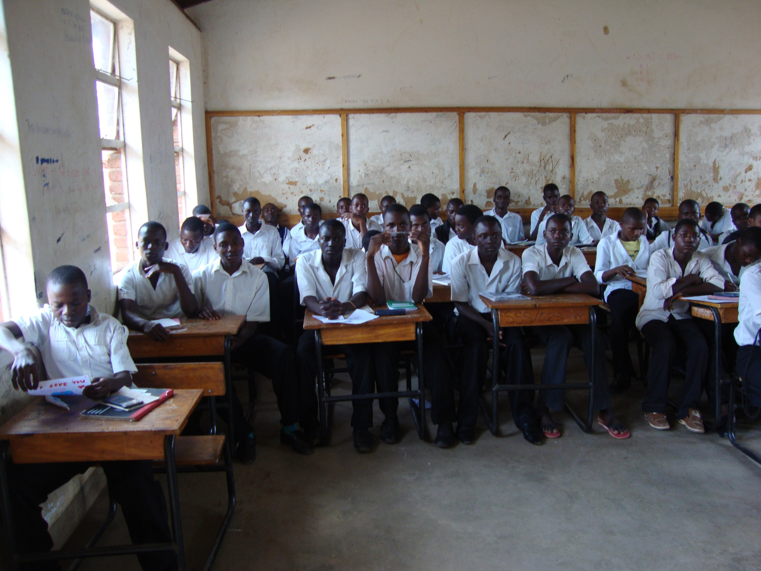

Slide 13
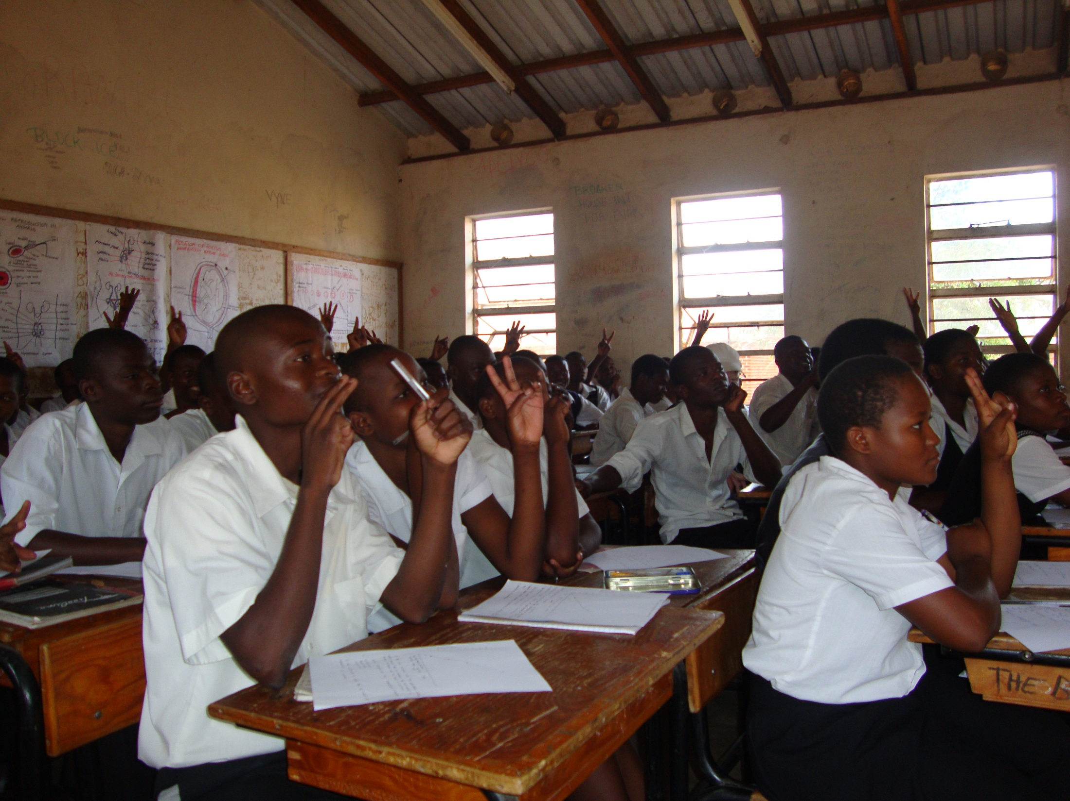

Slide 14
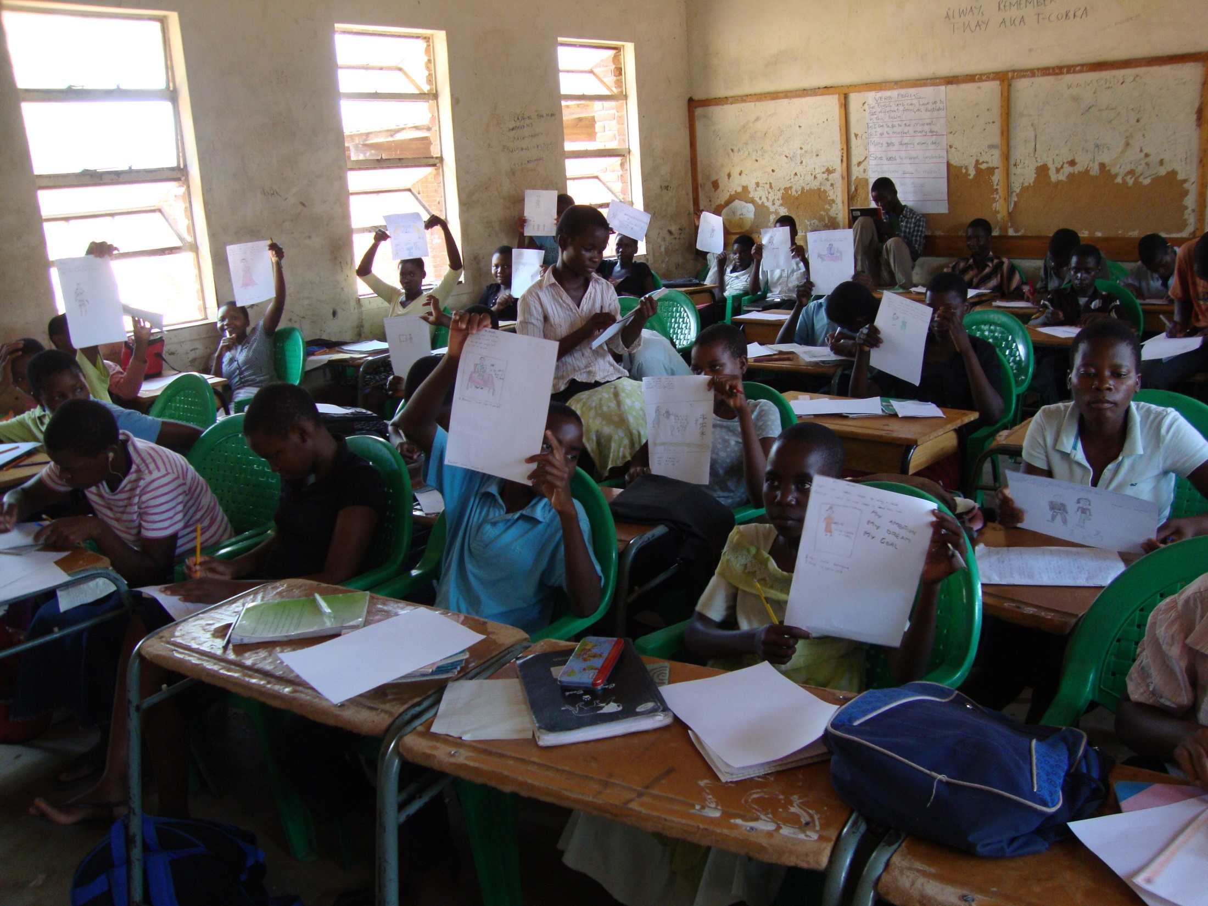
Making use of some of the resources!

Slide 15
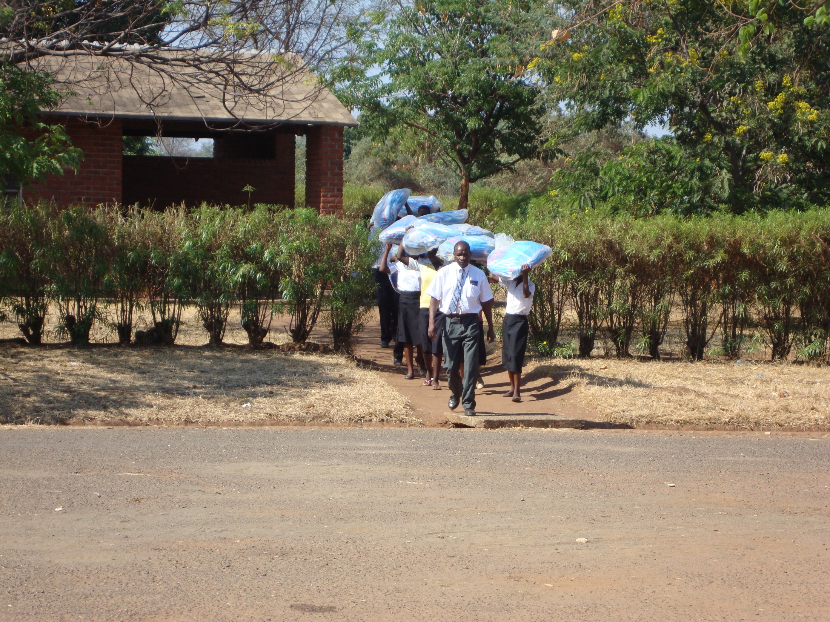
Overall, £790.00 was donated which was an amazing amount over 3 weeks so thank you!! 135 mosquito nets were delivered to the school last week. The head then allocated the nets to 135 of the most needy children – generally those whose parents could not afford the £6.50 for each net.

Slide 16
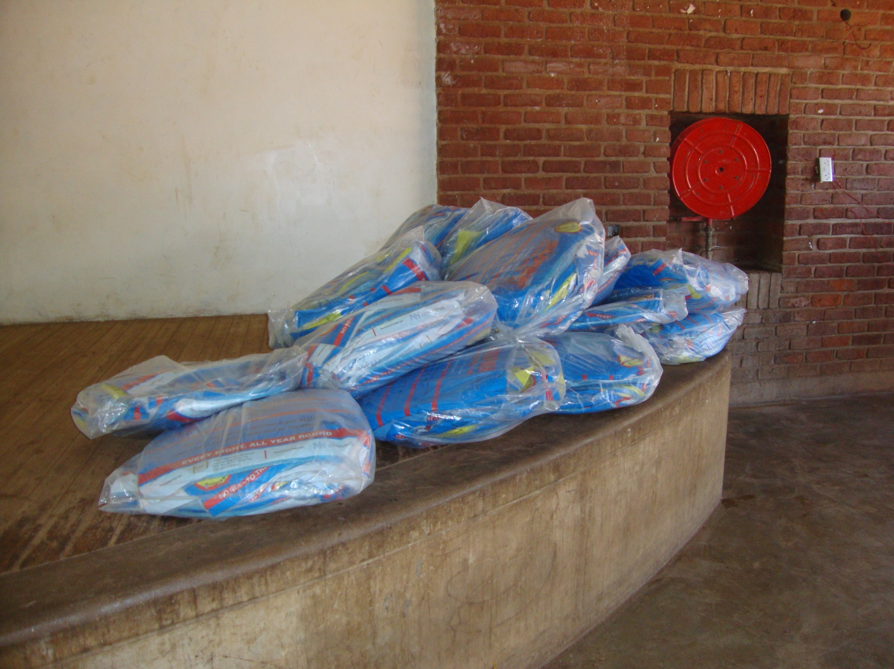

Slide 17
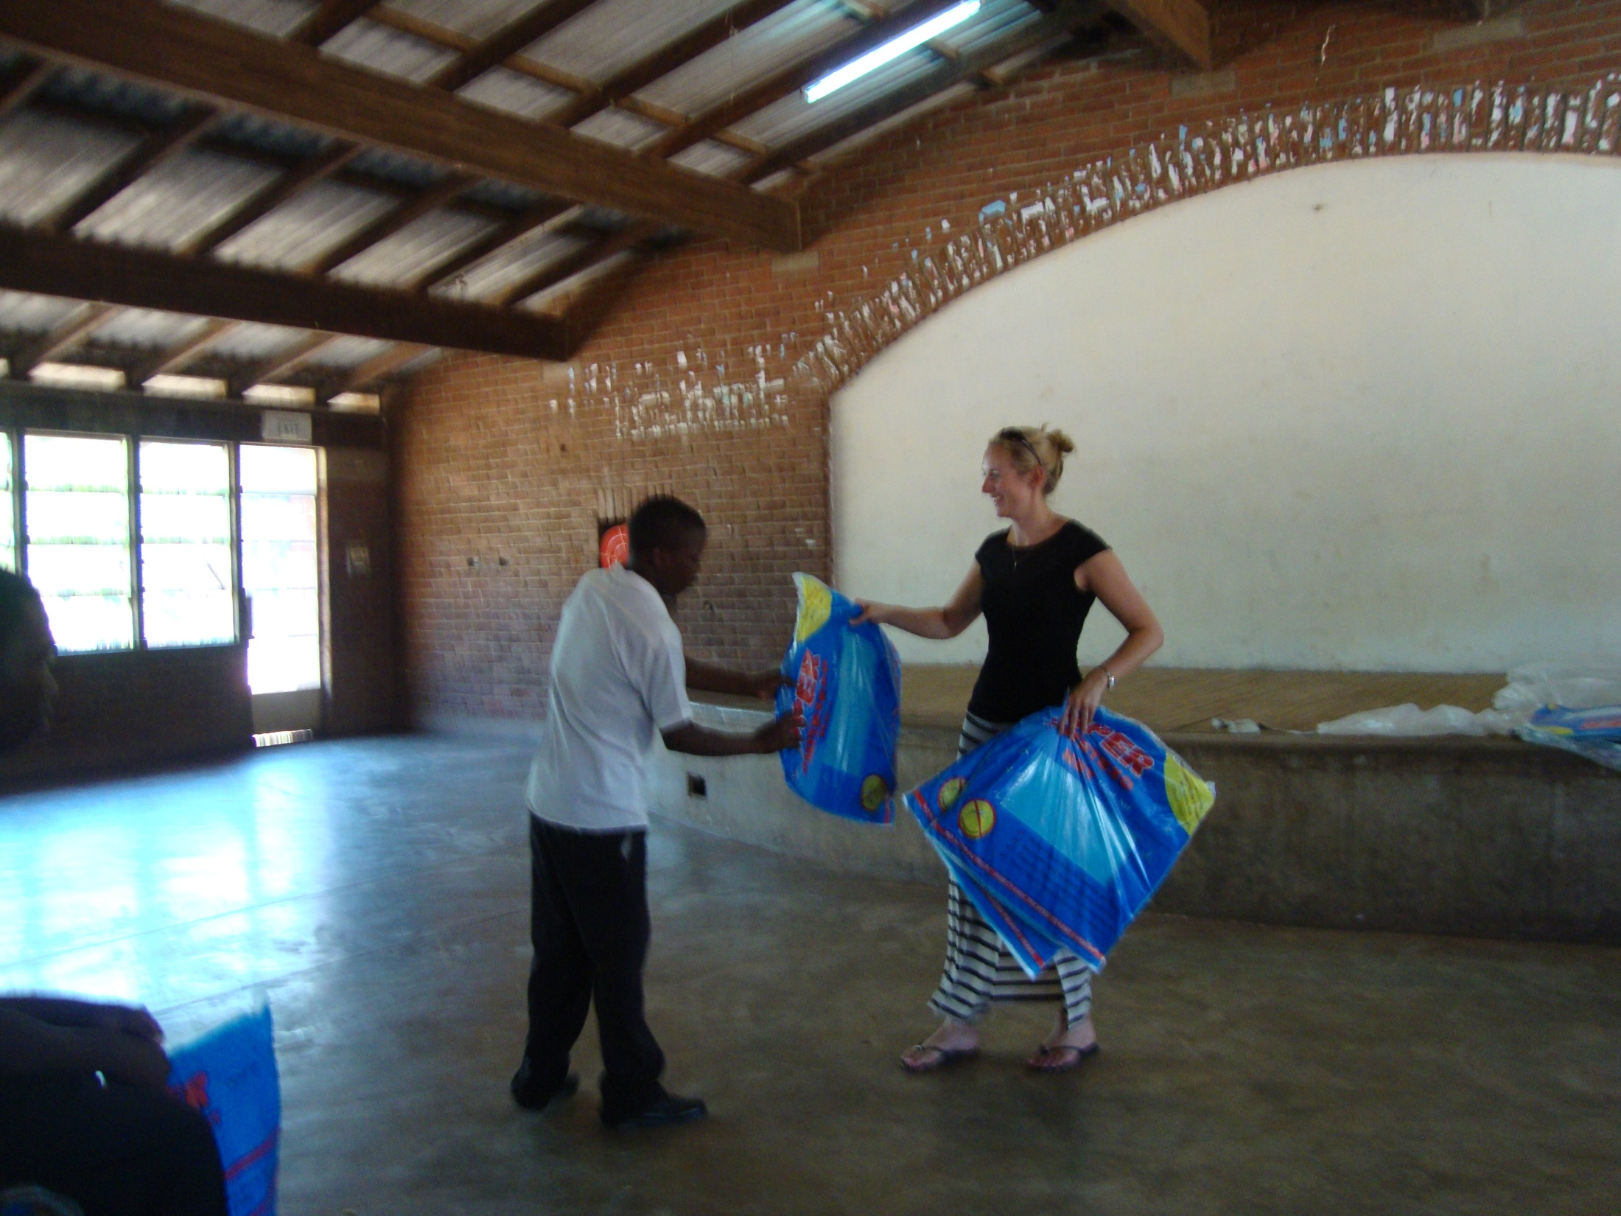
Pupils were very grateful for the nets and the head boy and girl made a speech thanking us for all the donations from both schools. They highlighted the point that they knew they were expensive and would make a difference to their lives.

Slide 18
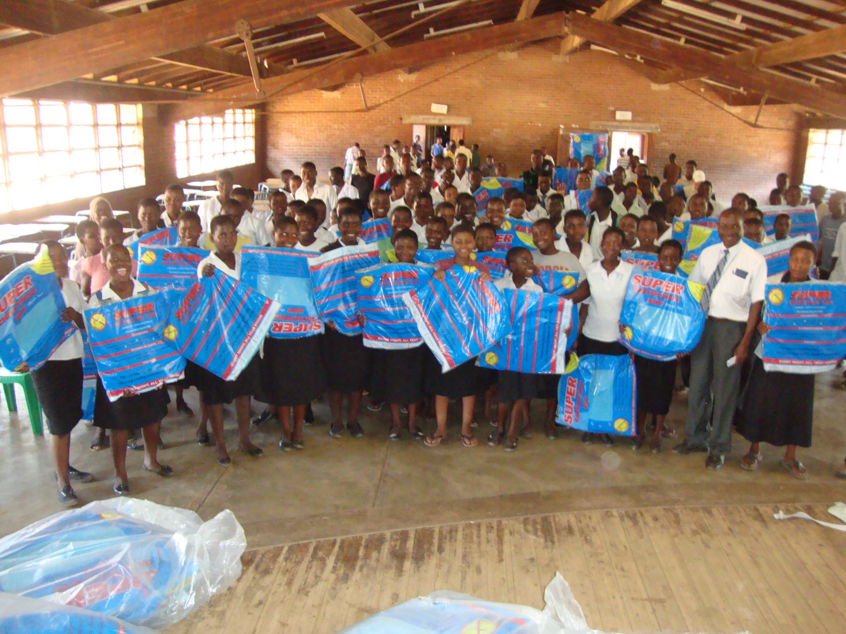
THANK YOU!
Without your support, these 135 children would not be protected from malaria.

