Slide 1
Observation Game

Slide 2
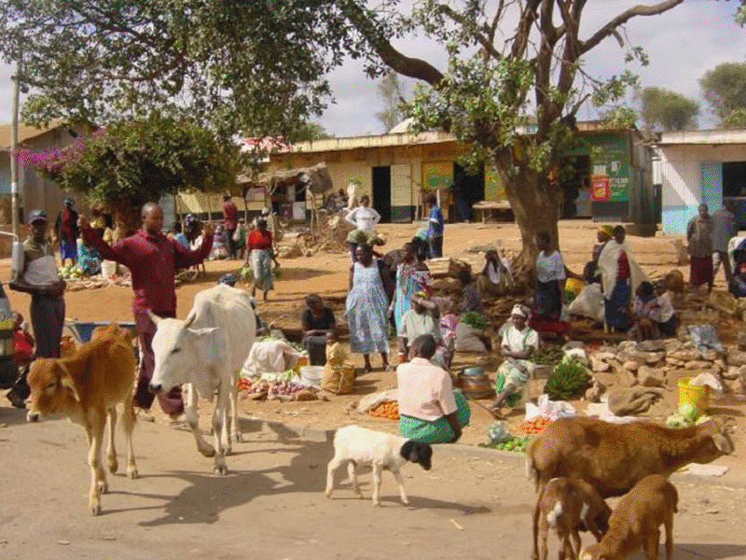
Ask the photo questions?
Who?
What?
Where?
Why?
When? How?

Slide 3
When I get back
I’ll give you the
the ANSWERS

