Slide 1
FOOD AND FARMING
This term we have looked at our food , and farming , and have visited the county show to explore local crafts and farming.
We are also interested in how food and farming differ across the world. Different countries have different diets, eat different food, farm different crops and keep different animals.
We are going to look at food and farming in Malawi.
First, let us find Malawi on a map. Malawi is in Africa. [see map, slide 2].
What is the weather like in Africa?
What kind of food might they grow?

Slide 2
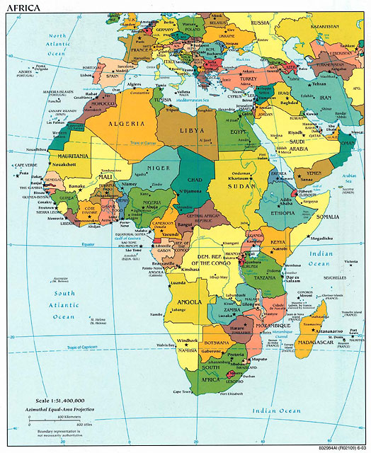
Malawi

Slide 3
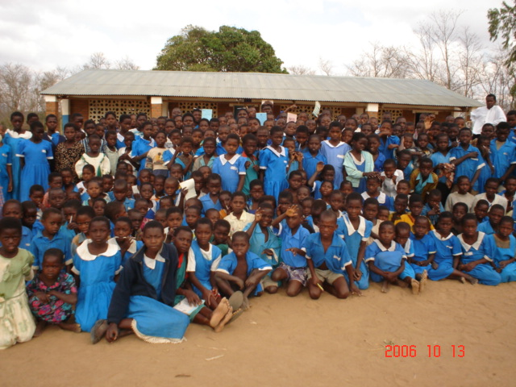
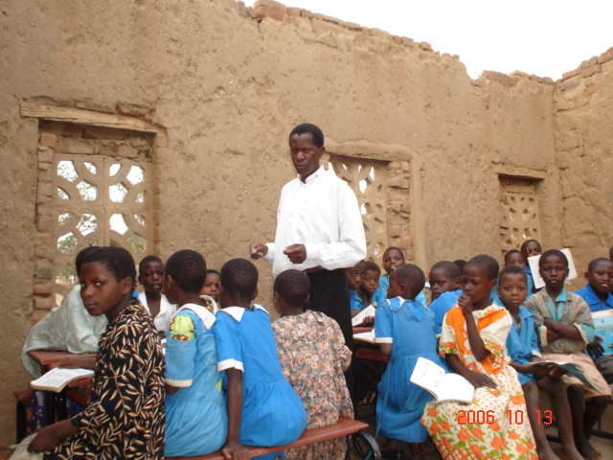
Here are the boys and girls in their school in Malawi. They want to teach you about food and farming in Malawi, and they want you to teach them about food and farming in Britain.
What do you notice about the different school and children?

Slide 4
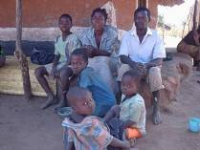
The boys and girls do not have Tesco, or Sainsbury, but they have to grow much of their own food, or go to local markets.
In my village, most of the people are small scale farmers. Maize is the main crop that is cultivated in our area. All the farming is done by hand. It is a tiresome task as I help my parents with gardening work.
What does ‘is done by hand’ mean?
What do we use on our farms, or in our gardens to grow food?
How much is done by hand?

Slide 5
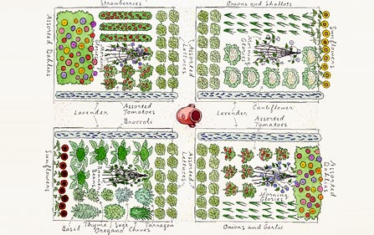
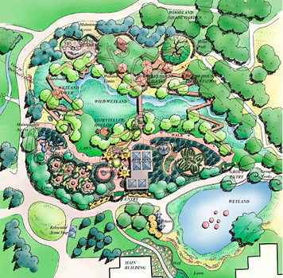
L.O. I know that my garden is used for different purposes. I know that I can grow some food crops in my garden.
Do you grow any food in your garden?
What might people grow?
What else do we grow in our gardens instead?
What else do we use our gardens for?
Draw and label your garden.
Write on any plants, trees, grassy areas, as well as play areas or outdoor eating areas.
Write on what you might do in your garden.

Slide 6
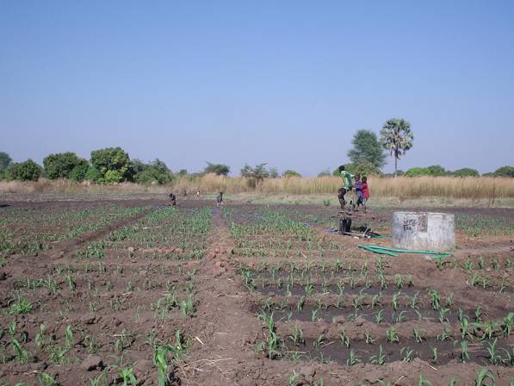
In most of villages, many people earn a living through small scale farming, where they use poor farming methods, which in turn results to low yielding. In most cases these people have called themselves farmers just because they do cultivation on their small scales. This is different from what it means to be a farmer in other developed countries. Anyone who does farming whether on a small or big scale, that individual is still called a farmer according to the understanding of Malawians. But if it were so it would astonish many people who come in to help the very same food programmes. Though many are subsistence farmers, the food they manage to raise from their fields is insufficient to run their families up to the next harvesting season.
L.O. I can compare a small farm holding with my garden.
Look at the example of the villagers small farm holding. They do not have gardens. Write down on your whiteboards everything that you notice about it.
Do a double bubble map to compare your garden with a small farm holding in Malawi

Slide 7
L.O. I can see similarities and differences between my garden and a small farm holding in Malawi
My garden
Malawi small farm holding
Different
Same
Different
I can grow food plants
I can grow food to sell
My garden is for playing in.

Slide 8
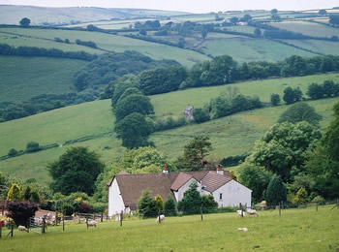
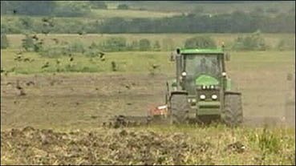
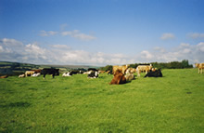
L.O. I can recognise similarities and differences between a British farm and a Malawi small farm holding.
Compare the picture of the Malawi small farm holding and the pictures of British farm. What similarities and differences can you see?
Write them in a double bubble diagram.

Slide 9
L.O. I can see similarities and differences between my a British farm and a small farm holding in Malawi
British farm
Malawi small farm holding
Different
Same
Different
It can grow food plants
The children have to help on the farm
It is much bigger

Slide 10
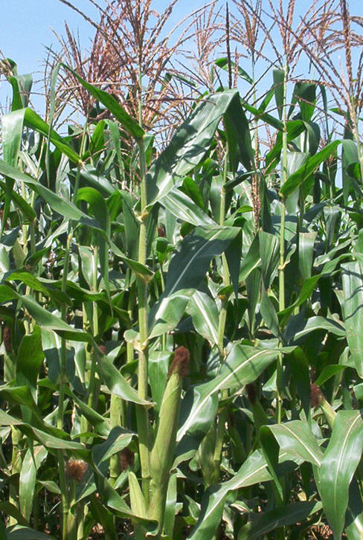
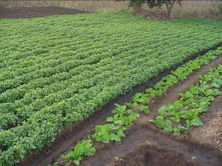
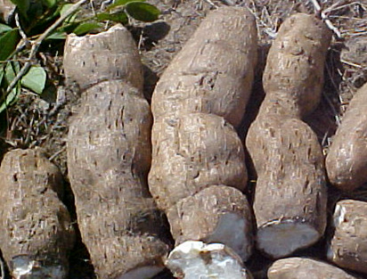
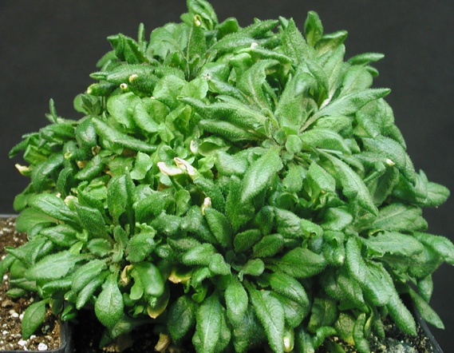
I Know what crops are grown in Malawi.
In Malawi many farmers grow maize. This is a staple food country wide. Soon after harvesting is done, people prepare their fields. They clear the land and make new ridges for the coming growing season. Land preparation generally starts in June to late October. This helps farmers to plant in time when the first good rains fall in November. Due to changes of climate, global warming and other reasons, people are encouraged to grow their crops in different seasons.
Other crops include beans, rice and cassava

Slide 11
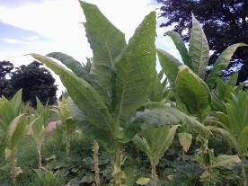
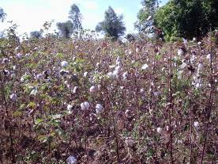
I Know what crops are grown in Malawi.
Other crops grown in small farm holders are called cash crops. This means they are grown for money, and are sold at market. These include tobacco and cotton.
What is made from tobacco?
What is made from cotton?
Farmers are encouraged to grow more cotton to get money for their families. In general cotton farming is done by man power. It involves a lot of work like insecticide chemical spraying and picking the cotton when it is ready. Cotton buyers grade the cotton and buy from the farmers, according to the weight and grade. Cotton seed in other factories is used to manufacture cooking oil and cotton seed cake for animals.
Tobacco is the main cash crop in the country even though it is planted in a few districts. Farmers auction their tobacco in our capital city. Tobacco growers have to form a club. Through this club, they transport their tobacco as a group. After the tobacco is sold, farmers are informed and the money is sent to the group’s bank account. The farmers will share the money according to the amount of tobacco and quality each had.

Slide 12
I know what crops are grown in Britain.
What crops do you think are grown in this country? Think about the weather, it is not that hot. Think about what fruit and vegetables you like to eat.
Use the internet to research British farming and to find out what crops are grown here.
Make a fact sheet about British farming, showing what crops are grown.
Remember to include:
A title
Some information, presented as bullet point or numbered points; or in text boxes.
Labelled diagrams and pictures.

Slide 13
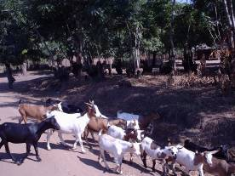
Animal Farming
L.O. I know what animals are farmed in Malawi and in Britain
Most farmers tame animals for many reasons but one main good aim is food. Other reasons are:
Milk for food and for sale
Meat for food and for sale
Skins and hides (used for making belts shoes etc)
The examples of animals raised in Malawi are: (a) Cattle: provides a wide range of beef in the country than any other livestock. Farmers raise cattle so that they should be able to find means of help when they need something. They sell the meat and have money, but they also benefit from the dung. In most areas cattle is used for dowry.
(b) Goats, pigs and poultry
What animals are farmed in Britain?
Use you reference books and the internet to produce a fact sheet about animal farming in Britain.
2. Make a double bubble diagram to compare animal farming in Britain and in Malawi.

Slide 14
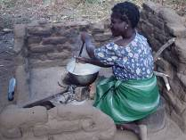
My mother is busy cooking food for the family. Together with my father they have been picking cotton all the morning. In my village there is no electricity. Cooking is done on firewood. A tripod stand made of three bricks has to be made for the pot. Nsima is that staple food in my country. It is made from maize flour. Stir until it is in porridge form. Allow the porridge to boil for 10-15 minutes. After that apply some flour to the boiling pot and stir until the nsima is a little bit harder. Make sure that all the flour is mixed properly by gently stirring in different angles. Using a saucer, soak the saucer in water; make larger lamps in to the plates until all the nsima is served in the plates. After making each lamp, it is important to keep soaking the saucer in water, so that nsima has not to stick on the saucer that is also called ‘Chipande’
Who does the cooking in your family?
What do they use to cook on?
Draw a plan of your kitchen, showing your oven, sink, cupboards and anything else that you use.
Comlete a double bubble diagram to show the things that are different, and the things that are the same.

Slide 15
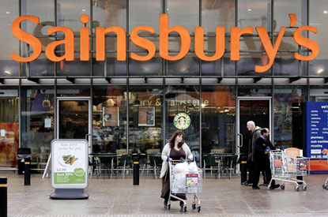
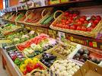
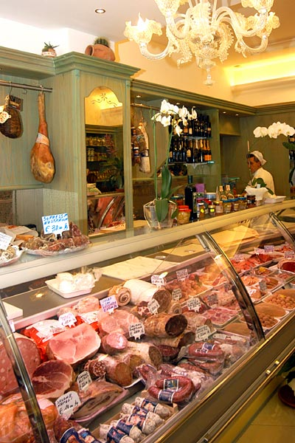
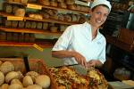
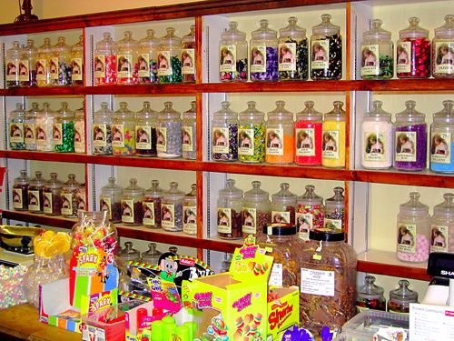
Where do we get our food from?
Apart from the supermarket, can you name any shops, and what they sell.
I will start you off – bakery sells bread. Brainstorm as many as you can.

