Slide 1
L.O. Be able to use information about the importance of trees and deforestation. L.F. Understand how to structure a balanced argument using for and against arguments.

Slide 2
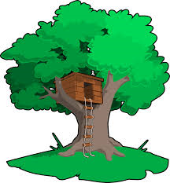
Which trees would you expect to find in the UK?

Slide 3
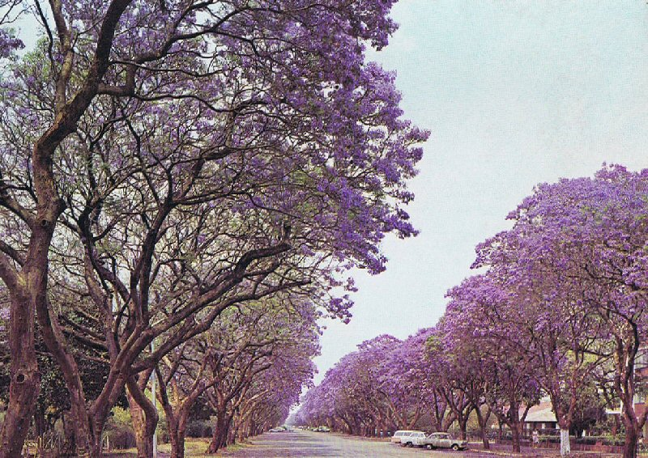
What trees would you expect to find in Malawi?
Palm
Boabab
Redwood
Ash
Butterfly Tree
Mahogany
Jacaranda

Slide 4
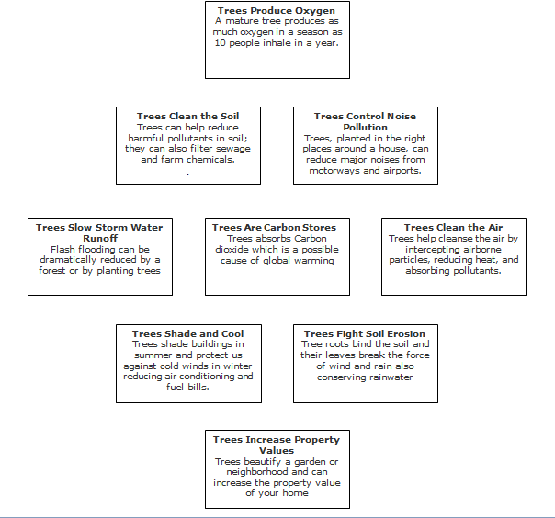
Are trees important? Why?
Activity 1: Work through the 'Diamond Ranking' boxes deciding on which you think is most important reason and place it at the top; the least important goes at the bottom.

Slide 5
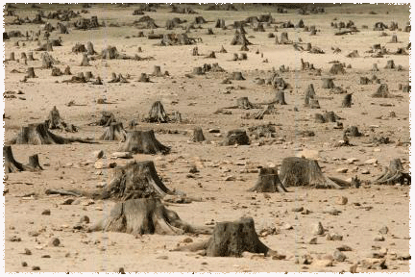
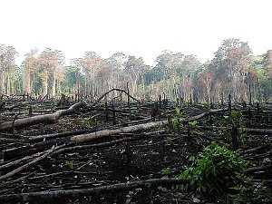
Having decided that trees are important, lets look at the issue of deforestation.

Slide 6
Activity: Role play cards - read your card and discuss how you would feel as well as giving clear reasons on your position.
You have 5 minutes before you feedback!

Slide 7
Activity: In your books, bullet point arguments for and arguments against deforestation.

Slide 8
What do you truly think?
What would you need to add to your bullet points to create a balanced argument?

