Slide 1
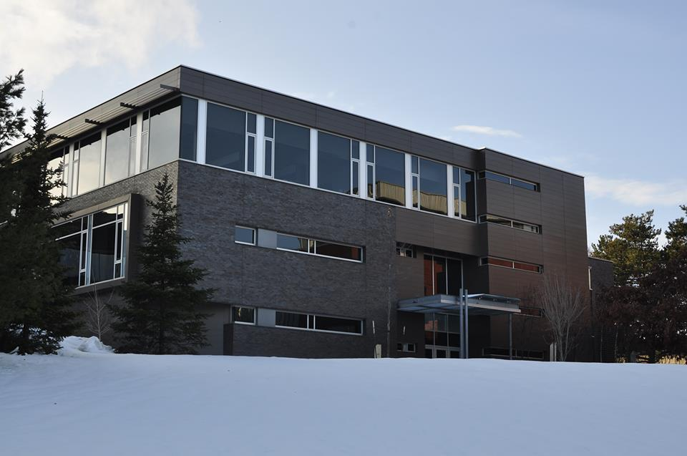
Elections Info Session
May 20, 2014

Slide 2
INTRODUCTION

Slide 3
AFSA INTRODUCTION
Mission: To provide all SAF students with the optimal experience by offering resources, opportunity and representation that a robust, unified and recognized organization can deliver.
Values:
Unified and inclusive community
Awareness and responsiveness
Opportunity and development
Open communication
Accountability
Innovation

Slide 4
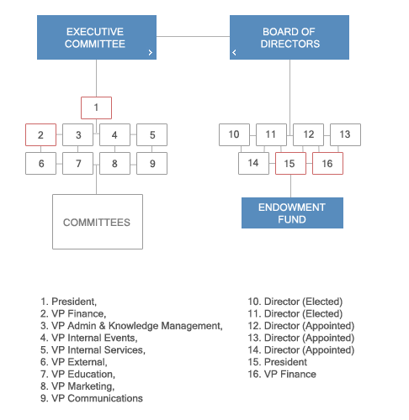
AFSA STRUCTURE

Slide 5
BOARD OF DIRECTORS

Slide 6
BOARD OF DIRECTORS
At a higher level…
The AFSA Board of Directors provides for the AFSA governance structure, focusing on oversight and long term strategy through …
Advocating for students
Administering the AFSA constitution & by-laws
Maintaining and standardizing SAF Communications
Overseeing elections and appointment process
Hosting the Annual General Meeting
Providing fiscal oversight
Developing and maintaining external relationships
Implementing regular feedback processes

Slide 7
BOARD OF DIRECTORS
At a more detailed level…
Annual budget approval
Amending and approving new and existing by-laws
Regularly meetings with faculty and administration
Responding to concerns and appeals (Internal and External)
Planning Annual General Meetings
Conducting feedback processes
Conducting internal financial review processes
Gathering and representing student’s viewpoints

Slide 8
BOARD OF DIRECTORS
Positions available…
2 Elected
3 Appointed
no restrictions on appointed directors

Slide 9
BOARD OF DIRECTORS
Appointment Rules/Process…
Application needs to be completed
Interviews will be conducted by BoD during the campaigning/elections period

Slide 10
EXECUTIVES

Slide 11
PRESIDENT – ZAC HOGG
Role:
Overseeing the day-to-day operations of the entire student organization and maintaining strong communication between all executive, board members, and faculty.
Ensures that current initiatives and projects are strategically aligned towards AFSA’s long term goals and objectives [AFSA’s V Year Plan]
spearhead organizational integrity; keeping executives accountable to their actions

Slide 12
VP FINANCE – ANNA LIANG
Role:
Direct all financial activities (e.g. cash receipts, accounts payable, report preparation) of the best student organization on campus
Manage a budget of over $80,000 from various sources [sponsorship, AFEF, operational]
Be involved with both Executive operations and high level issues on the Board of Directors

Slide 13
VP ADMIN/KM – YIDI XIONG
Role:
Responsible for the Running of and the Codifying of Executive Meetings
SAF Lounge maintenance and additions
Maintaining internal records
Running Special Projects as taken on
Capital asset projects

Slide 14
VP INTERNAL SERVICES – WENDY CAI
Role:
Responsible for planning and executive professional development services for students across all years
Work closely with SAF Experiential Learning and Career Development office to help develop top calibre students
Adopt a Co-op and similar programs
Career corner and other resources

Slide 15
VP INTERNAL EVENTS – GERRY ZHAN
Role:
Organize events that cater to the majority of the student body (i.e. Talent Show, Semi formals)
Try to create events that satisfy certain niches (i.e. Trivia, Basketball, Gaming)
Continue to develop and redefine offerings to improve engagement within student body

Slide 16
VP EDUCATION – LASH KUGATHASAN
Role:
Oversees the development of Industry based events/offerings for accounting and finance students
Organize exam-aid sessions
Advocate for academic fairness with the faculty of SAF
Create events and initiatives directed towards student’s academic career
Meet with SAF Experiential Learning and Career Development to discuss Co-op events and process
Works with the SAF faculty to discuss/deliver high level changes and administer lower level solutions to improve higher level issues

Slide 17
VP EXTERNAL – AHMED HUSAIN
Role:
Establish and maintain relationships with alumni, industry, other student organizations, and key stakeholders
Communicate with external stakeholders on AFSA initiatives and secure sponsorship
Oversees the development of Finance based events/offerings for accounting and finance students
Oversees the development of the AFSA Commerce Society umbrella

Slide 18
VP COMMUNICATIONS – IVAN WONG
Role:
All website updates, events/news/services
All website improvements and new features/new projects (e.g., exam bank)
Manage a small photography team to take photos for AFSA events
Manage a small team to write for the SAF E-Newsletter

Slide 19
VP MARKETING – DARYL DEEBRAH
Role:
Marketing various AFSA offerings to various AFSA stakeholders
Responsible for organizing the marketing of all events and services related to SAF Students through:
Posters
In class announcements
Promo and event recap videos
Jointly responsible for AFSA Facebook / Twitter
With VP Comm.

Slide 20
NEW POSITIONS

Slide 21
BOARD OF DIRECTORS

Slide 22
NEW BOARD ROLE
New position on the Board of Directors
Will be elected through bi-election if the AFSA referendum passes
Alumni who have graduated within 3 years are eligible and would also serve on the AFEF Board

Slide 23
EXECUTIVES

Slide 24
SPLITTING VP EXTERNAL ROLE
Expanding the AFSA VP roles and portfolios to maximize AFSA’s ability to serve the SAF students as best possible
Notes:
Proceeding the passing of the AFSA referendum
Current VP External being branded into VP Corporate Relations for transition purposes, and
New VP External will be elected in a bi-election

Slide 25
REASON FOR THE SPLIT
External Relations has had a primary focus:
Corporate Relations
Black Card
Corporate Sponsorship
Compared to other schools, we lack:
Commerce society umbrella of clubs
Conference/Competition program
New levy system
Need to shelter AFEF for SAF students

Slide 26
CURRENT EXTERNAL PORTFOLIO
Corporate:
Black Card
Sponsorship for a few large events
External
Direct subsidiaries: AFOW, (SAFletes, IIA)
Associated: UWAC, hEDGE (CLIC, ACE)
Related: DECA, SOS, UWMCC, etc
Conferences:
Conference Subsidy program

Slide 27
AREAS OF DEVELOPMENT
Corporate Relations
External (internal) Relations
Conferences and Competitions

Slide 28
CORPORATE RELATIONS
Portfolio dedicated to sponsorship
Increase focus into adding sponsors for:
Reach for the Stars
Adopt a Co-op
Finance Focus workshops/events
SAF Students in Business workshops/events
Internal Competitions
Increased functions:
Increase BlackCard vendors and deals
Can be source for affiliates/subsidiaries seeking sponsorship help
Deal with communication channels for Alumni/SAFAA and firms for networking events

Slide 29
EXTERNAL (INTERNAL) RELATIONS
A portfolio dedicated to relationship building
Increase focus into adding more collaboration with:
Affiliated and associated organizations (JDCC, UWAC, hEDGE, AFOW, etc)
Expanding AFSA’s commerce society focus
FEDs (advocacy, levy, addressing higher level needs)
External groups (Canadian Association of Business Students and their members)
Oversight and collaboration of Charity events with affiliates (such as JDCC)
Any other organization/firm not of a corporate nature

Slide 30
CONFERENCES AND COMPETITIONS
A role under the new VP External position and VP Education (not an Exec role)
Dedicated focus to a new conference program:
Seeking out conferences/competitions across the world
Creating a democratic system overseen by the trustees of the AFEF for the purpose of having as many students represent AFSA as possible at all competitions attended in the program
Selecting and training delegates for competitions in collaboration with the Education portfolio
Increasing/Expanding/Improving the Conference Subsidy program with the help of VP Corporate Relations

Slide 31
PORTFOLIOS AFTER SPLIT
Helps to better align, define:
VP Education
VP Internal Services
VP Corporate Relations (old External)
VP External Relations (new)

Slide 32
EDUCATION
SAF Students in Business/Finance Focus/Public Practice WORKSHOPS
Educational issues advocacy [ad hoc, from students]
Educational improvement projects (i.e. implementing hell-week) [from research]
Program feedback/Student Life in general/Student culture SURVEYS/RESEARCH
Exam Bank and other online educational resources
Midterm/Exam review sessions
Academic related sessions in general
Academic mentorship programs [non co-op related] (i.e. booking rooms for study groups)
Program assessment and consultation and research on gaps in curriculum
Student Engagement
Assist VP External [NEW] in:
New AFSA conference program
Management of Conference teams to represent AFSA
Focus of work for conferences revolves around training of teams

Slide 33
INTERNAL SERVICES
SAF Students in Business/Finance Focus/Public Practice SPEAKERS [panels, roundtables, etc]
Resume Critique/Job specific info sessions
Tips for First Years
Tax Clinic
Adopt a Co-op
Co-op specific “large” events ON CAMPUS/KW region [no firms]
Mock interview competitions
Specialized co-op social events ON CAMPUS/KW region [no firms]
Online Career Resources [career corner started by IS in 2013-2014]
Designation specific SPEAKERS with no workshop component [pure roundtable or lone speaker, and networking]
Designation specific WORKSHOPS with a professional development/speaker component
Internal Case Competitions
Internal Professional Related competitions [stock simulator, investment research challenge]

Slide 34
CORPORATE RELATIONS
Corporate Sponsorship
Black Card
Networking with employers OFF CAMPUS/GTA
Office Tours OFF CAMPUS/GTA/KW Region
Networking with alumni OFF CAMPUS/GTA/KW Region/ ON CAMPUS (for an event that is exclusively pure networking)
Relationships with SAFAA (SAF Alumni Association)
Partnering with corporate/alumni partners for AFSA Gives Back [with NEW External Relations]
Sponsorship related endeavours with AFSAAA (AFSA Alumni Association)
Managing relationships with AFSAAA (AFSA Alumni Association)
Co-op specific “large” events ON CAMPUS/KW region [multiple firm purpose; i.e. CATO night]

Slide 35
EXTERNAL RELATIONS [NEW]
Relationships with clubs under AFSA
Relationships with FEDs
Relationships with AFSA equivalent clubs/societies on campus
Relationships with FEDs clubs on campus
Relationships with CABS
Relationships with other CSA’s/BSA’s/Accounting or Finance Societies across Canada
Establishing relationships/partnerships with other clubs for a non-corporate purpose
AFSA Gives Back with non-corporate/non-alumni partners [charity events]
Conference Subsidy program
In collaboration with VP Education:
New AFSA conference program
Case Comp workshops (open to all students)
Management of Conference teams to represent AFSA

Slide 36
REFERENDUM

Slide 37
WHY A REFERENDUM?
With the changes we are looking to make as a possible uWaterloo commerce society, it is ideal to start a referendum to ensure the constitution is altered such that everything will flow as planned with such a re-organization within FEDs

Slide 38
WHY A REFERENDUM?
Compared to the rest of the country, AFSA is responsible for so much more than any other business or commerce association, in order to create strong new ventures that can be continually improved over time, we cannot simply add to the portfolios of the current Exec, but need to incorporate new Exec positions to allow for certain programs to have the resources essential for growth

Slide 39
WHY A REFERENDUM?
AFSA currently lacks a strong conference subsidy and conference engagement and/or participation or representation program like Sprott’s Sprott Competes or John Molson’s JMCC (John Molson Competition Committee)

Slide 40
WHY A REFERENDUM?
Currently the office of Vice President, External Relations, has to deal with corporate, internal, and external relations (not to mention conferences); it is beginning hard to manage all three as AFSA looks to steadily increase sponsorship over the next few years and improve its connections within and outside the university (such as other clubs/groups on campus and relationships with other business school student associations)

Slide 41
CHANGES
Amend the constitution for members; adding Class A, who are the current member base (SAF students) and Class B members, who would be non-SAF students choosing to pay a Class B levy to become a member
Amend the constitution for financial policy; allowing that each year, during elections, that Class A members vote for a set of AFSA services/events/offerings for which they will restrict from the Class B members

Slide 42
CHANGES
Reduce the AFEF endowment payment made by SAF students to $15 (under the AFEF Referendum)
Re-establish endowment fund governance best practices by re-establishing the AFEF Board, which will be differentiable from the AFSA Board, adding seats for the SAF Director, the Alumni Association, and a recent alumnus
Add a levy for Class A members of $35
Add a levy for Class B members $15

Slide 43
CHANGES
Rename the office of Vice President, External Relations to Corporate Relations
“for the purpose of focusing on relationships of a corporate nature that involve monetary or in-kind sponsorship for the organizations and/or its affiliates”

Slide 44
CHANGES
Create a new office of Vice President, External Relations
“for the purpose of building and maintaining relationships with organizations off and on campus with primary focus towards other business and commerce student associations across Canada and clubs and other societies internal to the University of Waterloo, and will also deal with managing a conference engagement and participation system which will rival similar programs run across the country; this portfolio will also deal with the conference subsidy program”

Slide 45
CHANGES
Create one new elected Director, and
Also create the explicit right for one Board of Director to be an alumnus who has graduated within the past 3 years; this will also create efficiencies with the young alumnus seat on the AFEF Board

Slide 46
CHANGES
Remove Vice President, Finance, as the automatic replacement to the President. BoD will now have the authority to appoint an “Exec Vice President” that would take over the President’s duties where the President cannot perform them

Slide 47
SUMMARY
All in all, a vote for a yes on the referendum will be a vote for more of your money being spent towards you – the students – and to allow for AFSA to take the lead in improving the business student experience at uWaterloo.

Slide 48
ELECTION INFO

Slide 49
ELECTIONS TIMELINE
May 20 Info Session
May 21 Applications Posted
May 25 All Applications Due
May 27 – 30 Campaigning Period
June 2 – 5 Voting Period
June 9 Results Announced

Slide 50
ELECTION RULES
Clarification of Commitment (Sept 1, 2014 – Aug 31, 2015)
Rules of acceptable behaviour within campaign period
Current AFSA Exec/BOD member for visible support
Campaigning will consist of:
Brief Web profiles
Forum debates/discussions
Facebook groups
Please visit www.uwafsa.ca/elections for a full list

Slide 51
CONTACT INFO

Slide 52
CONTACT INFORMATION - EXECS
Zac Hogg z.hogg@uwafsa.ca
Anna Liang a.liang@uwafsa.ca
Yidi Xiong y.xiong@uwafsa.ca
Wendy Cai w.cai@uwafsa.ca
Gerry Zhan g.zhan@uwafsa.ca
Lash Kugathasan l.kugathasan@uwafsa.ca
Ahmed Husain a.husain@uwafsa.ca
Ivan Wong i.wong@uwafsa.ca
Daryl Deebrah d.deebrah@uwafsa.ca

Slide 53
CONTACT INFORMATION - BoD
Michael Yang m.yang@uwafsa.ca
Mariam Azhar m.azhar@uwafsa.ca
Mateen Imran m.imran@uwafsa.ca
Stephen Chen s.chen@uwafsa.ca
Jonathan Quek j.quek@uwafsa.ca

Slide 54
THANK YOU!
We hope that you will consider an Executive or Board of Director position for 2013-2014 on AFSA – the officially recognized student voice of the School of Accounting and Finance.

