Slide 1


Washington Conservation Corps (WCC), Emergency Response Overview.
Stephanie Jackson
Phil Hansen

Slide 2
Overview
About the AmeriCorps, WCC, emergency response and the Veterans initiative.
Tsunami Clean up.
Hurricane Sandy.

Slide 3

AmeriCorps and the Washington Conservation Corps.
AmeriCorps is an initiative of the Corporation for National and Community Service (CNCS), that was created under President Bill Clinton by the National and Community Service Trust Act of 1993. AmeriCorps is one division under the CNCS that provides grants to hundreds of local community organizations throughout the U.S.
The Washington Conservation Corps (WCC), established in 1983, and was created to help lessen high unemployment rates for youth 18-25 years of age. The WCC is housed within the Washington State Department of Ecologies Shoreline program and currently employs approximately 475 members and additional support staff. We provide environmental conservation based services throughout the State of Washington as well as Emergency Response Support throughout the Nation. AmeriCorps provides educational awards/scholarships for members who complete their contract within our program.

Slide 4
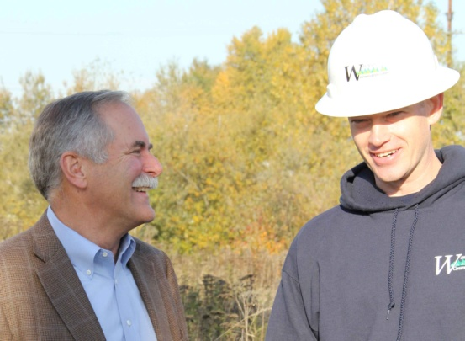
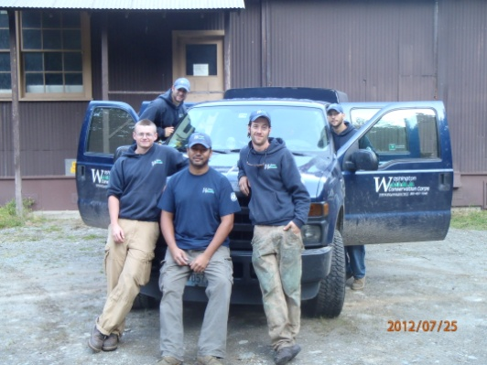
WCC’s Veteran Initiative
In 2011 legislation was passed allowing recently returning military Veterans to be exempt from our age restrictions to help lessen the high rate of unemployment held by Veterans and in turn provide transitional assistance from military to civilian life. Veterans within our program have proven to be very successful and add a rich layer of experiences to our crews.
Because of training and experience acquired within the military, Veterans are an integral part of our emergency response program. We benefit from their experience and continuation of civil service. They benefit knowing that they are making a direct difference for people on the ground and by obtaining training and experience that helps them transition while preparing them for possible careers in conservation or as emergency responders.
Public Lands Commissioner, Peter Goldmark and WCC Puget Sound VetCorps crew leader, Phil Hansen
The inaugural all Veteran crew

Slide 5
WCC Emergency Response Overview….
As disasters occur, FEMA contacts the CNCS to request assistance for communities that are underserved. From there, the WCC receives requests for contracts /budget proposals specific to the work needed. Once a contract is accepted, mission orders much like those in the military are drafted and sent out.
Once mission orders are given, crews can deploy with less than 24 hours notice. The Department of Ecology covers upfront costs that are mostly reimbursed by FEMA.
In response to higher demand for our services, we have expanded our emergency response program. We now have crews whose main focus is to be trained and deployable at any given time.
Our supervisors and members interested in emergency response work are required to obtain certifications from FEMA, have good working records and supervisory recommendations prior to deployment.
In addition to FEMA training certificates, our program provides many helpful courses including Wilderness first responder and first aid trainings. In house training and on the ground emergency exercises occur throughout the year.
For the 2013-2014 program year, through a stronger partnership with the Washington State Department of Veterans Affairs, we will be providing behavioral health training options specific to traumatic events and other high stressors for folks within the program.

Slide 6
Emergency response work that we perform.
Some of the work that we perform while deployed:
  Cleanup
  Mucking of homes
  Removal of danger trees
  Creation and management of Volunteer Recovery Centers (VRCs)
  Management of shelter operations
  Roof tarping
  Construction related work such as home building and dry wall installation etc.
  Oil spills
  Fires
Some recent deployments:
  October 31, 2012 multiple crew phases deployed to aid in response for Hurricane Sandy relief. Crews were sent to New York and New Jersey. Work performed was varied but included the establishment of Volunteer Recovery Centers, Shelter Operations and Cleanup.
  July 13, 2013 the WCC sent 10 members for flood response to Galena Alaska. Work performed includes mucking out of homes and debris cleanup. Crews have since been expanded to provide longer term assistance.
  Fires….

Slide 7
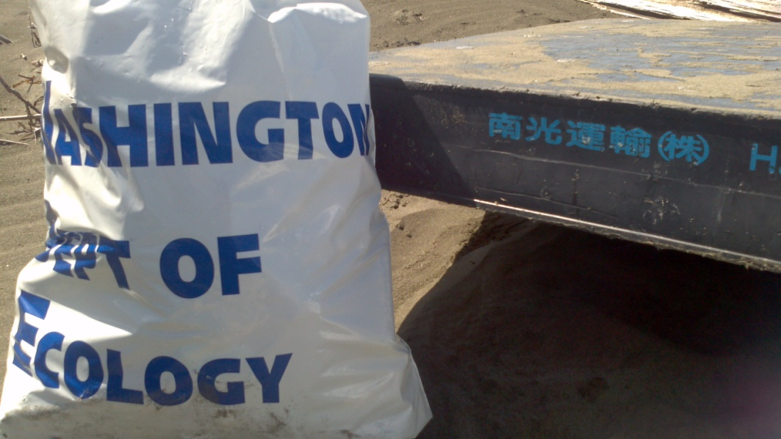
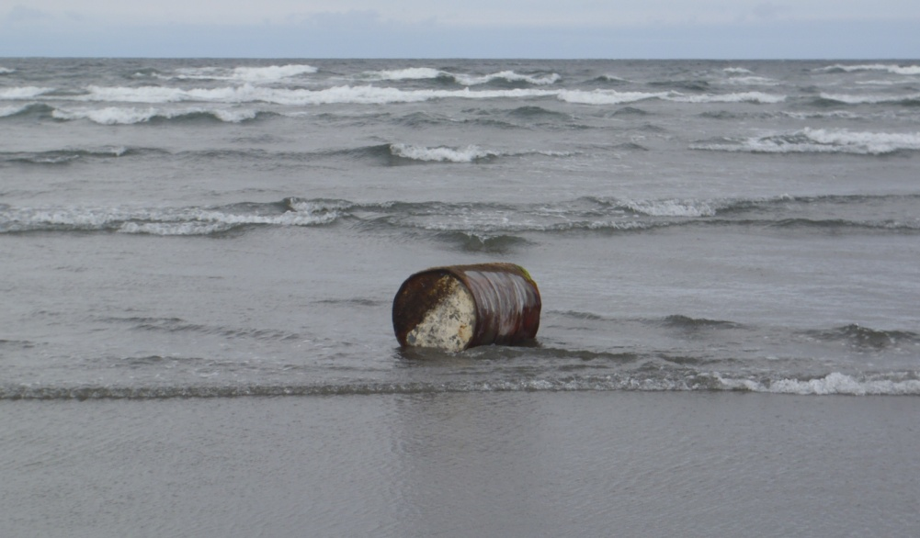
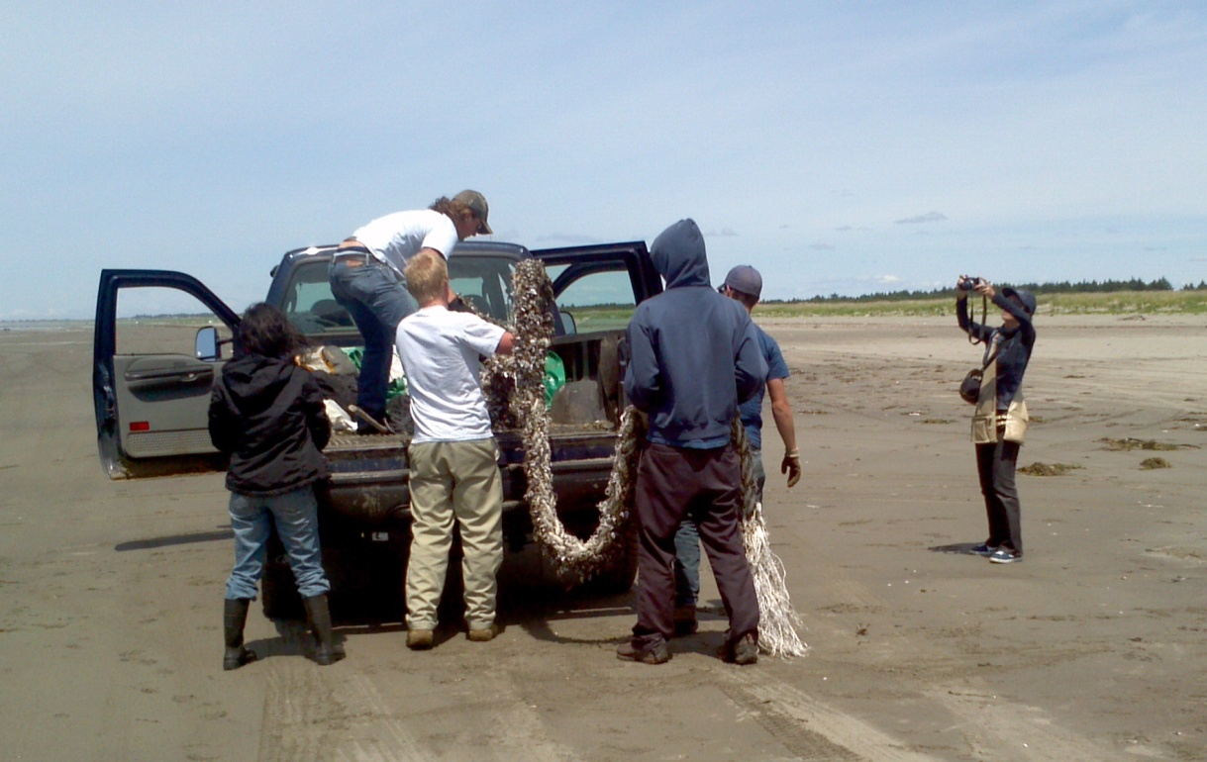
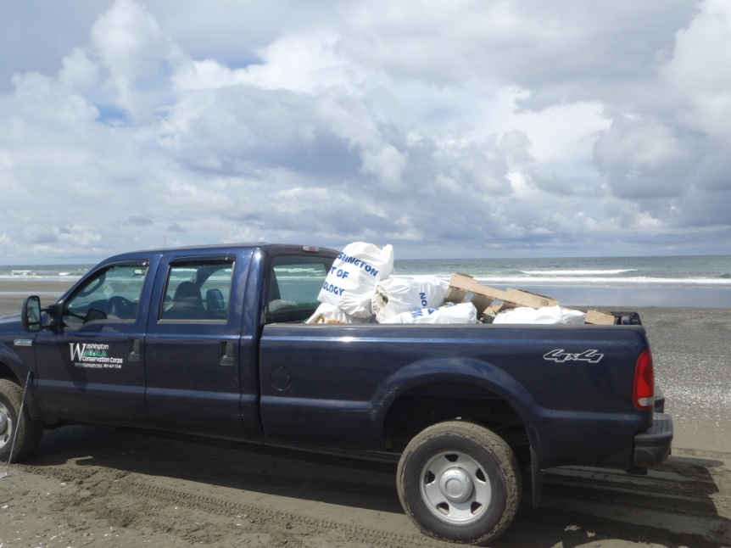
Tsunami Debris Cleanup

Slide 8
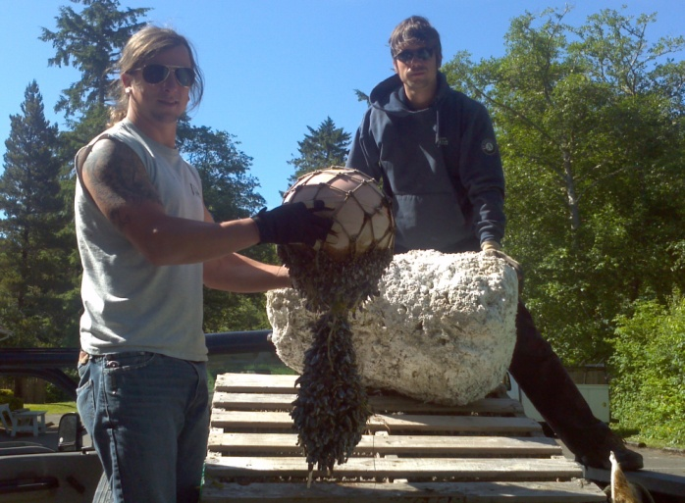
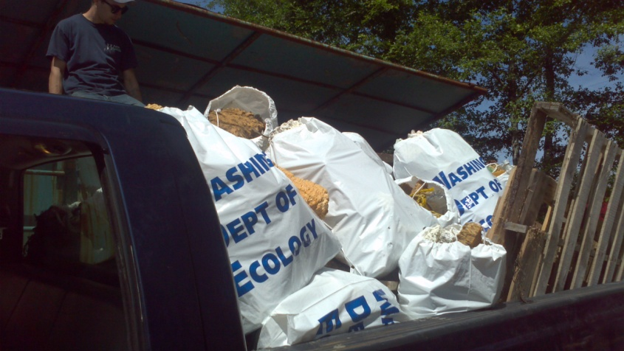
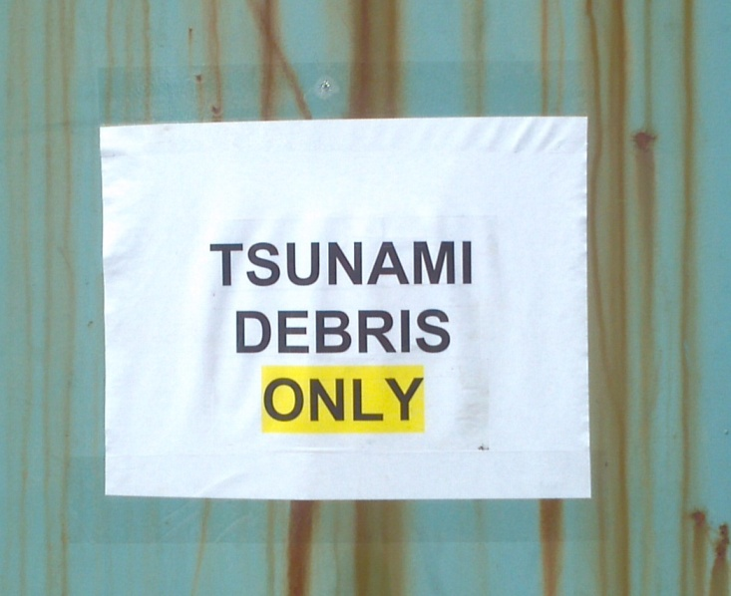
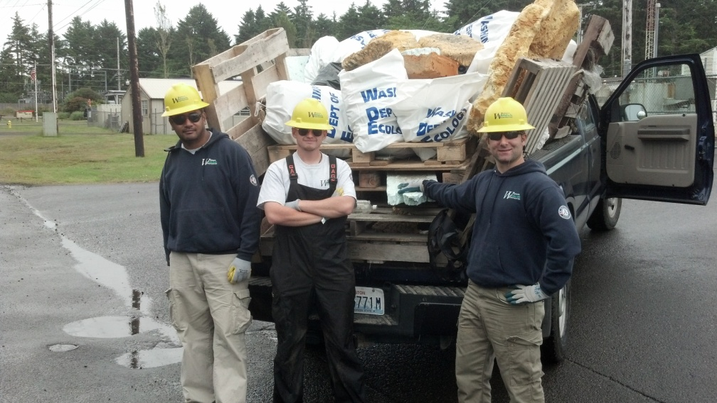
Tsunami Debris Cleanup

Slide 9
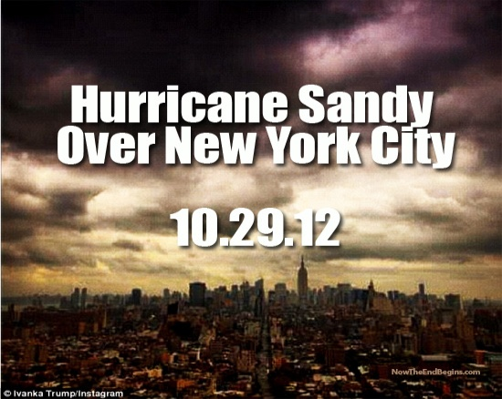
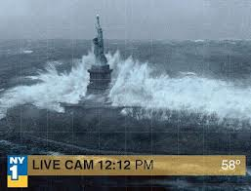
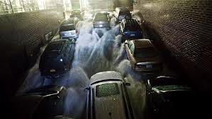
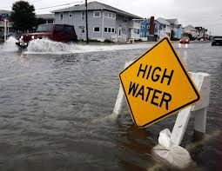
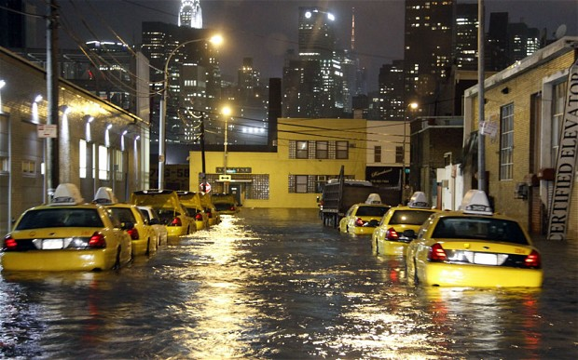
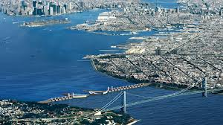
Hurricane Sandy- New York

Slide 10
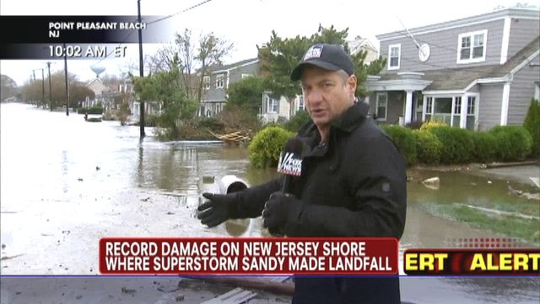
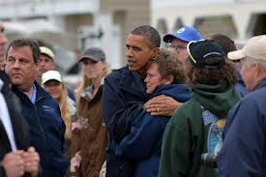
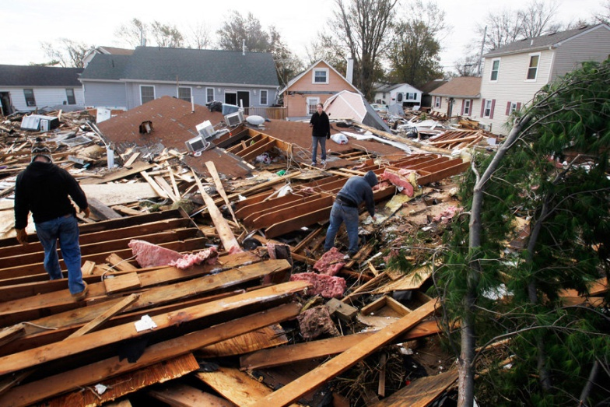
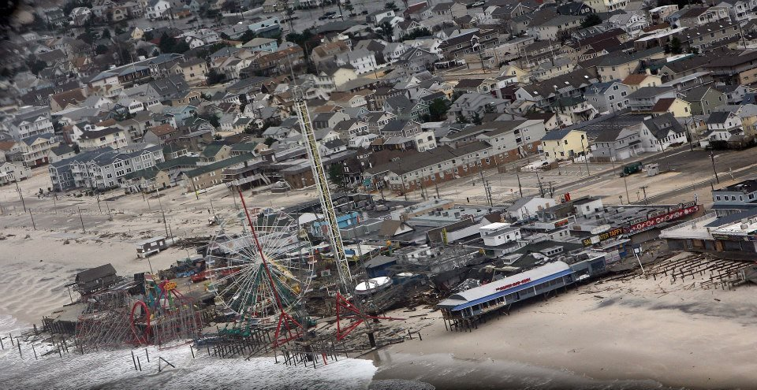
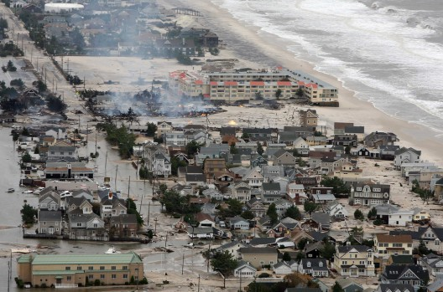
Hurricane Sandy- New Jersey

Slide 11
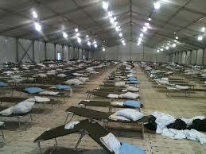
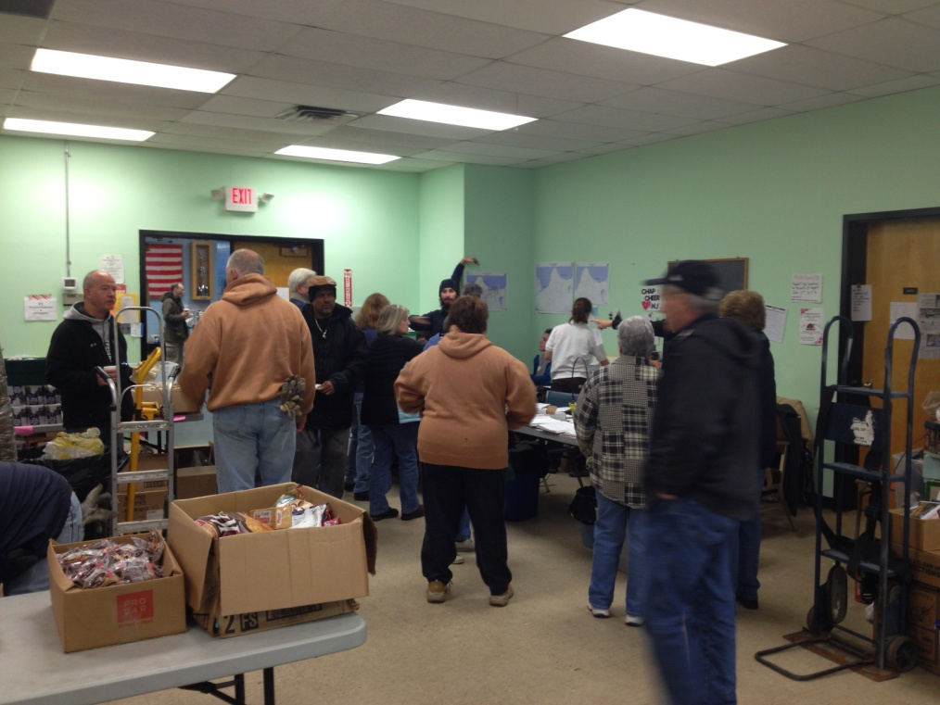
WCC Emergency Response: Hurricane Sandy
8 crews deployed initially/ drove from Washington to New York
Shelter Operations/ Donations Management

Slide 12
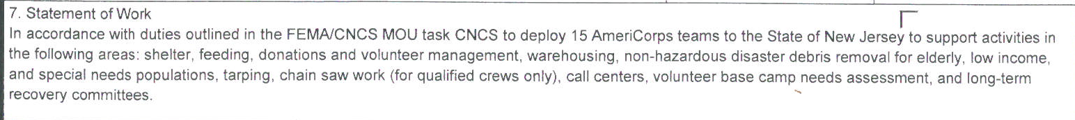
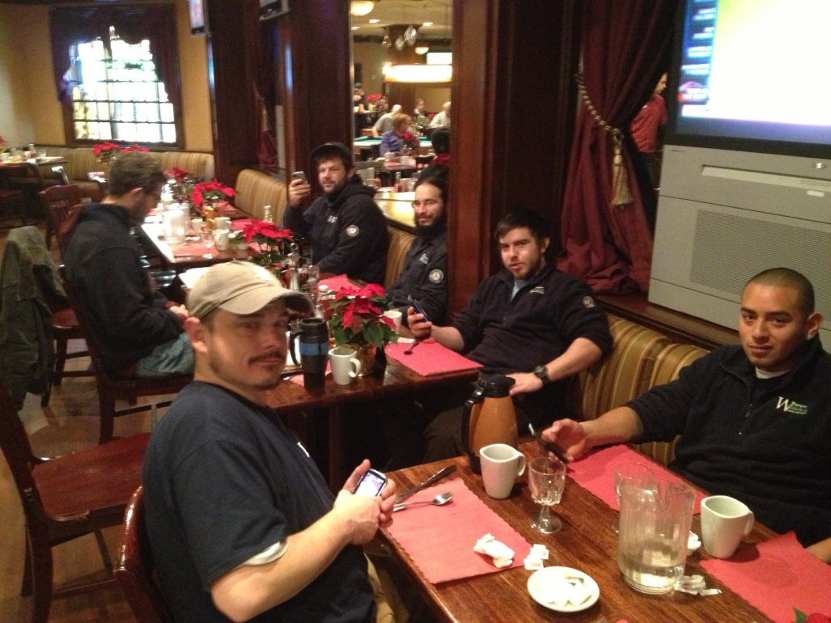
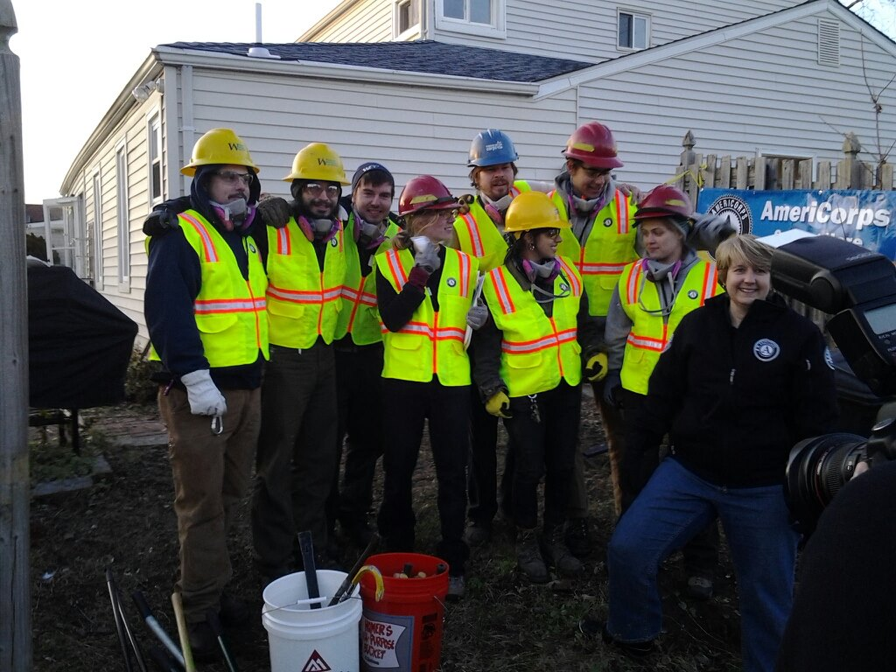
WCC Emergency Response: Hurricane Sandy
Mission Assignment to New Jersey

Slide 13
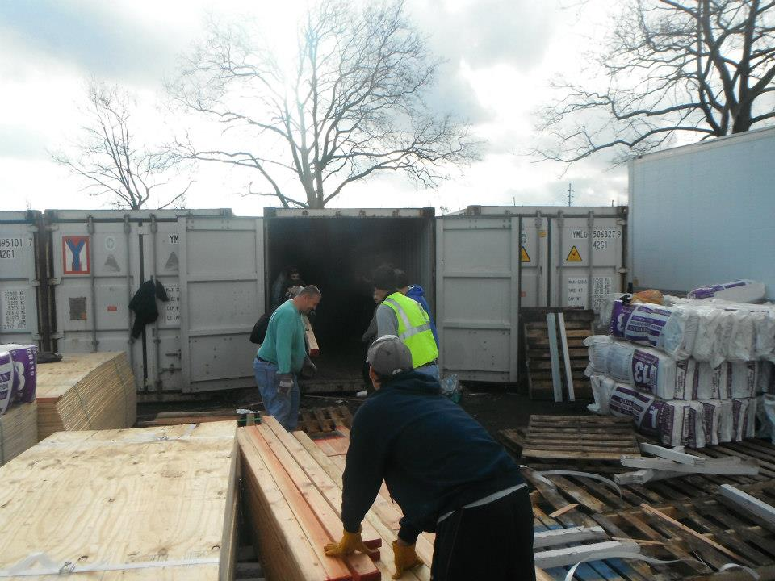
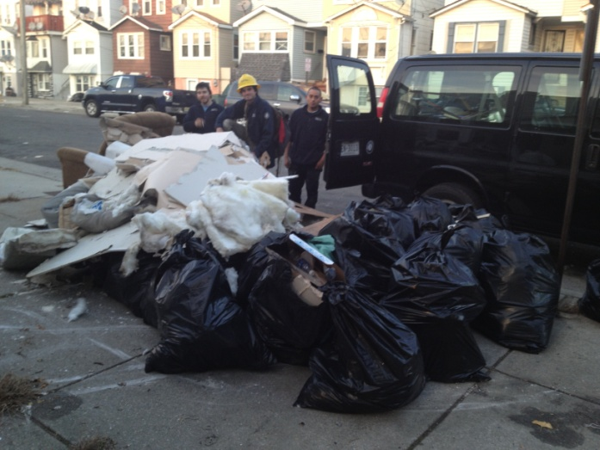
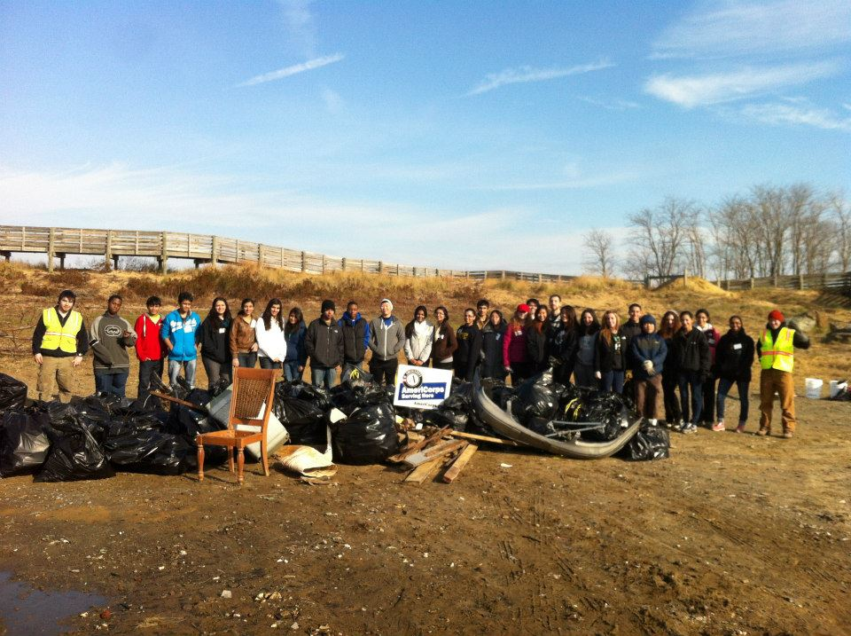
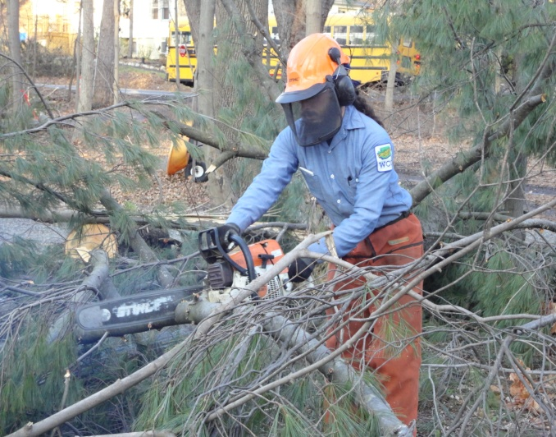
WCC Emergency Response: Hurricane Sandy
Daily Operations

Slide 14
Contact information for the WCC:
Emergency response coordinator:
Roland McGill Rmcg461@ecy.wa.gov
Fire response coordinator:
Kevin Farrell kfar461@ecy.wa.gov
Veterans program coordinator:
Stephanie Jackson swer461@ecy.wa.gov
http://www.ecy.wa.gov/wcc/emergency_response.html

