Slide 1
American Mystic—John Woolman
CS 665 Christian Devotional Classics

Slide 2
Quaker spirituality
Beginnings in 1640s in England
“Religious democracy of the Spirit”
That of God in all human beings
Community as context for the voice of the Spirit
Community as crucible in which spiritual impulses were tested.
Notes:
Read opening from The Story of Christian Spirituality.

Slide 3
The Society of Friends (Jn 15:14)
Focused on the inward, spiritual experience
Promoted a deliberate, quietistic devotion
Rejected external religions, which means a subtraction from the full human richness of Christianity with its close interlocking of inward and outward; yet plainly this renewed emphasis on the invisible is one which is perpetually needed if the realities of the spiritual life are to survive. --Underhill

Slide 4
John Woolman
Lived from 1720 to 1772
Developed unusual sensitivity of conscience and profound awareness of the “inner light” at an early age
His deep mystical consciousness of the unity in love of God and humanity drove him to vigorous and unpopular denunciations of slavery
He also developed a deep “concern” for animals

Slide 5
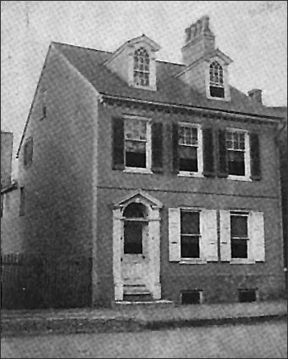
Called by Evelyn Underhill as the first of the modern mystics due to his interior vision of Divine Will and Love
Dramatically shaped by the writing of a bill of sale for a slave in his position of clerk and bookkeeper in a shop
Eventually, he refused to have anything to do with the transfer of slaves
The shop where Woolman worked

Slide 6
Life and Ministry
Provided funds to pay slaves for serving him
Saw the source of this injustice as the insatiable human desire for luxury
Due to the miseries of the plantation slaves, he
Refused sugar
Would not use silver spoons
Wore undyed clothes

Slide 7
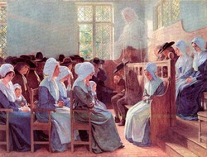
Quaker terms
http://www.nyym.org/index.php?q=glossary
http://swarthmore.quaker.org/Glossary.htm

Slide 8
Picture this…
His appearance was rather unusual. He only stood four and a half feet high. His chest bulged from his hunchback stance. His legs were small and uneven, his arms were longer than his legs. His head was huge with a prominent nose. He wore an enormous white hat. The rest of his face was covered with a snowy semicircle of beard falling low to his breast.

