Slide 1
Historical Background
The Desert Fathers and Mothers
CS 665

Slide 2
Desert Saints impacted by the writings of Origen
Origen insisted that the human spirit could ascend to the presence of God only if the turbulent desires of the body were brought into check.
He saw the mind, body, and soul as so intimately related that spiritual progress could only take place if the body was disciplined and the mind was purified by study.
His writings highly influenced that movement of ascetics that came to be called monasticism.

Slide 3
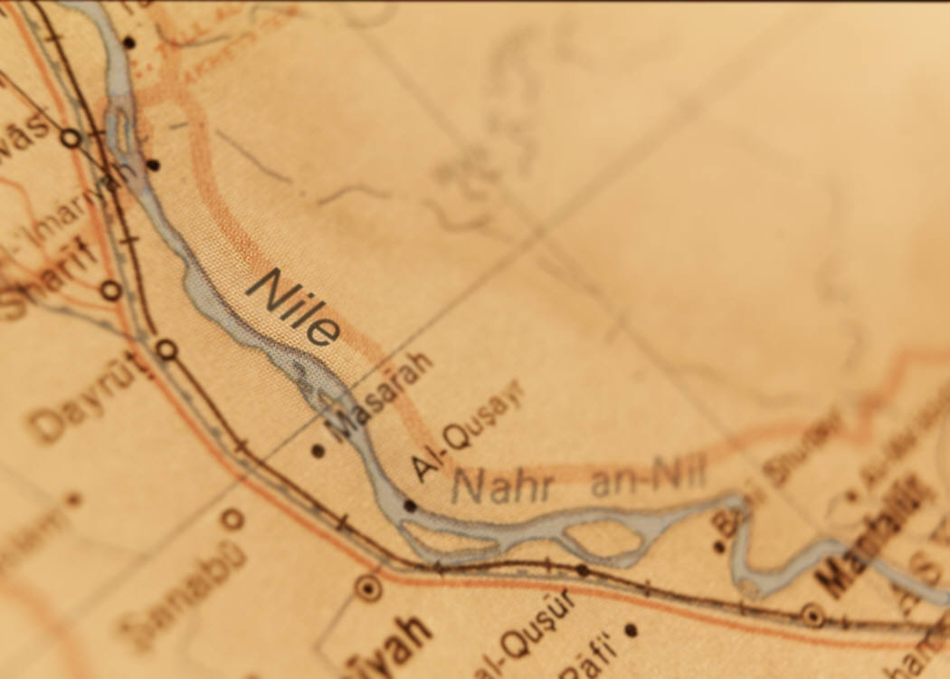
By the 4th century
The movement had developed in the Syrian countryside and semi-desert lands around the Nile in Egypt.
The quest for solitary asceticism led to the new name of “monk” (monachus) or “solitary person.”

Slide 4

The quest led to 2 expressions
A person, who lived in complete seclusion, was sometimes approached for wise spiritual advice, generally committing himself or herself in extreme simplicity of life to dispossession, celibacy, and constant prayer;

Slide 5
A group of monks, who gathered in a loose form of community around a famous teacher—the older teachers became known as the “old men” (Abbas) who emerged almost as a parallel authority structure to the bishops of urban communities.

Slide 6
A 3rd expression developed soon thereafter
Communes of Christian radicals—living a celibate lifestyle with an ascetical form of daily routine, especially manual labor, and the recitation of psalms.
Antony is an example of the first two expressions;
Pachomius is an example of the third expression.

Slide 7

The threefold pattern
Eremitic – living alone in seclusion
Lavriotic – living in a small colony of hermits
Cenobitic – living in a large household of monastics who shared common resources

Slide 8
Central Principle
Renunciation of the world – the spirituality of renunciation or asceticism became a dominant aspect of Christianity from the 4th century onward

Slide 9
Desert Saints and Struggle
The desert saints believed that struggle is normal, necessary, and even healthy in the spiritual life
  The fallen world imposes it (sickness, anxiety, death)
  Discipleship requires it (self-sacrifice, self-denial)
  Believers must choose to face it
    Read Sittser, page 75

Slide 10
These abbas and ammas withdrew into the desert to honor the God “incarnated in Christ.” The incarnation, in their minds, was not intended to spare them from suffering but to inspire them to choose suffering because, through the incarnation, suffering had become redemptive.

Slide 11
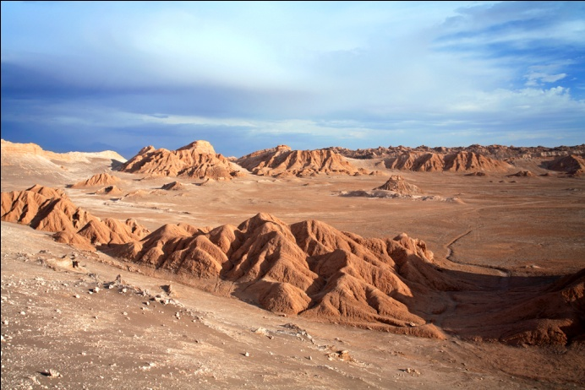
The flight to the desert represented both a protest and an affirmation
  A protest against a decadent and overly institutionalized ecclesiastical body
  A restatement of the gospel teaching to fit the changed conditions of the time.
They withdrew not so much to escape problems but to engage them.

Slide 12
The desert became a place to combat evil but also to cultivate holiness.
It was the battle for the soul that mattered most to them.
They came to understand that the Christian life requires struggle against the darkness that resides in the heart, epitomized by the egoism that runs rampant in every human being
They thought that only by facing that darkness would life and freedom be found.

Slide 13
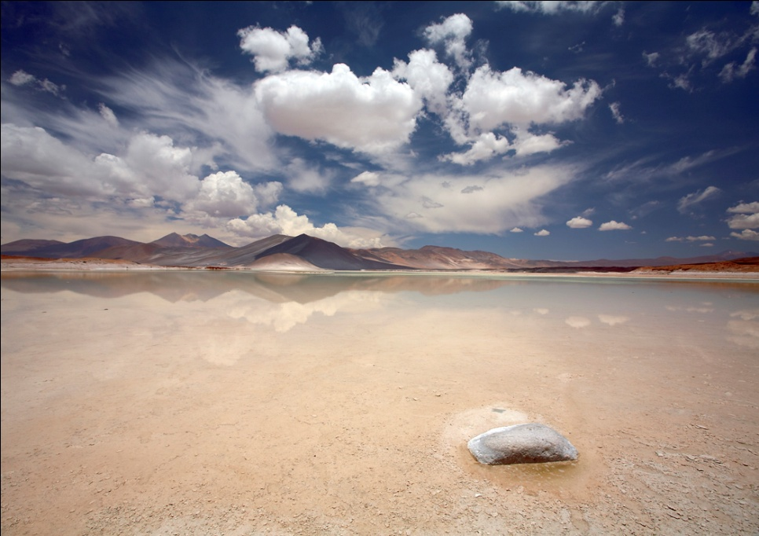
The call of the desert saints is to resist cultural values by seeking solitude in order to separate just enough from modern culture to allow the disciple to recognize, expose, and combat vulnerability to its seductive power.

Slide 14
Additional practices to consider
Sit in an empty church sanctuary for an hour in total silence, just to listen to God
Pray for ½ hour in the mornings before the noise of the day begins
Serve an inner city ministry one Saturday
Increase your regular giving by 2-3%
Set aside one day to invite a friend or a family into your home—invite those who rarely receive such invitations
Identify a controlling appetite and learn how to lessen those controls through Christ

