Slide 1
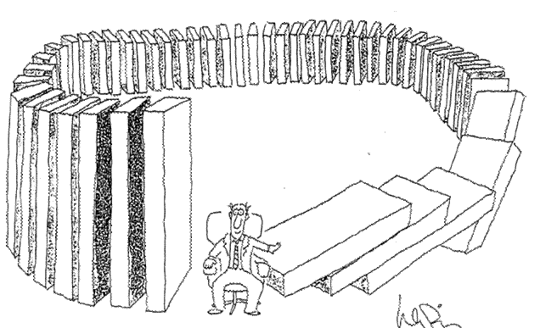
Congregations As Systems

Slide 2
What is a system?
A system is an entity that maintains its existence and functions as a whole through the interaction of its parts.

Slide 3
Systems thinking looks at the whole, and the parts, and the connection between the parts, studying the whole in order to understand the parts.

Slide 4
It is the opposite to reductionism, the idea that something is simply the sum of its parts.

Slide 5
A system is a number of parts acting as a single entity.

Slide 6
There are some general rules that apply to any system. This means that you can predict the behavior of the system without knowing any of the parts.

Slide 7
You can understand many different systems by using the principles of systems thinking.

Slide 8
Systems form part of larger subsystems and are composed in turn of smaller systems.

Slide 9
The properties of a system are the properties of the whole. These whole system properties are called emergent properties – they emerge when the whole system is working.

Slide 10
Every system has an optimum size and if it is made much larger or smaller than this without other changes, it will not function.

Slide 11
There is a limit to how big a man-made system can grow. Everything else being equal, at a certain point it will become unwieldy, hard to manage and more prone to breakdown.

Slide 12
As systems grow bigger, it makes sense to divide them into smaller systems and establish different levels of control.

Slide 13
Systems have emergent properties that are not found in their parts. You cannot predict the properties of a complete system by taking it to pieces and analyzing its parts.

Slide 14
Emergent properties emerge from the system when it is working.

Slide 15
The first lesson of systems thinking is to know whether you are dealing with detail or dynamic complexity – a jigsaw or a chess game.

Slide 16
A system will act like a strong elastic net – when you pull one piece out of position it will stay there only for as long as you actually exert force on it. When you let go you may be surprised and annoyed that it springs back to where it was before.

Slide 17
Whenever you make a change in any complex system – a business, a family or your own way of doing things – expect resistance. You cannot have stability without resistance, they are two sides to the same coin.

Slide 18
Reformers often make the mistake of pushing and pushing, and finally exhausting the system’s resilience, at which point it breaks down completely, to everybody’s cost.

Slide 19
When systems do change, they tend to do so relatively rapidly and often quite drastically.

Slide 20
There is a threshold beyond which a system will suddenly change or break down.

Slide 21
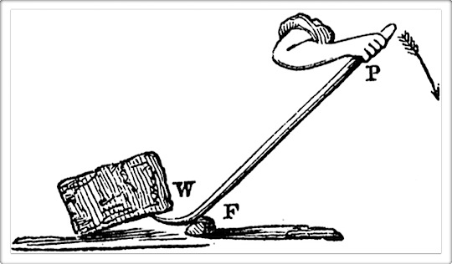
The Principle of Leverage
Change can be surprisingly easy if you identify the right connections. This doesn’t mean piling on the pressure, but knowing where to intervene so that a small effort can get a huge result.
This is leverage.

Slide 22
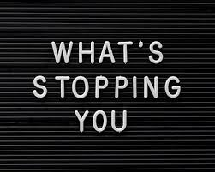
What is stopping the change?

Slide 23
As a general rule, the greater the control/influence of the system of the part you change, the more pervasive and wide-ranging the effects will be.

Slide 24
When you are dealing with a system you can never do just one thing.

Slide 25
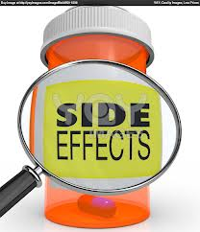
Expect side- effects

Slide 26
Thinking in Circles
Systems thinking is thinking in loops rather than in straight lines.

Slide 27
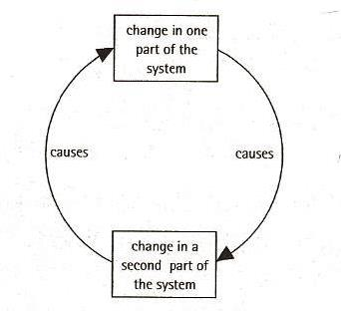
Feedback Loops

Slide 28
We experience feedback as the consequences of our actions coming back to us and so influencing what we do next.

Slide 29
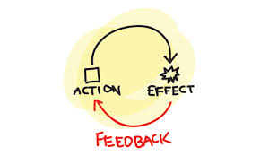
Feedback is often used to mean any response, but the essential point is that it is a return of the effects of an action, influencing the next step.

Slide 30
Two Types of Feedback Loops
Reinforcing Feedback:
When the changes in the whole system feed back to amplify the original change. In other words, change goes through the system producing more change in the same direction.

Slide 31
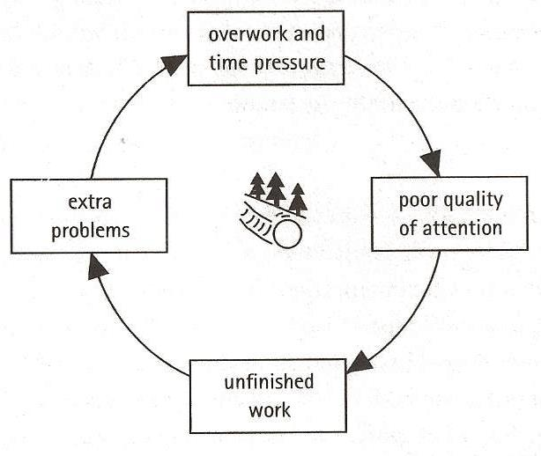
Reinforcing Feedback

Slide 32
Two Types of Feedback Loops
Balancing Feedback:
When the changes in the whole system feed back to oppose the original change and so dampen the effect.

Slide 33
Balancing Feedback
Balancing feedback limits growth and opposes change.

Slide 34
If you want to change a complex system, balancing feedback appears as “resistance”. When you want to maintain the system, it appears as stability.

Slide 35
A balancing feedback loop is set up by a difference between what the system has – the present condition- and what the system needs to balance

Slide 36
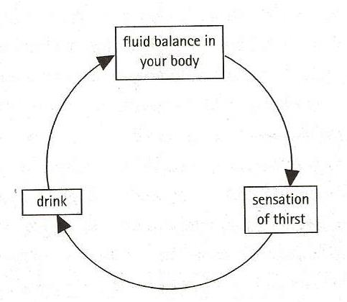
Balancing Feedback

Slide 37
Balancing feedback always acts to reduce the difference between where a system is and where is should be.

Slide 38
Balancing feedback will always move the system in the direction of the “true” desired state. Balancing feedback drives the system towards a goal.

Slide 39
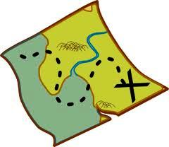
A system needs a way of measuring so that it can tell the difference between where it is and where it should be.

Slide 40
Systems need to measure accurately.

Slide 41
Feedforward
Reinforcing Feedforward: a self-defeating prophecy – telling yourself that you are afraid you won’t be able to sleep.
Balancing Feedforward: a self-fulfilling prophecy – telling a determined athlete that he or she is going to lose.
Our beliefs shape our future.

Slide 42
Delays
Often there is a delay between when a cause happens and its effect.

Slide 43
A delay may fool us into adjusting too soon, too late, or too much.

Slide 44
When you are dealing with systems, expect time delay. Do not expect to see the results of the change immediately.

Slide 45
What we do now will affect our lives in the future when the consequences come round again.

Slide 46
We mold the future by what we do now!

Slide 47
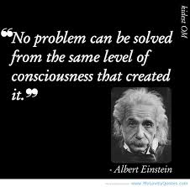
Mental Models

Slide 48
We cannot solve a problem with the same level of thinking that created it.

Slide 49
Mental Models
Our beliefs, ideas and assumptions.
They are our general ideas that shape our thoughts and actions and lead us to expect certain results.
Our mental models guide all our actions.

Slide 50
Our mental models are not facts!

Slide 51
We can evaluate and change our mental models.

Slide 52
Often changing a mental model is the leverage point that leads to breakthrough.

Slide 53
Unless solving a problem leads to a shift in mental models, it hasn’t been completely solved.

Slide 54
Congregations As Systems

