Slide 1
Are extraordinary relationships possible?
Notes:
How many of us have relationships that are less than what we would like.

Slide 2
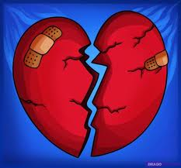
“Relationships often confound and confuse people. They sometimes end in disappointment and disillusionment.” Roberta Gilbert

Slide 3
How is it that well-meaning, principled, nice people end up with relationships that fall apart?

Slide 4
A Story From the Bible
Notes:
Samaritans & Jews – James & John “the sons of Thunder.” I didn’t come to ruin lives but to liberate them.

Slide 5
Jesus didn’t come to ruin the lives of people. He came to liberate them and to reconcile them.

Slide 6
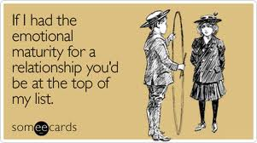
We can only love & relate to the level of our emotional maturity.

Slide 7
There are principles & practices that can be learned that will he help a person grow in emotional maturity.

Slide 8
Applying these principles isn’t easy, however. People change very slowly and usually with resistance. Most people will change very little in their emotional/relational maturity if left to themselves.

Slide 9
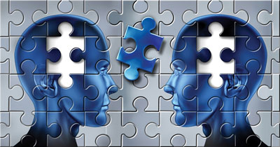
Let’s Talk About It!

Slide 10
3 Whys

Slide 12
1. We feel threatened by the actions of others.
A threat that we may have to give up some of who we are.
A threat of being dominated.
A threat of being taken advantage of.
A threat of being hurt.

Slide 13
1. We feel threatened by the actions of others.
A threat of rejection.
A threat of not being listened to or heard.
A threat of not being included.
A threat of being overlooked or ignored.

Slide 14
We become more focused
on how others are behaving toward us than we do with how we are behaving toward them.

Slide 15
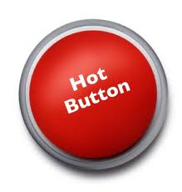
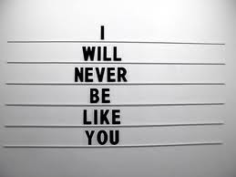
Wounds from our past live in our present.

Slide 16
Key Questions:
What are you being threatened by here?
What button, vow or lie is being triggered here?

Slide 17
A Key Practice/Skill
Self- Discovery and
Self-Awareness
Notes:
This is hard work – it is a skill that can be learned – it takes courage and intentionality

Slide 18
2. We react to threat in typical ways.
Conflict
Distancing
Cut-off
Overfunctioning/Underfunctioning
Triangling

Slide 19
Let’s Talk About It!

Slide 20
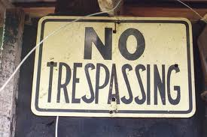
3. We lack clear boundaries.

Slide 21
3. We lack clear boundaries.
Boundaries define us in relation to others.
What is mine & what am I responsible for?
What is not mine & what am I not responsible for?

Slide 22
3. We lack clear boundaries.
“Togetherness is the force that tries to pull one back to the group when one is being ‘too much’ a self. It says, ‘Be like us,’ ‘Be for us more than for yourself,’ or ‘Think as we think.’”
Notes:
Roberta Gilbert

Slide 23
3. We lack clear boundaries.
“The family is made up of ‘donations’ of self from its members – parts of selves that are there more for the family than for the individual. In that way, the members ‘fuse’ together, or ‘lose self’ into the family.” This ‘huddling together’ or herding instinct kicks in whenever anxiety increases.”
The Eight Concepts of Bowen Theory
by Roberta Gilbert.

Slide 24
3. We lack clear boundaries.
Interpersonal fusion happens when a person can’t separate themselves from another person. They take responsibility for how another person feels or they expect the other person to take responsibility for how they feel.

Slide 25
Fused People:
Are on guard for any sign of interpersonal threat, always watching for any minor slight as well as overt attacks.
Tend to think others are responsible for their experience or they are responsible for others. They blame a lot.
Have a sensitivity to criticism – so they live their lives to avoid criticism. They also resent or fear those who are critical.

Slide 26
Fused People:
Seek approval & praise.
Work hard to please others.
Seek peace over progress.
View disagreement as disloyalty.
Feelings are more important than ideas. Can’t we all just get along and be happy?

Slide 27
3. We lack clear boundaries.
You are not responsible for the anxiety another person is experiencing and you are not responsible for calming or “fixing” their anxiety.
Don’t absorb the blame for another person’s problems or choices. Don’t’ blame someone else for your problems or choices.

Slide 28
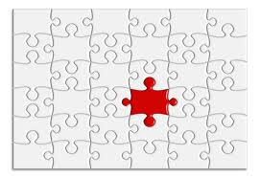
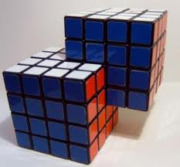
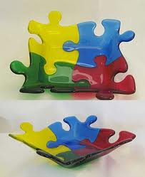
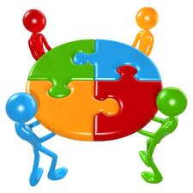
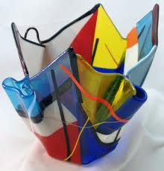
Where are the clear boundaries?

Slide 29
No is the one word
boundary.

Slide 30
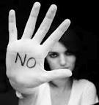
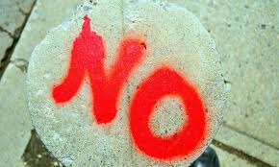
Practice saying no
with someone who is safe.
Notes:
Have everyone pair up. Have each person ask the other a question and respond with no.

Slide 31
I am responsible for what I say & how I say it.
I am not responsible for what you hear.
I am responsible for what I do.
I am not responsible for how you feel.
I am responsible for the choices I make.
I am not responsible for the choices you make.
I am responsible “for” myself.
I am responsible “to” others, to love them.
Notes:
ILL. Todd and I and the 301 team. We had to say no.

Slide 32
Boundaries without consequences are not boundaries. You must be willing to enforce the boundaries

Slide 33
Set Limits on yourself in terms of what you will allow yourself to be exposed to. Give Consequences that will cause them to feel the pain of their choices.

Slide 34
Where is one place in your life
that you need to establish a boundary?
Who is suffering the consequences? Make sure it is the person who needs it.

Slide 35
Let’s Talk About It!

Slide 37
3 Key Practices
1. Let go of expectations:
Lowering expectations of others is what makes closeness and connection possible. Raising your expectations of others will create defensiveness and distancing.

Slide 38
If we want to get people to distance from us, we need only to raise our expectations of them.

Slide 39
3 Key Practices
1. Let go of expectations:
Let go of your need for them to be different than they are. Allow people freedom to be themselves and to make their own choices.
Quit trying to control others or demand that they change.

Slide 40
3 Key Practices
2. Learn to become less reactive:
We have to find a way to manage our anxiety and our sense of threat.
Stop:
“Don’t just do something – Stand there!”

Slide 41
3 Key Practices
2. Learn to become less reactive:
Think:
Who do you want to be in this relationship? What are your guiding values?

Slide 42
3 Key Practices
3. Focus on yourself:
The only person you can change is you. Take responsibility for yourself.
What is my part in keeping this problem in place?

Slide 43
3 Key Practices
3. Focus on yourself:
Don’t blame others.
As long as we keep seeing “them” as responsible for our difficulties or unhappiness in life, we will stay stuck”

Slide 44
Who do you need to give up blaming?

Slide 45
Let’s Talk About It!

Slide 47
3 Kinds of People
1. The wise:
When truth presents itself, the wise person sees the light, takes it in, and makes adjustments.
The bottom line with the wise person is that talking helps – feedback helps – coaching helps.

Slide 48
3 Kinds of People
2. The foolish
The fool tries to adjust the truth so that he/she doesn’t have to adjust himself/herself.
When given feedback, they are defensive and immediately come back at you with a reason why it is not their fault.

Slide 49
3 Kinds of People
2. The foolish
Stop Talking because talking doesn’t help.
Set Limits on yourself in terms of what you will allow yourself to be exposed to.
Give Consequences that will cause them to feel the pain of their choices to not listen.

Slide 50
Who is suffering the consequences? Make sure it is the person who needs it.
Who is suffering the consequences? Make sure it is the person who needs it.

Slide 51
3 Kinds of People
The evil:
There are people in the world who hurt you because they want to hurt you. Evil people are not reasonable.
You have to go in protection mode, not helping mode, when dealing with evil people.

Slide 52
Let’s Talk About It!

Slide 54
3 Key Components
Separate: - but not separated:
Establish boundaries:
I am not responsible for someone else’s emotional well-being. I am only responsible to them to love them.

Slide 55
Two Kinds of People With Boundary Issues.
Compliants:
Say yes to the bad - & can’t say no.
They take on too much responsibility & won’t complain about it. They give in to the demands of others out of fear.

Slide 56
Compliants Are Afraid
Compliants fear hurting feelings.
Compliants fear the other person’s anger.
Compliants fear abandonment & loneliness.
Compliants fear retribution or punishment.
Compliants fear being viewed as selfish, un-spiritual, or being a jerk.
Compliants fear feeling guilty.

Slide 57
Compliants end up being controlled by others.

Slide 58
Two Kinds of People With Boundary Issues.
Controllers:
Don’t respect the boundaries of others & they can’t set boundaries for themselves.
They can’t hear no. Controllers aggressively or manipulatively violate the boundaries of others.

Slide 59
Controllers
Controllers have little ability to control their impulses or desires.
Controllers have limited ability to take responsibility for their own lives.
Controllers always blame someone or something.
Controllers use anger & guilt messages to get their way.

Slide 60
Controllers rarely feel loved because they know that the only reason people spend time with them is because they demand them to do so.

Slide 61
3 Key Components
Separate: - but not separated:
I express love through sacrifice & giving, and I compromise out of my own freedom to choose. I don’t do these things out of a reaction to my own anxiety or a need to keep the other person happy.
I can distinguish and choose between my feelings and my thinking.

Slide 62
3 Key Components
Separate: - but not separated:
I am able to rely less on the other person for support or to “complete” something that is lacking in me. We complement each other but we don’t complete each other.
Each person makes thoughtful & constructive contributions to the relationship.

Slide 63
Let’s Talk About It!

Slide 64
3 Key Components
2. Equal:
Equally important:
Neither person in the relationship thinks that he or she is “more” important or “less” important. There is mutual respect and appreciation. Each person is treated as if they are important.

Slide 65
3 Key Components
2. Equal:
Equally free:
There is no pressure to conform or to spend our lives doing what we must do. Neither person is pressured or coerced to change or give in. Each person is free to be themselves. We don’t give up part of ourselves in order to get along or to gain approval.

Slide 66
Proactive people don’t demand rights – they live them.

Slide 67
3 Key Components
2. Equal:
Equally responsible:
Each person takes responsibility for himself or herself. Neither person does for the other what he or she can do for themselves. “Raising our own threshold for the pain another is experiencing can often motivate the other to take more responsibility for his or her life.”

Slide 68
Let’s Talk About It!

Slide 69
3 Key Components
3. Open:
Verbal:
I learn to “say what is so for me.”
My communication is thoughtful. I think rather than just react emotionally.

Slide 70
3 Key Components
3. Open:
Verbal:
We talk about relevant & meaningful topics. We talk about the deep things not just surface issues. I am courageous enough to be honest.
I am clear about what I think & believe. I define myself clearly using “I” statements rather than “you” statements.

Slide 71
3 Key Components
3.Open:
Non-reactive.
I am self-regulated. I manage my own anxiety. I take responsibility for my own anxiety & for processing my anxiety. I learn to calm myself. I don’t blame others.

Slide 72
3 Key Components
3.Open:
Non-reactive:
I am self-aware. I know my typical patterns of reactivity to anxiety. I think deeply about my buttons, my vows, and the lies I’ve believed about myself. I do the hard and courageous work of self- discovery.

Slide 73
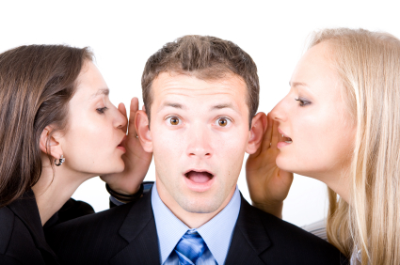
3 Key Components
3. Open:
Direct:
Break free from “Triangling”. Stop talking about the person to someone else. Stop venting and dumping anxiety on another person.

Slide 74
3 Key Components
3. Open:
Direct:
Go directly to the person. Talk to and with each other about any and all issues. Don’t make assumptions.

Slide 75
3 Key Components
3. Open:
Mutuality:
Neither speaks for the other.
Both individuals listen as much as they talk. “It is as difficult to be a good listener as it is to be a clear, direct, non-reactive speaker.”
Neither person takes responsibility for the emotions of the other.

Slide 76
Let’s Talk About It!

