Slide 2
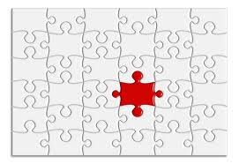
Boundaries are a key
component to
self-differentiation.

Slide 4
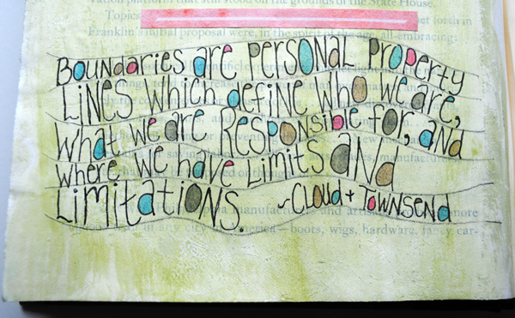

Slide 5
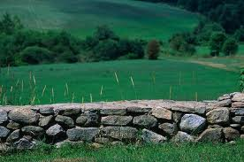
In the simplest sense a
boundary is a property line.
Boundaries define us:
what is me/mine &
what is not me/mine.

Slide 6
A story

Slide 7
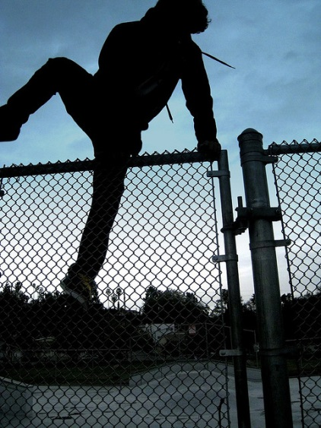
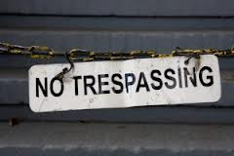
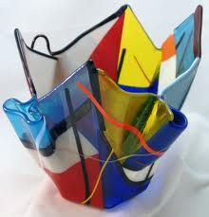
Two Threats to Personal Boundaries
Encroachment/Trespassers.

Slide 8
Fusion
Interpersonal fusion happens when a person can’t separate themselves from another person. They take responsibility for how another person feels or they expect the other person to take responsibility for how they feel.

Slide 9
Fused People:
Are on guard for any sign of interpersonal threat, always watching for any minor slight as well as overt attacks.
Tend to think others are responsible for their experience or they are responsible for others. They blame a lot.
Have a sensitivity to criticism – so they live their lives to avoid criticism. They also resent or fear those who are critical.

Slide 10
Fused People:
Seek approval & praise.
Work hard to please others.
Seek peace over progress.
View disagreement as disloyalty.
Feelings are more important than ideas. Can’t we all just get along and be happy?

Slide 11
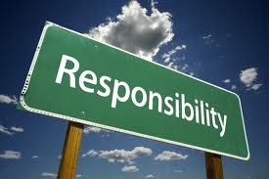
Boundaries are about what is mine & therefore my responsibility & what is not mine & is not my responsibility.

Slide 12
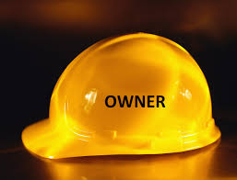
Boundaries are about
ownership.
I know who owns things such as
Feelings,
Attitudes,
Behaviors.

Slide 13
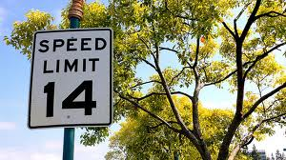
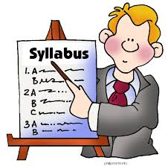
Boundaries involve
setting limits &
allowing consequences.

Slide 14
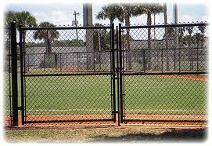
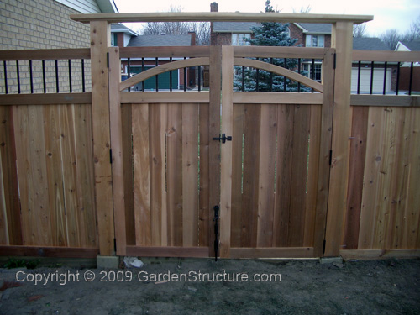
Boundaries are not walls
they are fences with gates.
We keep the good in & the bad out.

Slide 15
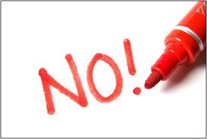
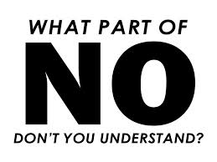
The one word boundary.

Slide 16
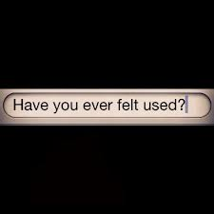
Boundaries keep us from feeling used
or taken advantage of.
Boundaries keep us from giving up
who we are.

Slide 17
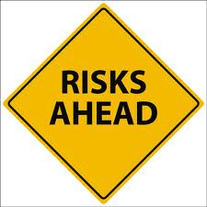
You face a risk in setting boundaries
& gaining control of your life.
The consequences of setting
boundaries will be countermoves by
controlling people.
Anger – Guilt – Blame.

Slide 19
The Triangle of Healthy Boundaries
Freedom
Love
Responsibility

Slide 20
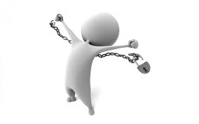
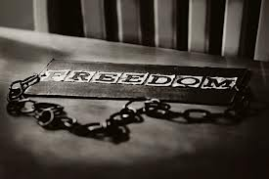
Freedom
God designed the entire creation for freedom.
Another human being can’t force you to do anything.
Take ownership of your freedom!

Slide 21
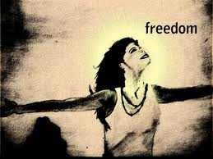
Freedom
Freedom is mutual – you must allow others to be free.
Freedom means we refuse to coerce, control, or demand.

Slide 22
Freedom
In relationships each person is free from the other and therefore free to love the other.

Slide 23
Freedom
Live free because love only exists where there is freedom.
Where there is no freedom there is slavery & where there is slavery there will be rebellion.

Slide 24
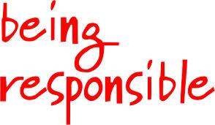
Responsibility
Boundaries help us determine who is responsible for what.
We are responsible to but not for others.
Responsibility involves action.

Slide 25
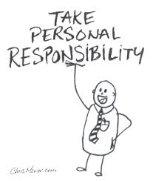
Responsibility
Take responsibility for your own freedom & empowerment.
Act both to avoid being a victim & to change the relationship. What is my role in keeping the problem in place?

Slide 26
Take responsibility for:
Feelings Desires
Attitudes Thoughts
Behaviors Values
Choices Talents
Limits Love
Give up being responsible for others!

Slide 27
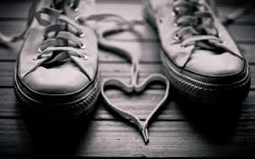
Love
Love is a free choice. No one can actually love another if she/he feels like she/he doesn’t have a choice not to.
Love tolerates short term hurt/pain so that there is not long term harm to the relationship.

Slide 28
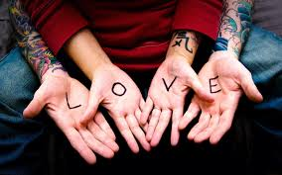
Love
Love tells the truth. Be courageous. Love & truth must coexist.
Love is not passive – loves takes action.

Slide 30
Four Kinds of People With Boundary Issues.
Compliants:
Say yes to the bad - & can’t say no.
They take on too much responsibility & won’t complain about it. They give in to the demands of others out of fear.

Slide 31
Compliants Are Afraid
Compliants fear hurting feelings.
Compliants fear the other person’s anger.
Compliants fear abandonment & loneliness.
Compliants fear retribution or punishment.
Compliants fear being viewed as selfish, un-spiritual, or being a jerk.
Compliants fear feeling guilty.

Slide 32
Compliants end up being controlled by others.

Slide 33
Four Kinds of People With Boundary Issues.
Controllers:
Don’t respect the boundaries of others & they can’t set boundaries for themselves.
They can’t hear no. Controllers aggressively or manipulatively violate the boundaries of others.

Slide 34
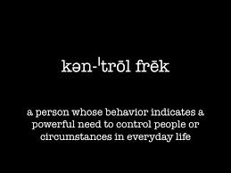
Controllers
Controllers have limited ability to take responsibility for their own lives.
Controllers always blame someone or something.
Controllers use anger & guilt messages to get their way.

Slide 35
Controllers rarely feel loved because they know that the only reason people spend time with them is because they demand them to do so.

Slide 36
Four Kinds of People With Boundary Issues
Avoidants: Say no to the good – can’t hear yes.
These individuals can’t ask for help when they need it. They withdraw when they’re in need. They avoid opening up, being transparent and being vulnerable.
These people set boundaries against receiving the care of others.

Slide 37
Four Kinds of People With Boundary Issues
Non-responsives: don’t hear the needs of others –can’t say yes.
Those with a critical spirit. They hate their own brokenness so they ignore the needs of others. You don’t deserve to be loved or cared for.
Narcissists. They are self absorbed. I just don’t care.
These people set boundaries against the responsibility to love.

Slide 39
Ten Laws/Principles of Boundaries

Slide 40
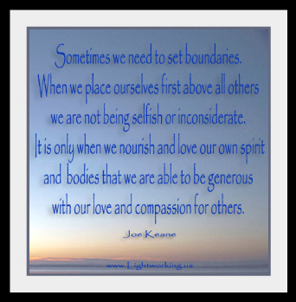

Slide 41
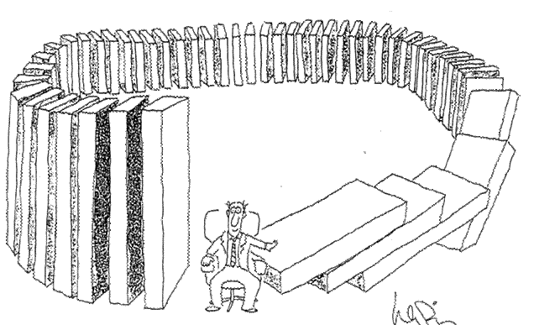
The Law of Sowing & Reaping
Our actions have consequences.

Slide 42
The Law of Sowing & Reaping
When we do loving, responsible things, people draw close to us. When we are unloving or irresponsible, people withdraw from us.
When you increase your expectations of other people you will reap them distancing from you.

Slide 43
The Law of Sowing & Reaping
Refuse to take responsibility for problems that aren’t yours.
Who is suffering the consequences? Is it the person who is making the choices?
Boundaries without consequences are not boundaries.

Slide 44
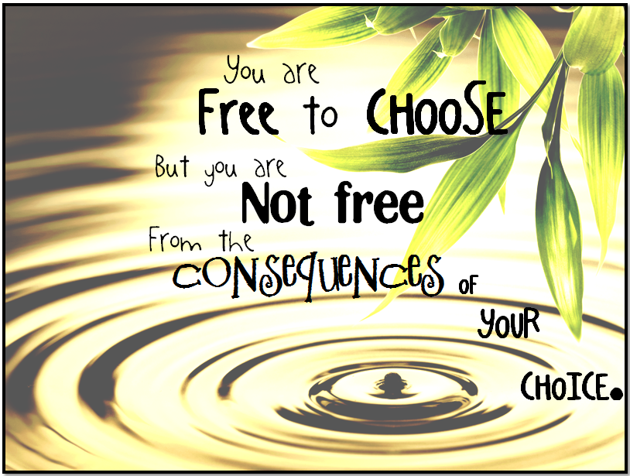

Slide 45
The Law of Responsibility
We are responsible to each other but not for each other.
I am not responsible for your feelings.
Refuse to rescue or enable bad behavior.
Make the other person responsible for what is theirs.
Be responsible for yourself.

Slide 46
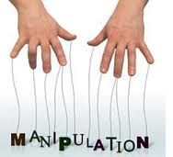
Be a safe person.
Refuse to withdraw emotionally.
Emotional withdrawal is a form of
manipulation & dishonesty.

Slide 47
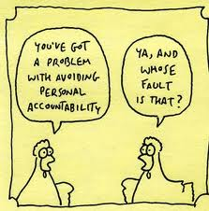

Slide 48
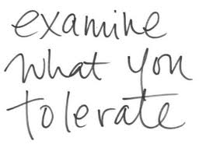
Set Limits

Slide 49
The Law of Power
The law of power clarifies what we do and don’t have power over.
We don’t have power over others even though we would love to change or fix them so that we can be more comfortable.
We don’t have the power to change someone else, but we can influence them.

Slide 51
The Law of Power
We do have the power to grow, to change, and to mature.
We do have the power to make good choices.
We do have the power to take charge of our own lives.

Slide 52
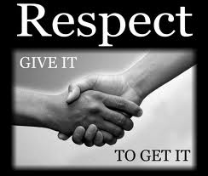
The Law of Respect
If we want others to respect our boundaries, we need to respect theirs.

Slide 53
The Law of Respect
Mature adults want freedom for others as much as their own.
Allow people to have their own mind, values, feelings, and preferences.

Slide 54
The Law of Motivation
We must be free to say no before we can wholeheartedly say yes.
No one can actually love another if he feels he doesn’t have a choice not to.
Having to do anything is sign that someone is afraid.
Fear always works against love.

Slide 55
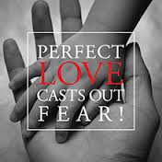
The Law of Motivation
Am I doing this out of fear or love?

Slide 57
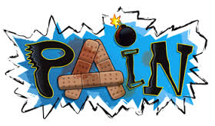
The Law of Evaluation
We need to evaluate the pain our boundaries cause others.
Just because someone is in pain doesn’t mean something bad is happening.

Slide 58
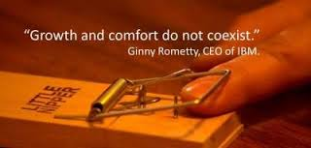
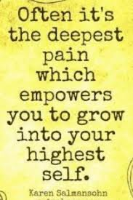
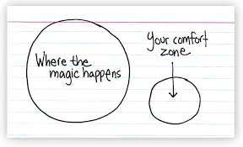
There is a difference between short term hurt & long term harm

Slide 59
Give up your fear of causing
pain/discomfort
Your capacity to tolerate discomfort in another person – requires the other person to take responsibility for his/her life.

Slide 60
The Law of Proactivity
We take action to solve problems based on our guiding principles, wants & needs.

Slide 61
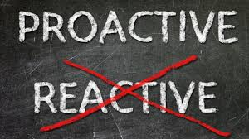
If other people have the power
to get you to react, they are inside
of your walls – they are inside of
your boundaries.

Slide 62
Proactive people don’t demand their
rights – they live them.

Slide 63
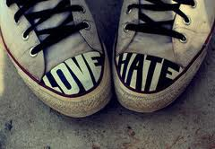
Proactive people are known more for
what they are love than for what
they hate.

Slide 64
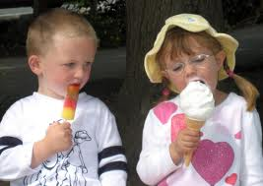
The Law of Envy
We will never get what we want if we focus outside of our boundaries on what others have.

Slide 65
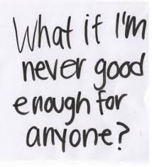
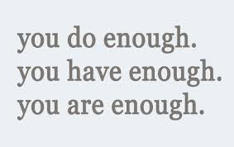
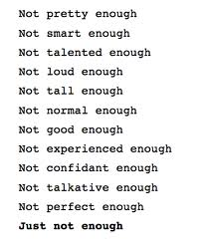
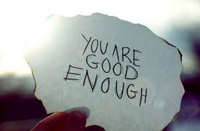
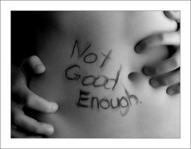
Envy is devaluing what we have
thinking it’s not enough.

Slide 66
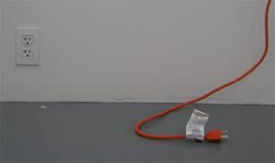
Envy is miserable because we’re
dissatisfied with our state –
yet powerless to change it!

Slide 67
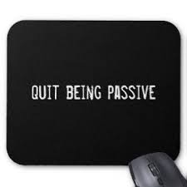
The Law of Activity
We need to take the initiative in setting limits, rather than being passive.

Slide 68
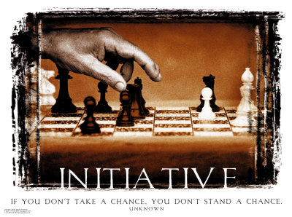
Take the initiative.
Assume the first move is yours.

Slide 69
The Law of Exposure
We need to communicate our boundaries.
A boundary that is not communicated
is a boundary that is not working.

Slide 70
Have the courage to speak up & make clear what you do & do not want.

Slide 71
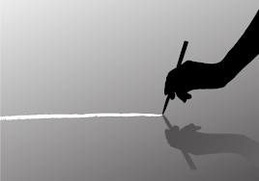
Boundaries are always about
you not someone else.
Boundaries are about self-control.

Slide 73
www.mymapcoach.com

