Slide 1
Introduction to the Missional Church Movement
Session Four

Slide 2
Be Missional
Living a life that reflects the heart of God.
Notes:
Tell the story of my journey of transformation – Wellspring – MSC – Tomball
Non Christians complaint that Christians don’t think – the discipline of Mental Models.

Slide 3
“Missio Dei” The Mission of God
Mission is understood as being derived from the very nature of God. The classical doctrine of the Missio Dei as God the Father sending the Son, and God the Father and the Son sending the Spirit is expanded to include yet another “movement”: Father, Son, and Holy Spirit sending the church into the world.

Slide 4
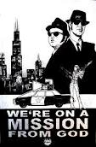
What is the mission of God?

Slide 5
What is God’s Mission?
Mission is the result of God’s initiative, rooted in God’s purposes to restore and heal creation.
“God’s mission is to set things right in a broken, sinful world, to redeem it, and to restore it to what God has always intended for the world.”

Slide 6
“Mission is faith in action. It is the acting out of the central prayer that Jesus taught his disciples to use: ‘Father, hallowed be thy name, thy kingdom come; they will be done on earth as in heaven.’” Lesslie Newbigin The Open Secret

Slide 7
From Souls to Wholes.

Slide 8
“As we have used the tools of biblical scholarship carefully, we have begun to learn that the biblical message is more radical, more inclusive, more transforming than we have allowed it to be. God’s mission embraces all of creation.”

Slide 9
It has taken us decades to realize that mission is not just a program of the church. It defines the church as God’s sent people. Our challenge today is to move from church with mission to missional church.

Slide 10
Defining a few terms:
Missions: something a church does as part of its life & programs.
Missionary: someone sent to do missions somewhere else – primarily in the form of evangelization.
Mission: a purpose or agenda – something to accomplish.
Missional: to join God in his mission as a way of life – reflecting his character.

Slide 11
What is the heart of God? What does God care about?
God formed a nation through Abraham that was intended to be “a blessing to the nations.” (Genesis 12:2&3)
God heard the cry of the oppressed in Egypt and sent Moses as his rescuer.
God is full of compassion and desires justice for every person.

Slide 12
Deuteronomy 10:17-19 He defends the cause of the fatherless and the widow and loves the alien, giving him food and clothing | Proverbs 31:8-9 Speak up for those who cannot speak for themselves, for the rights of all who are destitute
Deuteronomy 15:11 There will always be poor people in the land. Therefore I command you to be openhanded toward your brothers and toward the poor and needy in your land | Jeremiah 22:15,16 He defended the cause of the poor and needy…Is that not what it means to know me?
Job 29:11-13 I rescued the poor…the fatherless…the man who was dying; I made the widow’s heart sing | Amos 5:23,24 Away with the noise of your songs…but let justice roll on like a river, righteousness like a never-failing stream!
Psalm 68:5 A father to the fatherless, a defender of widows, is God in his holy dwelling | Isaiah 1:17 Learn to do right! Seek justice, encourage the oppressed. Defend the cause of the fatherless, plead the case of the widow.
Proverbs 14:31 Whoever is kind to the needy honors God | Isaiah 61:1-3 The Spirit of the Sovereign Lord is on me…

Slide 13
God Cares & Wants Us to Care.
Isaiah 58:1-12
Micah 6:8 -
And what does the Lord require of you? To act justly and to love mercy and walk humbly with your God.

Slide 14
The central vision of world history in the Bible is that all of creation is one, every creature in community with every other, living in harmony and security toward the joy and well-being of every other creature.
Leviticus 26:4-6
Isaiah 32:16-18
Ezekiel 34: 25-29
Ephesians 2:14

Slide 15
“That persistent vision of joy, well-being, harmony, and prosperity is not captured in any single word or idea in the Bible, and a cluster of words is required to express its many dimensions and subtle nuances: love, loyalty, truth, grace, salvation, justice, blessing, righteousness. But the term that in recent discussions has been used to summarize that controlling vision is shalom.”

Slide 16
“Shalom is derived from a root that conveys the image of wholeness, unity, and harmony – something that is complete and sound.”
Expository Dictionary of Bible Words Lawrence O. Richards

Slide 17
The consequence of justice & righteousness is shalom – an enduring sabbath of joy and well-being. But the alternative is injustice and oppression, which lead inevitably to turmoil and anxiety with no chance of well-being.

Slide 18
Jesus’ ministry to the excluded was the same, the establishment of community between those who were excluded and those who had excluded them. His acts of healing the sick, forgiving the guilty, raising the dead, and feeding the hungry are all actions of reestablishing God’s will for shalom in a world gone chaotic by callous self-seeking.

Slide 19
Shalom for “Haves” and “Have-Nots”
Shalom for “Have-Nots” involved crying out to God, asking Him to hear and to deliver. (A theology of salvation.)
Shalom for “Haves” includes questions about proper management and joyous celebration. (A theology of blessing.)

Slide 20
“So we imagine the world either as a dreaded burden soon to pass away, or as a rich gift to be valued and nurtured. So we imagine ourselves as persons, either as among the wretched, waiting for a new deal, or as a trusted, valued manager prepared to act responsibly and confidently. So we imagine and preach the good news, either as a promise of the upheaval or as an assurance of durability of what is.”

Slide 21
Shalom & Restored Wholeness

Slide 22
Shalom As Freedom & Unity
God intends freedom.
“Let us characterize slavery simply as that which keeps us from being joyous.”
God desires unity.
“God is against estrangement and fragmentation.”

Slide 23
“Mission is the mother of theology.”

Slide 24
“God is the ‘God who acts.’ It may be more accurate to refer to the Bible as the Acts of God rather than call it the Word of God.”

Slide 25
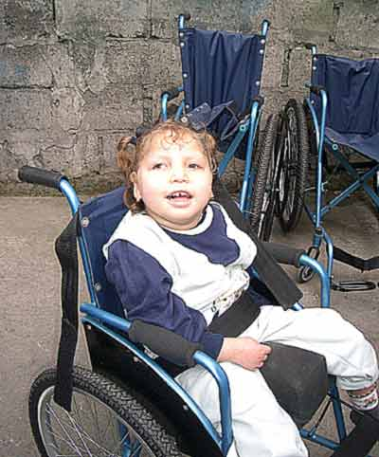
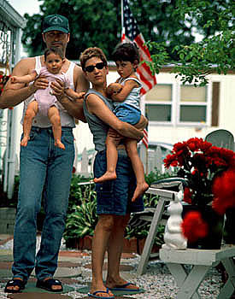
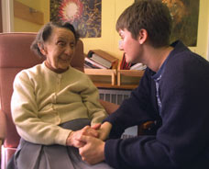
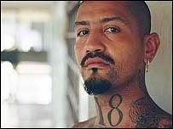
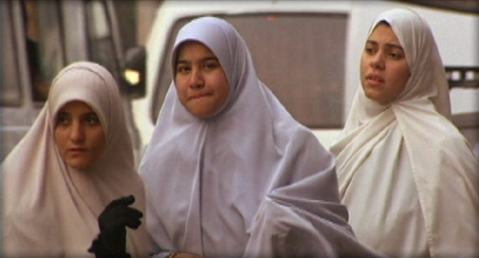
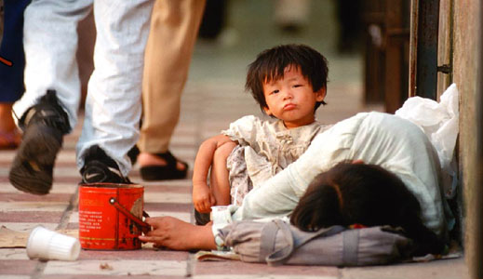
Look for the
overlooked and the
ignored. Matt. 25:40

Slide 26
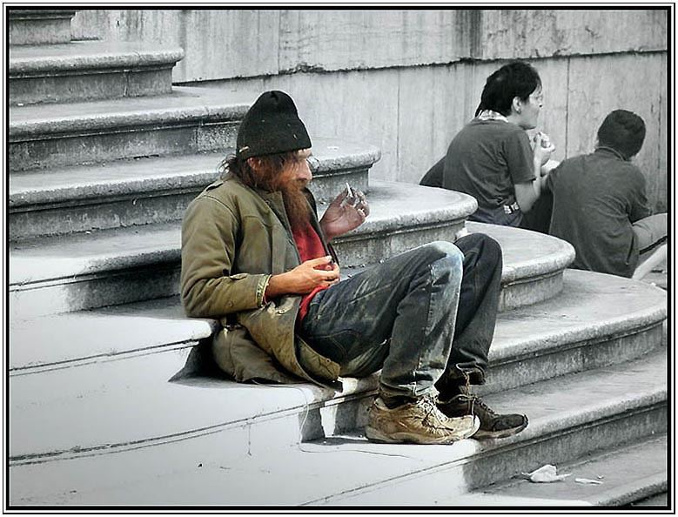
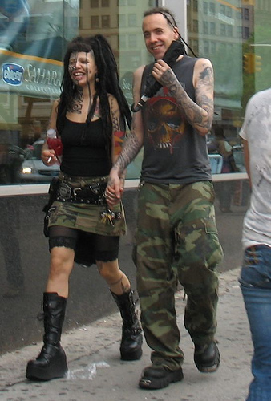
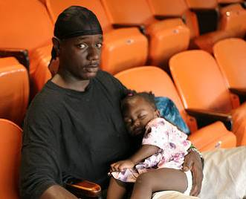
Notes:
Tell the day laborer story

Slide 28
Jesus came preaching & demonstrating the good news of the kingdom.
Matthew 4:17 & 23, 6:9-13, 6:33
God’s rule & reign.
God’s dream for the world.
“We describe God’s kingdom in terms of God’s dreams coming true for this earth, of God’s justice & peace replacing earth’s injustice & disharmony.” (Brian McLaren in The Secret Message of Jesus.)

Slide 29
“The reign of God is undoubtedly central to Jesus’ entire ministry. It is, likewise central to his understanding of his own mission.”
Bosch p. 31

Slide 30
“God’s reign is not understood as exclusively future but as both future and already present.” The future has invaded the present.” Bosch p. 32

Slide 31
Mortimer Arias says that the mission of God is “…to denounce anything that opposes God’s purpose for humanity, and to announce and incarnate the reign of God in our troubled world.” Announcing the Reign of God

Slide 32
“The kingdom of God, announced by Jesus, is multidimensional and all-encompassing. It is both a present and a future reality. It has to do with each individual creature and with the whole of society.” It embraces all dimensions of human life: physical, spiritual, personal and interpersonal, communal and societal, historical and eternal. And it encompasses all human relationships – with the neighbor, with nature, and with God.” Arias P. xv

Slide 33
The zone of God’s rule includes: Reconciled Relationships

Slide 34
“The kingdom of God, in short compass, is the society in which the will of God is established to transform all of life. The kingdom of God is more than what God is doing ‘within you’ and more than God’s personal ‘dynamic presence’; it is what God is doing in this world through the community of faith for the redemptive plans of God – including what God is doing in you and me. It transforms relationships with God, with self, with others, and with the world.” Scot McKnight – A Community Called Atonement

Slide 35
An All-Inclusive Mission
“What amazes one again and again is the inclusiveness of Jesus’ mission. It embraces both the poor and the rich, both the oppressed and the oppressor, both the sinners and the devout. His mission is one of dissolving alienation and breaking down walls of hostility, of crossing boundaries between individuals and groups.”

Slide 36
The zone of God’s rule includes: Restored Wholeness

Slide 37
An All-Inclusive Mission
“Thus there is, in Jesus’ ministry, no tension between saving from sin and saving from physical ailment, between the spiritual and the social.”
“What amazes one again and again is the inclusiveness of Jesus’ mission. It embraces both the poor and the rich, both the oppressed and the oppressor, both the sinners and the devout. His mission is one of dissolving alienation and breaking down wall of hostility, of crossing boundaries between individuals

Slide 38
“Discipleship involves a commitment to God’s reign, to justice and love, and to obedience to the entire will of God. Mission is not narrowed down to an activity of making individuals new creatures, of providing them with ‘blessed assurance’ so that, come what may, they will be ‘eternally saved’.

Slide 39
“Mission involves, from the beginning and as matter of course, making new believers sensitive to the needs of others, opening their eyes and hearts to recognize injustice, suffering, oppression, and the plight of those who have fallen by the wayside.”

Slide 40
“To become a disciple means a decisive and irrevocable turning to both God and neighbor. What follows from there is a journey which, in fact, never ends in this life, a journey of continually discovering new dimensions of loving God and neighbor, as ‘the reign of God and his justice’ are increasingly revealed in the life of the disciple.”

Slide 41
“Discipleship involves a commitment to God’s reign, to justice and love, and to obedience to the entire will of God. Mission is not narrowed down to an activity of making individuals new creatures, of providing them with ‘blessed assurance’ so that, come what may, they will be ‘eternally saved’.

Slide 42
“Luke 4:16-21 has, for all practical purposes, replaced Matthew’s ‘Great Commission’ as the key text not only for understanding Christ’s own mission but also that of the church.”
Notes:
Tell the story of John the Baptizer and Jesus – “Is this what you were expecting?” Luke7:18

Slide 43
For Luke, salvation means acceptance, fellowship, & new life. “Whatever salvation is, then, in every specific context, it includes the total transformation of human life, forgiveness of sin, healing from infirmities, and release from any kind of bondage.”

Slide 44
“For Luke, salvation actually had six dimensions; economic, social, political, physical, psychological, and spiritual.”
Notes:
Wholeness “Shalom” in all six dimensions.

Slide 45
Restored Wholeness in Six Dimensions.

Slide 46
The Economic Dimension
The ability to work at jobs with livable wages.
The capacity to manage money.
The opportunity to accumulate wealth.
Quality education opportunities.
Affordable housing.
Generosity.

Slide 47
The Social Dimension
Reconciliation
Forgiveness
Graciousness
Hospitality
Peacemaking
Equality
Empowered

Slide 48
The Physical Dimension
Affordable & accessible healthcare.
Proper nutrition
Clean water
Rest & Relaxation
Proper exercise
Whole & healthy living conditions
Physical Health

Slide 49
The Psychological Dimension
No feelings of inferiority or shame.
No feelings of being “less than” or not enough.
No god complex or sense of superiority.
Mentally whole & healthy.
No worry, anxiety, or depression.
No stress overload.
At Peace.
Joyful.

Slide 50
The Political Dimension
Jesus is Lord – rather than Caesar.
No political party or government fully represents the Jesus agenda.
Politics are about power & control.
We speak out against governments that oppress, abuse, kill, or act unjustly.
We work to repair systems that perpetuate injustice.

Slide 51
The Spiritual Dimension
We acknowledge God.
We have a spiritual connection with God.
We work for the purposes of God, reflecting God’s character.
We are free. There is no coercion.
We are full of life.
We engage in spiritual practices.

Slide 52
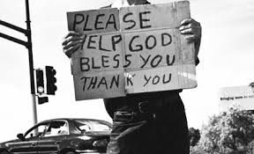
“The Kingdom of God transforms
relationship with God, with self,
with others, and with the world.”

Slide 53
“Atonement is only understood when
it is understood as the restoration of
humans in all directions.”
People are made for:
“union with God,
communion with others,
love of self,
& care for the world.”

Slide 54
The zone of God’s rule includes: Re-established Justice

Slide 55
The entire ministry of Jesus, and his relationships with the poor, with women and with other marginalized people witness, in Luke’s writings, to Jesus’ practice of boundary-breaking compassion, which the church is called to emulate.

Slide 56
Justice/Righteousness
“Linked with God’s reign in a mysterious way is the concept dikaiosyne, which is perhaps the most characteristically Matthean notion of all.”
“It is unlikely that Matthew has found this term in his sources; it is introduced by himself at each point.”

Slide 57
“The translation of dikaiosyne poses problems, however, at least in English. It can refer to justification (God’s merciful act of declaring us just), or to righteousness (a preeminently religious or spiritual concept; an attribute of God or a spiritual quality that we receive from God), or to justice (people’s right conduct in relation to their fellow human beings.)

Slide 58
“Most English New Testament translations reveal a bias toward the second meaning.” Matt. 5:6, 5:10, 5:20 & 6:33

Slide 59
Romans 14:17
The Kingdom of God is justice, wholeness & celebration.

Slide 60
We are called and sent to represent God’s dream for the world. It is our task to create foretastes of God’s kingdom here on earth.

Slide 61
As followers of the way of Jesus we represent the reign of God in the world. By “being” different. We love one another
As followers of the way of Jesus we serve the reign of God. By “doing” acts of mercy and justice.
As followers of the way of Jesus we announce the reign of God. By “speaking” good news.

Slide 62
The Kingdom of God is both a gift we receive and a realm that we inhabit.
The daily life for a follower of Jesus is about asking how one may move more fully into the realm of God’s reign & how one may welcome & receive God’s reign into the fabric of one’s life this day more than ever before.

