Slide 1
Housing in Silicon Valley

Slide 2
Overview
What is Silicon Valley?
Why is the business community engaged in housing?
What have we done?
What’s on the horizon?

Slide 3
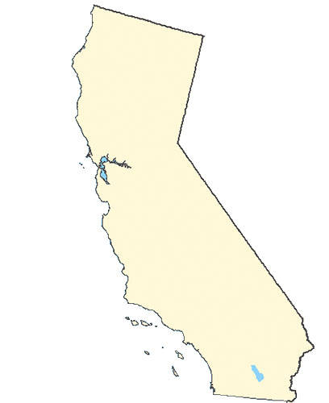
Silicon Valley
4 million people
San Francisco
Los Angeles

Slide 4
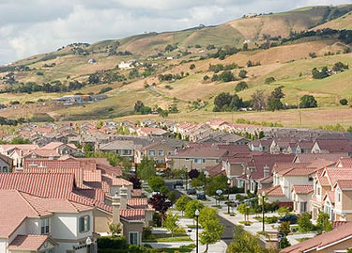
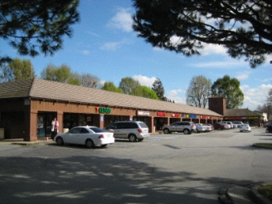
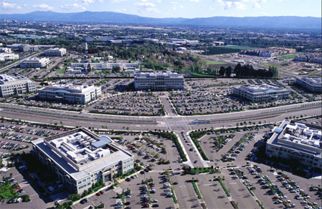
Suburban Land Use

Slide 5
Innovation Center
Robust job growth– added 42,000 jobs in 2012.
1/3 of venture capital in US
Not everyone shares in this growth
18% decline in incomes for African Americans
5% decline for Latinos

Slide 6
Shortage of Homes
Housing growth 7,526, job growth 42,000
$1.05 million single family home
$2,128 average rent

Slide 7
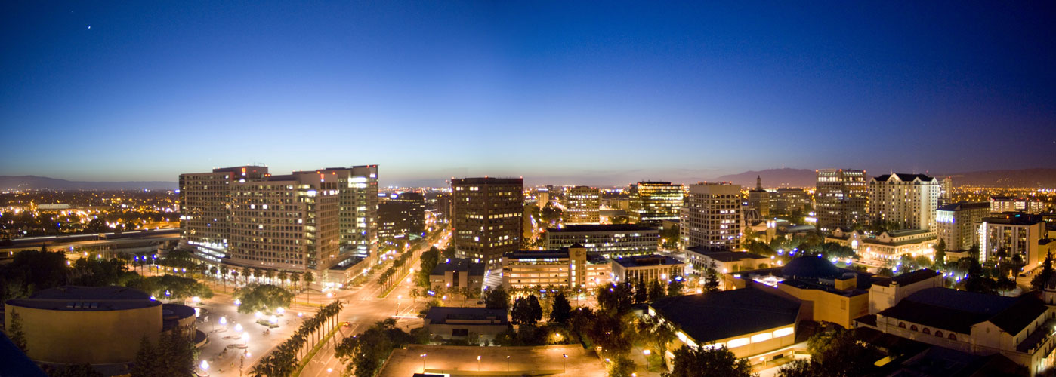
Silicon Valley Leadership Group
385 members
1 out of 3 private sector jobs

Slide 8
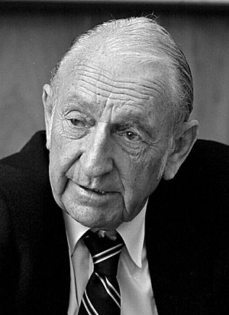
David Packard Hewlett-Packard CEO and Silicon Valley Leadership Group Founder
“Our job, as CEOs, is not to sit on the sidelines, to cheer or jeer.
Our job is to get into the game and move the ball forward.”

Slide 9
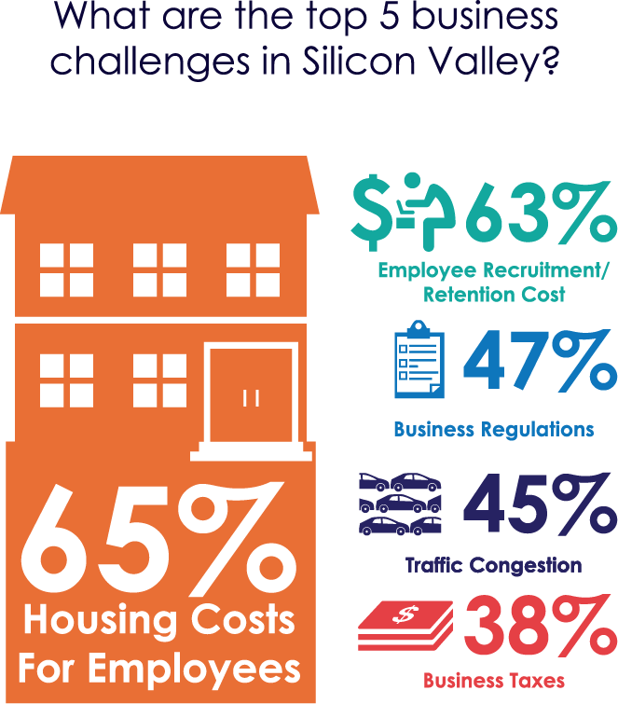
2013 CEO Business Climate Survey
#CEOSummit

Slide 10
Home Prices in Other Tech Centers
Austin: Rents - $933
Purchase - $184,000
Seattle: Rents - $1,438
Purchase - $430,000
Silicon Valley: Rents - $2,128
Purchase - $1.05 million
#CEOSummit

Slide 11
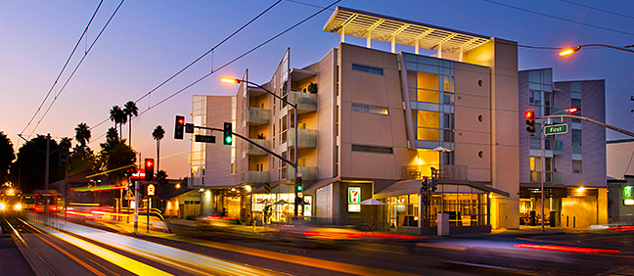
Engaging Business Community on Housing
Housing advocacy
229 developments, representing 65,000 homes
Education on housing issues

Slide 12
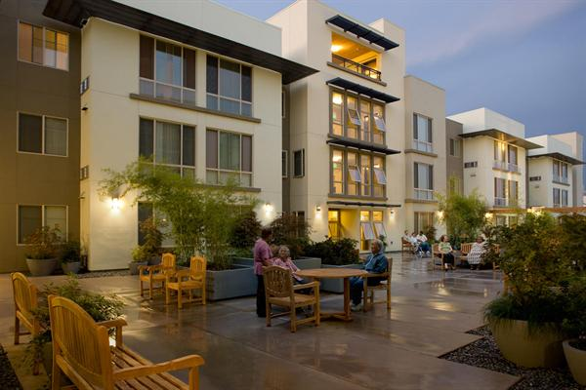
Housing Trust of Silicon Valley
Raised $76 million – public and private
Leverages $1.88 billion
Created 9,988 housing opportunities
3 programs
First-time homebuyer loans
Multifamily loans
Finally Home loans for recently homeless

Slide 13
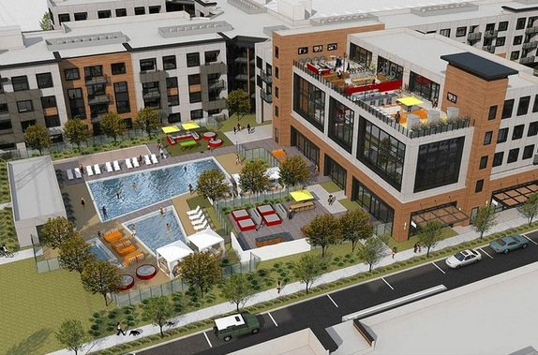
Facebook – Anton Menlo Apartments
$120 million, 394-apartment community within walking distance of headquarters

Slide 14
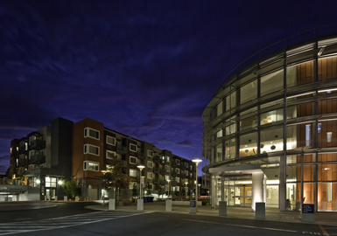
Google – Fair Oaks Senior Housing
$19 million investment
123 low-income senior apts
Next door to county clinic

Slide 15
Conclusion
Silicon Valley housing challenging
Leadership Group focused on solutions
Create political will for homes
Raise local funds
Strongest when we work together

Slide 16
Contact Information
Bena Chang
bchang@svlg.org
www.svlg.org

