Slide 2
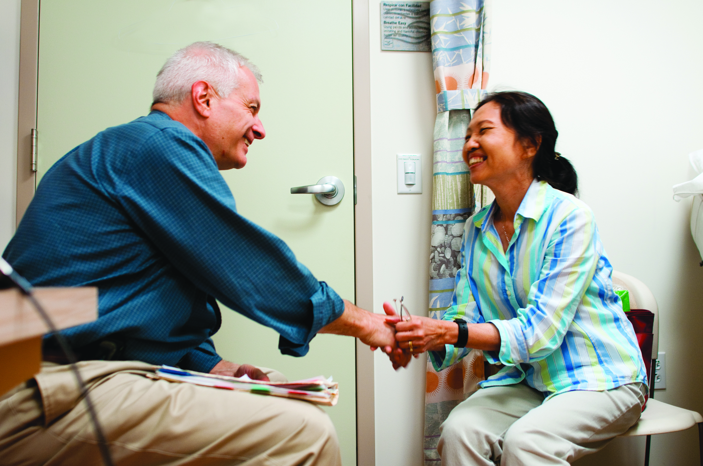
About AFC

Slide 3
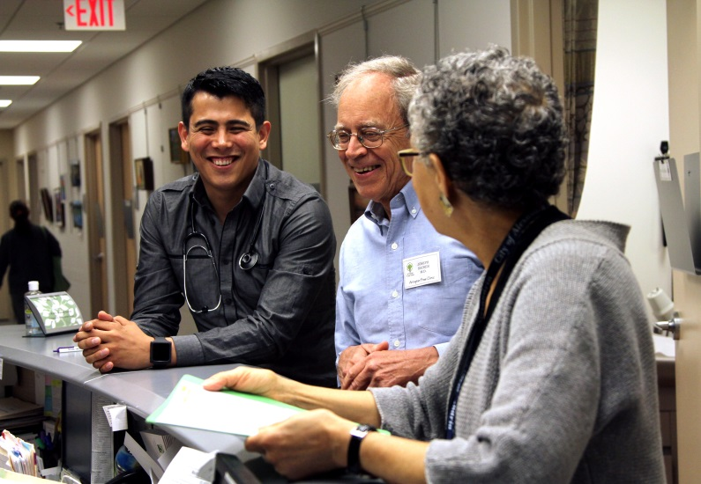
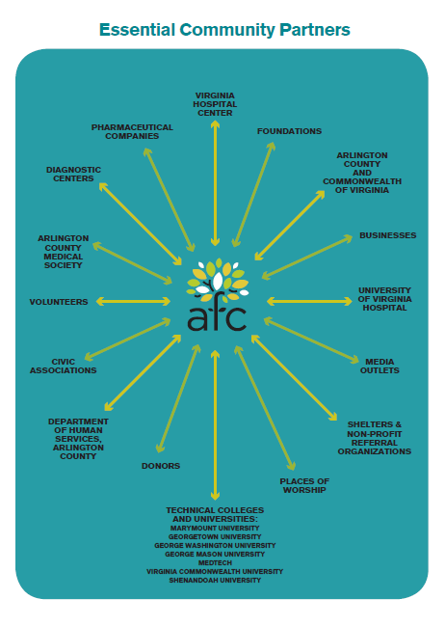
Clinical Services

Slide 4
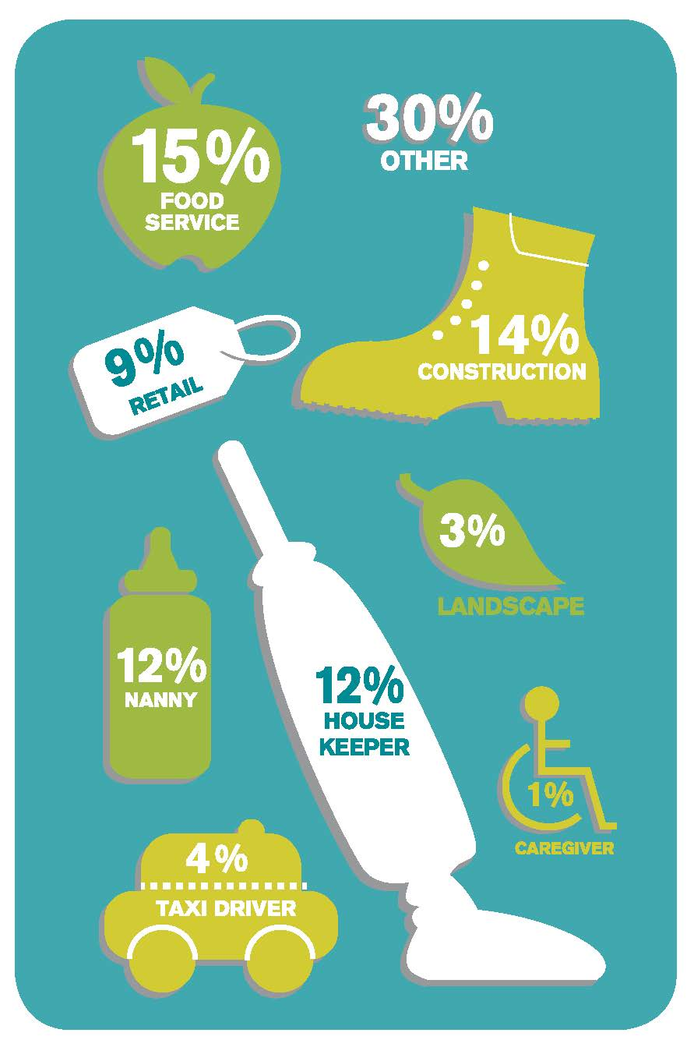
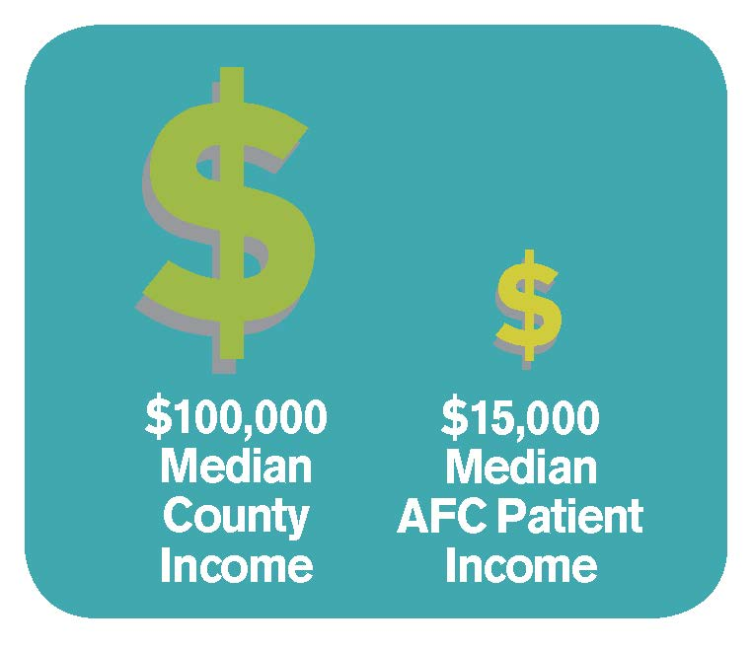
Very Poor…
Over 70% work at one or more low-wage jobs that don’t provide health insurance.

Slide 5
…Very Sick
60 patients
only one appointment
10%
serious illness
1/2 of those
multiple chronic diseases
1/3
chronic disease
Complexity
25%
>10 visits/year

Slide 6
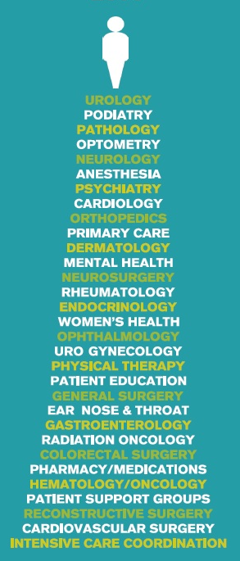
Visits & Specialty Care
Patient with chronic disease
Average 10 visits/year
$1,500/ year in visits
Our patients are very lucky, but they are the minority.

Slide 7
Ex: Insulin-Dependent Diabetic Patients
>10 visits/year
Nurse Practitioner Program
At $150 per visit = $1,500
Medications
Foot & eye exams
At $650/month
Supplies
Education
At $150/month

Slide 8
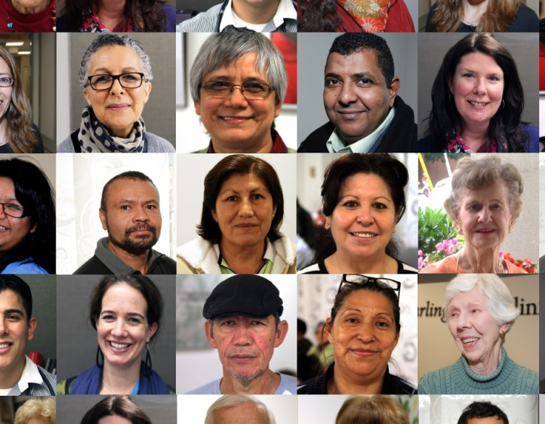
Care Model
Family, Employment, Food, Transportation, Housing, Family
Specialists, x-rays, labs, Hospital, Medications
MDs, NPs, MAs, Case Manager, Volunteers, Care Team
Patient
1,700 Patients
10,000 Medical Visits

Slide 9
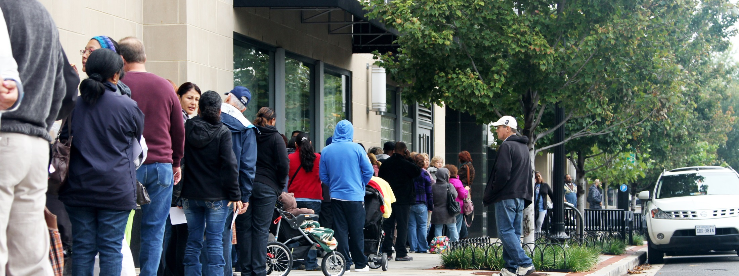
Need for Services
1,073 attended Lottery
285 taken via Lottery
The need continues to be great…
162 taken via shelters & VHC

Slide 10
Increasing Access: Dental
Comprehensive Care
Primary & Specialty Care
Pharmacy
Mental Health
Dental

