Slide 1
Missional Multiplication Passion: The Fuel for Multiplication
Dr. Tim Roehl

Slide 2
Passion: The Fuel
The Call…
Rescue the
Perishing!

Slide 3
What will you do?

Slide 4
Passion: The Fuel
I. God’s Focus—Rescuing the Lost,
Restoring Relationship
1. What is lost is invaluable to God because of
our worth to Him. (Luke 15:1-3)
2. His love initiates an all-out intentional search
for the lost…He longs for us to be found and
restored to relationship! (Luke 15:4,8,20)
3. Rescuing the lost inspires a great heavenly
celebration! (Luke 15:5-6, 9-10, 22-24, 31-32)

Slide 5
Passion: The Fuel
II. Our Fuel—God’s Love and Longing
for the Lost
1. Flows from intimacy with Jesus…infused
with the joy of our salvation! (Psalm 126:1,2)
2. Knows the importance of what’s at stake…
both in the here and now and in the
hereafter. (Luke 15:32)
3. Goes intentionally and incarnationally in spite
of all obstacles. (Psalm 126:5-6)

Slide 6
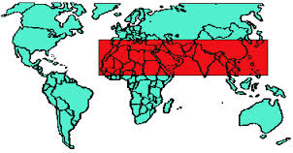
Did You Know…
Over 2/3 of the people in our world have never heard about Jesus?

Slide 7
Passion: The Fuel
“Go…make disciples…to the ends of the earth…” (Matthew 28:20, Acts 1:8)
His passionate, redemptive love in and through us is the basis for missional multiplication.
When we are fueled with love from God’s heart, we become His redemptive hands, feet and voice in our world.
How’s your “fuel gauge” when it comes to a heart for lost people?

Slide 8
Maximum Missions
III. Playing our part as Jesus’
Missionaries “…you shall be My witnesses…” We all contribute to Jesus’ Great Commission…
Who are you praying for? “Before you speak to people about God, talk to God about people.”
Who’s your “mission field”? Who has God sent you to?
How are you using your gifts, skills and experience for Jesus?
How are you serving others in love?
Who are you listening to and sharing with?
How are you supporting God’s work around the world?

Slide 9
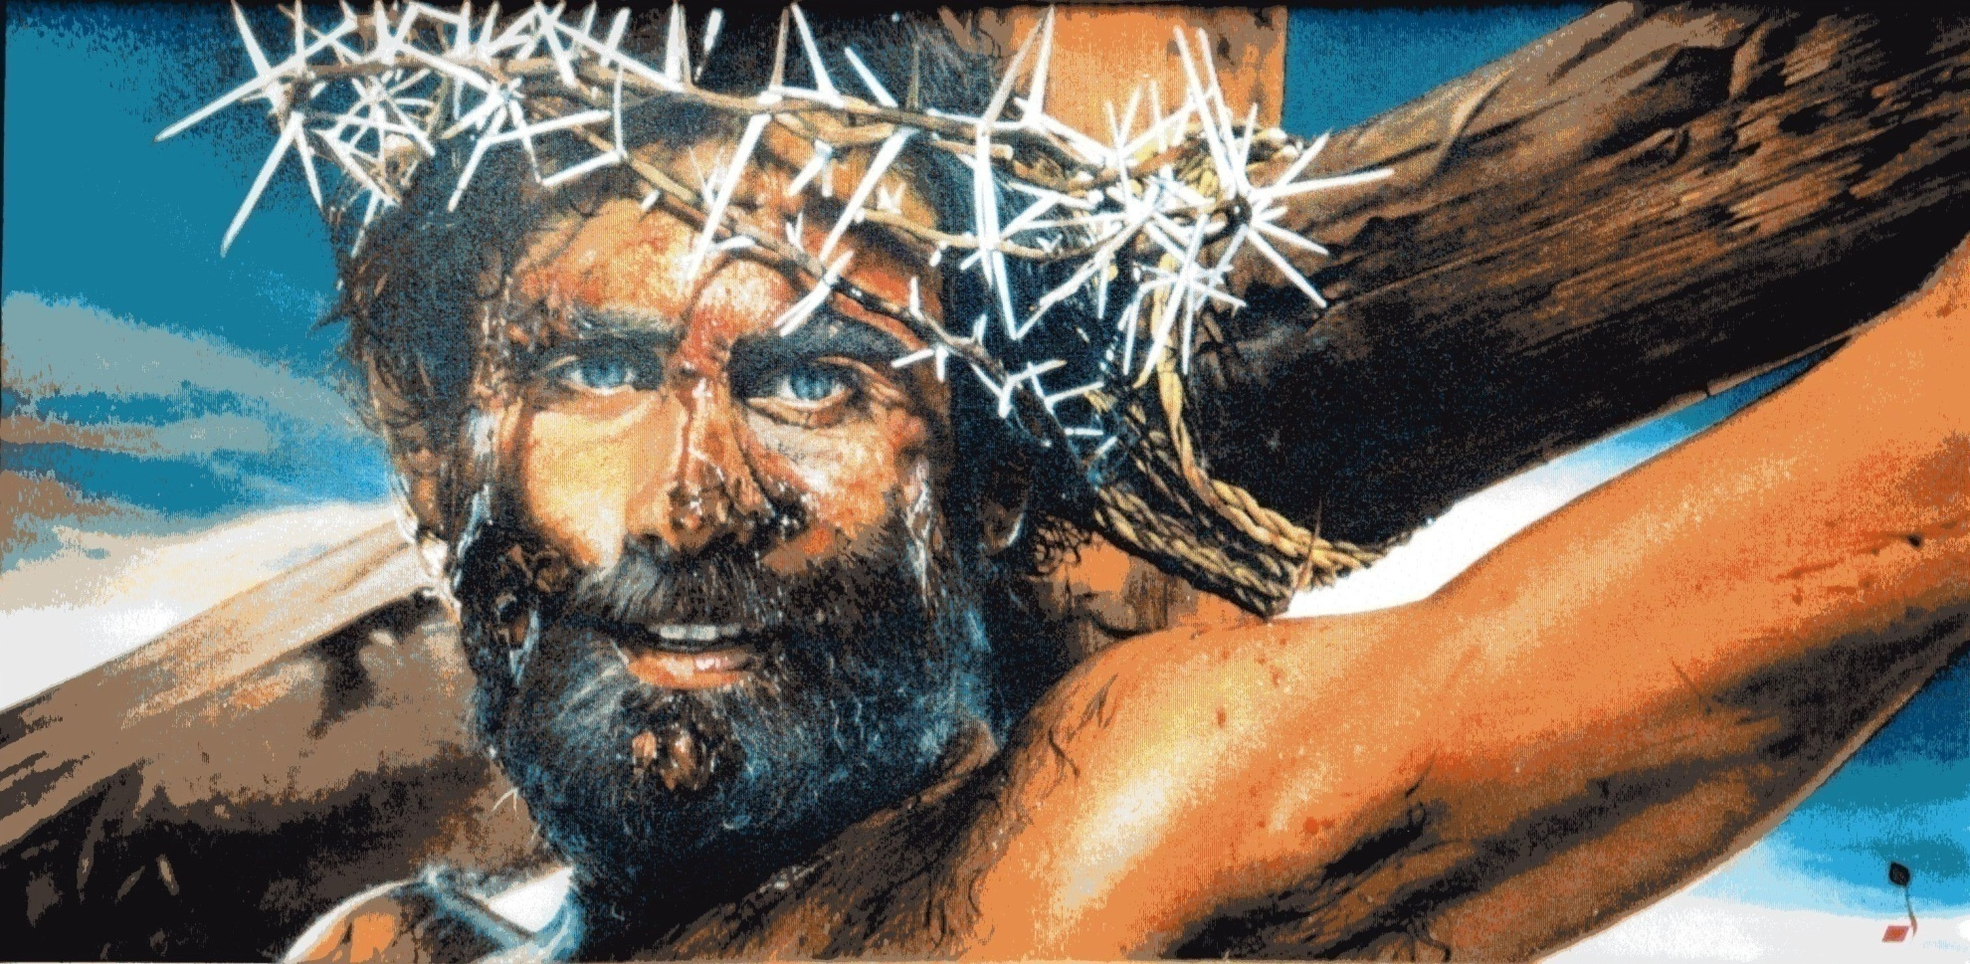
Because It’s All About…
Joining Jesus on His Mission!
“The Son of Man has come to seek and save the lost…and give them life more abundantly.” (Luke 19:10, John 10:10)

