Slide 1
Missional
Multiplication
Perspective: Focusing Multiplication
Dr. Tim Roehl

Slide 2
Perspective: Focusing
1. Geographically (v.1ff)
“From one man He made every nation of men, that they should inhabit the whole earth; and He determined the times set for them and the exact places where they should live. God did this so that men would seek Him and perhaps reach out for Him and find Him, though He is not far from each one of us…” (Acts 17:26-27)
2. Culturally (v. 1)

Slide 3
How many of you have ever been on a mission field?

Slide 4


Slide 5
Time for a Pop Quiz
Where is the world’s largest Christian church?
What is the dominant religion there?
Where is the 2nd largest church in the world?
What is the dominant religion there?
Where is the world’s largest Buddhist temple?
Where is the largest Muslim training center?
Where is the largest Hindu training center?
Where is the largest Transcendental Meditation training center?
What is the dominant religion in the above 4?

Slide 6
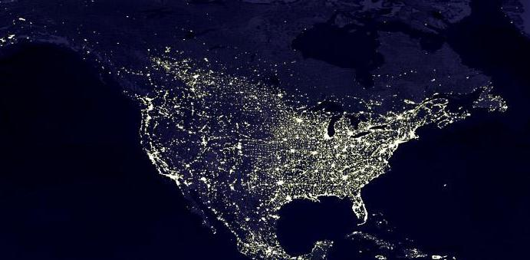
A View From Above…

Slide 7
Every 24 Hours…

Slide 8

In the Next 24 Hours...
11,350 babies will be born, 6,663 people will die
6,110 marriages and 3,110 divorces
3,542 abortions and 4,016 illegitimate births
87 suicides, 36 AIDS deaths and 119 alcohol deaths
12,267 kids under 13 will take their first drink
2,948 kids under 13 will have sex for the first time
1,312 drop-outs and 6,000 teens will start smoking
38,186 arrests, 4,785 of them drug related
5,587 bankruptcies, 73,248 will go on food stamps

Slide 9
In the Next 24 Hours...
68,493 people will seek treatment for depression
414 will convert to Islam
406 will convert to Buddhism
115 will become Wiccans
1,787 will become Mormons
16 churches will close their doors permanently
Thousands will die without knowing the love of Christ
In a mission field called...

Slide 10

North
America

Slide 11
What is 50,000 miles long and getting one half mile longer everyday?

Slide 12

The line of Americans currently untouched by your church and mine.

Slide 13
Top Ten Facts
You Need To Know About “Mission Field North America”

Slide 14
Fact #1
North America is the only continent where Christianity is not growing.

Slide 15
The decline in Christianity has been going on for nearly fifty years…there are now over 280 million unchurched people in our country.
Fact #2

Slide 16
The “80/80” Reality...
80% of Americans are unchurched …80% of churches are plateaued or in decline…80% of unchurched are open…80% of Christians never invite someone to church!
Fact #3

Slide 17
Over half of all churches in America did not add one new member through conversion last year.
Fact #4

Slide 18
8,000 churches (10 per day) are closing their doors every year … and we are starting only about 3,500 per year…even though new churches are 11 times more effective at reaching people for Christ than existing churches!
Fact #5

Slide 19
Fact #6
In the past 15 years churches in the USA have spent 500 billion dollars on buildings and programs…with no appreciable growth.

Slide 20
North America is the largest English speaking mission field in the world.
Fact #7

Slide 21
Conversions to other religions and dropouts from Christianity are escalating.
Fact #8

Slide 22
Far too many churched people believe and behave identically to their unchurched counterparts.
Fact #9

Slide 23
No matter how you do the math, current conversion rates still point to one horrible conclusion: lost people lose.
Fact #10

Slide 24
Listen to Things on Street Level…
What did you see?
What did you hear?
What did you feel?
How do you see things where you live?
What should be our response?

Slide 25

Why is it hard to see people as lost...
when they look just like you?

Slide 26
Turn to Your Neighbor
Why do you think most people do not look to the church for their life’s orientation?

Slide 27
Multitudes Hang in the Balance…
What will our response be to this vast mission field at our door?
“Numbers” must become names and needs!

Slide 28
But…There is Hope!
”Surprising Insights from Unchurched People”
(from “The Unchurched Next Door” by Thom Rainer)
1. Most unchurched people prefer to attend church on Sunday morning if they attend.
2. Most unchurched people feel guilty about not attending church.
3. 85% of unchurched people are at least ‘somewhat likely’ to attend church if they are invited. Yet…only 21% of active church attenders invite anyone to church in a given year… and only 2% of Christians invite an unchurched person!
4. Very few unchurched people have had someone share with them how to become a Christian…and Christians have not been real influential in their lives.
5. Most unchurched people have positive views of pastors and the church.
6. Unchurched people would like to develop a real and sincere relationship
with a Christian.

Slide 29
What the Lost are Looking For…
10. I don’t care how much you know until I know how
much you care.
9. Have compassion on me. Don’t condemn me because
my life’s a mess.
8. Ask “permission” to tell me about God, don’t just
push Him on me. Talk with me, not at me. Listen to
me. Find out about my world before you expect me
to be interested in yours.
7. Use words I can understand.
6. Have a sense of humor! I want Christianity that can
be enjoyed, not endured.

Slide 30
What the Lost are Looking For…
5. Don’t focus on your church. Labels don’t mean
much to me. I’m looking for people who live like
they really love God. Chances are I’ve been burnt
or bored in church situations in the past.
4. Don’t just tell me about your faith, show me your
faith by serving others in love.
3. Take your time. Don’t tell me everything at once.
Give me time to let God work in my life.
2. Tell me how God can make a difference in my daily
life, not just at church on Sunday. If I’m going to
be a Christian, I want it to work in real life.
1. Make Jesus real to me. Show me simply how to
know Him from His Word, and chances are I’ll want
to know Him, too. After all, I really do want to go
to Heaven.

Slide 31
Become a Missionary…Right Here!
Burn with a holy passion for God…
Yearn for the lost…and pray!
Learn all you can by redemptive listening
Discern spiritual issues and needs…
Meet needs in love…
Share your story…and God’s story…
Help start new ministries and churches…
Expect God to work through you!

Slide 32
Perspective: Focusing
3. Generationally (v. 1-3)
4. Organizationally (v. 4)
5. Numerically (v. 5)
6. Situationally/Strategically (v. 6-8)

Slide 33
Perspective: Focusing
7. Spiritually (v. 6-10)
Key questions:
  What is the Spirit saying?
  What are we “seeing?”
  What are we discerning from others?
  Where are the doors open?
  Will we obey now? (v. 10) “immediately”
Pay attention to your situation…
Pay attention to the Spirit…
Others are counting on us!

Slide 34
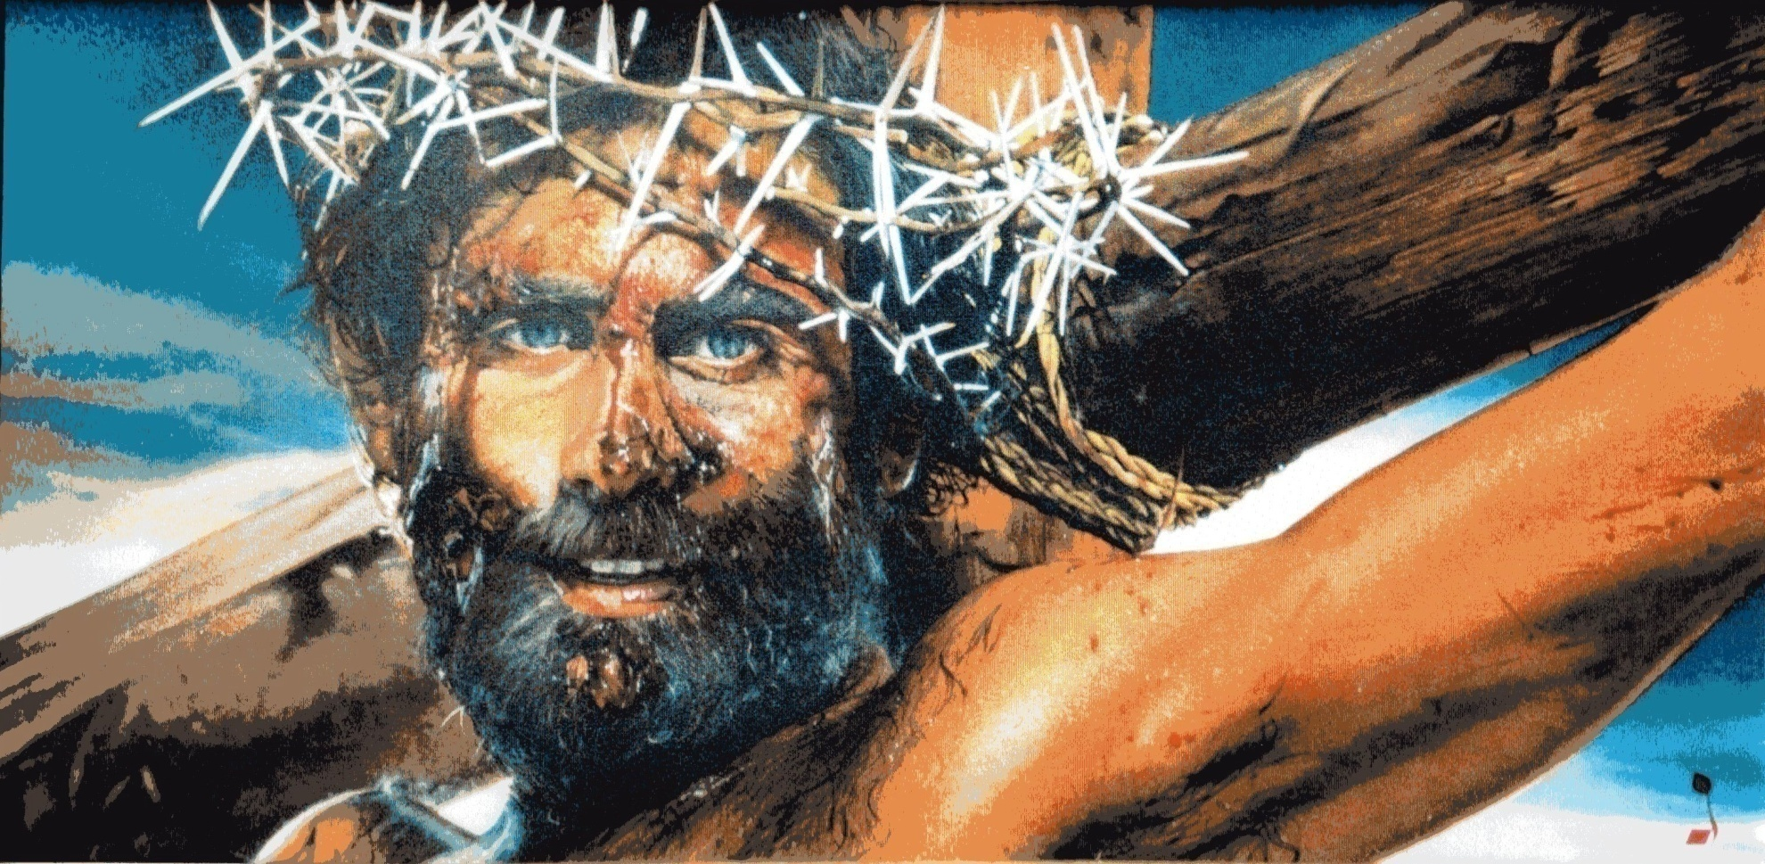
Because It’s All About…
Joining Jesus on His Mission!
“The Son of Man has come to seek and save the lost…and give them life more abundantly.” (Luke 19:10, John 10:10)

