Slide 1
AZFA National Conference 2010
If I were a Green Exhibit:
Conceptualizing What Green Really Means to Exhibit Design
Mariusz Bleszynski, AIA, LEED AP
Stacey Tarpley, Zoological Designer
October 4, 2010

Slide 2

Once upon a time in Never Never Land…
Exhibits are all self-sustaining & zero-energy
Buildings and equipment disappear into the natural landscape, made of recycled & recyclable content
Zoos have zero carbon footprints (and actually produce energy for the world!)
LEED Certification
Conservation Leadership

Slide 3
What can we do?
…how much does it cost? and what’s my ROI? and what does it look like? and how does it affect the guests? and how does it affect the staff? and what about the animals…?

Slide 4
Maximize Recycled Content
  Reuse existing structures and plant content
  Divert construction waste from landfill
  New materials selected based on ease or recycling and local sourcing
What does it cost?
  Added effort during design & construction
Will I see a return on investment?
  Limited financial return
  LEED Credits
  Public Awareness

Slide 5
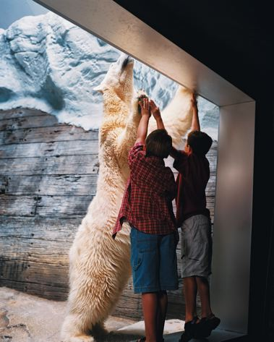
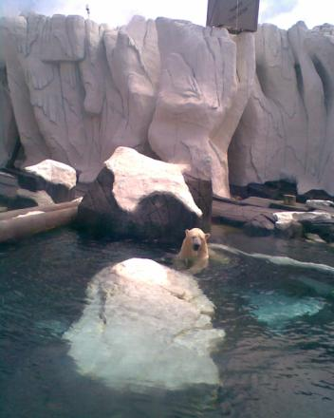

Sea World San Diego
We LOVE fake rock!

Slide 6
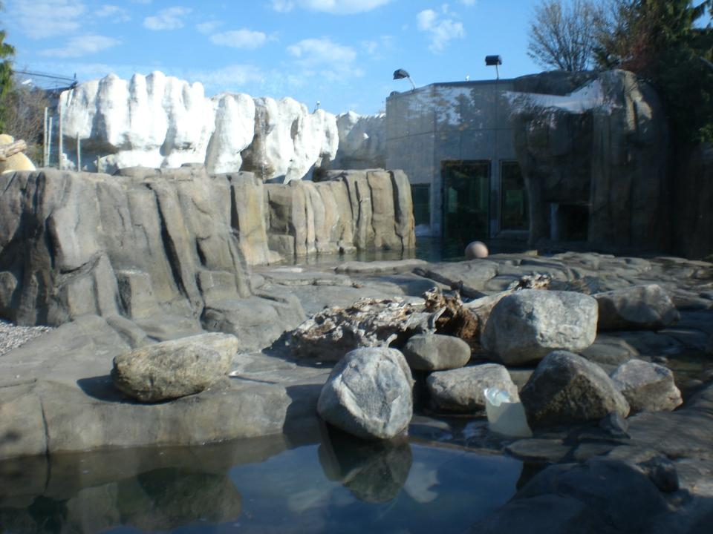
Will the polar bears be fooled by concrete ice?
Toledo Zoo

Slide 7
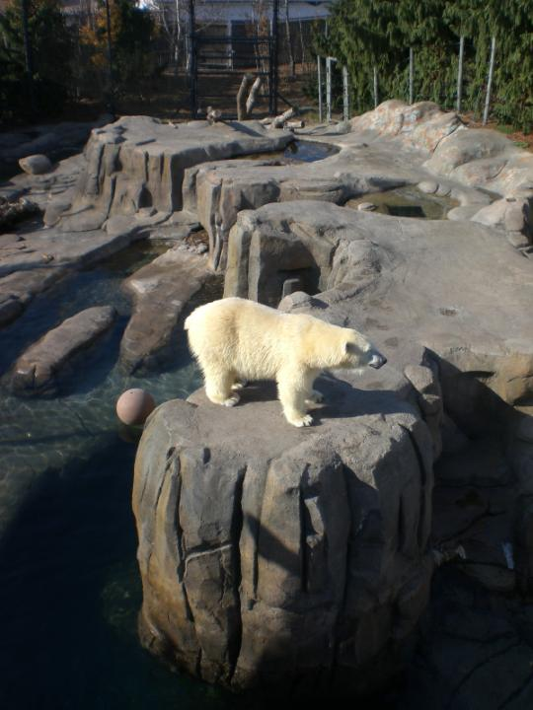
Toledo Zoo
Do they appreciate the concrete jungle concept?

Slide 8
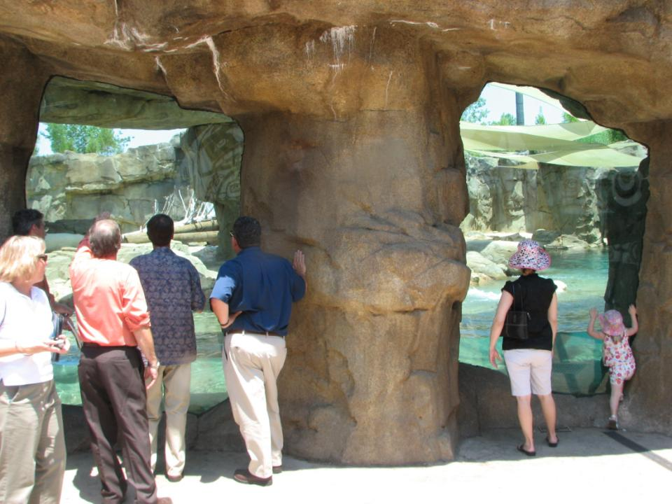
Memphis Zoo

Slide 9
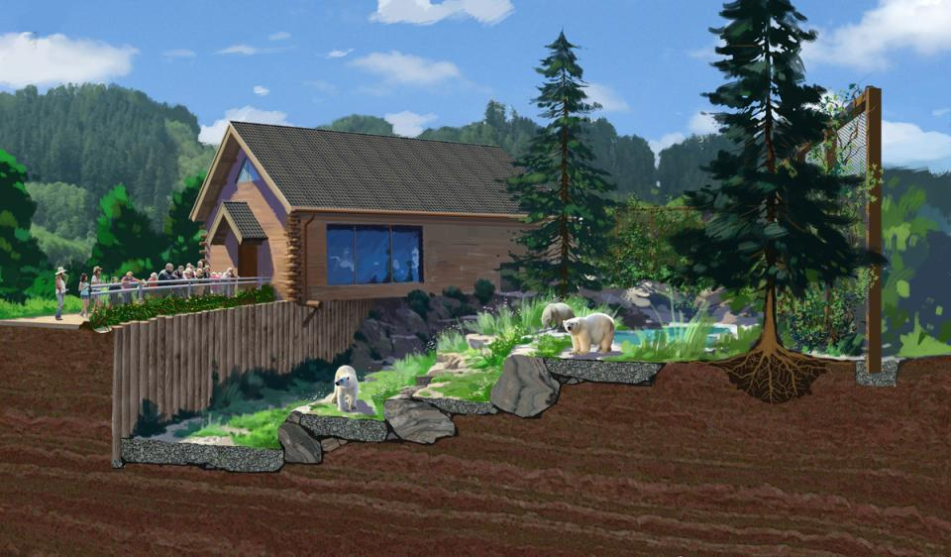
What if we loved rock a little less?

Slide 10
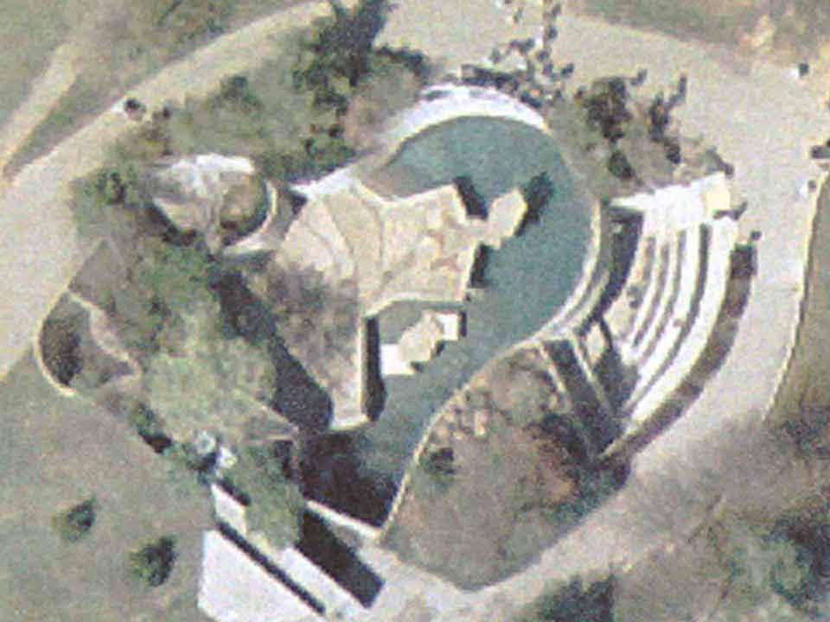
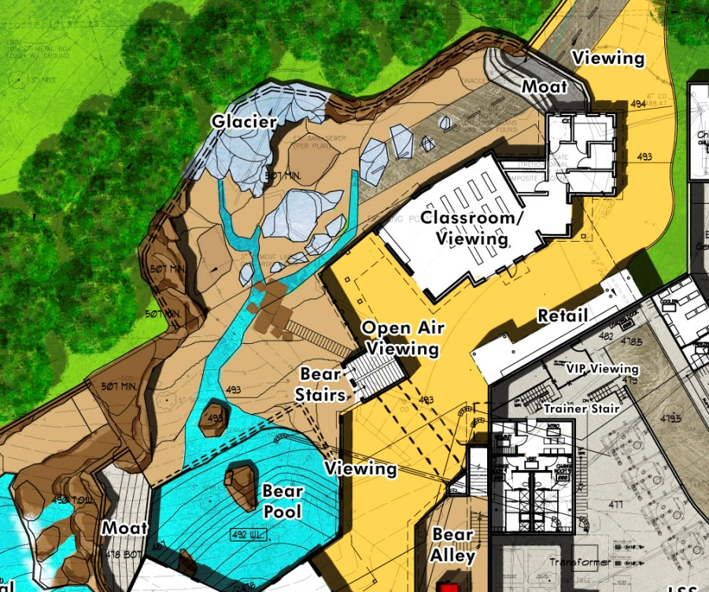
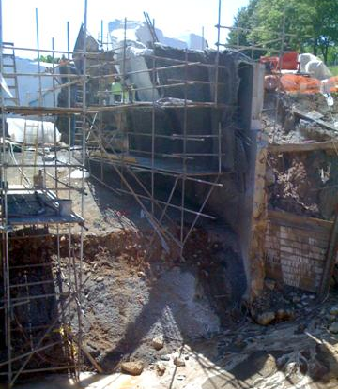
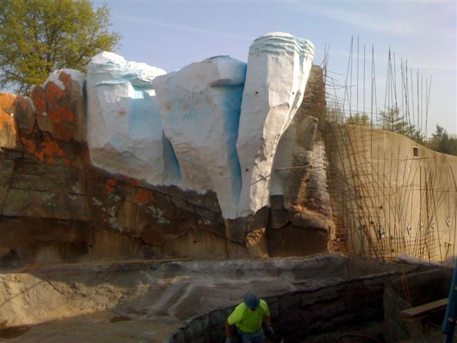
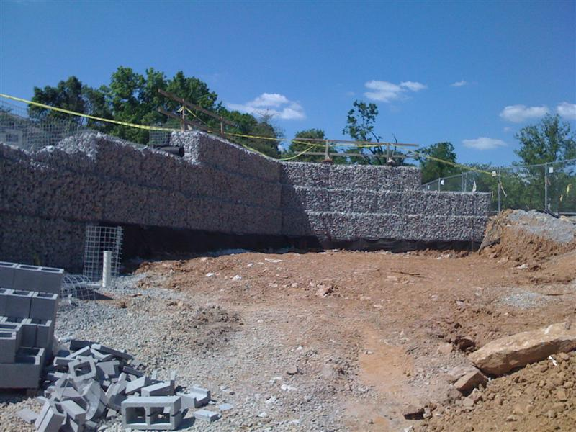
Maximize Recycled Content
Louisville Zoo

Slide 11
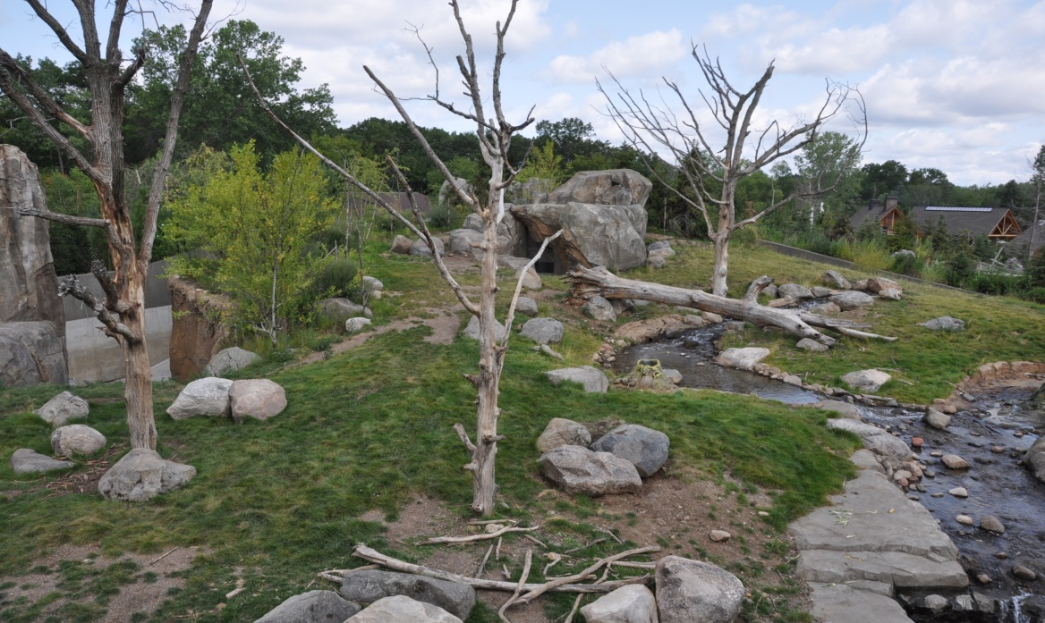
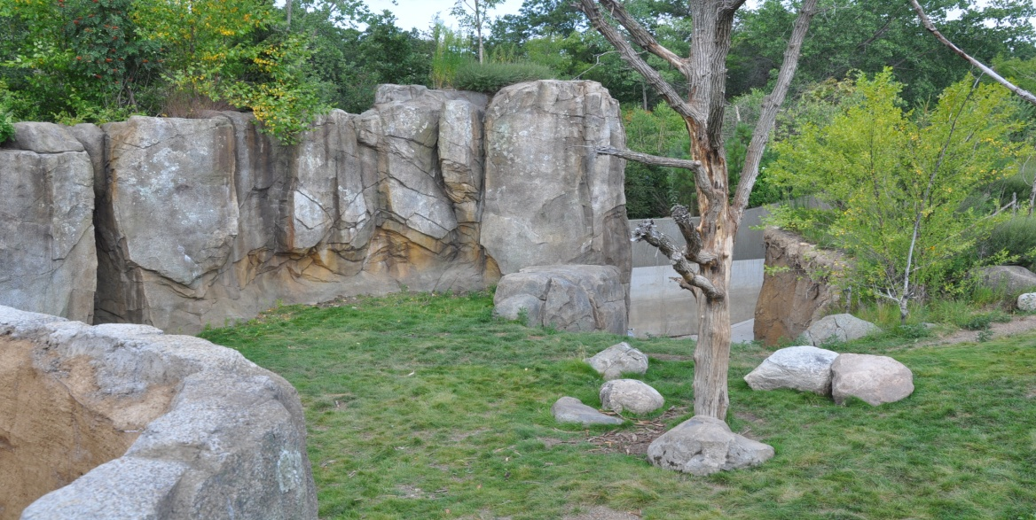
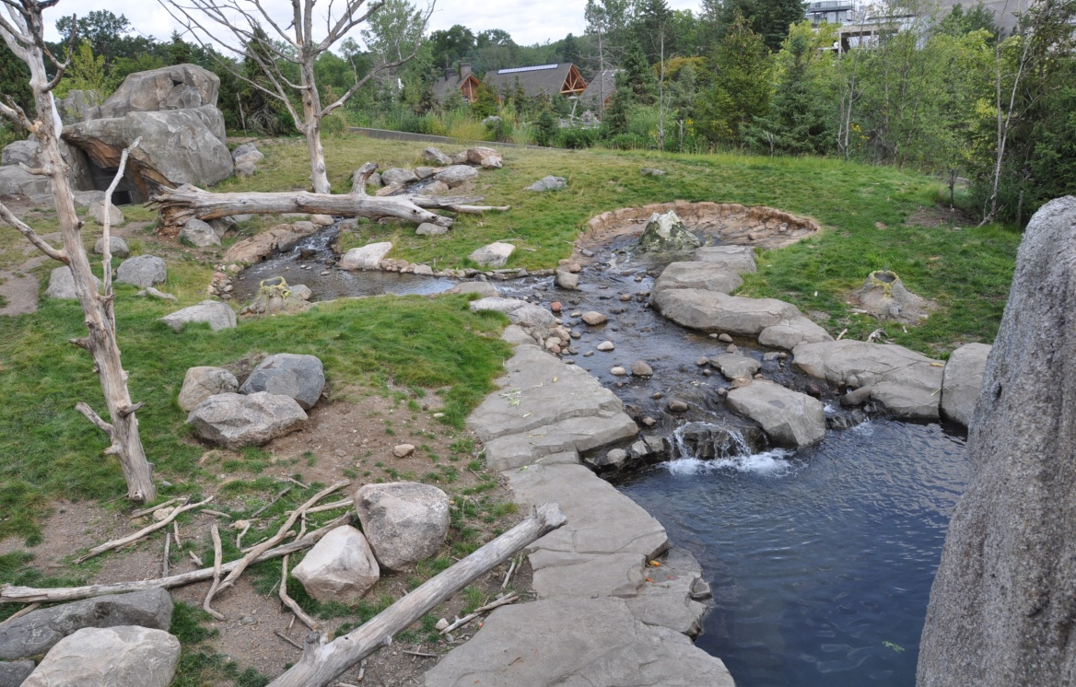
What if we loved rock a little less?
Maximize natural substrates
  Richer habitat
  Runoff to aquifer
  Simpler maintenance
  Improve guest perception
Minnesota Zoo

Slide 12
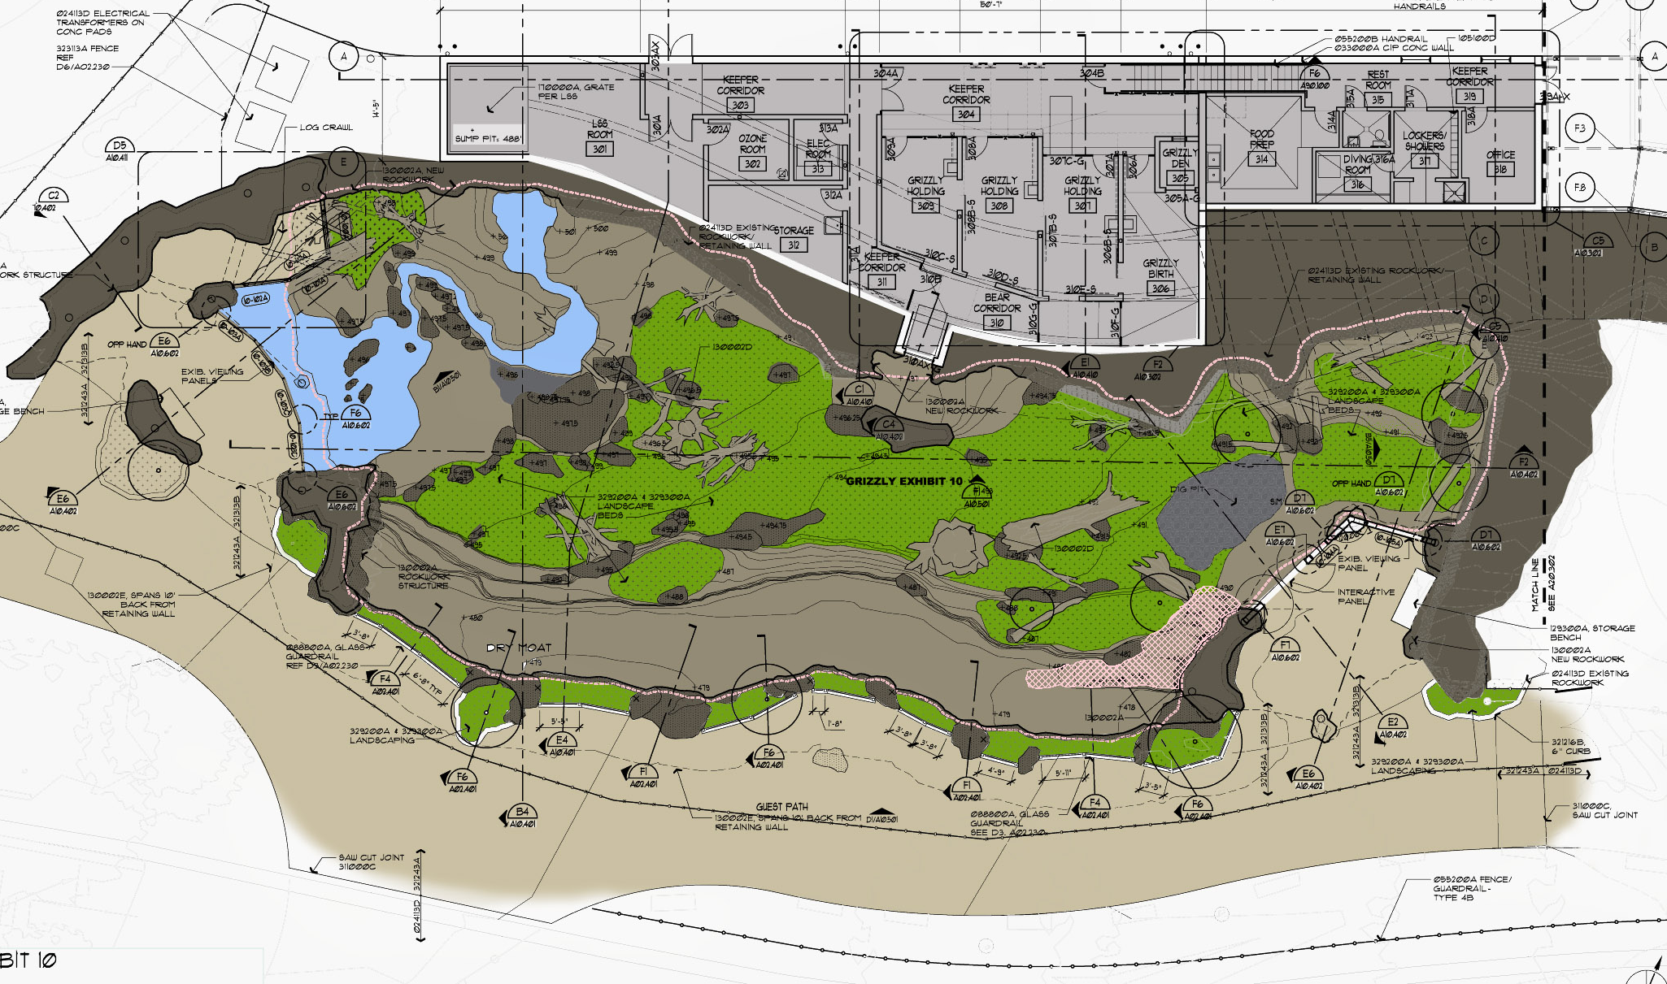
What if we loved rock a little less?
EXHIBIT FLOOR 85% PLANTED
MOAT AS RUNOFF COLLECTOR
St. Louis Zoo
ROCKWORK POCKETS PROTECT ING PLANTS

Slide 13
What if we loved rock a little less?
CONTAINMENT MOATS AS GREEN SWALES:
remove silt and pollution from surface runoff water
St. Louis Zoo

Slide 14
What if we loved rock a little less?
TOPSOIL / PLANTING MEDIA & PLANT COMPOSITION
FILTERING / WATER RETENTION MEDIA – SAND & GRAVEL
DIGGING BARRIER – 6” – 8” STONE
PERMEABLE GEOTEXTILE
ROCKWORK EDGE
Replace rockwork exhibit floors with permeable soil beds
St. Louis Zoo

Slide 15
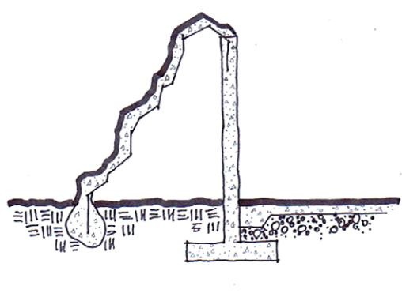
Other savings on concrete?
FREE STANDING
SHOTCRETE WALL
CIP CONCRETE SUPPORT WALL
VOID
Frequently rockwork shotcrete walls are supported by CIP concrete

Slide 16
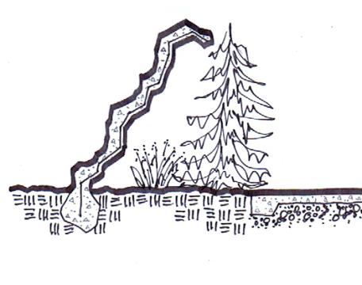
Other savings on concrete?
FREE STANDING
SHOTCRETE WALL SUPPORTED BY BUTRESSES
UTILIZE SPACE
Well engineered shotcrete will support itself!

Slide 17
Other savings on concrete?
SHOTCRETE FREE-FORMED SINGLE SHELL
EARTH FORMED FOOTING
Kansas City Zoo

Slide 18
Other savings on concrete?
SHOTCRETE RETAINING WALL STRUCTURE AND CARVED LAYER AS ONE SYSTEM
SOIL ANCHORS DRILLED IN TO REDUCE EXCAVATION
St. Louis Zoo

Slide 19
Use Less Concrete
  Cover less ground with it
  Design leaner structure
  Reuse existing if possible

Slide 20
Use Geothermal Heating / Cooling
  Use earth thermal mass to deposit or extract heat for buildings through heat pumps
  Has to be thermally balanced!
What does it cost?
  Geothermal pump $2,500 per ton
  Drilling & installing wells $10,000 to $30,000 each
Will I see a return on investment?
  5 to 10 years
  LEED credit

Slide 21
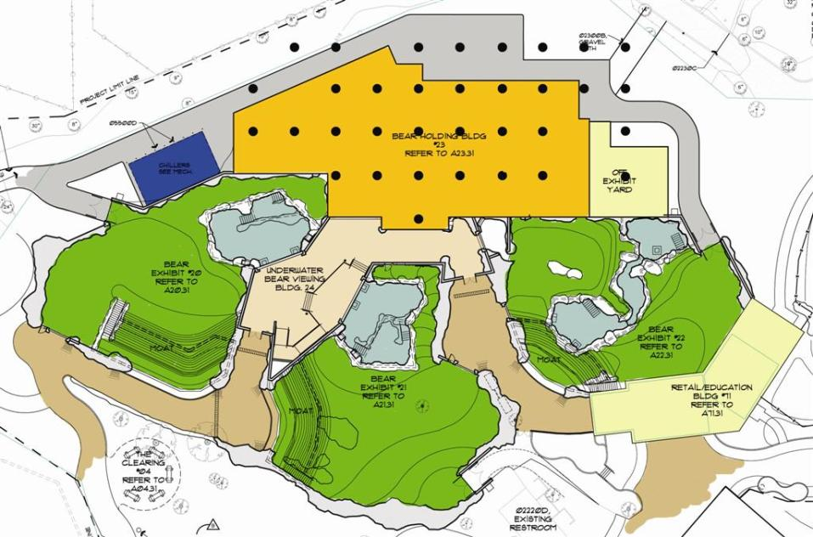
With Geothermal
12,000 sf. holding building
35 wells

Slide 22
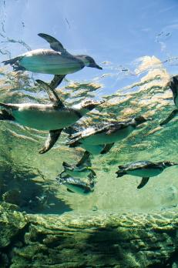
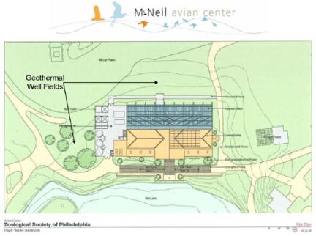
Geothermal Examples
Toledo Zoo: 32 wells to heat aquarium water
Philadelphia Zoo: 52 wells to heat new bird exhibit
Toronto Zoo: Heating and cooling year round for Macaques
Woodland Park Zoo: Heating and cooling Humboldt penguins pool
Henry Vilas Zoo: Heating and cooling Children’s Zoo Barn

Slide 23
Use Solar Panels
  System converts solar radiation into direct current electricity
  Frequently combined with energy storage
  Solar panels integrated with building envelope
What does it cost?
  Installed cost of complete system $8,000-$12,000 per kW
Will I see a return on investment?
  12 to 15 year
  LEED credit
How long do they last?
  20 to 40 years
  Typical warranty: 25 years

Slide 24
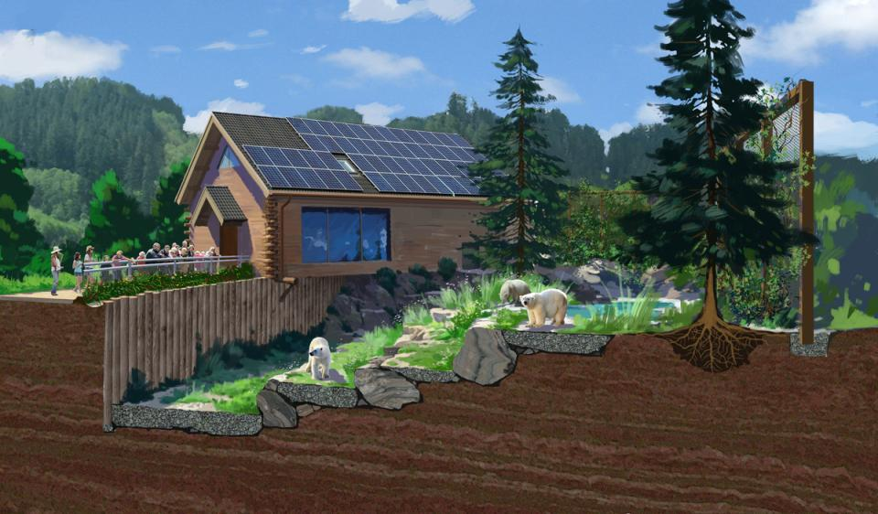
Use Solar Panels
SOLAR PV PANELS ON INVISIBLE SIDE TO REDUCE GLARE

Slide 25
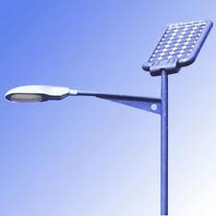
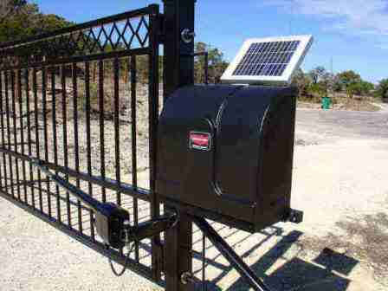
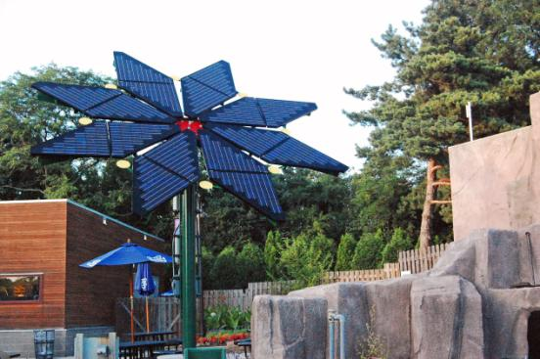
Use Solar Panels
Non-exhibit uses and remote locations
  gates
  lighting
  signage

Slide 26
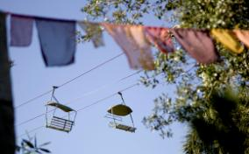
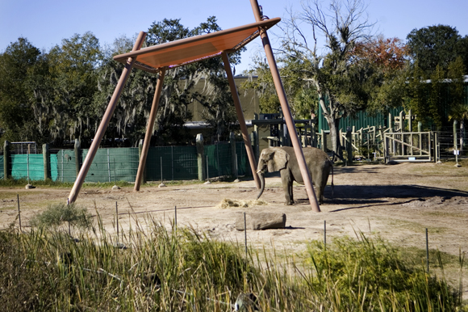
Use Solar Panels
SOLAR PV PANELS ON SHADE STRUCTURE
Lowry Park Zoo

Slide 27
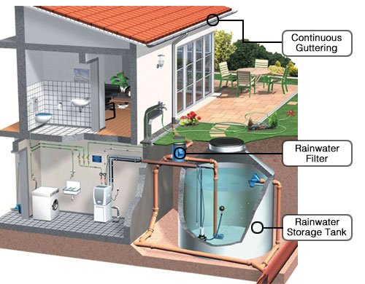
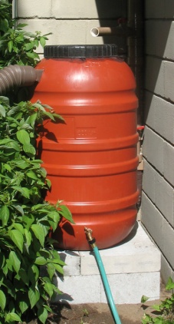
Use Water Recycling
  Harvesting water from roof runoff or from non-contaminated building uses and using it for irrigation, washdown or toilet flushing
  Greywater purification by large particle filter, bioculture filter and UV
What does it cost?
  Low end: rain bins $300 each
  Higher end: greywater system for home $1,000 - $2,500, small commercial system $10,000
Will I see a return on investment?
  13 years due to high maintenance cost
  Benefits municipal systems
  LEED Credits

Slide 28
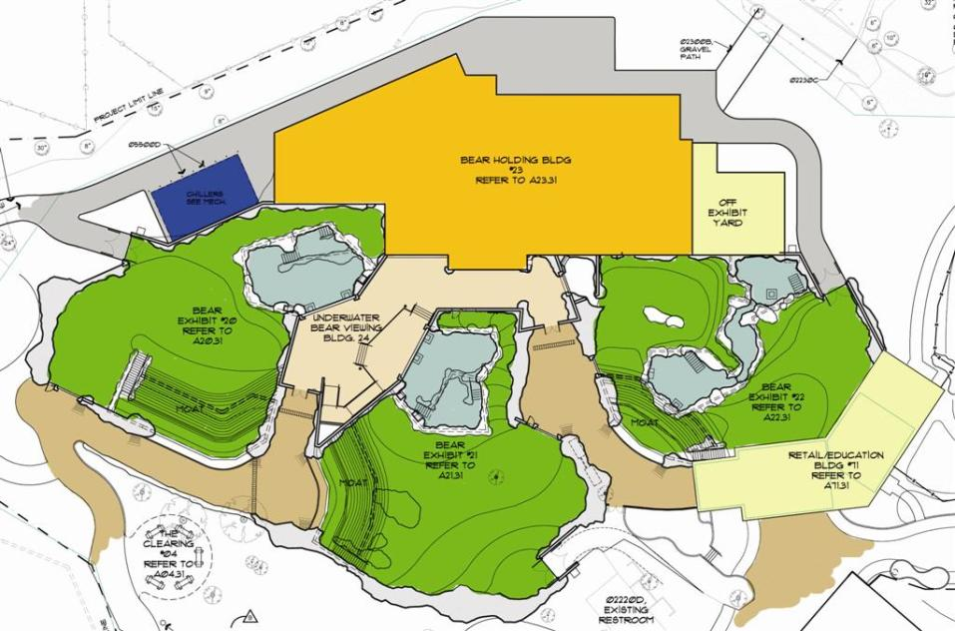
Use Water Recycling
WATER STORAGE CISTERN, FILTERS AND UV DISINFECTANT IN BASEMENT

Slide 29
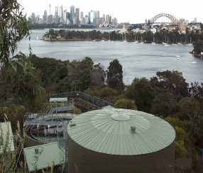
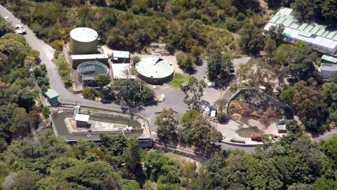
Use Water Recycling
Australia’s Taronga Zoo
  Instated nearly 15 years ago
  Storm runoff, animal wash down, and moat flushing zoo-wide
  Reuse for irrigation, animal wash down, moat refill, and toilets throughout zoo
  Save $66,000 (US) annually

Slide 30
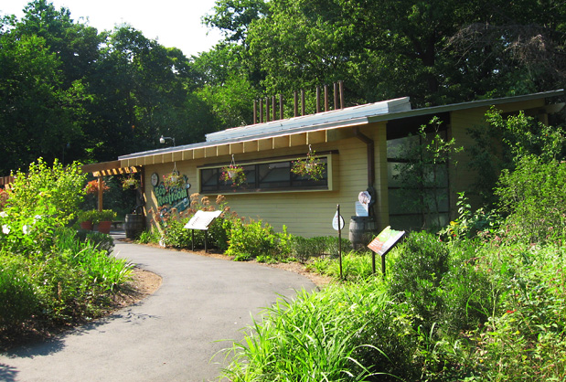
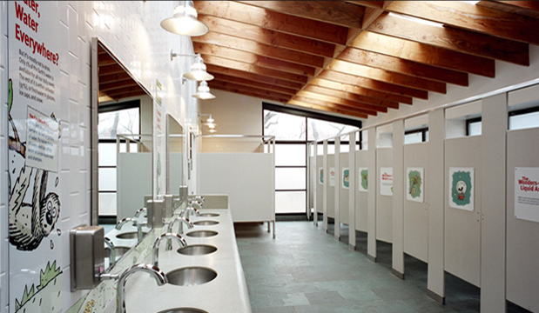
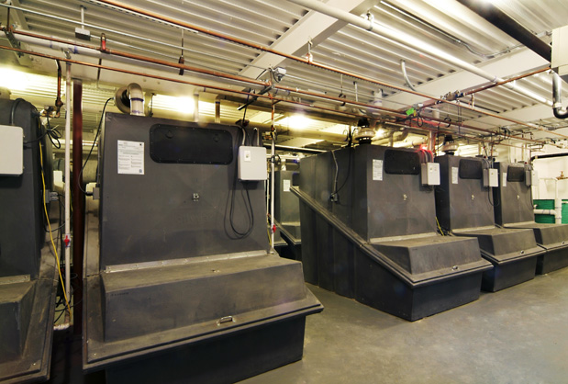
Use Composting Toilets
  Toilets which use little or no water and treat toilet wastes on-site for reuse as valuable compost
What does it cost?
  $6,000 per unit designed for public facility + building cost
  Rebates for sewage charges
Will I see a return on investment?
  Reduces water and sewage municipal charges, plant nutrients
  Benefits municipal systems
  Education
Bronx Zoo

Slide 31
Use Native Plants
  Select native plants close in appearance to exhibit theme
  Reduce or eliminate irrigation & fertilization
  Better survival rate
What does it cost?
  No added cost
Will I see a return on investment?
  Delete irrigation: $4 per sf of site
  Reduce water bill: 3 - 18 gal/sf/season (depends on hydrozone)
  No replanting
  LEED Credit

Slide 32
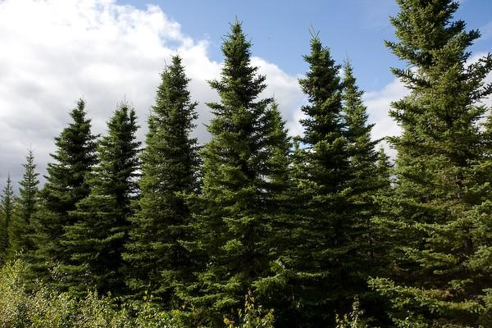
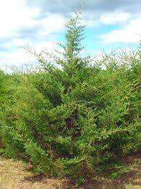
Create the Arctic with St. Louis Natives???
Black Spruce Picea mariana
No Pines native to Missouri
Eastern Red Cedar
Juniperus virginiana

Slide 33
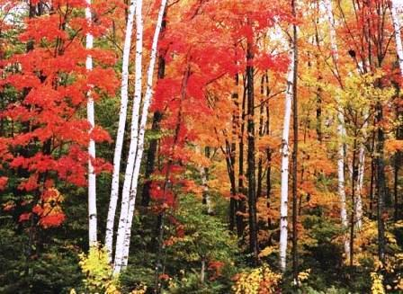
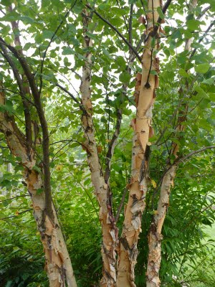
Paper Birch Betula papyrifer
River Birch Betula nigra

Slide 34
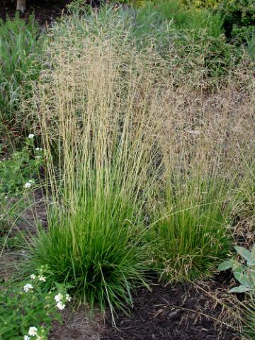
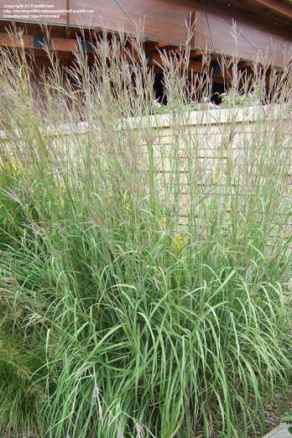
Tufted Hair Grass Deschampsia caespitosa
Big Bluestem Andropogon gerardi

Slide 35
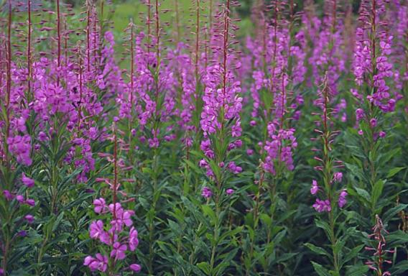
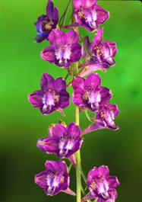

Fireweed
Epilobium angustifolium
Tall Larkspur
Delphinium exaltatum

Slide 36
Using native plants on exhibit
PLANT SELECTION NATIVE / NON NATIVE
St. Louis Zoo

Slide 37
Use Water Based Chillers
  Based on more efficient evaporative cooling
  Equipment indoors – will last longer
  Easier to renovate and expand
  It is Quiet! – air based chillers generate 65 -100 dB
What does it cost?
  25% higher equipment cost
  Add cost of building
  Overall cost increase +/- 50%
Will I see a return on investment?
  40% utility cost
  7.1 years

Slide 38
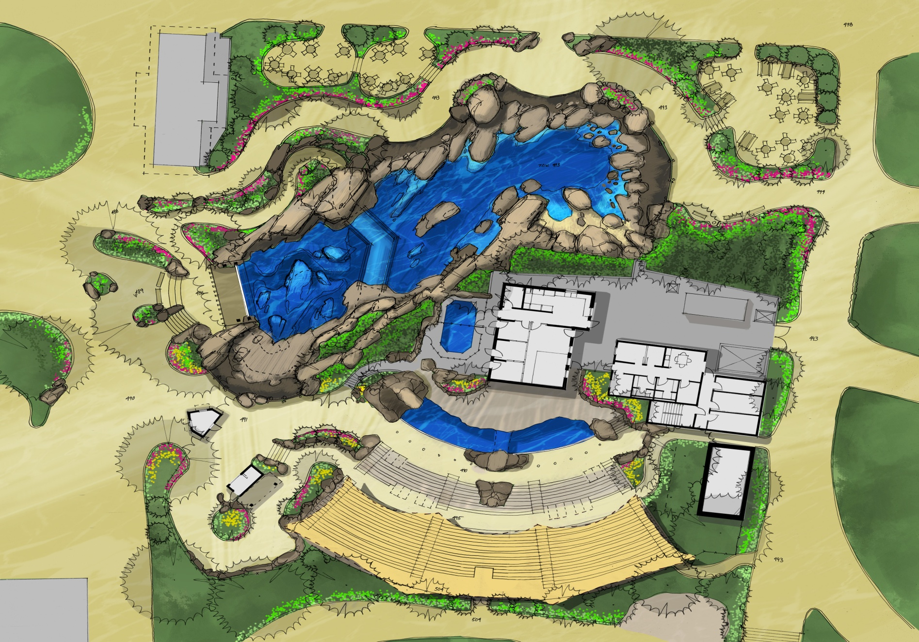
Use Water Based Chillers
COOLING TOWER - IN THE MIDDLE OF EXHIBIT
St. Louis Zoo
10/4/2010
38

Slide 39
Other things to remember…
PLAN EARLY
If you want LEED, you need sustainable design charrette
  If you don’t follow LEED, STILL do charrette to identify sustainable options
  Request value engineering early in design
Buy Energy Star equipment
Select competent builder
Educate your staff about performance
System commissioning
Select efficient lighting and use sensors

