Slide 1

Why do so many researchers misreport p-values?
Jelte M. Wicherts

Slide 2
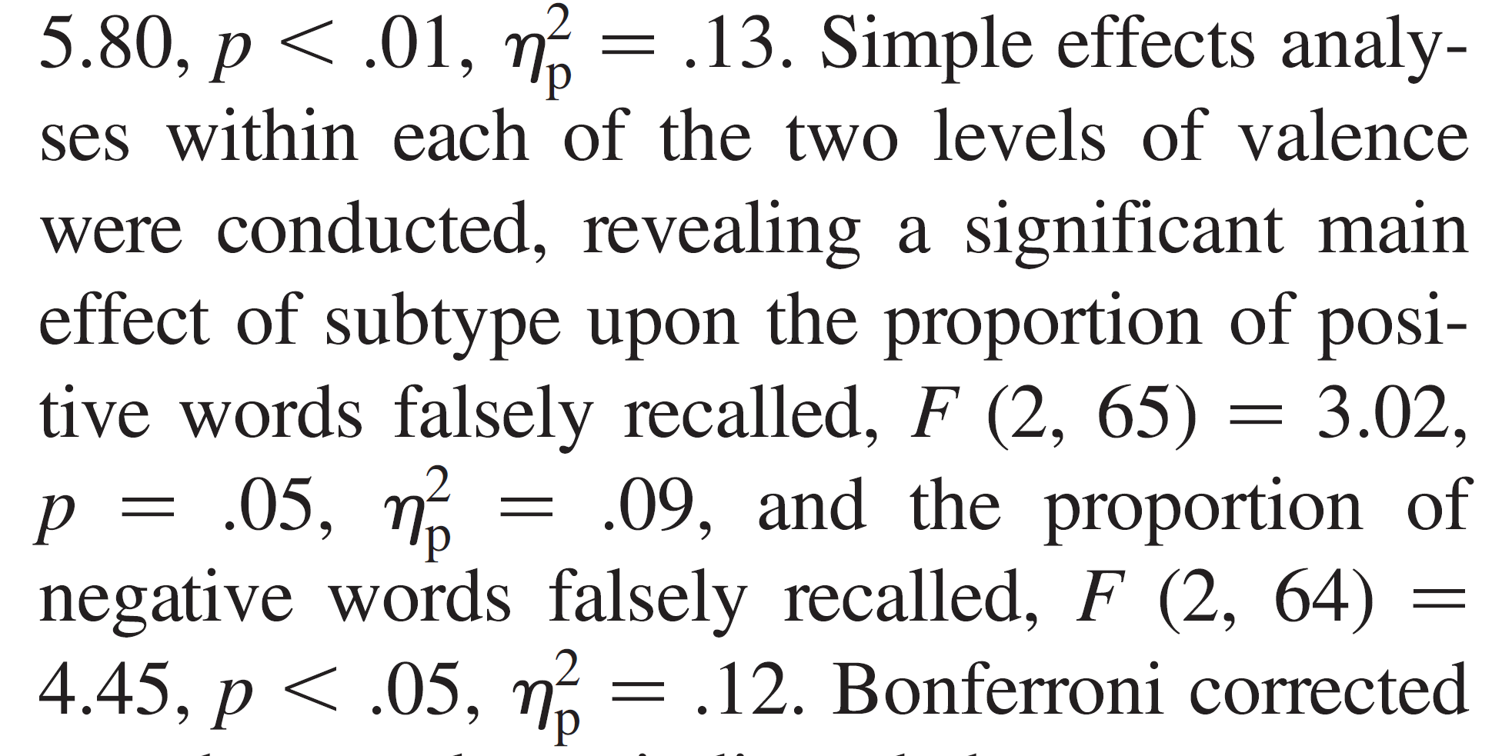
Misreporting of statistical results in psychology
p = .06
Source: Bakker, M. & Wicherts, J. M. (2011). The (mis)reporting of statistical results in psychology journals.
Behavior Research Methods, 43, 666-678.
Notes:
Of 142 high-impact papers, 53.5 % contained errors. 17.6% contained gross errors.
38% Nature
25% BMJ
36% Psychiatry journals
REPLICATION ALERT

Slide 3
Reporting errors are related to failure to share data
DATA NOT SHARED (N=28)
DATA SHARED (N=21)
Source: Wicherts, J. M., Bakker, M., & Molenaar, D. (2011). Willingness to share research data is related to the strength
of the evidence and the quality of reporting of statistical results. PLoS ONE, 6, e 26828.
Notes:
REPLICATION ALERT

Slide 4
Misreported results are common
Source: Nuijten, M. B., Hartgerink, C.H.J., Van Assen, M. A. L. M., Epskamp, S., & Wicherts, J. M. (2016). The Prevalence of Statistical Reporting Errors in Psychology (1985-2013). Behavior Research Methods

Slide 5
Misreported results have been around for decades
Source: Nuijten, M. B., Hartgerink, C.H.J., Van Assen, M. A. L. M., Epskamp, S., & Wicherts, J. M. (2016). The Prevalence of Statistical Reporting Errors in Psychology (1985-2013). Behavior Research Methods

Slide 6
Misreported results indicate other p-hacking tricks
Questionable Research Practice | Prev.
In a paper, failing to report all of a study’s dependent measures | 78%
Deciding whether to collect more data after looking to see whether the results were significant | 72%
In a paper, selectively reporting studies that “worked” | 67%
Deciding whether to exclude data after looking at the impact of doing so on the results | 62%
In a paper, reporting an unexpected finding as having been predicted from the start | 54%
In a paper, failing to report all of a study’s conditions | 42%
In a paper, “rounding off” a p value (e.g., reporting that a p value of .054 is less than .05) | 39%
Stopping collecting data earlier than planned because one found the result that one had been looking for | 36%
In a paper, claiming that results are unaffected by demographic variables (e.g., gender) when one is actually unsure (or knows that they do) | 13%
Falsifying data | 9%
Source: John, L. K., Loewenstein, G., & Prelec, D. (2012). Measuring the prevalence of questionable research practices
with incentives for truth-telling. Psychological Science.

Slide 7

P-hacking
Remove outliers (Z > |2|)
Call this a “failed study”
Perform
new study
P>.05
?
P>.05
P<.05
Add 10 cases
P<.05
P>.05
Redo analysis with adapted
dependent var.
?
P<.05
Effect!
P>.05
Planned
analysis
P<.05
Misreport the p-value as being <.05
Write
paper
Notes:
65% 2nd dependent
57% sequential testing
41% removed outliers
23% misreported p value
48% publication bias

Slide 8
But why?

Slide 9
Design
Implement multiple flexible independent variables
Measure multiple flexible dependent variables
Measure additional variables that enable data selection (e.g., background variables, awareness checks).
Use a vague and flexible theory and non-falsifiable hypotheses
Use scales that show ceiling or floor effects (creating artefactual interactions)
Run multiple small (underpowered) studies
Create confounds in the design (e.g., different questions, lack of blinding)

Slide 10
During data collection
Not using random assignment to conditions
Incomplete blinding of experimenters and/or participants (experimenter effects, disclosing hypotheses to participants, using non-naïve participants)
Discarding data depending on outcomes or observed behavior
Quitting data collection after having received a "hit" rather than a "miss"
Adding data or quitting data collection earlier based on intermediate significance testing
Filling in of missing values or decisions in coding in an unblinded manner

Slide 11
Analyses
Various ways to deal with violated assumptions of statistical tests (non-parametric analysis, transformations)
Use ad hoc scales by deleting, recoding, combining, weighing, or transforming item scores.
Choices on how to deal with missingness and outliers
Use of alternative inclusion and exclusion criteria
Choice between among multiple independent variables, conditions, and covariates
Choice between among multiple dependent variables
Choice among statistical models, estimation methods, and inference criteria (Bayes factors, Alpha, one-sided testing)

Slide 12
Reporting
Report only a subset of many analyses
Failure to report sensitivity analyses in the report
Failure to report data exclusions, missingness, transformations
Not adequately testing interactions (i.e., only comparing simple effects across conditions)
Failure to correct for multiple testing
HARKing or explorative studies presented as confirmatory
Not reporting so-called “failed studies”
Misreport p-values

Slide 13
p-value
Implement multiple flexible independent variables
Implement multiple flexible independent variables
Measure multiple flexible dependent variables
Measure additional variables that enable data selection (e.g., background variables, awareness checks).
Use a vague and flexible theory and non-falsifiable hypotheses
Use scales that show ceiling or floor effects (creating artefactual interactions)
Run multiple small (underpowered) studies
Create confounds in the design (e.g., different questions, lack of blinding)
Measure multiple flexible dependent variables
Measure additional variables that enable data selection (e.g., background variables, awareness checks).
Use a vague and flexible theory and non-falsifiable hypotheses
Use scales that show ceiling or floor effects (creating artefactual interactions)
Run multiple small (underpowered) studies
Create confounds in the design (e.g., different questions, lack of blinding)
Various ways to deal with violated assumptions
Use of alternative inclusion and exclusion criteria
Choice between among multiple independent variables, conditions, and covariates
Choice between among multiple dependent variables
Choice among statistical models, estimation methods, and inference criteria (Bayes factors, Alpha, one-sided testing)
Use ad hoc scalesChoices on how to deal with missingness and outliers
p
P-value

Slide 14
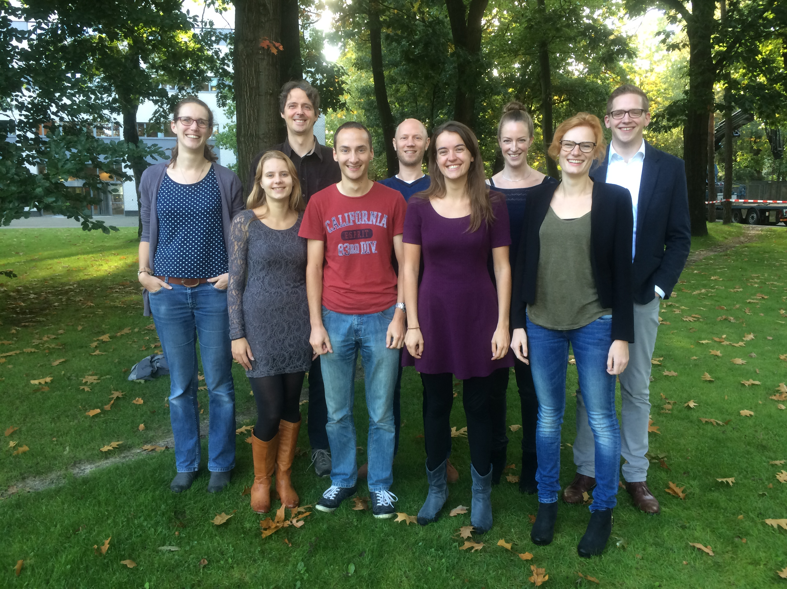


Thanks!
Marcel
van Assen
Coosje
Veldkamp
Chris
Hartgerink
Marjan
Bakker
Paulette
Flore
Robbie
van Aert
Michèle
Nuijten
Hilde
Augusteijn
+ Sacha
Epskamp
@JelteWicherts
http://metaresearch.nl
J.M.Wicherts@uvt.nl

Slide 15
Overarching
Insufficient detail in pre-registration
Combining various DFs
Pre-registering a study multiple times

Slide 16
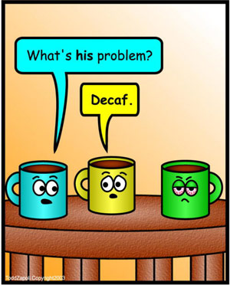

Cognitive effects of alcohol and caffeine
Or: does it help to drink coffee
on the “morning after”?

