Slide 1
Resources for Improving Comfort and Saving Energy/Money at Home
Richard Reilly, LEED AP, BPI BA & EP
Notes:
Hopefully we will all benefit from our mutual journey tonight…I am not a scientist or engineer.

Slide 2
Intro & Housekeeping
Energy Programs Manager of the Missouri Botanical Garden’s Earthways Center
LEED AP, BOC, BPI BA & EP
Advisory Board Member of The Center for Sustainability at SLU
Old Carpenter and Part of a Team!
Notes:
We’ll be learning together…I’ll be available via email any time after this class

Slide 3
Goals
You will know how to make a plan based on where you are now
You will have 3 (at least) ideas to help you make smart decisions about energy efficiency
You will gain insider info to quality resources in the EE field

Slide 4
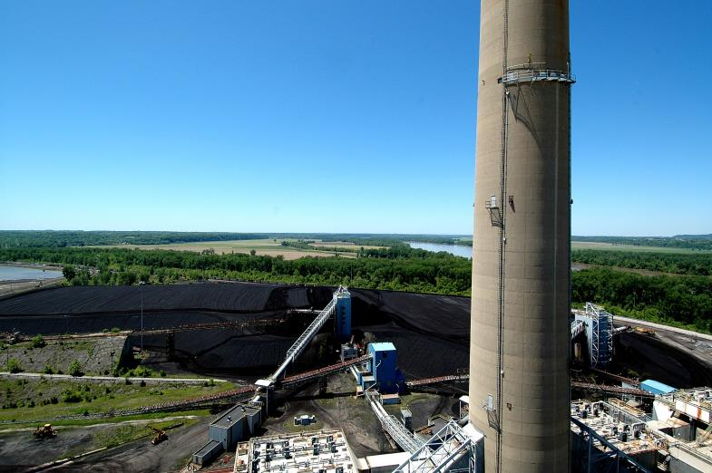
Notes:
This is a view from the roof of the Labadie coal fired power plant on the Missouri River
The black coal field is a 45 day supply for the plant – which serves a good portion of our region

Slide 5
If all our electricity came from
LABADIE

Slide 6
Notes:
Overview of energy use by sector and at home
Buildings, not transportation is the big user
Seasonal loads and base load need to be understood

Slide 7
Baseload vs. Seasonal Consumption
Notes:
Understanding the energy we consume every day and that we consume on a seasonal basis is important for planning changes
Where are we inefficient? Where are we doing best? How can we improve all?

Slide 8
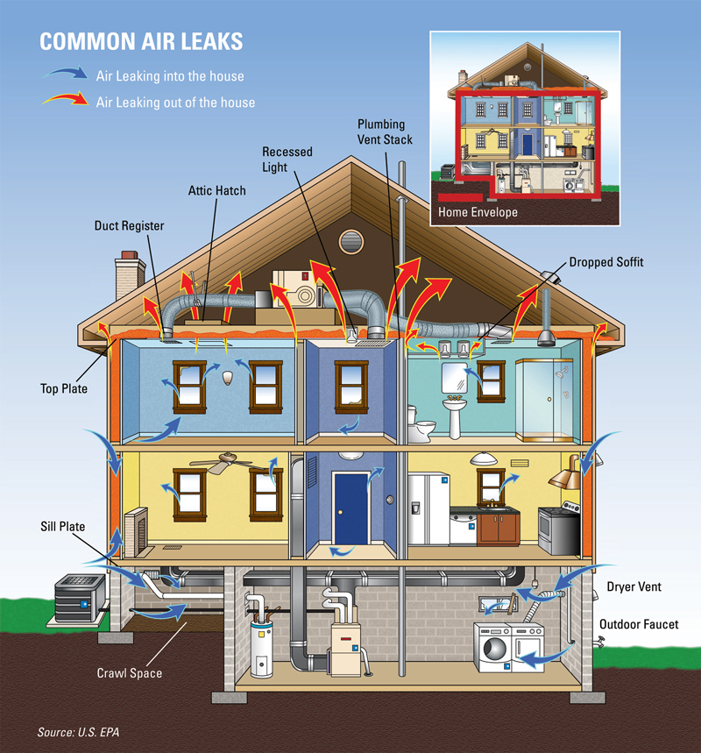

Slide 9
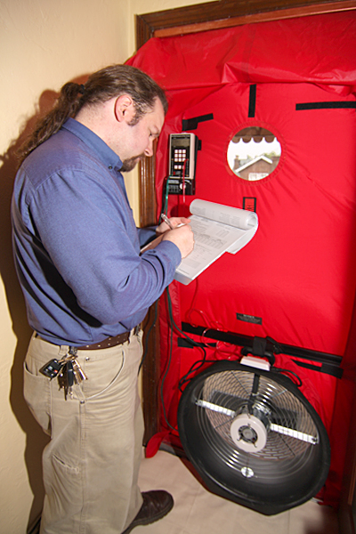
Energy Efficiency Basics
Make a plan
Embodied energy and durability
The gamut from weatherization to deep energy retrofits
Analyzing your energy consumption
Vampire electric/smart strips
Mini-meters
Home Energy Assessment/Audit
Safety 1st
CAZ
Blower Door
HVAC, lighting, appliances, IAQ & more
You now have a baseline!

Slide 10
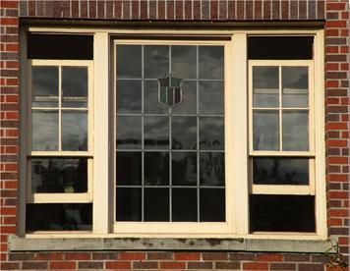
Double Hung Windows & Interior Transoms
Cool air in the bottom
and warm air out the top
Other old school/ DIY strategies
Deciduous trees on the south side
Using shades/curtains when appropriate
Notes:
Older homes have simple techniques to increase comfort
Do you use these things and understand the intention?

Slide 11
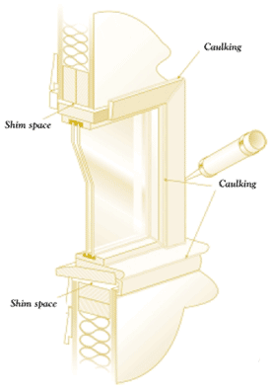
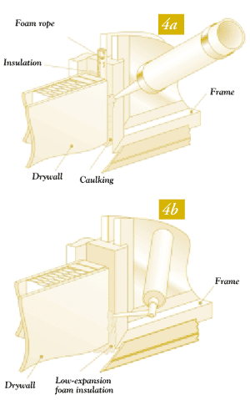
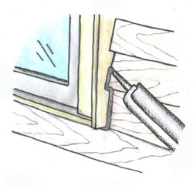
Windows
Notes:
Caulking can be learned and a DIY project
Or part of a weatherization package from a contractor
Either way it is important

Slide 12
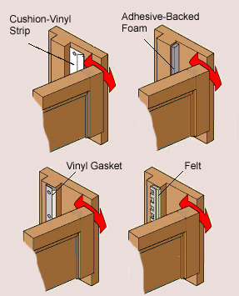
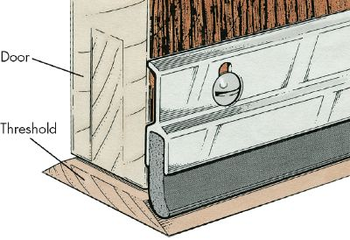
Doors
Notes:
Easy DIY stuff- Weatherstripping your doors and windows
An important part of weatherization
Each door improved can put 10 bucks or more in your pocket every year

Slide 13
Insulation saves money
Sealing
Ventilation
Moisture control
Proper installation
R-value and an
old brick home
Notes:
Construction project coming up? Frame houses and gut rehabs can really benefit from increased wall insulation

Slide 14
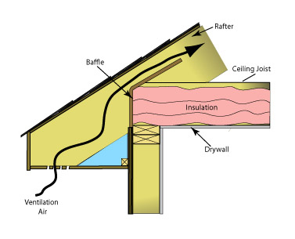
Attic Insulation
Notes:
Air sealing and attic insulation can do wonders in an old brick home
Air seal in bsmnt, attic and with windows and doors all around

Slide 18
Missouri Botanical Garden
Real world experience:
Air sealing, then insulation
Trust but verify
In hvac bigger is not better – it’s worse
Windows typically have the lowest ROI
Questions?????
Web Resources
www.mobot.org/sustainability
http://www.ameren.com/sites/AEA/Pages/Home.aspx
http://www.lacledegas.com/efficiency/
www.greenhomeguide.com
www.greenbuildingadvisor.com

