Slide 1
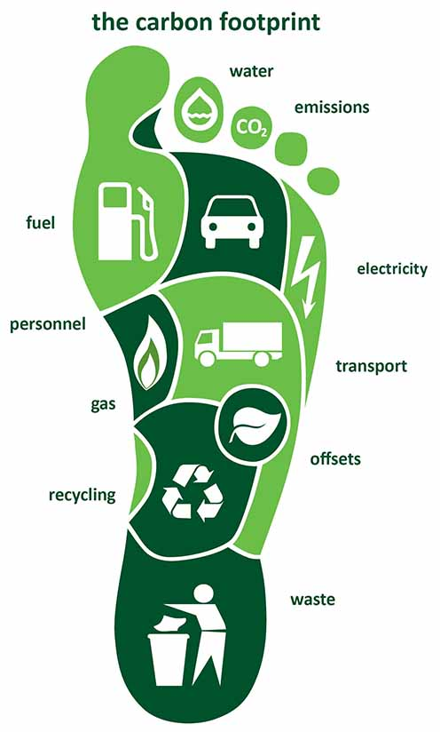
What is a Carbon Footprint? Why should it be reduced?

Slide 2
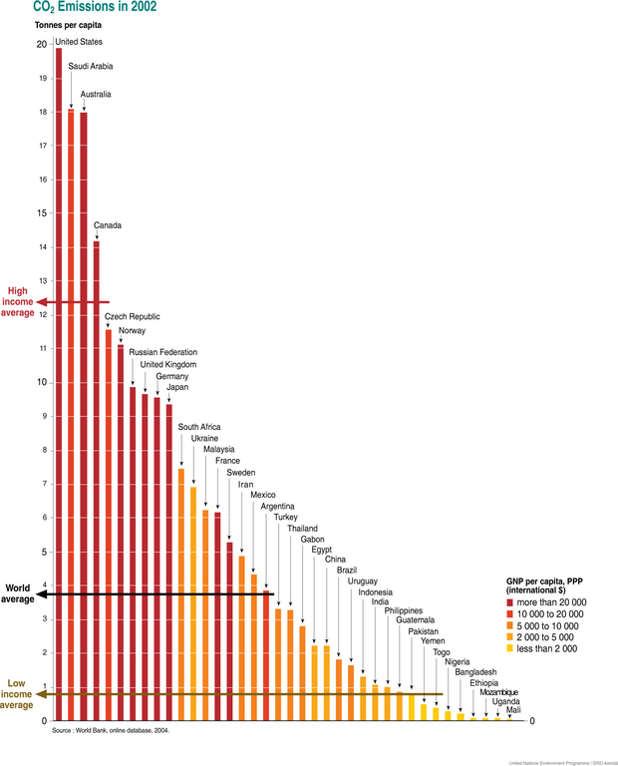
A carbon footprint is the measure of the amount of greenhouse gases, measured in units of carbon dioxide, produced by human activities. A carbon footprint can be measured for an individual or an organization, and is typically given in tons of CO₂-equivalent (CO₂-eq) per year. For example, the average North American generates about 20 tons of CO₂-eq each year. The global average carbon footprint is about 4 tons of CO₂-eq per year

Slide 3
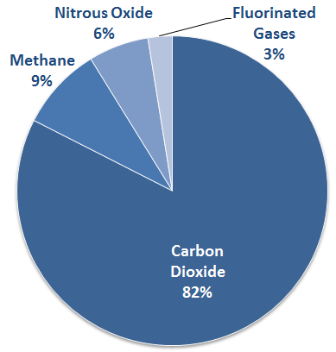
Gases that trap heat in the atmosphere are called greenhouse gases.
U.S. Greenhouse Gas Emissions in 2012
Source: Environmental Protection Agency
Greenhouse gases are important because they influence how much of the sun's energy is absorbed on earth and how much is radiated back into space.
Notes:
Carbon is not BAD - All of Earth’s Carbon-based lifeforms are living because of it. Carbon combustion releases energy – like the function of CARBohydrates in foods we eat, provide fuel for our muscles to work (people GET the food CARB analogy)

Slide 4
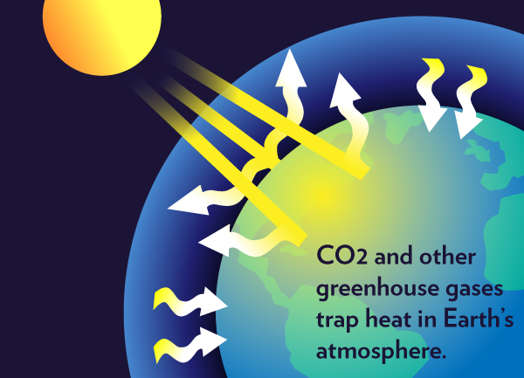

Slide 5
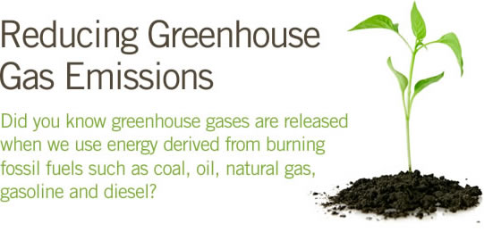
Notes:
carbon in ancient plant and animal bodies got compressed over eons of time and under zillions of pounds of Earth’s pressures into the seams of coal, oil, natural gas – the “Fossil” fuels – which we are now drilling/piping/blasting out and then BURNING. When the energy stored in this ancient carbon is released through combustion, the by-product CO2 is released too

Slide 6
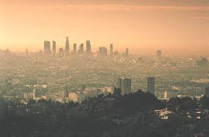
Smog is a direct result of car and industrial emissions and has adverse health effects on humans and the environment
Notes:
Increased burning of our increased demand for fossil fuels by an increasingly industrialized – and increasingly LARGE – human population of Earth has increased the concentration of CO2 in the atmosphere.
Like too much of any good thing, excess CO2 concentrated in atmosphere – vs where it was “sequestered” in those fossil fuel seams, in soil, in living plants, etc. – becomes a pollutant – and a problem.

Slide 7
Air quality impact on human health

Slide 8
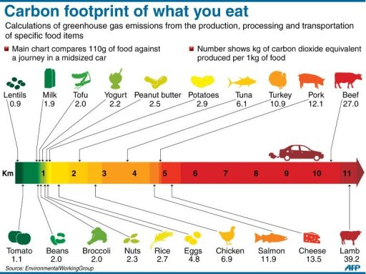

Slide 9
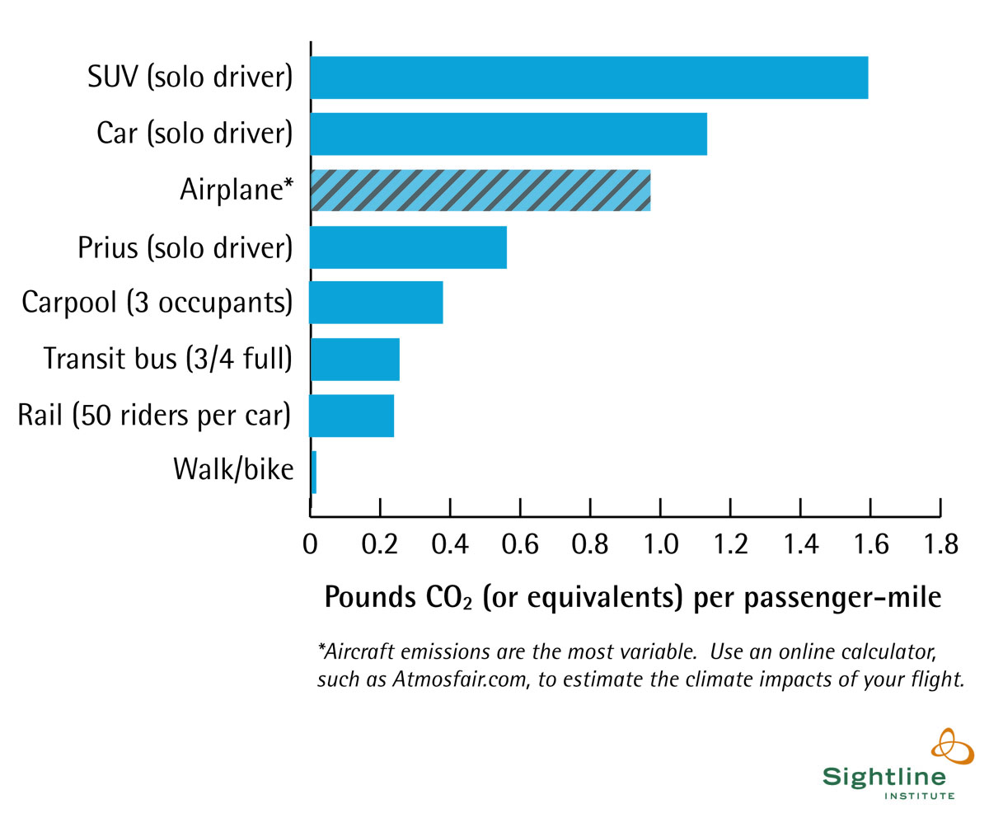
Bike or Walk for short trips

Slide 11
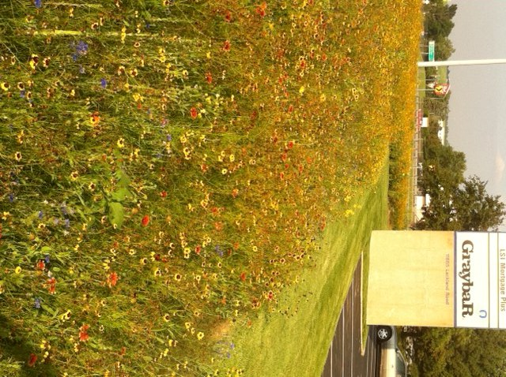
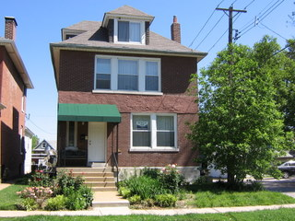
Residential and commercial examples of planting natives and reducing the need to mow.
Notes:
Graybar cut their landscape maintenance costs by more than 50% by leaving only a narrow mowed strip along parking lot and property edges, and converting the rest of the planted area around their building with the John Deere Native Wildflower Mix – looks GREAT too. Imagine if all our highway right-of-ways and the dippy grass fields around corporate campuses looked like that GraybaR photo?

Slide 12
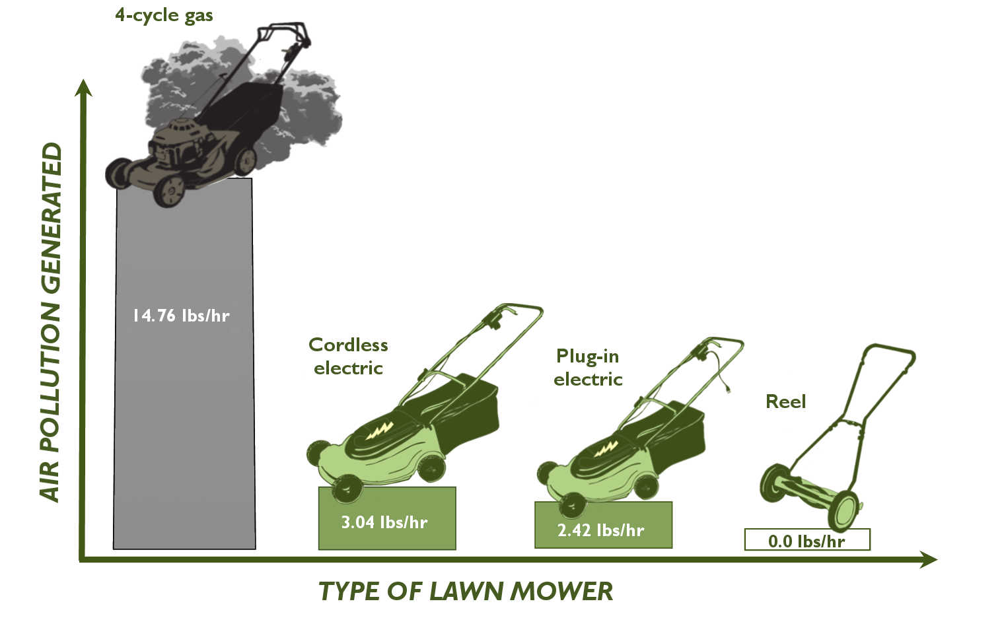
Low-mow landscaping can save you time, money, and hassle--and make our air cleaner.
Instead of grass, plant trees, shrubs, flowers, groundcover, edible plants, and even low-mow grasses. These plants can help you displace turf grass and save mowing time.
From the Lawn Care for Cleaner Air, http://www.louisvilleky.gov/apcd/lawncare

Slide 13
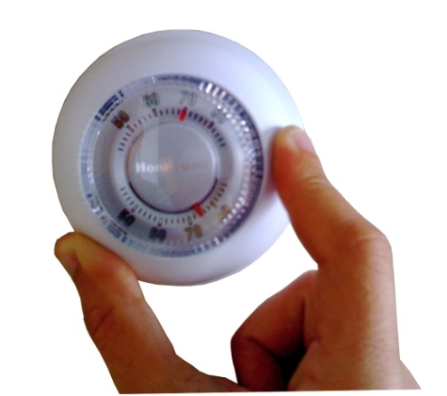
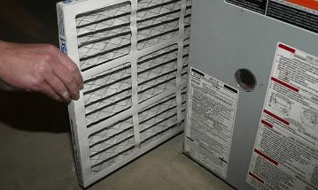
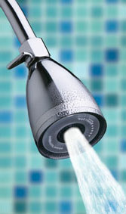
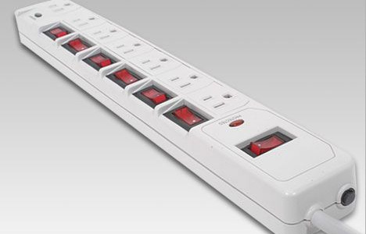
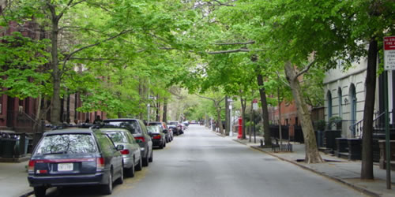
Some EASY ways to reduce our carbon footprint; switch to CFL bulbs, install low flow water adapters, lower your thermostats, buy Energy Star rated appliances.
Can you think of some others?

Slide 14
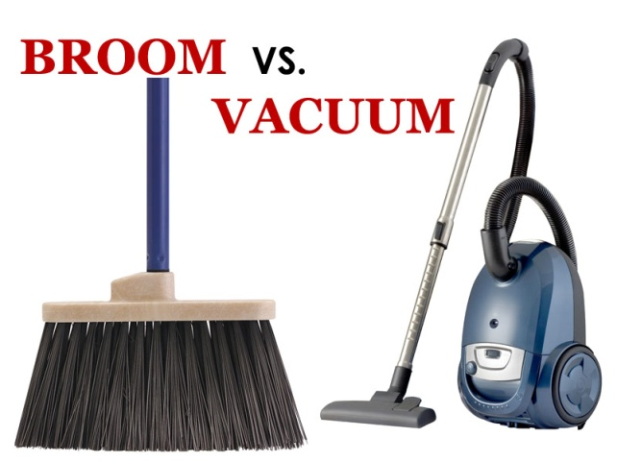
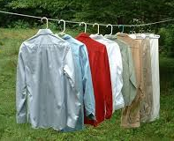
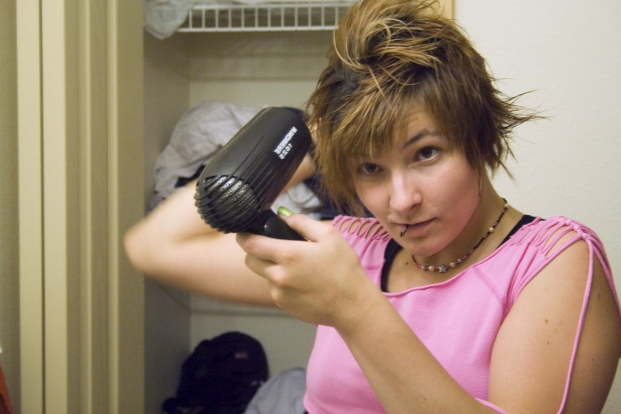
Ways of reducing your carbon footprint
Household vacuums use 200-700 watts
Electric clothes dryer uses 2000-4000 watts, gas dryers use 300-400 watts
While digital frames use little electricity, if each US family had one, the country would need 5 new power plants to keep pace with electric demand
Hair dryers use 1000 - 1500 watts

Slide 15
Questions / Comments

