Slide 1
At-Home Map Basics with a Lego City
Created by the #ucfathome crew –
Dr. Tim Hawthorne (UCF) and his kiddos
Aiden (8), and Elizabeth (6) from Partin Elementary in Oviedo, FL

Slide 2
This is an audio-guided power point led by Team Hawthorne. Turn your volume on.

Slide 3
The Plan
Learning goals:
Understand how to navigate a map using a grid
Understand how to measure map distance with a scale bar
Learning benefit: families – including adults and kids– work together and have fun!
Follow-up activities for you
Answer the questions on slide 7 and 8 and 9
Create your own map at home (with Legos or other toys)
Post your answers and map creations online on the Citizen Science GIS Facebook page at: www.facebook.com/citizensciencegis

Slide 4
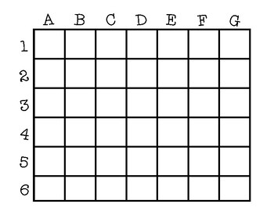
What’s a map grid?
“On maps showing greater detail, the grid is often given numbers and letters. The boxes made by the grid may be called A, B, C, and so on across the top of the map, and 1, 2, 3, and so on across the left side.”
“In the map’s index, a park’s location might be given as B4. The user finds the park by looking in the box where column B and row 4 cross.”
Source: https://www.nationalgeographic.org/encyclopedia/map/

Slide 5
What’s a scale bar on a map?
The scale bar represents the relationships between the distance on a map and the actual geography being show on the map
All maps are reduced sizes of what you see in the real world
You can’t map a whole city on a small map on a sheet of paper ☺
Sometimes the scale bar looks like a ruler…and you can estimate how far away two locations are on a map.

Slide 6
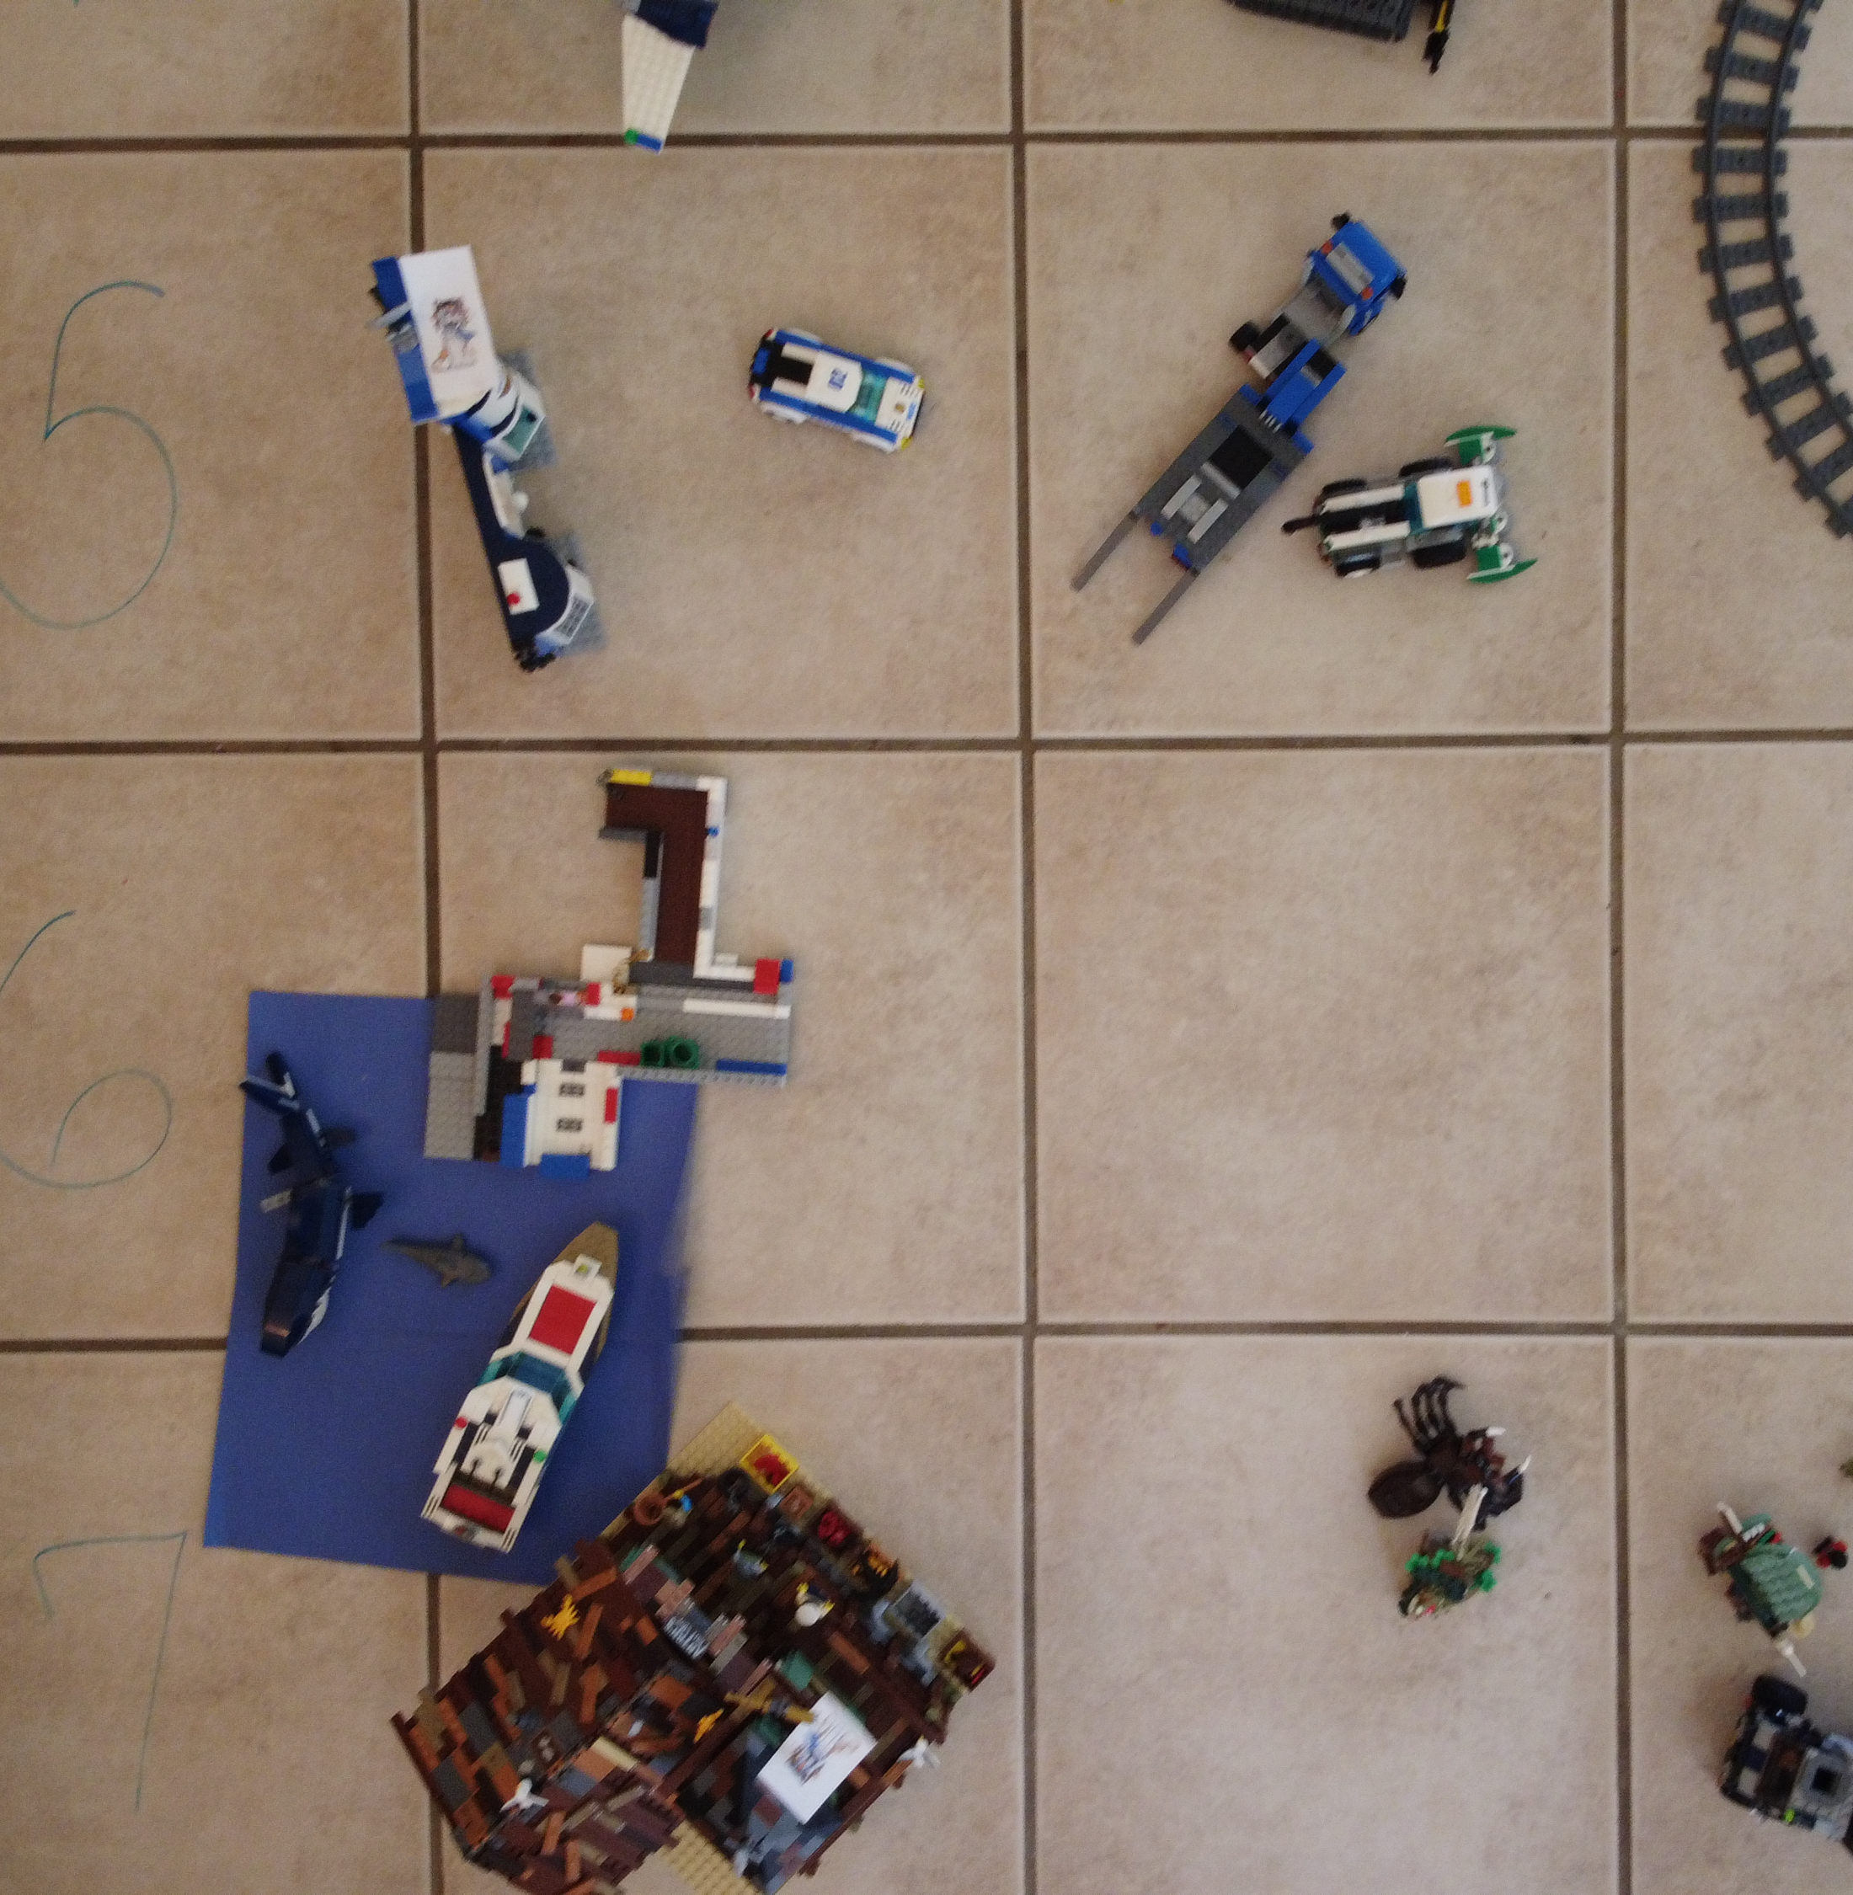
Got it? Cool. Now, we’re going to see if you can use grids and scale bars on our Lego City Map!

Slide 7
Lego City Map
Map grid included to identify location of Lego sets
Scale bar in lower right.
In inches
0” 15” 30” 45”

Slide 8
Grid questions: Use the Lego City Map on previous slide
Is there a lego set located in D3? Circle the answer. Yes No
Is there a lego set located in C7? Circle the answer. Yes No
Can you find the large, brown t-rex dinosaur? If so, write down the grid location on the map. __________
Can you find the white, police airplane? If so, write down the grid location on the map. __________
Can you find the white and black lego boat on the blue lake? If so, write down the grid location on the map. ____________

Slide 9
Scale questions: Use the Lego City Map again
Directions:
Use the blue scale bar to estimate the distances on the map. Remember the blue scale bar represents inches in the Lego City.
Measure from the middle of the Lego set to the middle of the other lego set.
6. About how far is it from the pirate coaster ride in E6 and the boat in F5?
7. About how far is it from Cinderella’s castle in G4 to the old fishing store in A7?

Slide 10
Review Questions
8. Write a sentence to explain what a map grid does on a map.
9. Write a sentence to explain what a scale bar does on a map.

Slide 11
At-Home Mapping and Social Media Challenge
Congratulations! You know how to read maps.
Share you work and tag some friends, including photos and videos of your own map models with legos or toys on
www.facebook.com/citizensciencegis

