Slide 1
A State of Suspended Animation: Current conditions and the economic and fiscal outlook for the Commonwealth of Massachusetts
Testimony submitted to the Virtual Economic Roundtable (Joint Committee on Ways and Means & the Executive Office of A&F)
prepared and delivered by:
Michael D. Goodman, Ph.D. Professor of Public Policy Executive Director, the Public Policy Center (PPC) University of Massachusetts Dartmouth
Co-Editor, MassBenchmarks Twitter: @Mike_Goodman
April 14, 2020

Slide 2
The COVID-19 pandemic affects our economy in a number of ways
Source: OECD

Slide 3
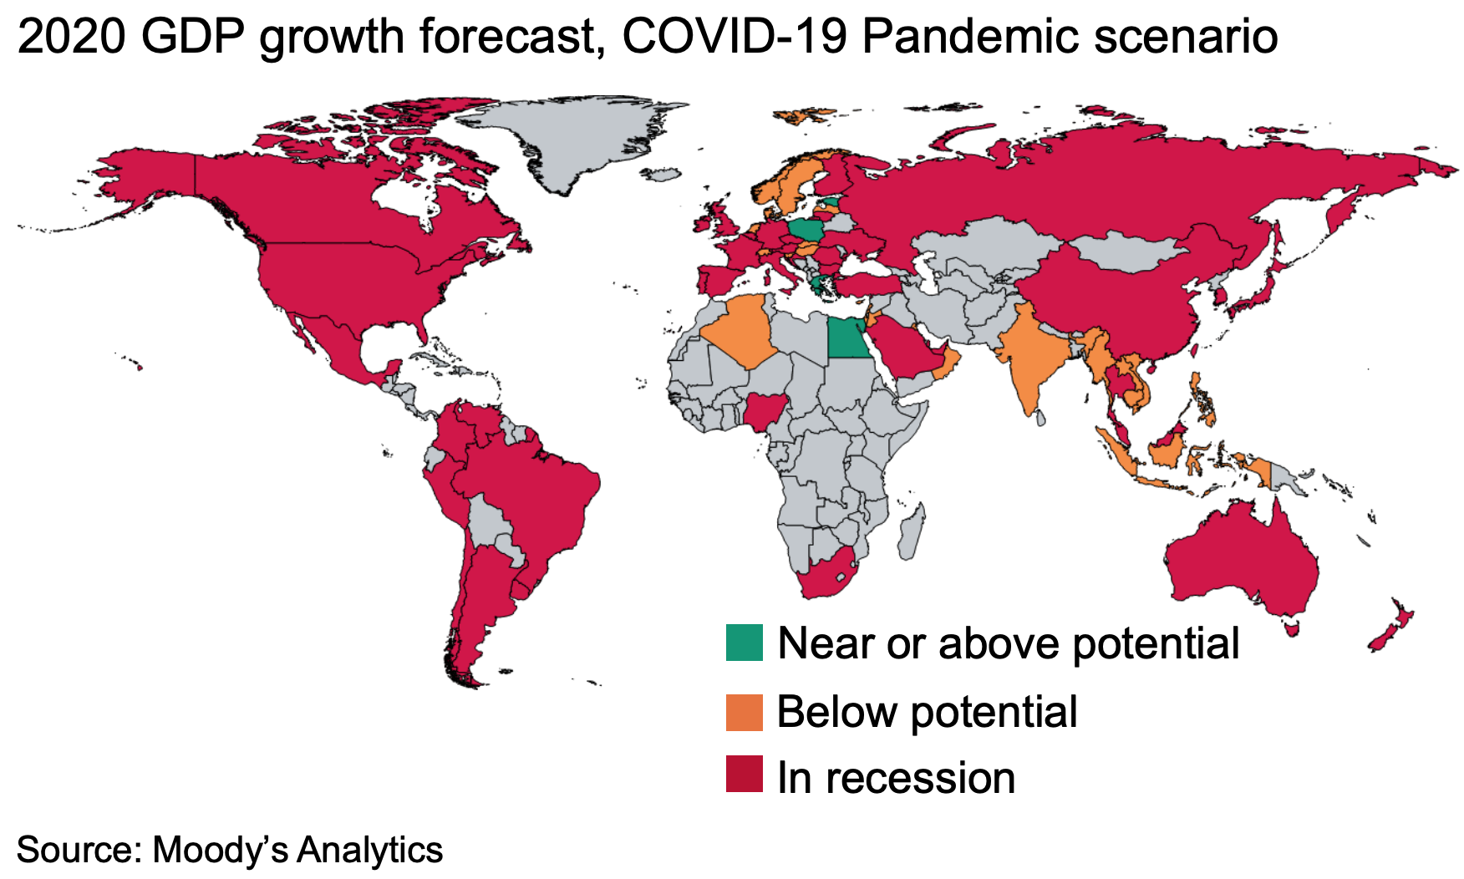
A global recession is a virtual certainty

Slide 4
The national economy is expected to experience its sharpest contraction ever in Q2 2020
“Gross domestic product is expected to decline by more than 7 percent during the second quarter. If that happened, the decline in the
annualized growth rate reported by the Bureau of Economic Analysis
would be about 4X larger and would exceed 28 percent. Those declines could be much larger, however.” -- Congressional Budget Office https://www.cbo.gov/publication/56314

Slide 5
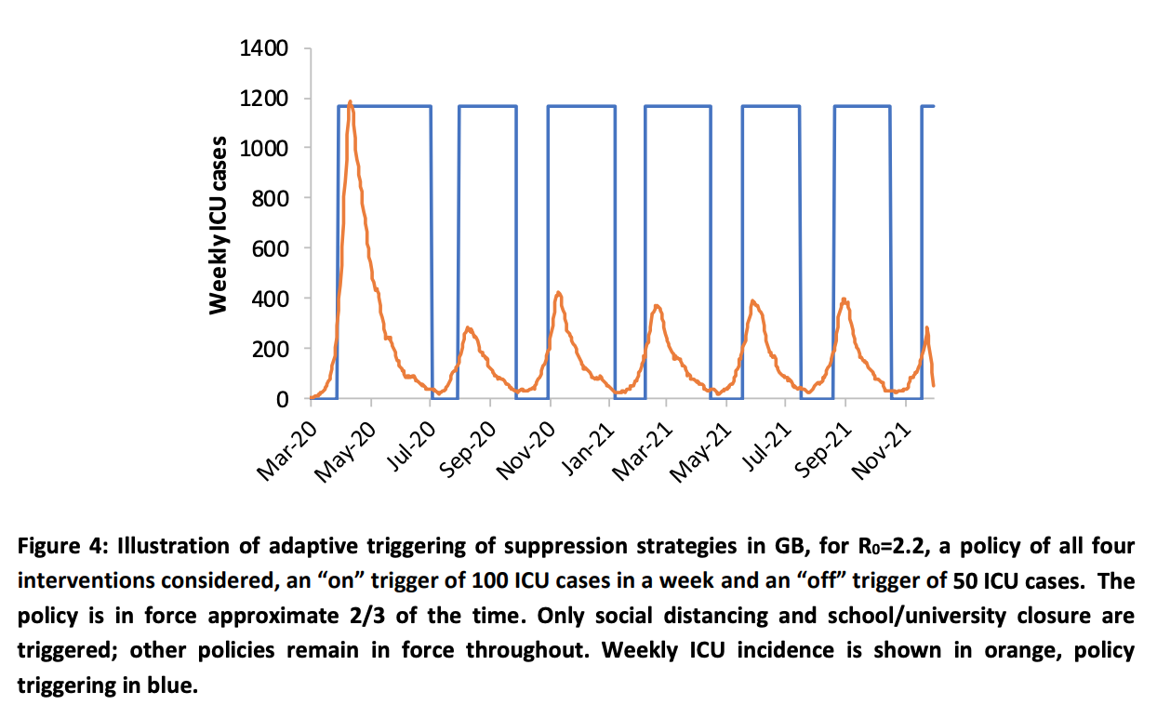
The depth & duration of the downturn will be a function of the effectiveness of our public health response
Source: https://www.imperial.ac.uk/media/imperial-college/medicine/sph/ide/gida-fellowships/Imperial-College-COVID19-NPI-modelling-16-03-2020.pdf

Slide 6
The demand for state resources can be expected to rise substantially in coming months

Slide 7
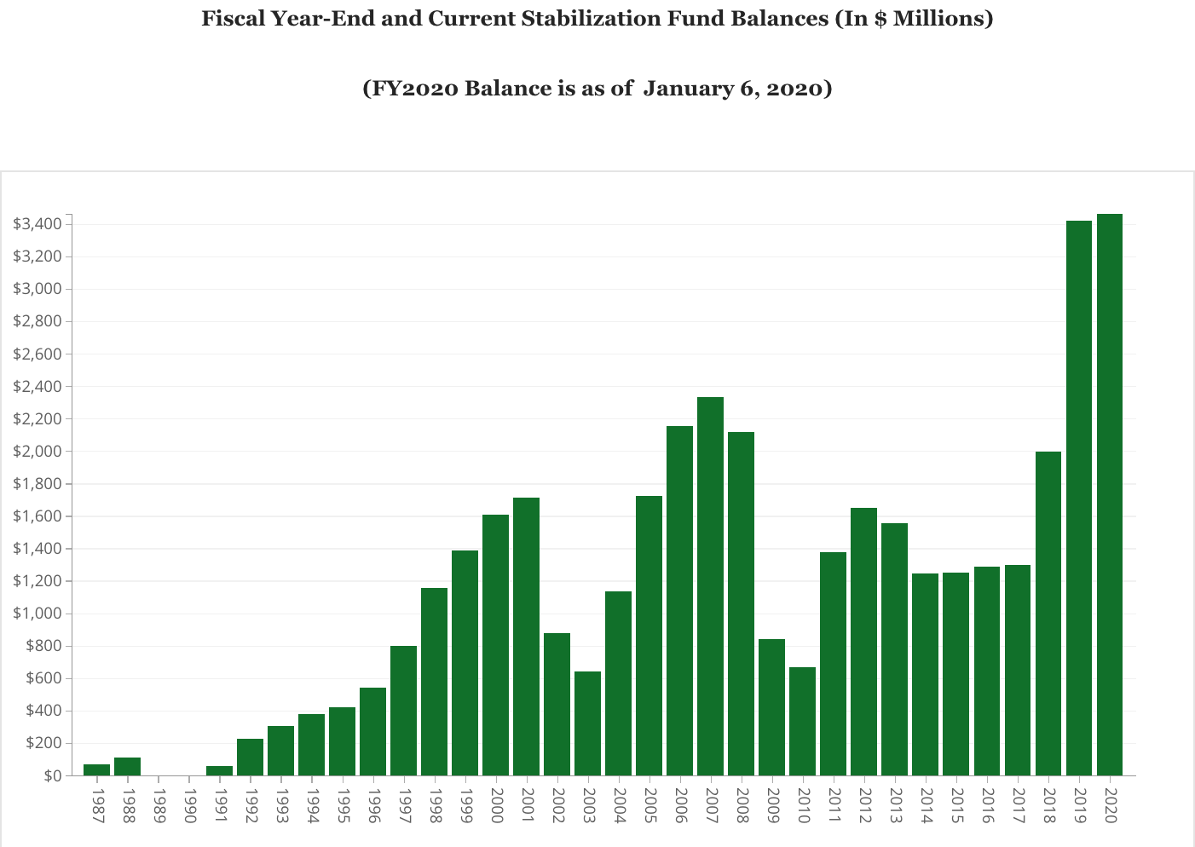
The rainy-day fund provides a near-term but insufficient fiscal buffer for what lies ahead

Slide 8
Our UI trust fund is inadequately capitalized for long-term unemployment at current levels
Source: US Department of Labor

Slide 9
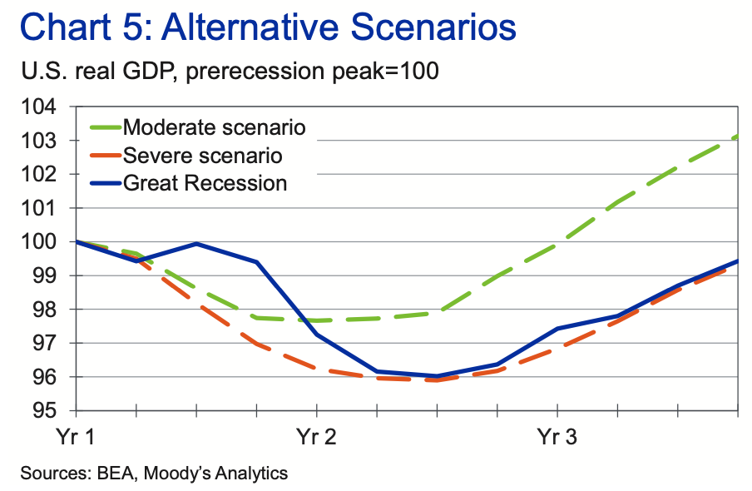
Moody’s most recent fiscal stress test reveals the scale of the fiscal challenge facing the Commonwealth
 | Tax Revenue Shortfall (%) | Tax Revenue Shortfall ($ mil) | Medicaid Spending Increase (%) | Medicaid Spending Increase ($ mil) | Combined fiscal shock (%) | Combined fiscal shock ($)
Moderate Recession | -8.3% | $ (3,777.29) | 1.1% | $ 516.56 | -9.4% | $ (4,293.85)
Severe Recession | -11.8% | $ (5,373.34) | 1.3% | $ 593.80 | -13.1% | $ (5,967.14)
Source: https://www.moodysanalytics.com/-/media/article/2019/stress-testing-states-2019.pdf

Slide 10
The recently enacted Cares Act helps but, substantial additional federal aid will be needed soon

Slide 11
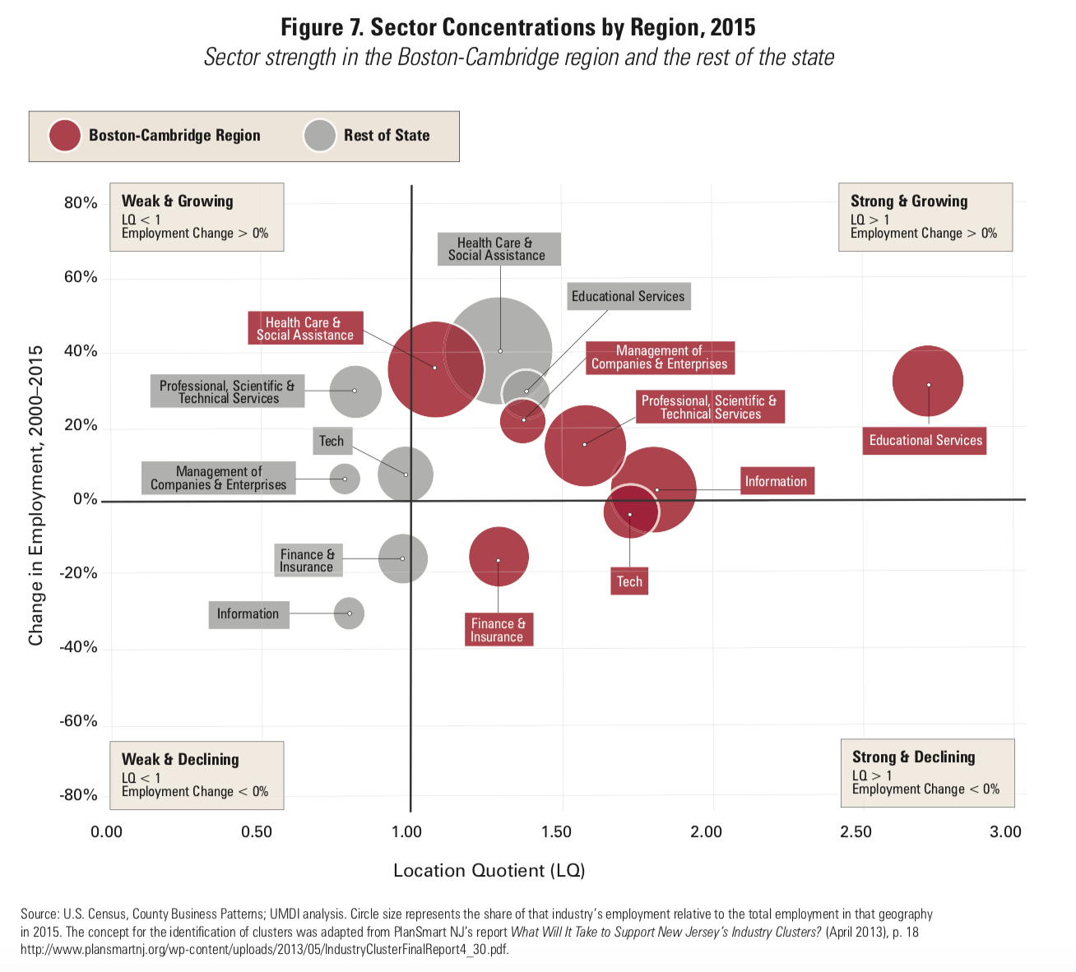
“Eds and Meds” have long been the backbone of the Massachusetts economy

Slide 12
Health and Human Services have been stalwart countercyclical employment stabilizers historically

Slide 13
Reduction in elective surgeries and non-COVID-19 services creates large financial problems
“Hospitals rely on these services not just to sustain a stable revenue base, but to help offset the cost to provide other essential health care services to the community. In fact, non emergent services may equate to 30 to 60 percent of a hospital’s revenue base, and some projections suggest that a hospital could see 75 to 100 percent of these services eliminated during the pandemic. These revenue losses alone will have a significant financial impact, and many hospitals will struggle to survive economically as the pandemic progresses.” -- Charles Kahn, CEO, Federation of American Hospitals

Slide 14
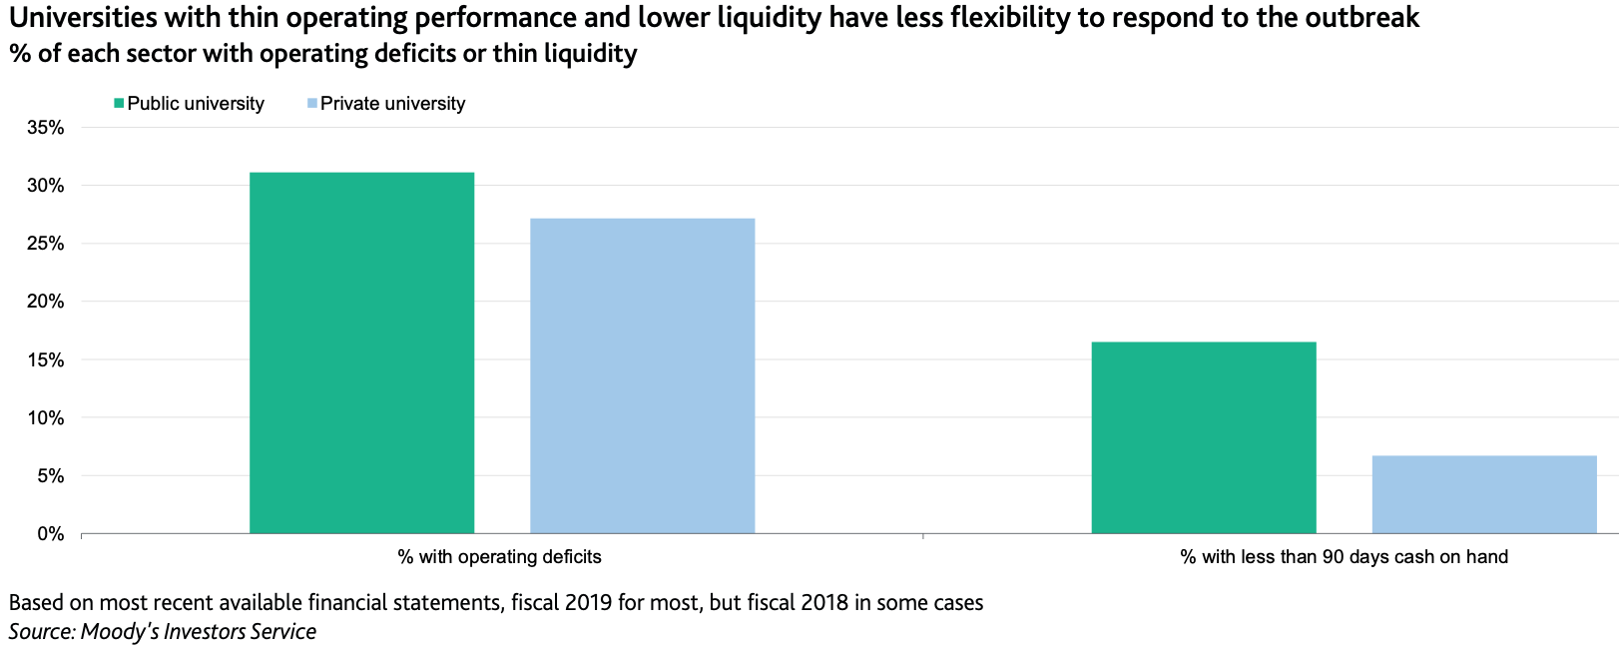
Many higher educational institutions are very financially vulnerable
“While the duration and full financial impact of the current crisis is unknown, universities' response to the outbreak will immediately reduce revenue and drive expenses higher. For fiscal 2021, universities face unprecedented enrollment uncertainty, risks to multiple revenue streams, and potential material erosion in their balance sheets.” -- Moody’s Investor Service
https://www.documentcloud.org/documents/6814099-Outlook-Higher-Education-US-18Mar20-1.html

Slide 15
Policymaking for an economy in suspended animation
Public health comes first
Take whatever action is needed to “bend the curve” to allow caseloads to be manageable given the capacity of our healthcare system.
Expand system capacity to prepare for the very real possibility of subsequent waves of the virus in coming months.
Prioritize human needs
The pace of the recovery will depend critically on the extent of the damage done to household and business balance sheets. The further they are permitted to fall, the longer it will take them to recover.
Protect key assets and institutions
Massachusetts has long relied on its world-class healthcare and educational institutions to fuel our innovation economy and to buffer the economic consequences of previous recessions. This time it appears it will be different absent strategic intervention and support.
Substantial additional federal assistance will be indispensable to minimizing avoidable social and economic suffering

Slide 16
Questions?
Michael D. Goodman, Ph.D. Professor of Public Policy Executive Director, the Public Policy Center (PPC) University of Massachusetts Dartmouth
Co-Editor, MassBenchmarks Twitter: @Mike_Goodman

