Slide 1
The Economic Outlook: 2020
Welcome To The Recession
Beth Ann Bovino, U.S. Chief Economist
Bethann.bovino@spglobal.com
212-438-1652
Copyright © 2016 by S&P Global. All rights reserved.

Slide 2
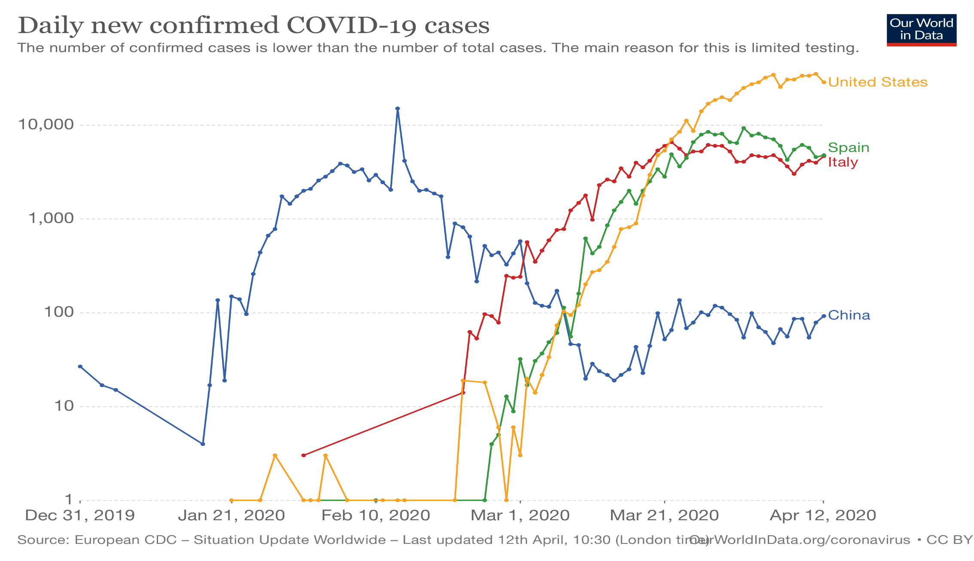
The Health Response To COVID-19 Dynamics Is Key

Slide 3
U.S. Economy Is In Recession
Recession in first half of the year
The spread of the virus has landed on U.S. shores.
After sickening much of the world (in recession).
The suspension of Boeing 737 MAX production and exports.
Saudi Arabia-Russia standoff and plummeting COVID019 driven oil demand, drove oil prices to 20-year lows. Energy investments to fall, with no cushion from household/business travel.
A slow recovery in the second half
When households venture into the public domain?
When will business start rehiring?
U.S government stimulus and Fed action help cushion the blow
The path of the virus will dictate the terms

Slide 4
Coronavirus Hit To U.S. Economy
Boarders closed
Social Distancing
Supply Chains
Travel and tourism shuttered
Webinar nation? Appetite for business travel declines sharply
Stay-vacations now. Reduced leisure travel
Consumer spending on services collapse.
Spending on durable goods also in decline
Businesses reduces face to face contact
With events canceled
Around 90% of U.S. population at home. (over 300 million)
Inventories run down
Business demand drop
Factories close in U.S.
Lockdown risk
Market turbulence speeds up the economic impact.
But, fiscal and monetary policy actions provide support

Slide 5
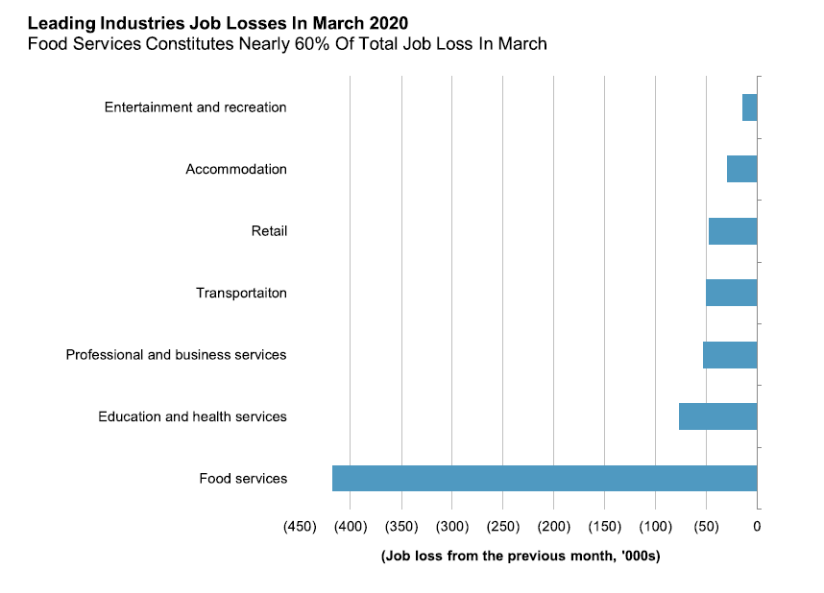
Historical lows now a regular theme for the U.S. jobs market.

Slide 6
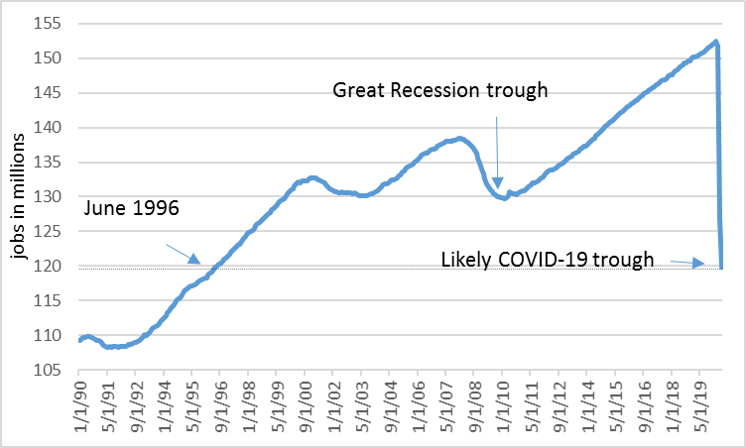
U.S. Jobs Projected To Fall To Lowest In Decades

Slide 7
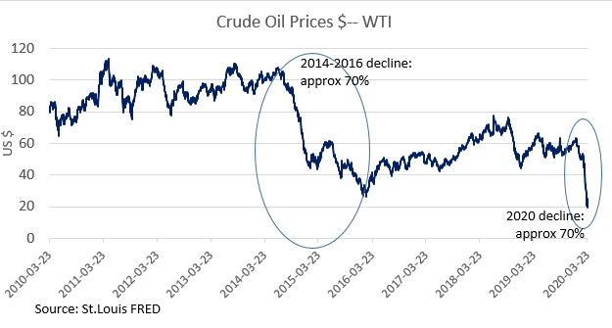
Oil Prices Have Fallen Below Break-Even For Many Producers
Another shoe to drop for U.S. Private Business Fixed Investment

Slide 8
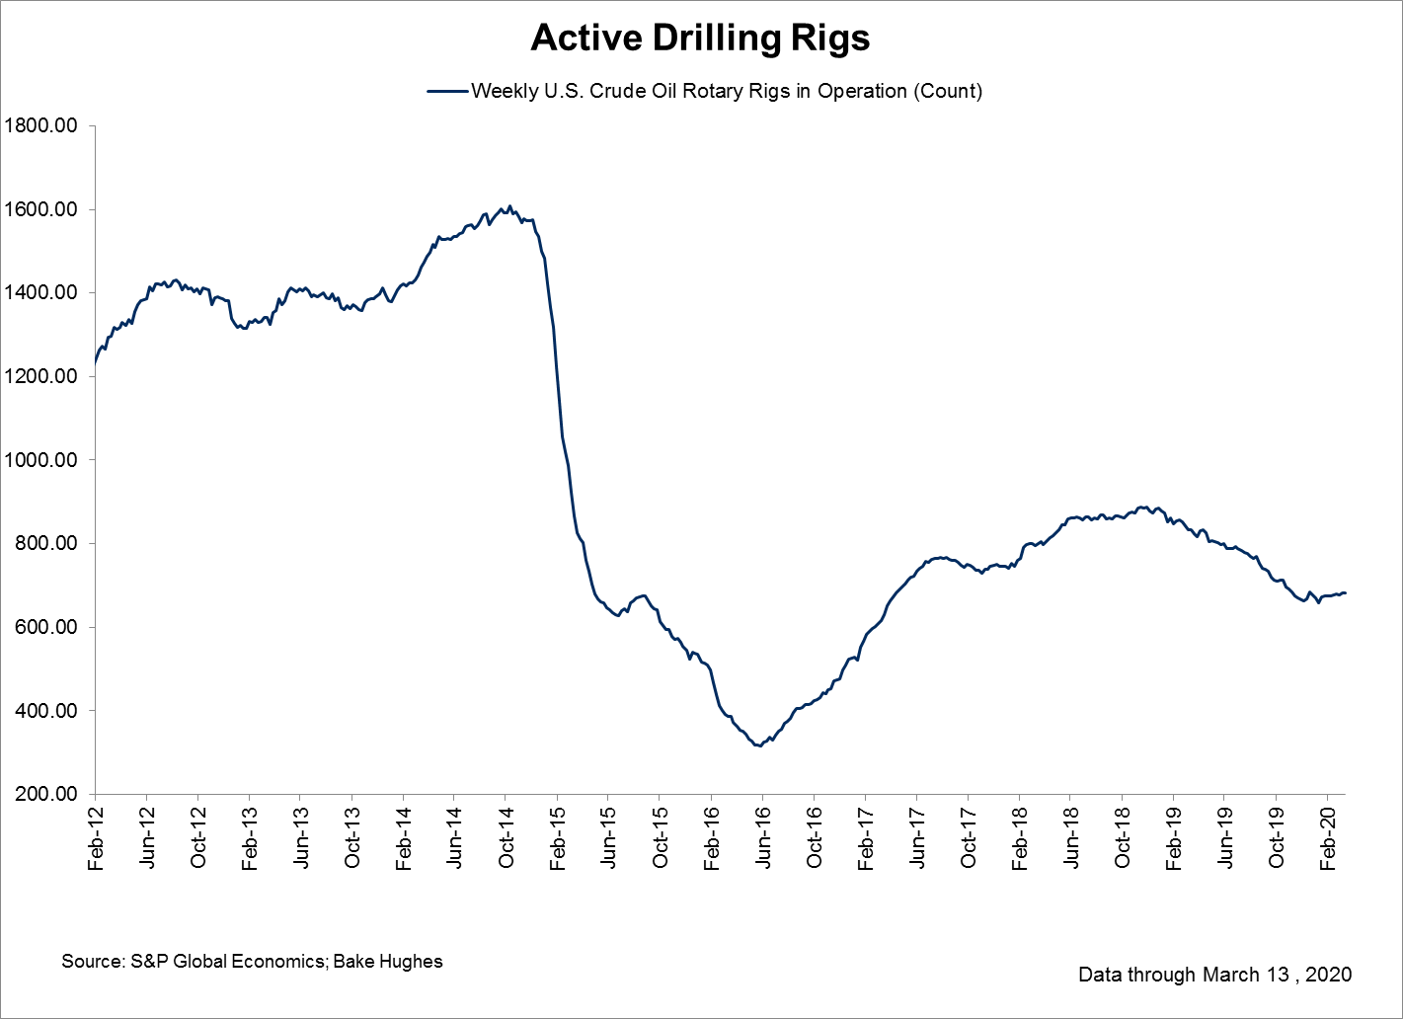
After Modest Drilling Since Last Oil Price Drop

Slide 9
Policy: Use The Kitchen Sink, Be Countercyclical
Fed Policy – Use its balance sheet and an alphabet soup of facilities
Cut rates to zero, buy assets to hold down risk-free yields
Stand ready to intervene in CP, MM and even corporate (IG) credit markets to support liquidity and ensure that markets function reasonable well.
Macro-Prudential – be counter cyclical
Ease capital burdens to allow banks to lend and absorb shocks.
Flexibility around repayments, foreclosures in return to lending to critical sectors.
Fiscal –surprisingly quick to respond, despite domestic squabbles
Lifeline to households
Support labor market and SMEs, and keep them intact as much as possible.
Use guarantees to ease borrowing costs and financial conditions.
Talks of an infrastructure package next, well see where it goes.
Bottom line: think big, make temporary and conditional on “good” behavior.

Slide 10
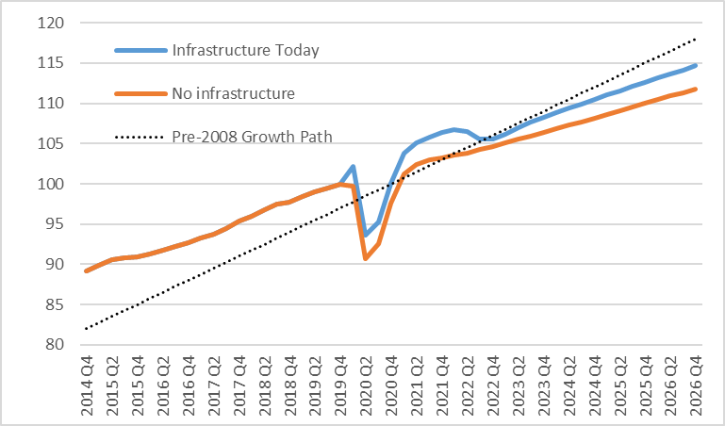
What about the shape of the U.S. recovery?
Ways To Change The Shape This Time

Slide 11
Copyright © 2020 by Standard & Poor's Financial Services LLC. All rights reserved.
No content (including ratings, credit-related analyses and data, valuations, model, software or other application or output therefrom) or any part thereof (Content) may be modified, reverse engineered, reproduced or distributed in any form by any means, or stored in a database or retrieval system, without the prior written permission of Standard & Poor's Financial Services LLC or its affiliates (collectively, S&P). The Content shall not be used for any unlawful or unauthorized purposes. S&P and any third-party providers, as well as their directors, officers, shareholders, employees or agents (collectively S&P Parties) do not guarantee the accuracy, completeness, timeliness or availability of the Content. S&P Parties are not responsible for any errors or omissions (negligent or otherwise), regardless of the cause, for the results obtained from the use of the Content, or for the security or maintenance of any data input by the user. The Content is provided on an "as is" basis. S&P PARTIES DISCLAIM ANY AND ALL EXPRESS OR IMPLIED WARRANTIES, INCLUDING, BUT NOT LIMITED TO, ANY WARRANTIES OF MERCHANTABILITY OR FITNESS FOR A PARTICULAR PURPOSE OR USE, FREEDOM FROM BUGS, SOFTWARE ERRORS OR DEFECTS, THAT THE CONTENT'S FUNCTIONING WILL BE UNINTERRUPTED, OR THAT THE CONTENT WILL OPERATE WITH ANY SOFTWARE OR HARDWARE CONFIGURATION. In no event shall S&P Parties be liable to any party for any direct, indirect, incidental, exemplary, compensatory, punitive, special or consequential damages, costs, expenses, legal fees, or losses (including, without limitation, lost income or lost profits and opportunity costs or losses caused by negligence) in connection with any use of the Content even if advised of the possibility of such damages.
Credit-related and other analyses, including ratings, and statements in the Content are statements of opinion as of the date they are expressed and not statements of fact. S&P's opinions, analyses, and rating acknowledgment decisions (described below) are not recommendations to purchase, hold, or sell any securities or to make any investment decisions, and do not address the suitability of any security. S&P assumes no obligation to update the Content following publication in any form or format. The Content should not be relied on and is not a substitute for the skill, judgment and experience of the user, its management, employees, advisors and/or clients when making investment and other business decisions. S&P does not act as a fiduciary or an investment advisor except where registered as such. While S&P has obtained information from sources it believes to be reliable, S&P does not perform an audit and undertakes no duty of due diligence or independent verification of any information it receives. Rating-related publications may be published for a variety of reasons that are not necessarily dependent on action by rating committees, including, but not limited to, the publication of a periodic update on a credit rating and related analyses.
To the extent that regulatory authorities allow a rating agency to acknowledge in one jurisdiction a rating issued in another jurisdiction for certain regulatory purposes, S&P reserves the right to assign, withdraw, or suspend such acknowledgement at any time and in its sole discretion. S&P Parties disclaim any duty whatsoever arising out of the assignment, withdrawal, or suspension of an acknowledgment as well as any liability for any damage alleged to have been suffered on account thereof.
S&P keeps certain activities of its business units separate from each other in order to preserve the independence and objectivity of their respective activities. As a result, certain business units of S&P may have information that is not available to other S&P business units. S&P has established policies and procedures to maintain the confidentiality of certain nonpublic information received in connection with each analytical process.
S&P may receive compensation for its ratings and certain analyses, normally from issuers or underwriters of securities or from obligors. S&P reserves the right to disseminate its opinions and analyses. S&P's public ratings and analyses are made available on its Web sites, www.standardandpoors.com (free of charge), and www.spcapitaliq.com (subscription) and may be distributed through other means, including via S&P publications and third-party redistributors. Additional information about our ratings fees is available at www.standardandpoors.com/usratingsfees.
Australia: S&P Global Ratings Australia Pty Ltd holds Australian financial services license number 337565 under the Corporations Act 2001. S&P Global Ratings' credit ratings and related research are not intended for and must not be distributed to any person in Australia other than a wholesale client (as defined in Chapter 7 of the Corporations Act).
STANDARD & POOR'S, S&P and RATINGSDIRECT are registered trademarks of Standard & Poor's Financial Services LLC.
spglobal.com/ratings

