Slide 1
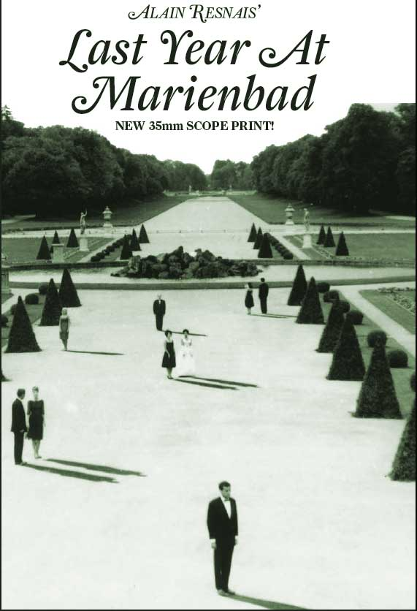

Slide 2
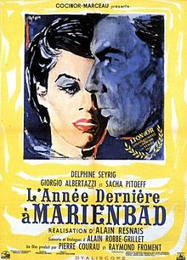

Slide 4
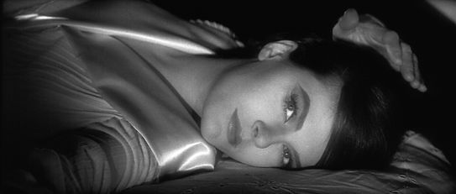

Slide 5
1. La caméra stylo

Slide 6
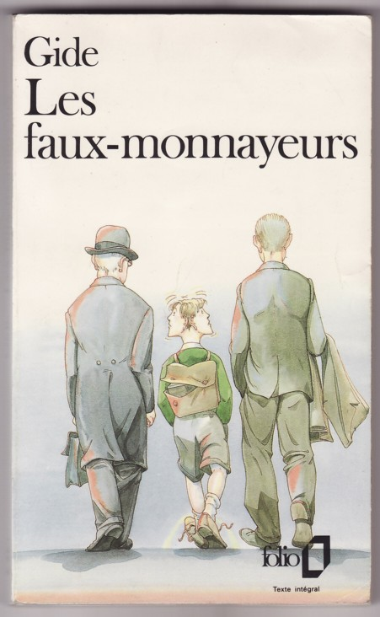
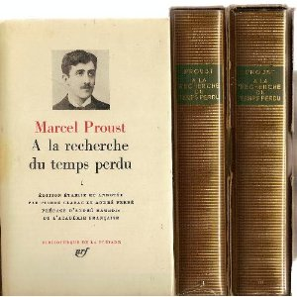
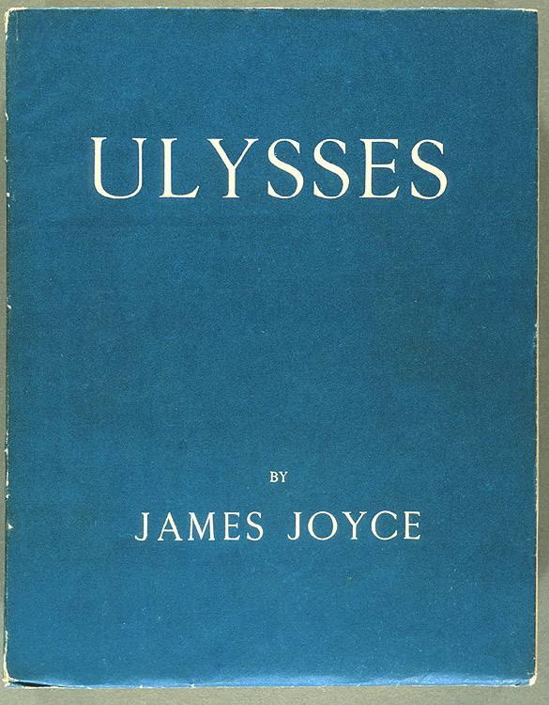

Slide 7
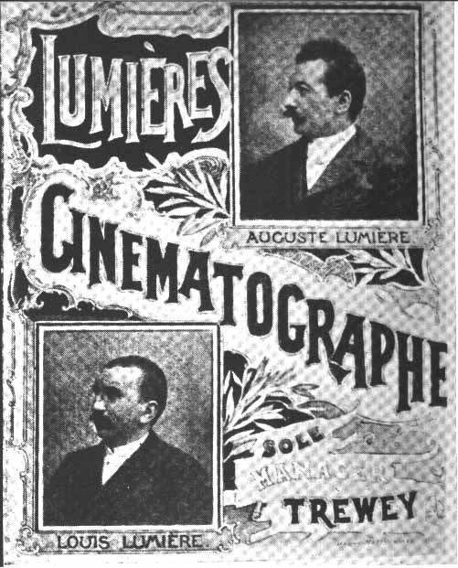

Slide 8
La sortie de l’usine (1895)

Slide 9
L’arrivée d’un train en gare de la Ciotat (1895)

Slide 10
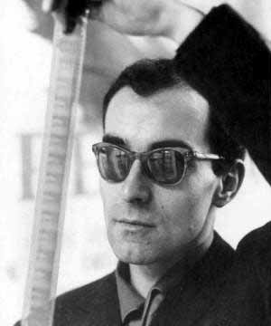

Slide 11
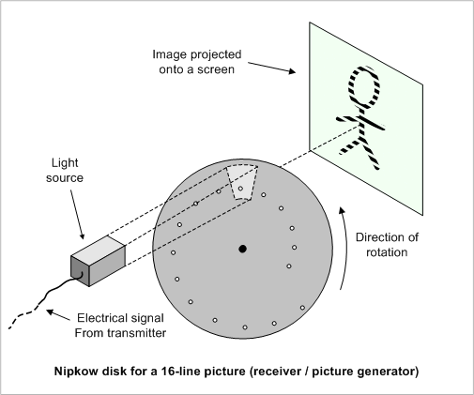

Slide 12
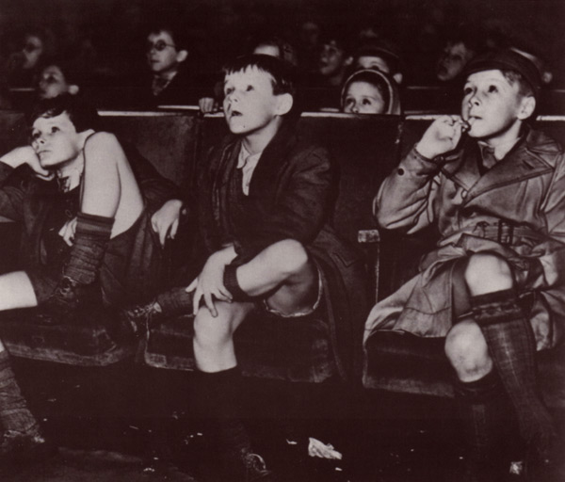

Slide 13
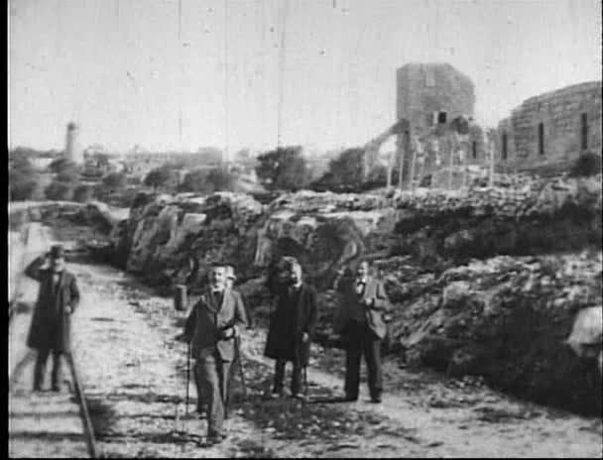
Leaving Jerusalem by Railway (1897)

Slide 14
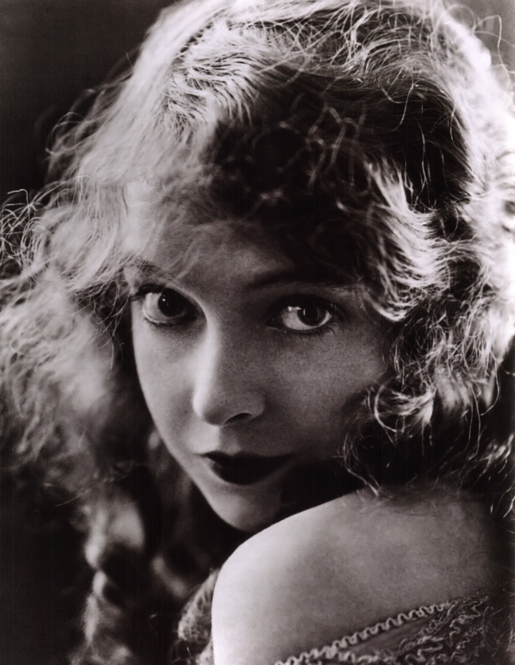

Slide 15
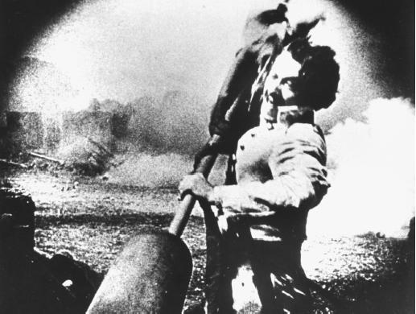

Slide 16
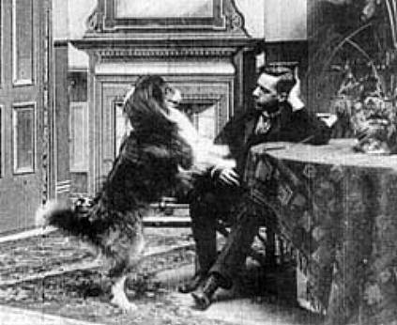
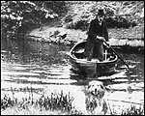
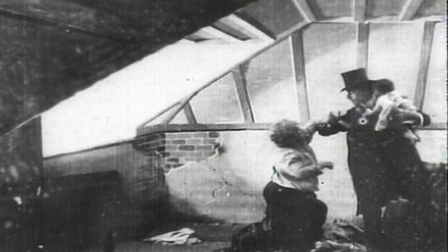
Rescued by Rover (1905)

Slide 17
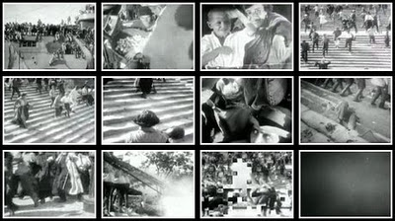
Odessa Steps sequence, The Battleship Potemkin (1925)

Slide 18
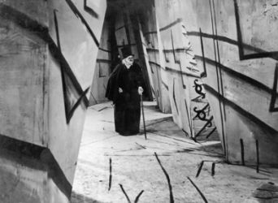
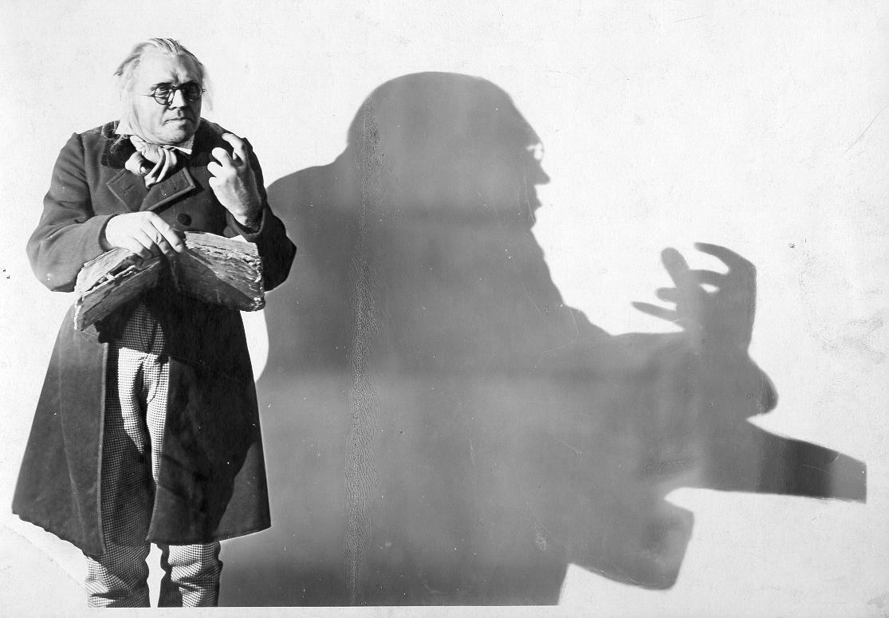
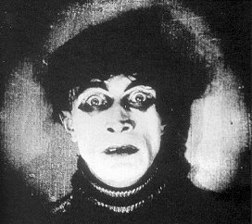
Das Kabinet des Dr Caligari (1920)

Slide 19
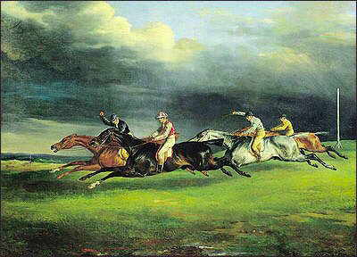
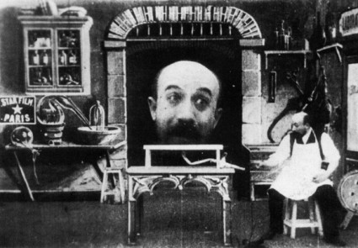
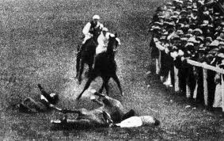
A Méliès fantasy tableau
Truth at the Epsom Derby

Slide 20
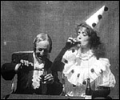
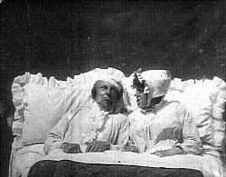

Slide 21
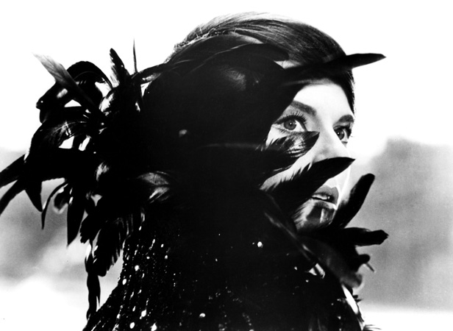

Slide 22
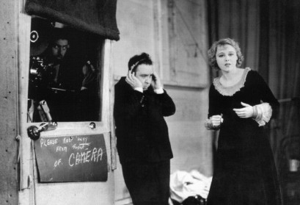

Slide 23
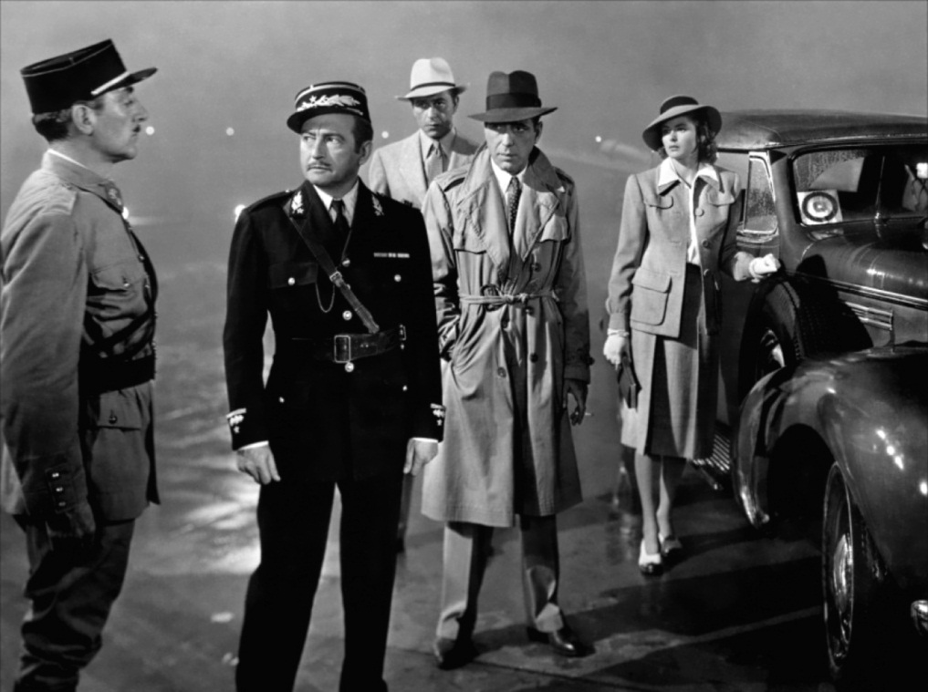
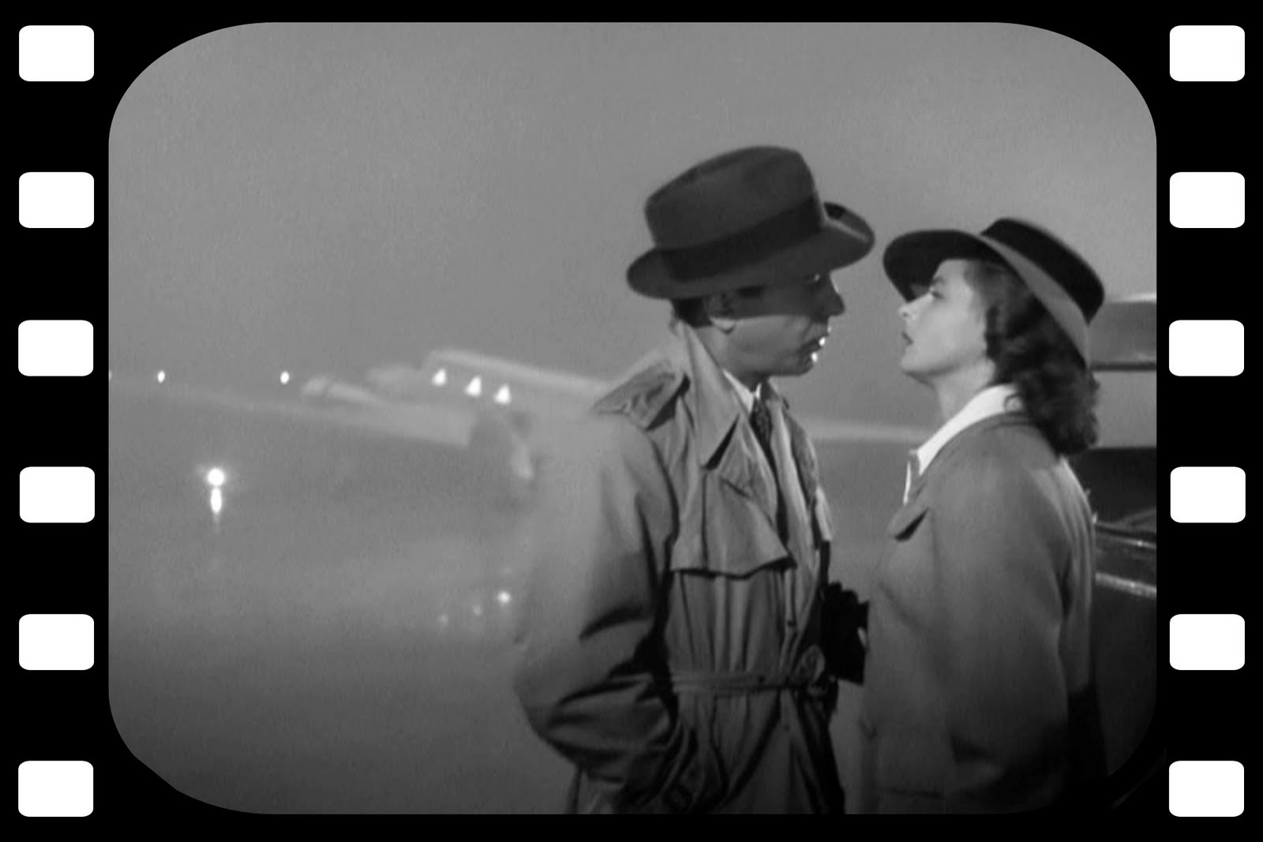
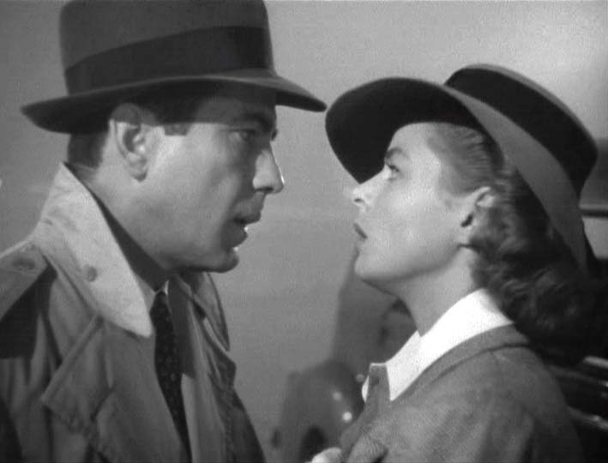

Slide 24
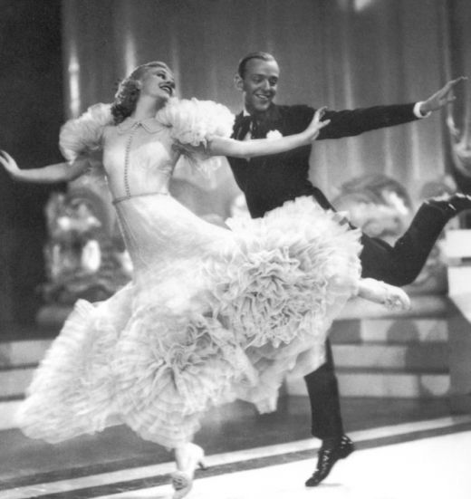
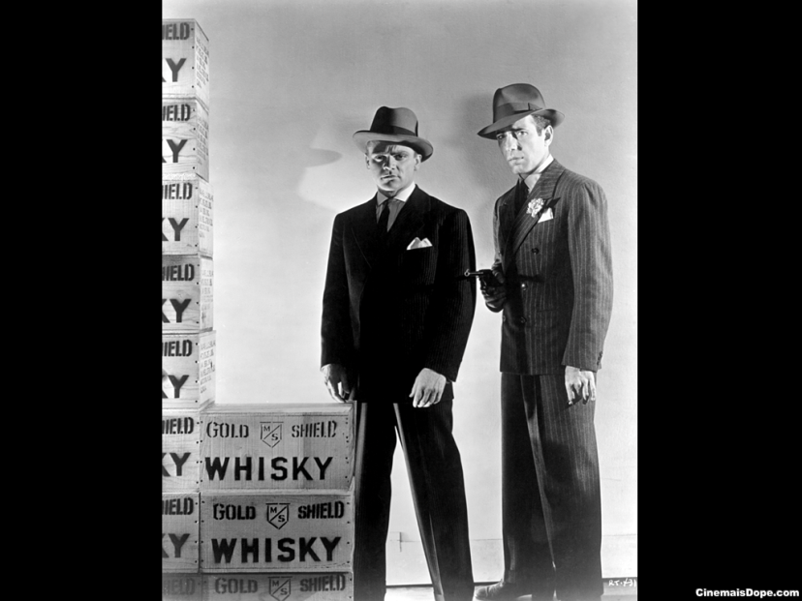
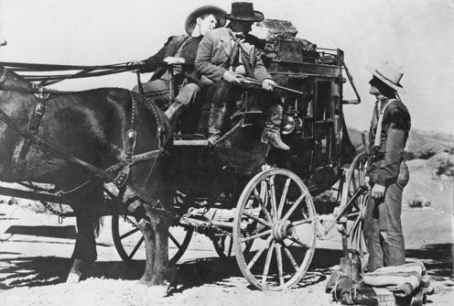

Slide 25
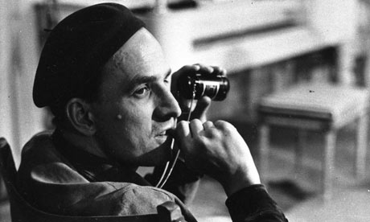
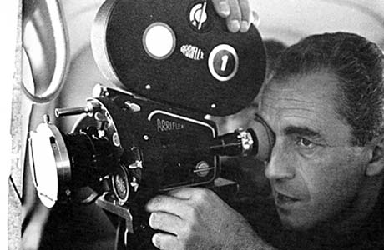

Slide 26
2. Genesis

Slide 27
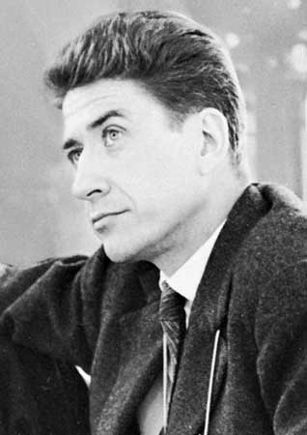

Slide 28
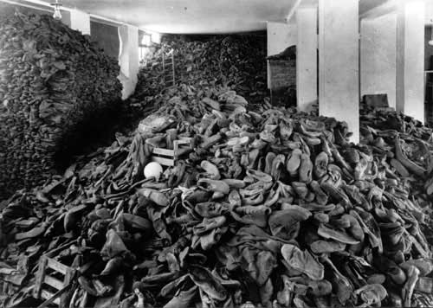
Nuit et brouillard (1955)

Slide 29
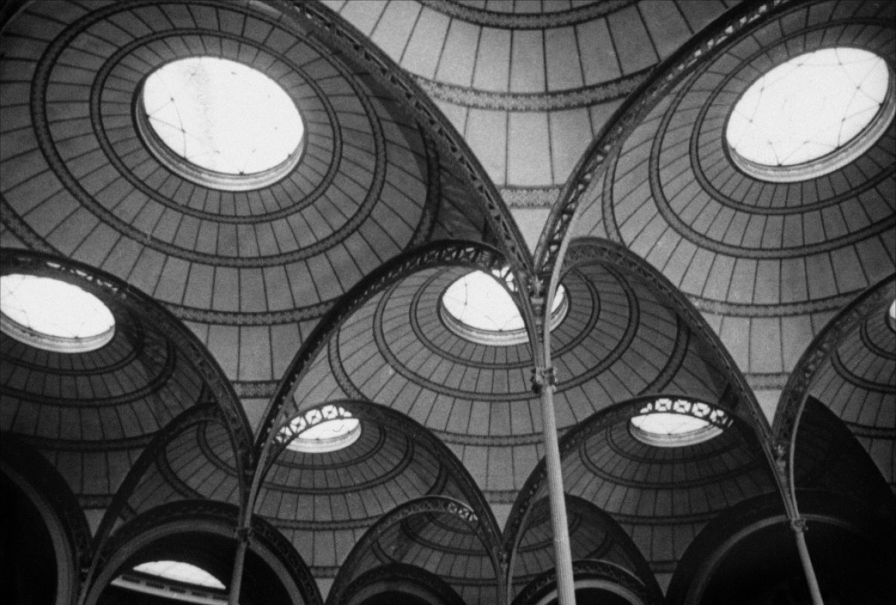
Toute la mémoire du monde (1956)

Slide 30
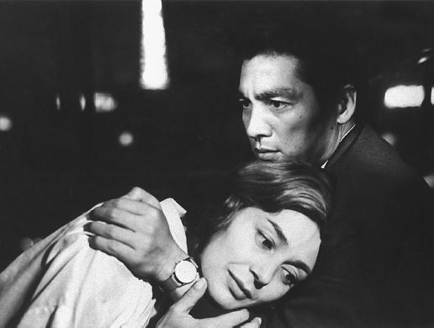

Slide 31
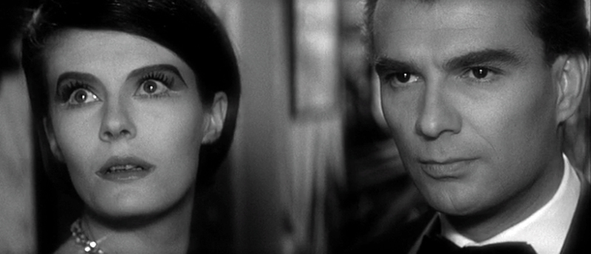

Slide 32
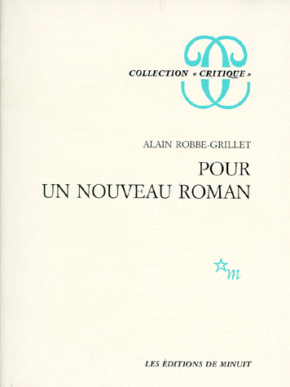

Slide 33
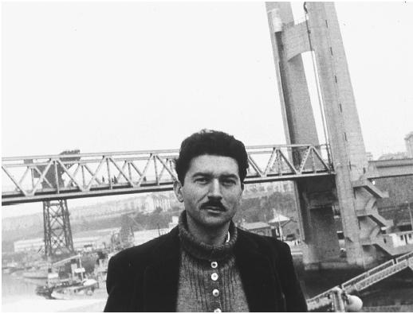

Slide 34
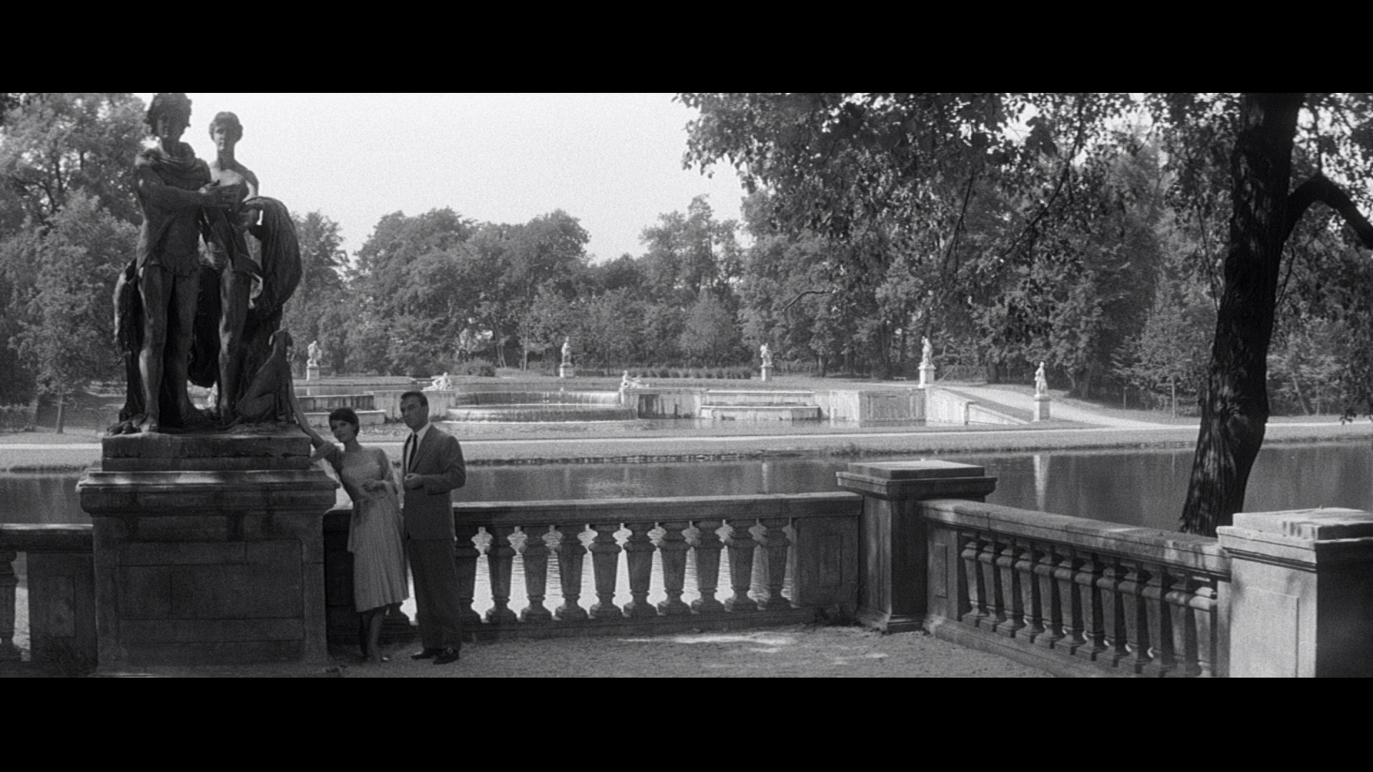

Slide 35
3. The story so far…

Slide 36
4. Synopsis

Slide 37
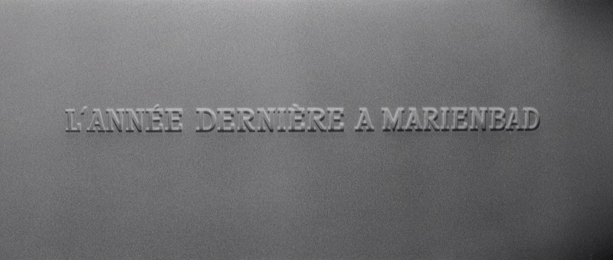

Slide 38
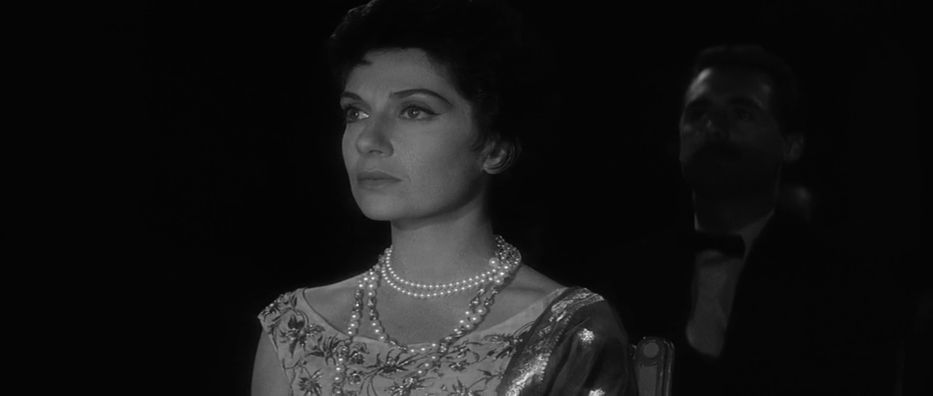
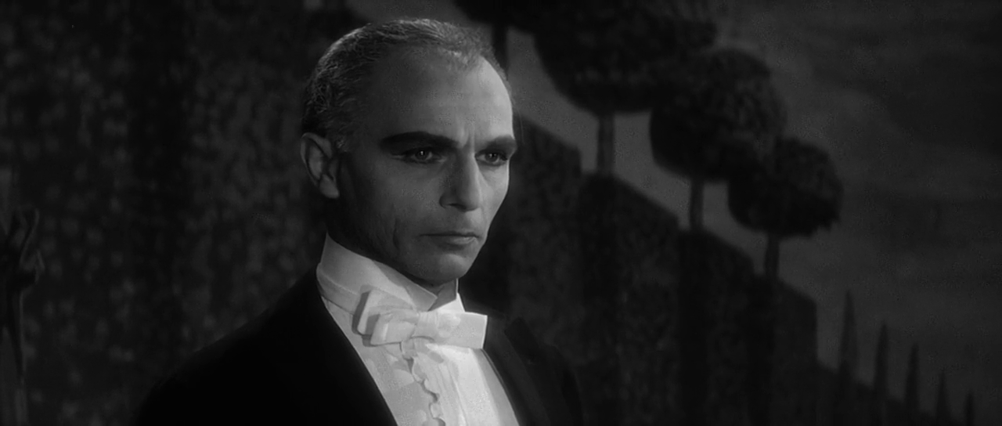

Slide 39
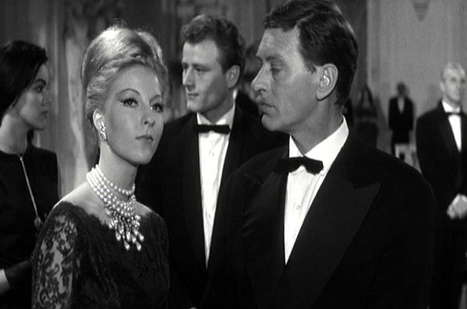
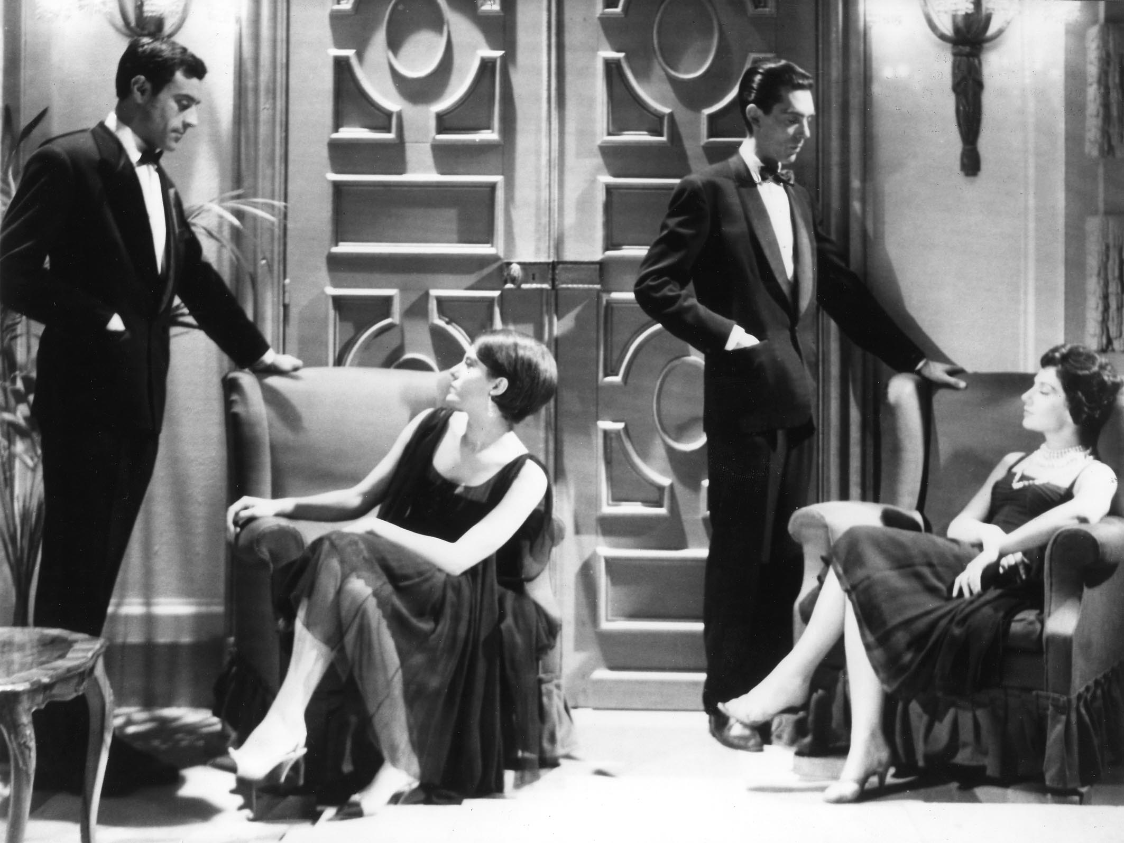

Slide 40
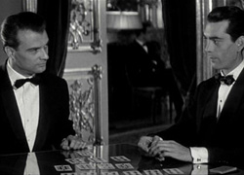

Slide 41
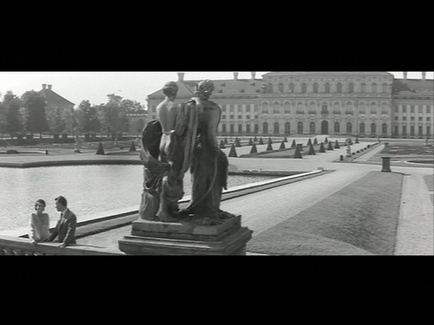

Slide 48
5. …Or did they?

Slide 53
Film: 26,00-27,00

Slide 54
Film: 10,35-10,47

Slide 59
Film: 36,01-37,34

Slide 60
Film: 1,21.10- 1,21.45

Slide 61
Film: 17,03-18,12

Slide 62
Film: 24,42-25,08

Slide 63
6. Un fil d’Ariane

Slide 65
Film: 1,11.15- 1,11.25

Slide 68
Film: 1,15.56 - 1,16.18

Slide 70
Film: 0,00.50 – 0,01.40

Slide 75
Film: 22,45 – 23,38

Slide 78
Film: 1,06,38 – 1,07,39

Slide 79
7. The opening, an opening

Slide 80
Film: 4,31 – 5,59

Slide 81
…silent rooms, in which the footsteps of the advancing figure
are absorbed by carpets so heavy, so thick that no noise reaches
his own ears, as if the ears themselves of the figure advancing once more, along these corridors, through these salons, these galleries, in this building from another century, this immense, luxurious, baroque, lugubrious hotel, in which endless corridors give way to silent, deserted corridors, weighed down by a cold and sombre décor of wooden carvings, stucco, moulded panels, marbles, black mirrors, black-tinted paintings, columns, sculpted door frames, rows of doorways, of galleries, transverse corridors leading in turn to deserted salons, salons weighed down by the ornamentation of another century, silent rooms… in which the footsteps of the advancing figure are absorbed by carpets so heavy, so thick that no noise reaches his own ears, as if the ears themselves …

Slide 82
…were very far, very far from the ground, from the carpet, very far from this heavy, empty décor, very far from this complicated frieze spread across the ceiling, with its branches and garlands, like ancient foliage, as if the ground was still sand or gravel, or stone pavings over which I was advancing once more as though to meet you, between these walls weighed down with carvings, with stucco, with mouldings, with paintings, with framed engravings, amongst which I was advancing … amongst which I was already myself waiting for you, very far from this décor in which I find myself in front of you now.

Slide 86
Film: 1,17.25 - 30

Slide 89
Film: 11,08-11

Slide 90
Parallel lines building a picture (of a skyscraper) in the titles to North by Northwest (1959)
Bland, anonymous characters in Psycho (1960)

Slide 91
8. Conclusion

Slide 92
Film 1,26.30 - end

