Slide 1
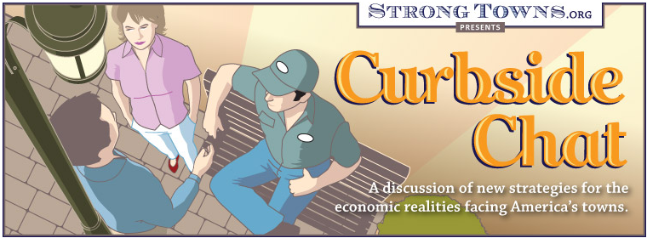
CNU 21 Closing Plenary
June 1, 2013

Slide 2


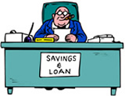


Investment in the community….
Powerful Incentives
Initial cost to the public for new growth: minimal
Benefit to the public budget for new growth: substantial
The catch is that the public agrees to maintain the improvement forever.
…creates new growth…
…which increases tax revenue.

Slide 3
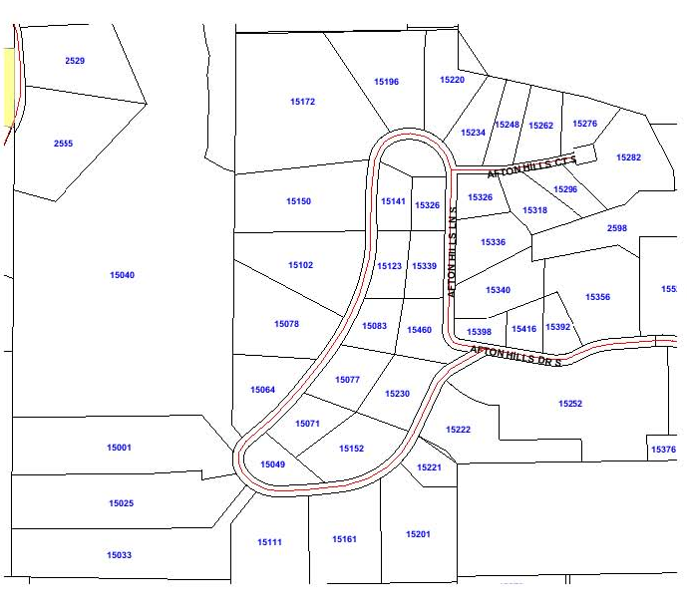
Local Road Rehabilitation
Road Maintenance Project
$354,000 total cost
79 years to recoup public expense from tax base
To break even requires a 46% increase in property tax rates

Slide 4
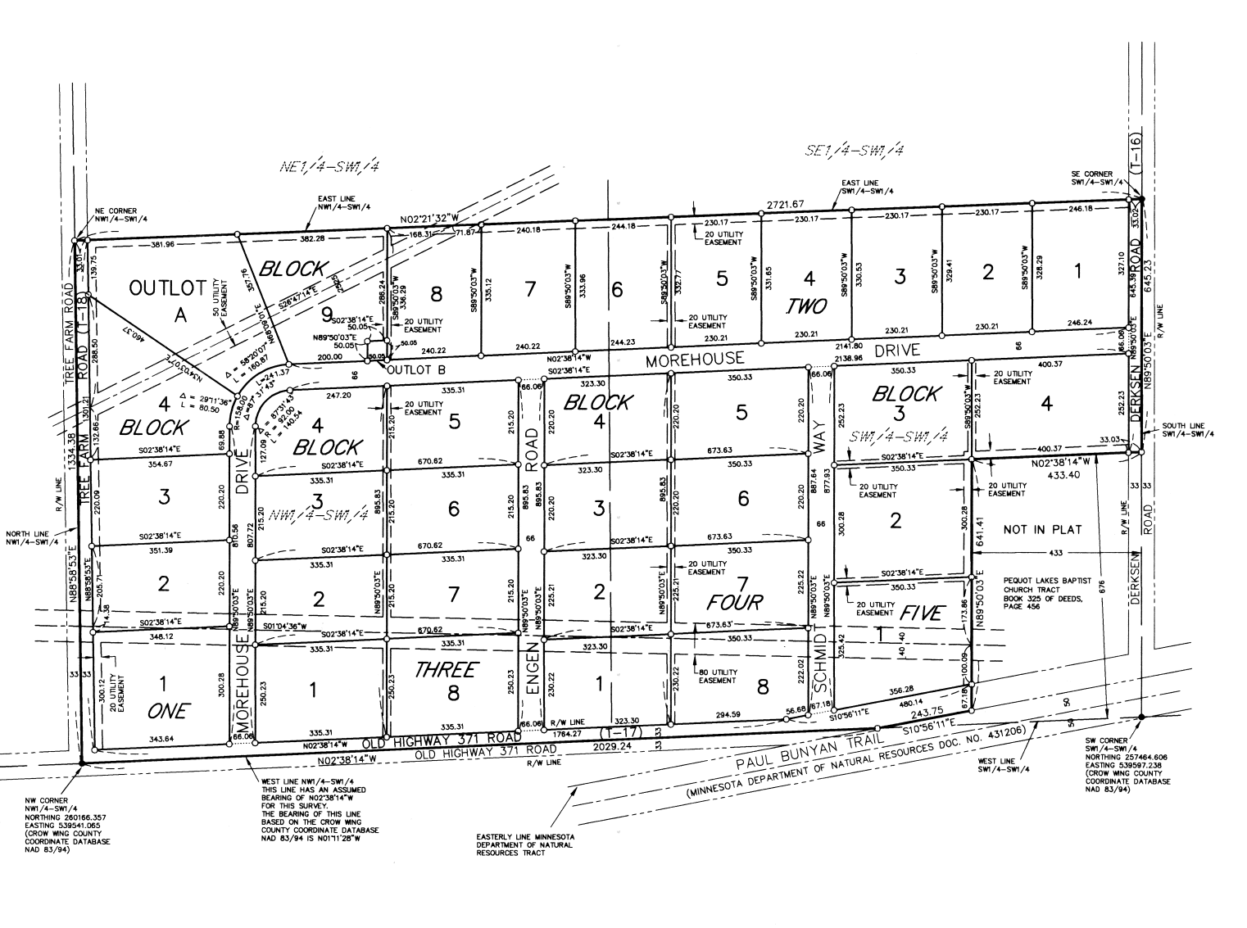
Industrial Development
Industrial Park Development
$2.1 million inflation-adjusted total cost
$6.6 million in improvements induced
Payback from current conditions happens in 29 years if all revenue devoted only to debt

Slide 5
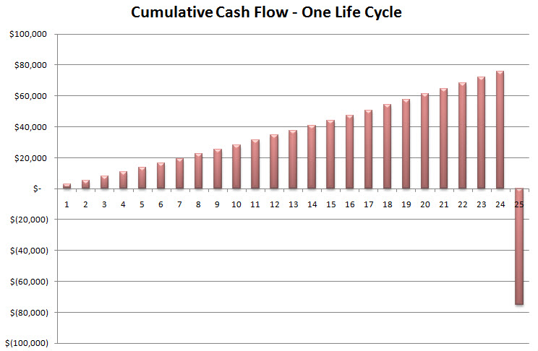
Growth Ponzi Scheme

Slide 6
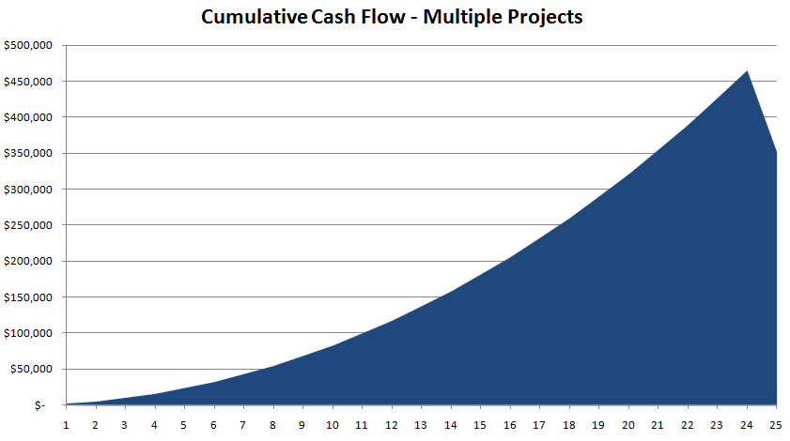
Growth Ponzi Scheme

Slide 7
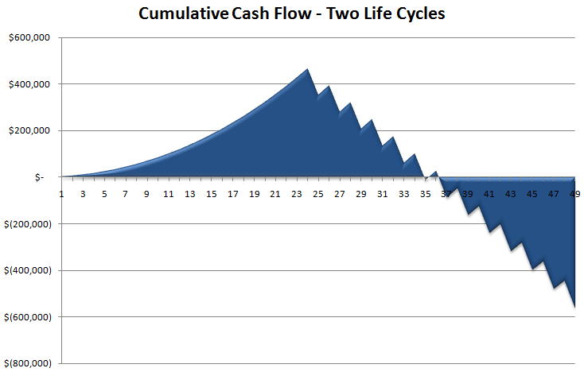
Growth Ponzi Scheme

Slide 8
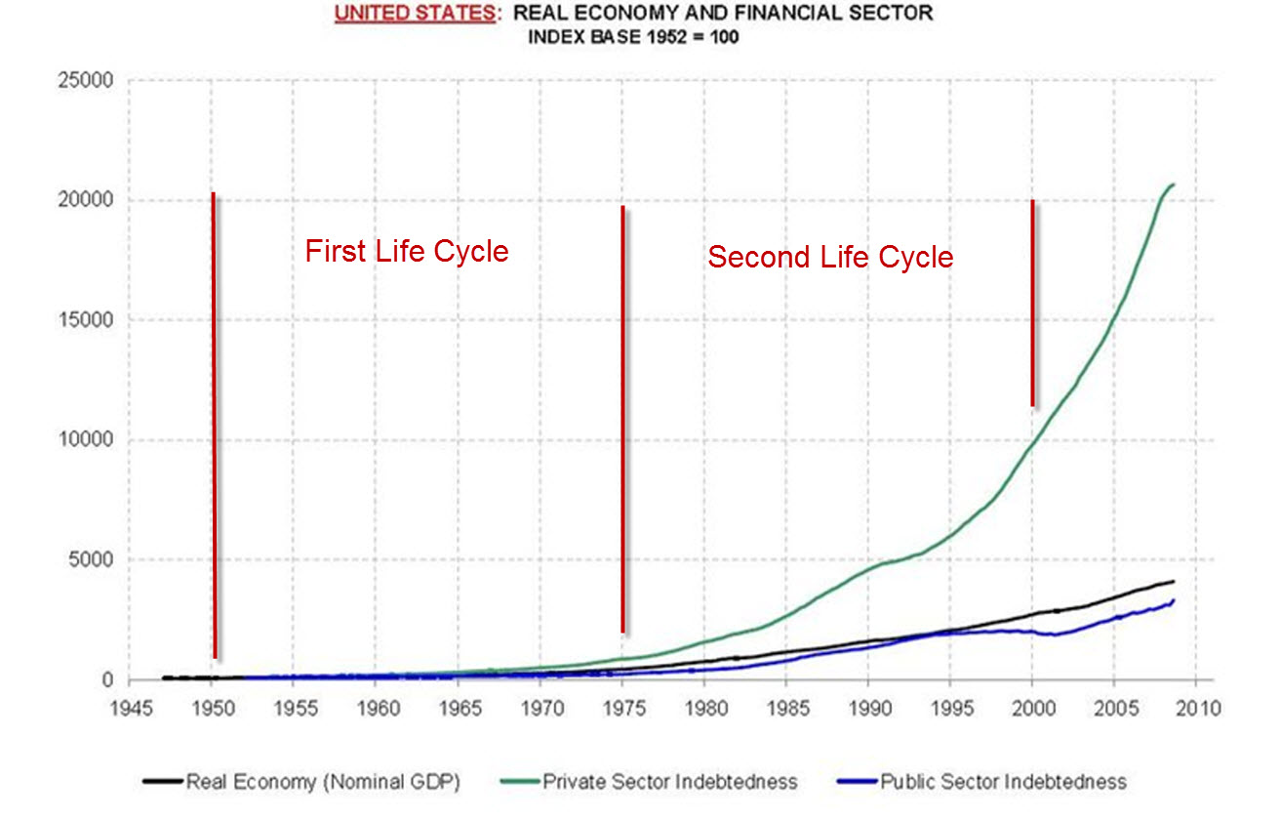
Notes:
http://andrewsullivan.theatlantic.com/the_daily_dish/2009/11/chart-of-the-day-ctd.html

Slide 9
Serious implications for the future
The “Mechanisms of Growth” we have become accustomed to are waning.
Local governments are going to be forced to absorb the local costs of the current development pattern.
This can’t be done in the current pattern of development without large tax increases and/or large cuts in services.

Slide 10
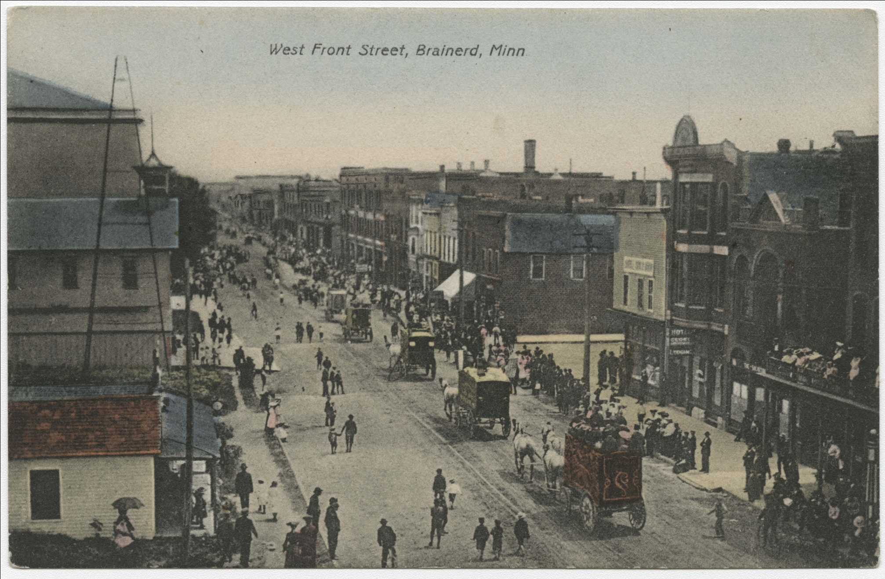

Slide 11
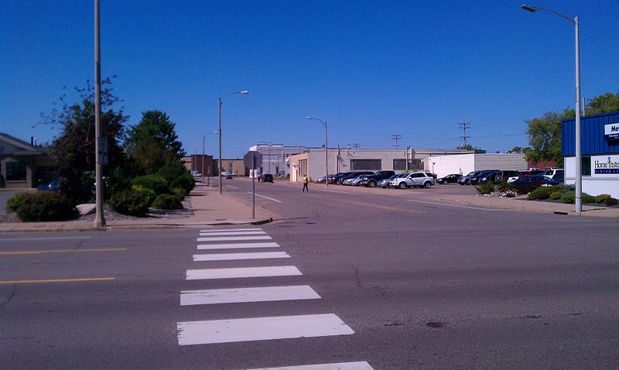

Slide 12
The Next New Urbanism
1. Relentlessly prove ourselves as the high return public investment.

Slide 13
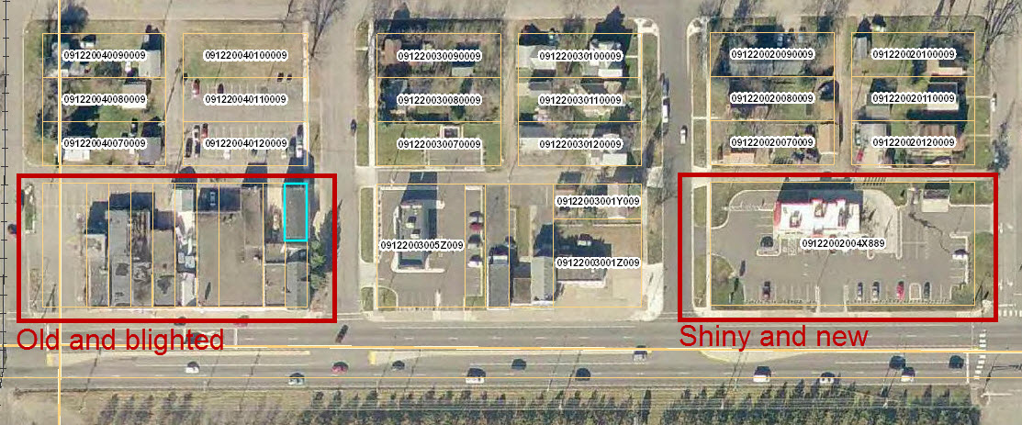
High Return Public Investment

Slide 14
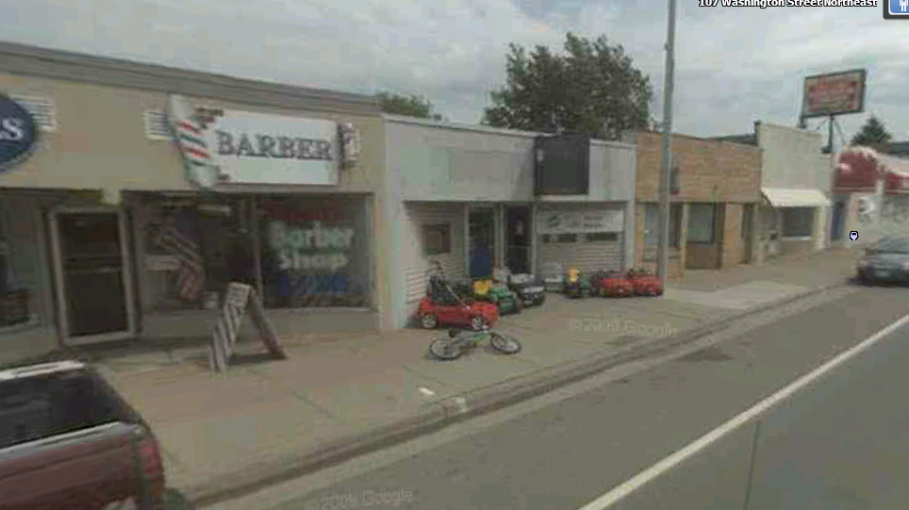
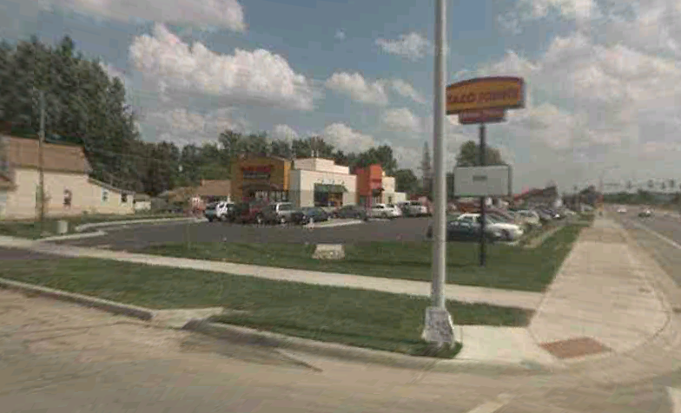
$1,136,500
$803,200

Slide 15
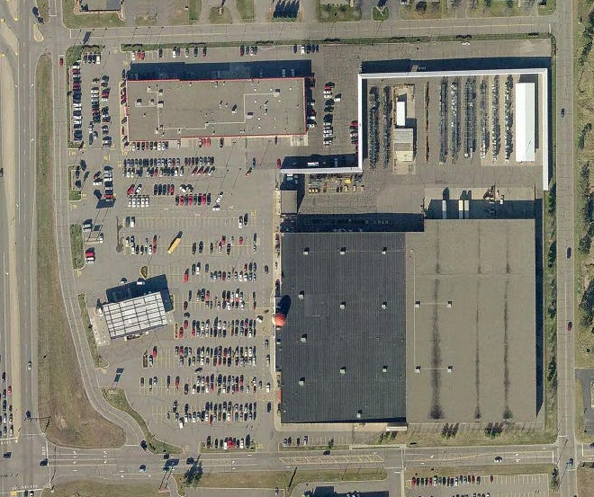
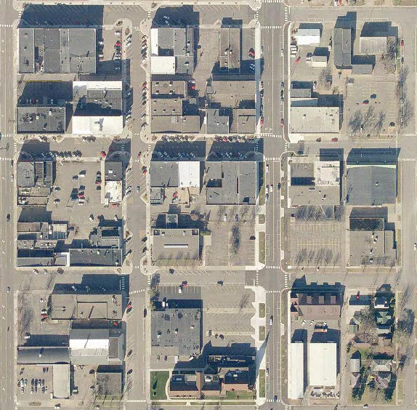
High Return Public Investment
Highway Oriented $0.6 million/acre
Traditional Pattern $1.1 million/acre

Slide 16
The Next New Urbanism
1. Relentlessly prove ourselves as the high return public investment.
2. Champion an incremental approach.

Slide 17
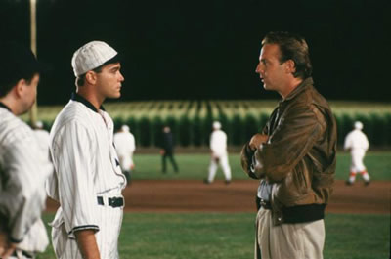
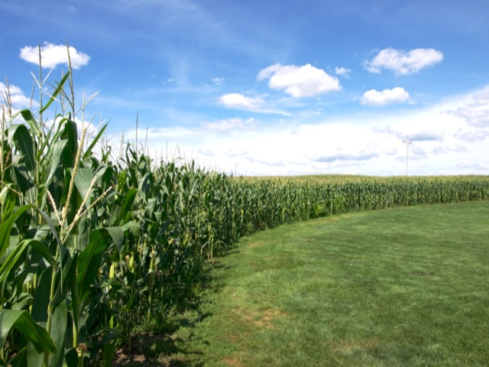
Build it and they will come….

Slide 18
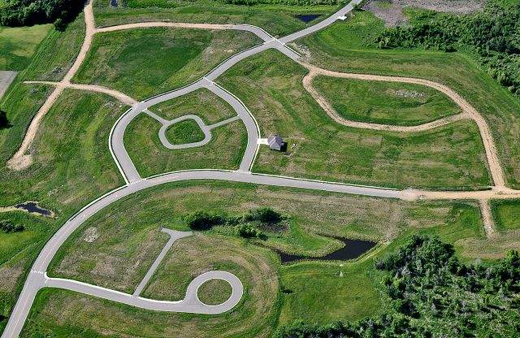
Build it and they will come….

Slide 19
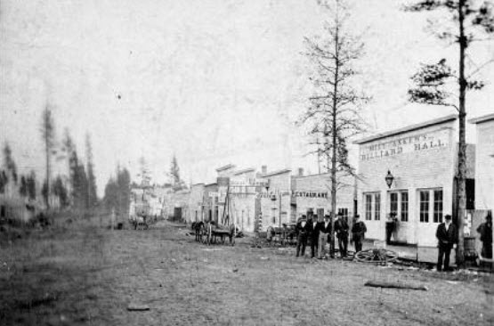

Slide 20
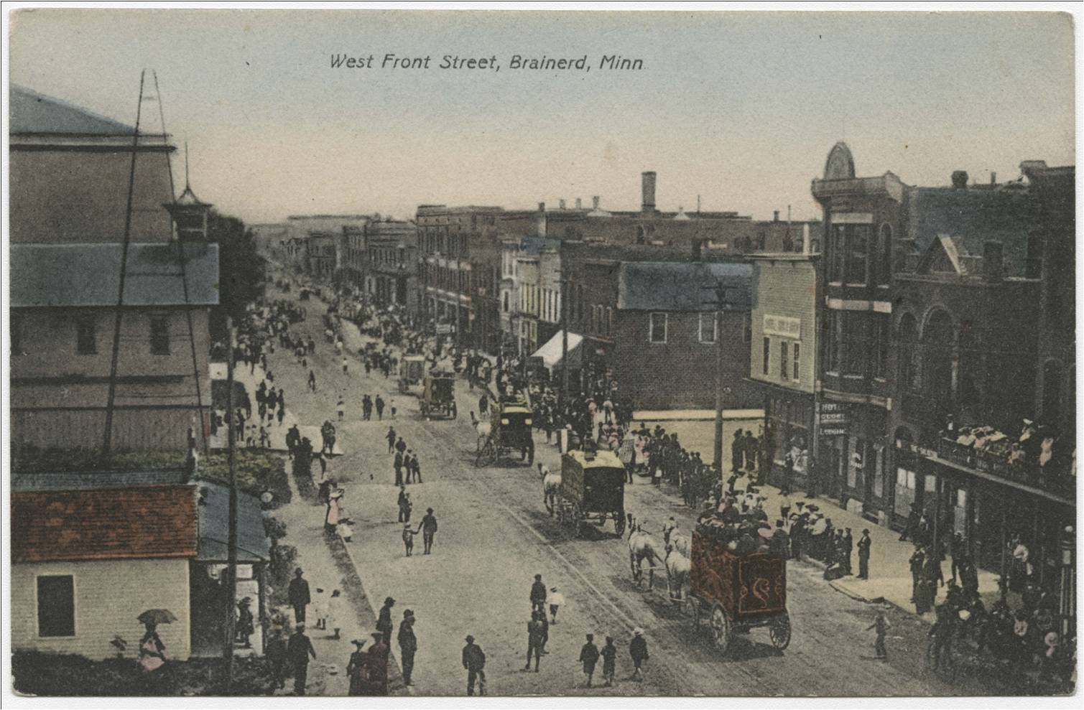

Slide 21
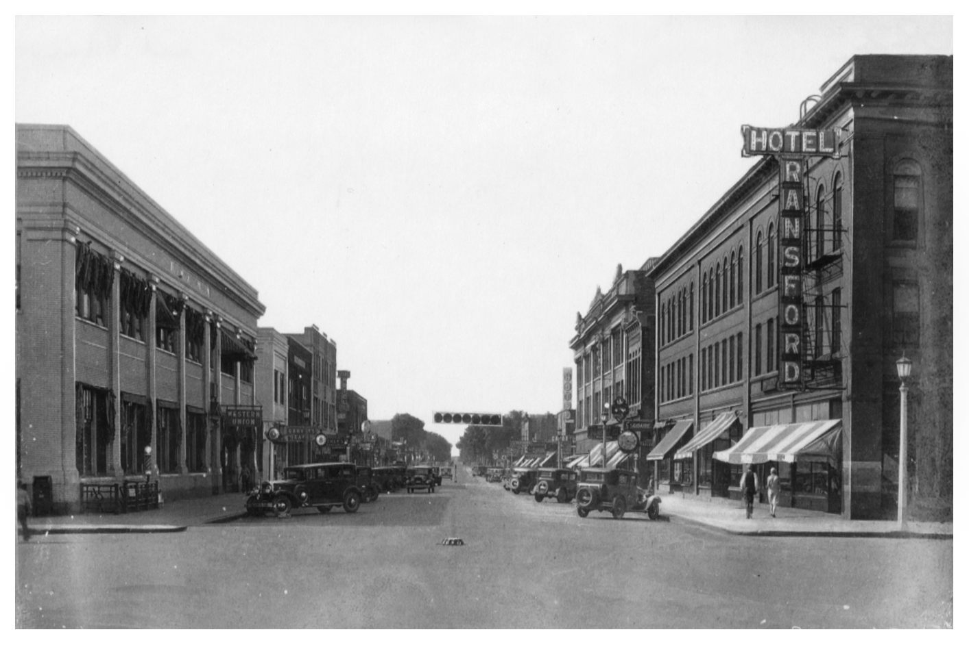

Slide 22
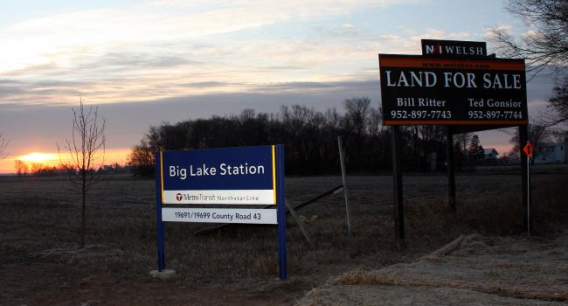

Slide 23
The Next New Urbanism
1. Relentlessly prove ourselves as the high return public investment.
2. Champion an incremental approach.
3. Advocate for an end to top down solutions and instead embrace local problem solving.

Slide 24
Innovation that happens from the top-down tends to be orderly but dumb.
Innovation that happens from the bottom-up tends to be chaotic but smart.

Slide 25
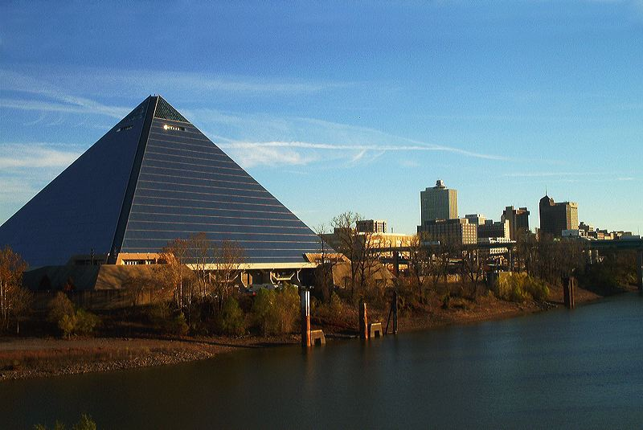

Slide 26
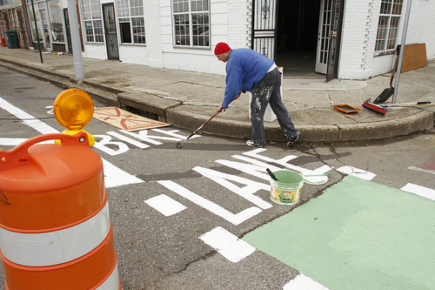

Slide 27
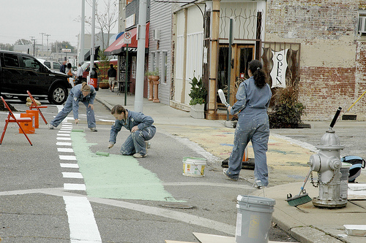

Slide 28
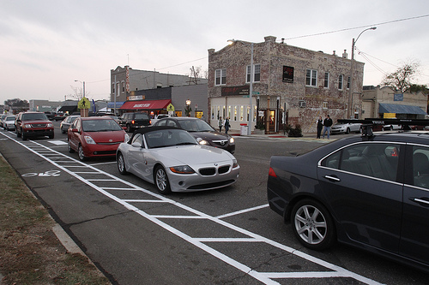

Slide 29
The Next New Urbanism
1. Relentlessly prove ourselves as the high return public investment.
2. Champion an incremental approach.
3. Advocate for an end to top down solutions and instead embrace local problem solving.

Slide 30
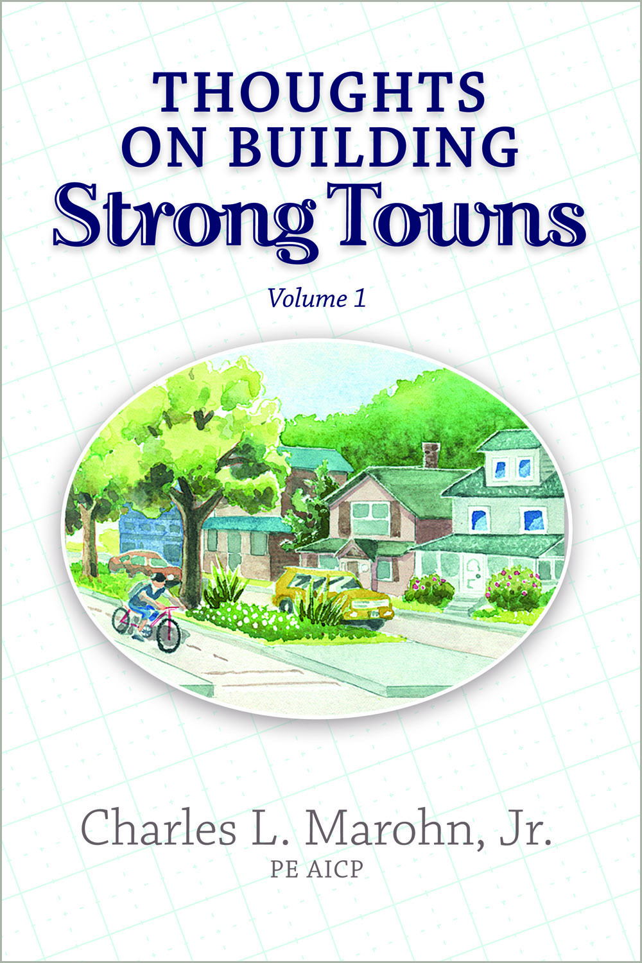
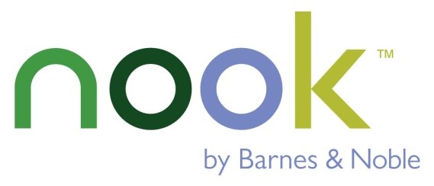

Now Available…
www.StrongTowns.org
www.StrongTowns.net

