Slide 1
Brainteaser
When you apply a certain formula to it:
13 becomes 10
33 becomes 30
72 becomes 55
What does 4 become?

Slide 2
Brainteaser
Switch to binary!

Slide 3
Market Update
NFPs: +192k, U3: 6.7%
Increasing selloff in global equities, tech/biotech hurting
European PMIs mixed, no move from Super Mario

Slide 4
Quantitative Finance Society
Corporate Scandals

Slide 5
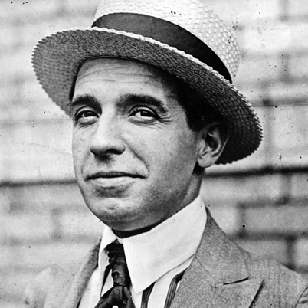
Ponzi
Started at Banco Zarossi in 1907
Served 3 years for forging a signature on a cheque
Originally used IRCs
Promised 50% in 45 days, 100% in 90

Slide 6
Enron
NG pipeline mergers in 1985
SPVs, Mark-to-market, accelerated revenue, the works…
“Well, thank you very much, we appreciate that…asshole.”
Side note: Arthur Andersen surrenders CPA license

Slide 7
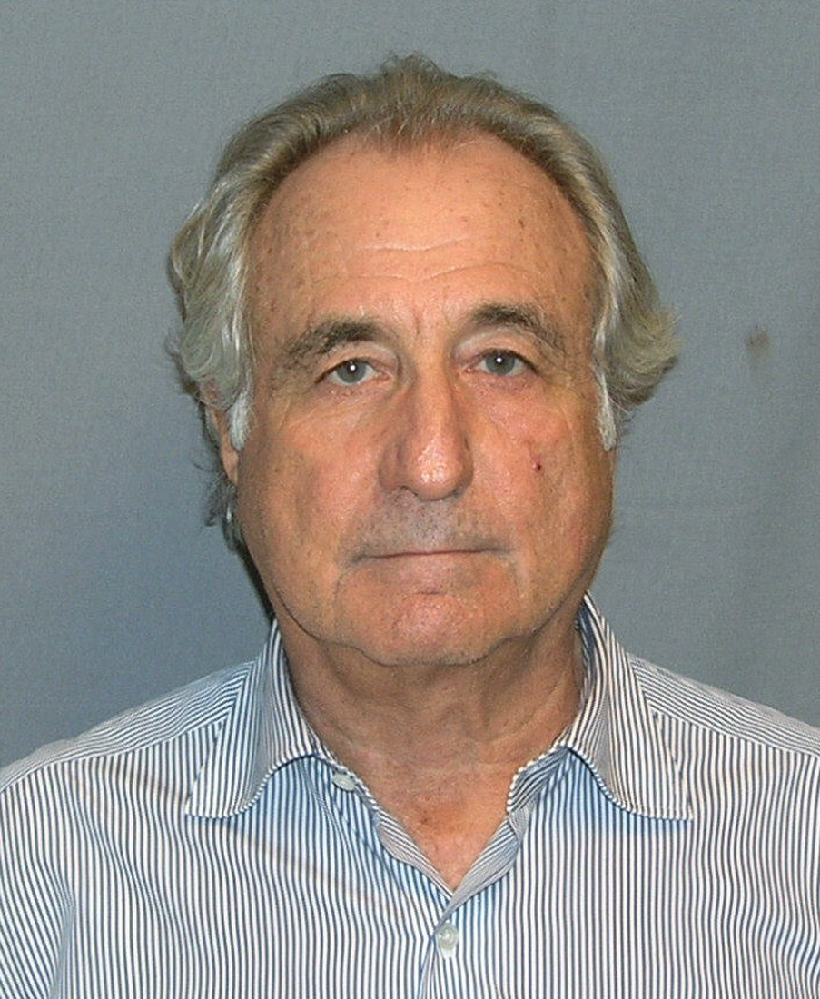
Madoff
NASDAQ market maker
Convertible arb, futures & options
Unusually stable returns
Real business initially, but eventually Ponzi scheme

Slide 8
Sino-Forest
Over 700k hectares in forest land
Wood, pulp, timber, etc.
Rise of Muddy Waters
40 subsidiaries in China, 16 in Virgin Islands
Paulson dealt $720mn loss

Slide 9
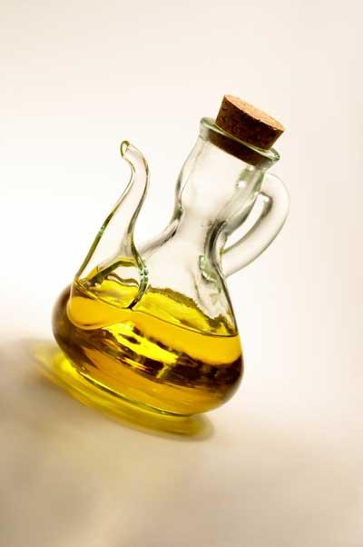
Salad Oil Scandal
Tino de Angelis founds the Allied Crude Vegetable Oil Company
Securitized loans with inventory
Vats and vats of oil, but…
…mostly water!
American Express drops 50%

Slide 10
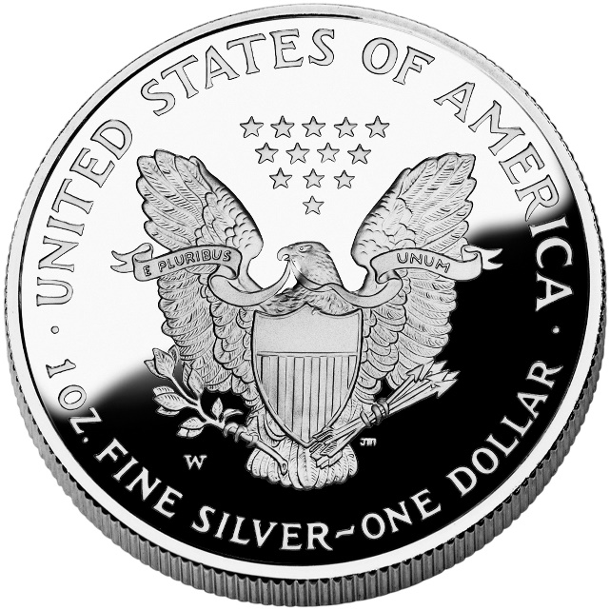
Silver Thursday
Hunt brothers start accumulating silver in 1973
Traded front-month futures on margin, had to roll over
By 1979, controlled over 30% of all silver
Went from $6 to over $45 in one year
COMEX and CBOT step in

