Slide 1
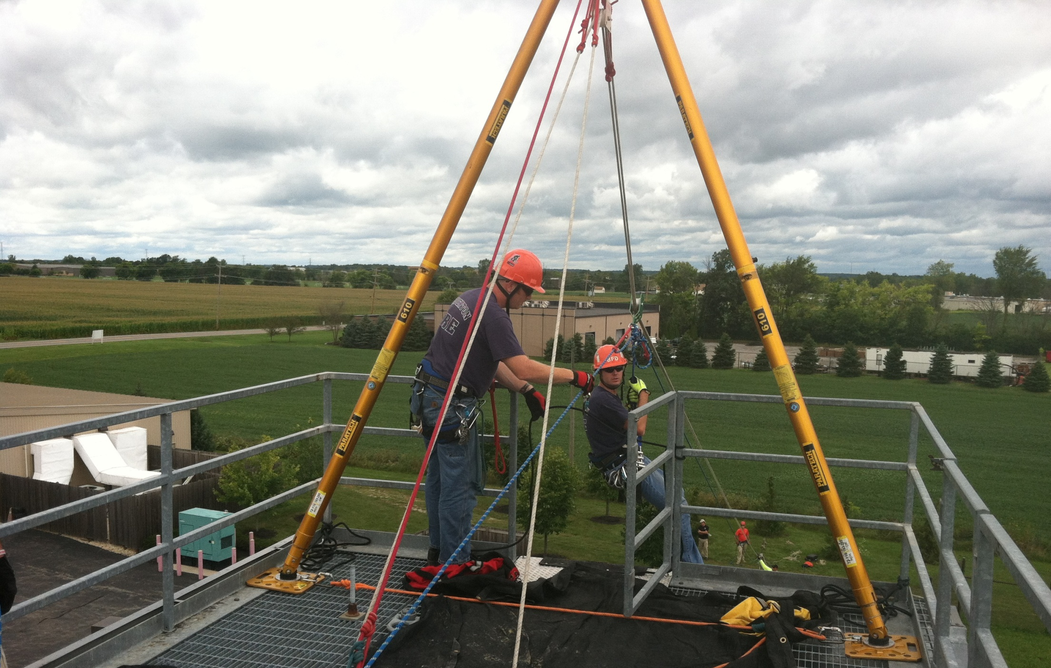
Mod 4: Equipment
Rope Rescue Level I

Slide 2
PERSONAL EQUIPMENT AND PROTECTION
Headgear – NFPA,UIAA, CE
Footwear
Gloves
Harnesses - NFPA
Headlamp - Intrinsically Safe (consideration)
Cutting Tool*
Safety Glasses
Notes:
Discuss the PPE expected for evolutions during the course
Cutting tools should not be utilized at any time during the course by a student unless done so under the direct supervision of the instructor.

Slide 3
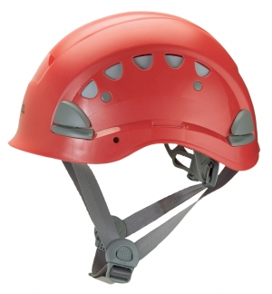
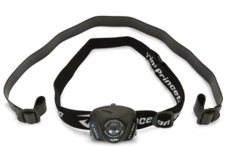
Personal Protection and Equipment
Headgear
Three point suspension
High adjustability
Ventilation properties
Approved protective shell
Lightweight
Narrow profile
Lighting
Lightweight
Variable settings
Notes:
Lighting should have variable settings that are easy to access for different environments and applications
Some helmets have integrated lighting

Slide 4
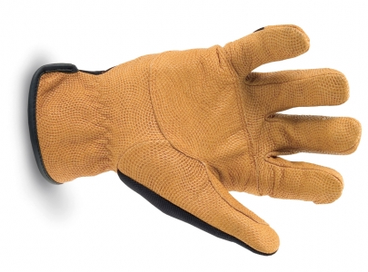
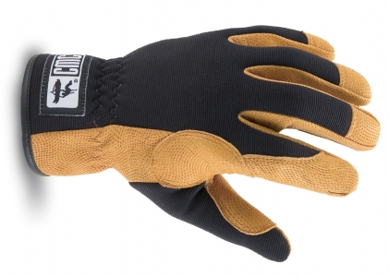
Personal Protection and Equipment
Gloves
Provide dexterity
Weather and environment appropriate
Reinforced to Protect palm and fingers
Notes:
Rope travelling through the palm and fingers can create a great deal of friction, especially on long descents, and require greater protection in those areas than a standard glove

Slide 5
Personal Protection and Equipment
Footwear
Provide ankle support
Weather and environment appropriate
Non slip sole with aggressive tread

Slide 6
HARNESSES
General harness types:
Commercial or manufactured
Improvised
Webbing or Rope
Choose a harness for:
Comfort
Safety
Security
Function

Slide 7
NFPA 1983 Harness Classes
Class I – Seat Harness
Design load of 300 lb (1.33 Kn)
Designed for emergency escape
Features
Comprised of lesser dimension products which impact comfort and security
NOT INTEDED FOR RESCUE APPLICATIONS
Notes:
Discuss the importance of integrated turnout gear escape harnesses not being utilized as rescue harnesses due to their design load and application.

Slide 8
NFPA 1983 Harness Classes
Class II – Seat Harness
Design load of 600 lb (2.67 kN)
Designed for rescue
Features
Limited attachment points
Secure if properly fitted
Rapid donning
Provides a high degree of maneuverability
Notes:
OSHA does not recommend Class II harnesses for rescue applications

Slide 9
NFPA 1983 Harness Classes
Class III – Full Body Harness
Design load of 600 lb (2.67 Kn)
Designed for rescue
Features
Multiple attachment points
High level of comfort and security
May limit ability to invert depending on attachment point
May be time consuming to don

Slide 10
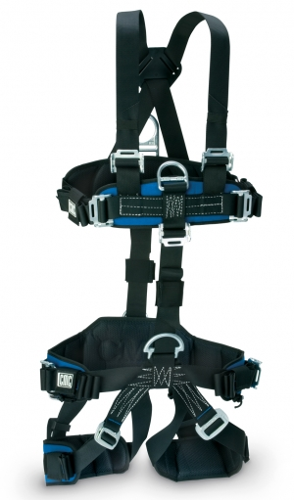
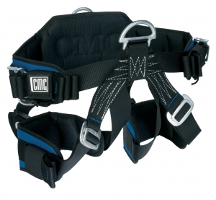
Class III
Class III Combination
Class II

Slide 11
Rope
Classification Of Rope Stretch Per CI 1801-91
Three classifications for rope
Static
Low Stretch
High Stretch or Dynamic
Each classification is based upon the relationship between elongation and MBS.
The following chart depicts acceptable elongation ratios within each classification when a load equal to 10% of the MBS is applied

Slide 12
Rope Stretch Classification
Static = Less than 6% stretch at 10% MBS
Low Stretch = 6 – 10% stretch at 10% MBS
High Stretch = Greater than 10%, typically 40 – 60% stretch at 10% MBS
Notes:
NFPA requires test materials to be evaluated for elongation at 300lbf, 600lbf, and 1000lbf.

Slide 13
Rope Design
Fibers Used To Make Rope
Natural Fibers
Sisal, Hemp And Manila
Qualities
Condemned for rescue use per NFPA 1983
Low resistance to abrasion
Limited ability to absorb shock loading
Strength degradation
Decay
Low breaking strength
No continuous fibers
Notes:
Natural fibers are only as long as the elements they come from and must be spliced together creating weak points

Slide 14
Rope Design
Fibers Used to Make Rope
Synthetic Fibers
Polyolefin (polypropylene or polyethylene)
Polyester (Dacron)
HMPE ( extended chain high modulus polyethylene)
Aramid Fibers
Nylon
Qualities
Do not decay
Do not age as quickly as natural fibers
Produce more advanced configurations and fiber designs than natural fibers
Virgin fibers that can be produced as continuous elements

Slide 15
Fiber Performance Analysis
Notes:
Discuss the four rating categories:
Impact loads
Melting point
Abrasion
TS
Discuss the performance of the different fibers and explain why Nylon is the predominant fiber in life safety rope

Slide 16
Rope Design
Special Properties
Polyolefins (Polypropylene) does not absorb water and floats.
Primary application: Water Rescue
HMPE (Spectra) is extremely slippery and does not hold knots well or resist impact loads
Primary application: Climber’s slings and runners

Slide 17
Rope Design
Special Properties
Aramids (Kevlar) is highly susceptible to abrasion and damages easily with sharp bends. Very high heat resistance
Primary application: Search lines
Polyester (Dacron) maintains strength when wet but is not as resistant to impact loads as Nylon.
Primary application: Life Safety (Rescue)
Nylon (Type 6 and Type 6.6 (Perlon)) may lose 10 – 15% of its strength when wet.
Primary application: Life Safety (Climbing and Rescue)
Notes:
Nylon 6: Perlon
Greater elongation properties thus greater shock loading qualities
Climbing Rope
Nylon 6.6
Higher melting point, Higher breaking point, Better resistance to wear
Rescue Rope

Slide 18
Rope Design
Blends
Fibers can be combined to achieve optimal rope performance
Predominant blends for life safety will involve nylon and polyester
Notes:
Ex: Hybrids or blends result in Nylon retaining strength when combined with Polyester if wet.

Slide 19
Rope Design
Laid Construction (twisted or hawser laid)
Oldest, most familiar design
Twisting of fibers into yarns, yarns twisted into strands, strands twisted into rope
Tends to untwist when loaded
Susceptible to abrasion
Plaited Construction
Bundles of fibers plaited together
Prone to abrasion and “picking”
Tend to be soft and pliable
Notes:
Utility based design

Slide 20
Rope Design
Braided Construction
Solid Braid.
Single weave of three or more fibers
Load supporting fibers vulnerable to destruction
Hollow Braid
Not used for life safety
Sometimes has a filler yarn inside
Essentially a very thick sheath
Notes:
Utility based design

Slide 21
Rope Design
Double Braid
A solid braid (core) covered by a hollow braid (sheath)
50% strength in core and sheath
Outer sheath slips on core easily
Easily contaminated
Susceptible to “picking” and abrasion

Slide 22
Rope Design
Kernmantle Construction
Compound German word – kern = core; mantle = sheath
Core fibers covered by woven sheath.
a. Core = 85% to 95% of rope strength
b. Sheath = 5% to 15 % of rope strength
Does not spin or twist when loaded
Sheath protects load carrying fibers
Block Creel construction
Notes:
Block Creel construction is a requirement of NFPA 1983 for rescue rope
Rope constructed without knots or splices in:
Yarns
Ply yarns
Strands
Braids
rope

Slide 23
Rope Design
Two type of Kernmantle
Dynamic (High Stretch)
This rope is designed with a twisted core that mechanically acts as a spring when under a load
May stretch as much as 60% before failing
Relatively thin sheath
Easy to handle and manipulate
Due to elasticity it performs poorly in rescue applications
Primarily utilized in climbing applications
Notes:
Typically more colorful and more intricate tracer design than rescue rope

Slide 24
Rope Design
Two type of Kernmantle
Static (Low Stretch)
This rope is designed with a core that has parallel cords to facilitate low stretch when under a load
May not stretch more than 20% before failing
Relatively thick sheath
Better protection of the core and abrasion resistance.
Primarily utilized in rescue applications

Slide 25
Rope Design
Rope selection for Rescue Applications
Diameters of 3/8”, 7/16”, 1/2” and 5/8” are most common
7/16” – 5/8” is the required diameter for “G” design load per NFPA 1983
Federal Test Method 191A, Method 6016 insures that rope is in compliance with designated performance standards
Color and patterns can be selected to designate purpose and length
Dynamic rope should only be considered based on fall factor
Notes:
Color and patterns can be utilized to denote:
Application (belay, main, etc.)
Length

Slide 26
Software
Accessory Cord
Smaller diameter rope
Sizes from 3mm to 9mm
2 types of cord
Climber’s cord
Rescue cord
Applications
Progress capture devices (7 – 8 mm typically)
Load Release Hitches (10mm rope preferred)
Notes:
Climber’s cord is more supple and grips better when applied as a Prusik
Rescue cord is static kernmantle, Prusik
Load Release Hitches have better break strengths and performance under impact loads at 10 mm. than at 9mm but most rope manufacturer’s market 9mm as LRH.

Slide 27
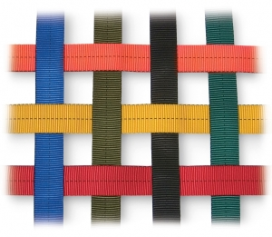
Software
Webbing
Manufactured from nylon or polyester
Application: Improvised harnesses, lashing, utility
Does not absorb shock loading well
Sized from ½” to 2”

Slide 28
Software
Flat Webbing
Single layer of material
More expensive
Stronger but stiffer
Tubular Webbing
Supple and easier to work with
Edge stitched or shuttle loom construction
Less costly
Holds knots better
Notes:
Flat webbing is similar to seat belt material
Tubular webbing will form a tube when rolled by fingers
Water knot is typical knot for webbing

Slide 29
Software
Webbing Strength
1” tubular, nylon (most common)
4000 lb. T.S
2” tubular, nylon
6000 to 8000 lb. T.S
2” flat, polyester
6000 lb. T.S
1” flat, nylon
6000 lb. T.S
2” tubular nylon webbing should be the primary choice for improvised harnesses due to comfort and performance
Notes:
1” tubular webbing has a lower design load and is very uncomfortable for personnel due to the thin diameter.
2” webbing is stronger and more comfortable
If webbing is utilized as life safety attachment points (anchors) it should used in pairs for strength requirements as well as susceptibility to catastrophic failure from abrasion or cutting.

Slide 30
Software Maintenance
Maintain rope logs
Document usage, inspection and maintenance
Logs create a working history of the rope which will help insure safe operations and documentation in case of failure or lack of product performance
Each rope should have a distinguishing identification that correlates to the log. This is usually accomplished by marking the end of the rope and protecting the mark with heat shrink or whip end dip.
Notes:
Every time rope is used it should be inspected and documented
If regular training or usage of rope does not occur, an inspection regimen should be developed per manufacturer’s guidelines
Discuss legal ramifications of not maintaining sound rope documentation

Slide 31
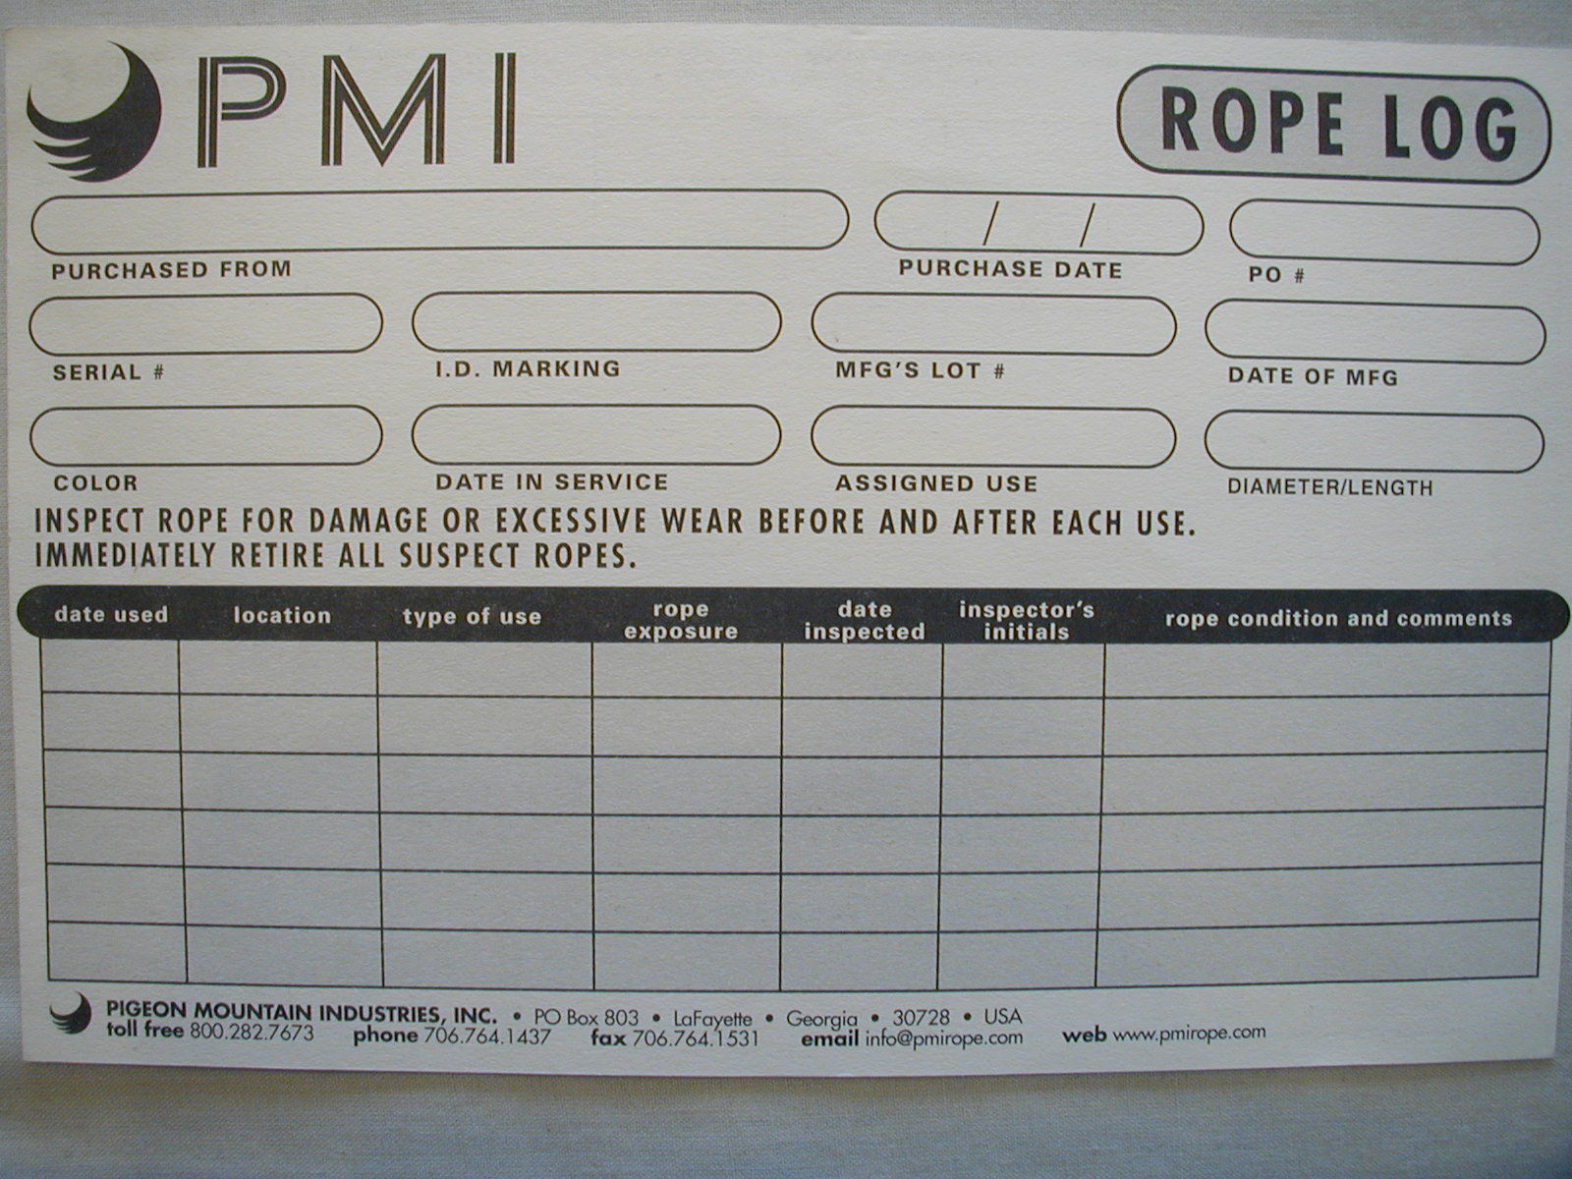
Care and Use of Rescue Rope and Related Equipment

Slide 32
Software Maintenance
Avoid exposing rope to:
Harmful Substances
Overloading
Damage From Falling Objects
Heat Fusion
Excessive Knots and Bending (4:1 / 2:1 Rule)
Flash Rappels
Abrasion
Notes:
Harmful Substances:
Acids – nylon; Bleaches – nylon; Alkalis – polyester;
Heat Fusion:
2 synthetic materials rubbing together, causing heat of friction.
Moving rope against stationary rope
Rope running across harness components
Rope running across anchor material
Preventing heat fusion
Redirect
Rig to avoid contact with specific materials
4:1 rule / 2:1 rule
Rope does not significantly lose strength until it has a bend less than 4 X its diameter (this rule applies to natural fiber rope more than synthetic which realistically uses a margin of 2:1). The 4:1 rule also applies to safety and efficiency margin for pulleys. The diameter of a pulley should be at least 4 X the diameter of the rope to insure safety and efficiency.
Techniques to avoid abrasion
Mechanical edge protection
Improvised rope pads
Commercial rope pads

Slide 33
Software Maintenance
Inspection
Tactile and visual evaluation of software should be conducted before and after each use
Any lack of uniformity in the presentation of the rope or evidence of exposure to the previous list of hazards require the rope or rope section to be removed from service and tagged for retirement
Manufacturer’s recommendations should be followed in regards to rope life span and performance and wear standards
Notes:
Lack of Uniformity
Deformities
Abrasion
Sheath wear
Excessive picking
Discoloration or evidence of substance exposure
Cuts, tears
Repair
If only a section of rope is damaged it can be cut out and the remainder of the rope stay in use

Slide 34
Software Maintenance
Washing Software
Soak products first to gently dislodge debris
Wash products with agitation or direct pressure and gentle soaps or manufacturer’s recommended detergent.
Thoroughly rinse products
Do not heat products to dry them
Protect from UV rays
Commercial hose dryers can be used only if ambient air is circulated
Commercial washers may be used if they are front load and the rope is daisy chained
Commercial devices are also available for use
Notes:
Describe commercial rope washers

Slide 35
Software Maintenance
Storage and Care
Rope should be bagged and stored in well ventilated areas not exposed to UV rays or environmental elements
Do not leave rope on concrete floors due to the presence of potentially damaging sealants and cleaning acids.
Do not walk or step on rope to avoid compressing debris into the sheath
Do not throw rope bags or coils over edges. Lower the tail to the ground.
Notes:
Discuss the use of the bottom grommet to capture the rope with knots above and below
Advantages: creates fixed object on end of rope helps prevent accidental loss of the line
Disadvantages: slows down deployment process if utilizing both ends of the rope with midpoint kills

Slide 36
Software Protection
Software is susceptible to abrasion and cuts and requires padding or mechanical protection at points of contact
Edge rollers
Roof rollers
Entry ease
Canvas or vinyl tarps, bags, or segments
Carpet segments
Fire hose sleeves
Notes:
Discuss the importance of anchoring edge protection

Slide 37
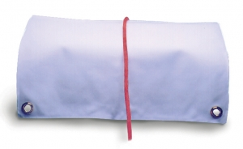
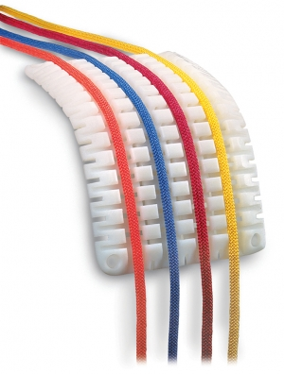
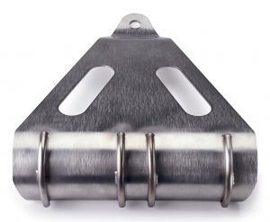
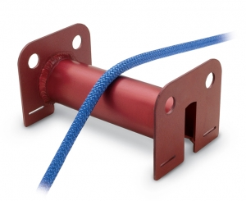
Software Protection
Notes:
Discuss the various environments and impact they have on edge protection (ex: natural terrain may require tarps to cover large areas of exposed rock)

Slide 38
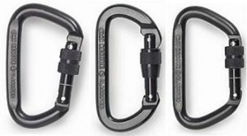
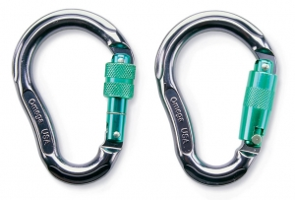
Hardware
Carabiners
Metal components that link the elements of a high angle system

Slide 39
Hardware
Basic Parts Of Carabiner
Spine (major axis)
Latch
Gate
Hinge/Pin
Nose (minor axis)
Notes:
Latch – Depends on manufacture – 3 Basic styles:
Claw – Claw slips into slot on nose
Key lock – Key hole shaped slot. Does not snag soft material
Pin - Pin gets trapped in slot, adds to overall strength
Gate - 3 Basic Styles
Non locking.
1. 1st Carabiners designed for rock climbing.
2. Easily opened for accidental release of components.
“Reversed and Opposed”
Locking
Collar that manually threads to lock
Auto Locking
¼ turn collars or detent pins that when manipulated lock and unlock

Slide 40
Hardware
Carabiners
Various locking mechanisms and design features
Alloys and lightweight composites have created lighter and stronger carabiners
Performance capabilities of carabiners can only be evaluated through their labeling
Hard linking, gate loading, over loading, and accidental gate opening under load can cause catastrophic failure.

Slide 41
Hardware
Basic Shapes of Carabiners
Oval
“D” Shape
Modified “D”
Pear shaped (HMS)
Designed for use with a munter hitch

Slide 42
Construction Materials for Carabiners
Aluminum Alloy
Advantages
Light weight
Do not rust
Less expensive
Disadvantages
Not as strong as steel
Easily damaged
Locking mechanisms may wear out
Steel and Steel Alloys
Advantages
Very strong
Locking mechanism hold up better than some aluminum
Disadvantages
Heavy
More expensive
Potential for rust (unless plated or stainless steel)
May spark

Slide 43
Carabiner Strength and Labeling
Strength ratings usually represent the ideal situation
Established with latch closed and locking mechanism activated
User should also know unlocked strength, gate open strength and short axis strength
4 Labeling systems for carabiners sold in U.S.
CE and UIAA
NFPA and ANSI
Notes:
CE and UIAA
1. CE – European committee for standardization.
2. UIAA – Union of International Alpine Association.
3. Stamped with major axis, minor axis and gate opening strength shown in kilonewton’s (kN)
NFPA
1. Carabiners meeting NFPA 1983. 01 ed. Standard on life safety rope and auxiliary equipment marked with the following:
a. Meets NFPA 1983 – 01 ed.
b. Logo at manufacturer.
c. Label of 3rd party that certified product.
d. “P” or “L” for personal or light use, “G” for general use.
e. Major axis breaking strength with gate closed
ASTM F32 Search and Rescue Committee

Slide 44
Carabiner Strength and Labeling
NFPA requirements for labeling
Permanently affixed labeling 2mm or larger
“G” – General Use
“L” – Light Use
“E” – Personal Escape
“MBS” – Minimum Break Strength
“Meets NFPA 1983 2006”

Slide 45
Carabiner Strength and Labeling
NFPA 1983 testing requirements for carabiners and screw links
Light use major axis gate open: 7 kN (1574)
Light use major axis gate closed: 27 kN (6069)
Light use minor axis gate closed: 7 kN (1574)
General use major axis gate open: 11 kN (2473)
General use major axis gate closed: 40 kN (8992)
General use minor axis gate closed: 11 kN (2473)
Design loads for all hardware require:
Light Use: 1.33 kN (300)
General Use: 2.67 kN (600)
Notes:
First listings are the testing requirement loads for carabiners and screw links
Design load listings apply to all hardware

Slide 46
Carabiner Strength and Labeling
Application
Strength and labeling of carabiners should be used as a guide to select the proper device for the required performance
Sound knowledge of theoretical forces applied and system engineering are required for safe and appropriate usage of carabiners.
Two basic categories of carabiners
Light Use: (300 lbs.)
General Use: (600 lbs.)

Slide 47
Carabiner Strength and Labeling
Notes:
Discuss the labeling elements of the two examples and what they are designed for

Slide 48
Hardware
Screw Links
May replace carabiners as certain links in the high angle system – predominantly harness attachment
Various shapes with common locking mechanism
Advantages
Inexpensive
Strong regardless of direction of load

Slide 49
Hardware
Screw Link Advantages
Inexpensive
Strong regardless of direction of load
Small – reduce rigging length
Screw Link Disadvantages
Screw links can become misaligned if forces are applied when they are not locked.
Must be screwed fully for strength
Require high number of turns to operate sleeve

Slide 50
Use and Care of Carabiners and Screw Links
Inspection
Excessive side loading of gates (tightness)
Hinges, pins, latches, threads
Burrs and scratches
Care
Wash and dry
Apply WD40 to hinges, wipe off excess
Keep secure to gear slings or harness.
Do not drop, kick or toss.
Remove from service if dropped from significant height

Slide 51
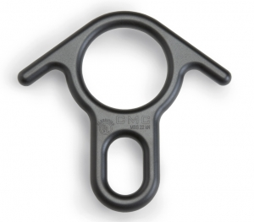
Descent Control Devices
Rescue Eight
Break Bar Rack
Friction is adjusted by manipulation of the rope and offers limited control
Friction can be multiplied through rigging but must be unloaded to do so
Friction is adjusted by manipulation of rope and bars and offers superior control
Friction can be multiplied and reduced by integration or removal of bars without unloading
Notes:
Rescue 8
Discuss the single loop and double loop for friction option
Discuss inability to change rigging once loaded
Rescue 8 twists rope
Inexpensive and quick to rig (good option for a rapid rappel to perform victim assessment)
BBR
Discuss physics behind the rigging and how to adjust it even while loaded
Does not twist rope
Expensive and slower to rig (recommended DCD for rescue applications

Slide 52
Brake Bar Racks
Steel or Aluminum
Steel: Greater speed less control
Capabilities
Can accept two ropes
Aluminum: Slower with greater control but glazing occurs
Twisted Eye, Straight Eye, “U”
Proficiency
Require greater degree of training to master
Frame
Bars
Nut
Eye
Notes:
Primary DCD for rescue work – can be utilized to rappel with as well as system lowering
Steel generates less friction and lasts longer but is a faster rack and requires a higher degree of mastery
Aluminum generates greater friction and glazes the rope with aluminum residue and generates more heat. Aluminum racks are slower and easier to control.
Both are available in NFPA compliant variations
Two ropes can be passed through the rack (ex. Lowering a stokes basket with ropes rigged to each end for greater control and safety)
Rack orientation determines type of rack to be used. The rack should always be oriented with the nut down.
Twisted eye: waist attachment where metal rigging point is sewn in horizontally.
Straight eye: chest attachment where vertical webbing loops are rigged together with a horizontal tri link
“U” has no rigging eye and the frame forms a “U” with a nut on each end – limited application
Proficiency
As rescuers, we must trust the engineering of the BBR and allow it to perform. It takes repetition to develop a tactile understanding of the necessary force and manipulation required to allow the rope to travel at our discretion.
BBR anatomy – point out the elements of the BBR with special attention to the hyper bar as an option.

Slide 53
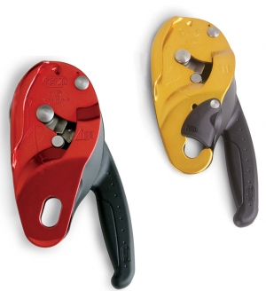
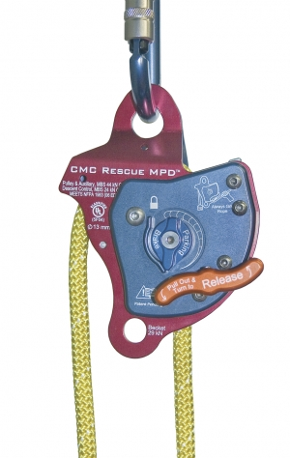
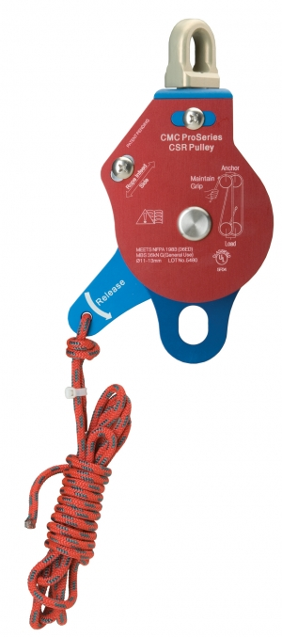
Descent Control Devices
Specialized Devices
Often serve multiple purposes
Escape DCD’s
Notes:
Items (few examples)
Petzl ID
CMC MPD
CMC CSR
Generally easier to use and “fireman proof” but are significantly more expensive
Some Can perform the role of hauling hubs as well as DCD’s.
Some devices use a toothed cam which can cause severe damage or failure to rope subjected to impact loads – may also cause “picking” of the sheath.
Escape DCD’s will not meet NFPA standards for rescue applications and should only be used for designed purpose.

Slide 54
Strength and Labeling Requirements
NFPA 1983 testing requirements for descent control devices
Personal escape: 13.5 kN. (3034)
Light Use: 13.5 kN. (3034)
General Use: 22 kN. (4946)
Notes:
Discuss the importance of using the right rack for the job – “G” rated BBR should always be utilized with a design load of 600 lbs and highly recommended for all rescue applications because of the potential for a two person load. If the two person load is equal to a one person load (design load of 300 lbs), a light use device could be used but erring on the side of over engineering is recommended when load values are unknown.

Slide 55
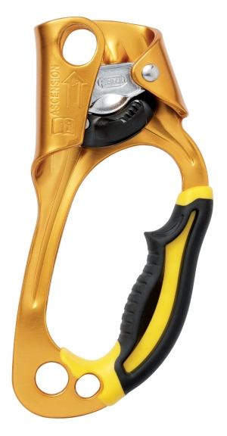
Rope Grab Devices
Personal Ascenders
Used to travel up a fixed rope
Designed for one person’s body weight
May have handle with safety catch to apply with one hand
Most are for ½” ropes or less
Slide freely in one direction, locked in place after correctly applying downward force. Toothed cam grips rope
Notes:
Devices that grip the rope when needed
Self rescue
Ascending / climbing

Slide 56
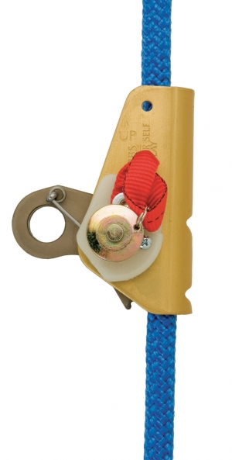
Rope Grab Devices
General Use Ascenders
Must be taken apart to apply on rope
Hold well on wet, icy and muddy ropes
Teeth designed to cause minimum damage to rope sheath
2 Most common
Gibbs®
Rescusender®
Not intended to be used in belay systems
Notes:
Gibbs® – Many modals and sizes
Rescusender® – less damaging to rope under stress of hauling systems
Can be used in hauling systems but do not perform as well under overloading or impact loads as Prusiks which provide “forgiveness” factor through the application of better energy absorption and slippage which provides visual and audible indicators.

Slide 57
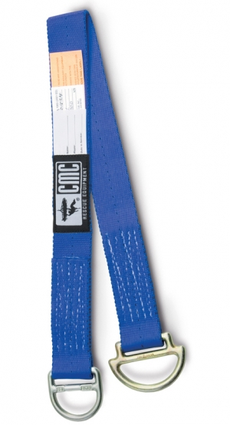
Anchoring Equipment
Anchor straps
Designed to be stand alone elements that can have their own edge protection to provide rapid deployment anchors
NFPA
Light Use: 32 kN (7194)
General Use: 45 kN (10,120)
Application
Can be configured as basket, straight, or choker
Notes:
NFPA requirements indicate minimum break strength
Application carries wide differential in strength
Basket – strongest
Choker – ½ strength

Slide 58
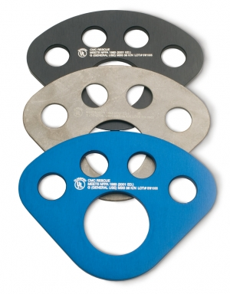
Anchoring Equipment
Anchor Management Hardware
Keep anchor systems neat and orderly
Rigging Plates
“O” Rings
Notes:
Not essential but provide multiple attachment points to facilitate accurate rigging

Slide 59
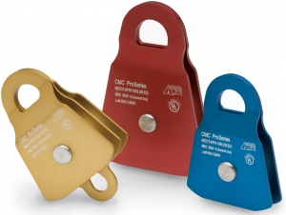
Pulleys
Application
Reduce rope friction
Change direction of a running rope
Position a rope more conveniently
Directionals
More room to work
Reduce abrasion
Development of mechanical advantage hauling systems
Notes:
Pulleys can be replaced with carabiners as an example but the friction generated would negate the advantages gained
Directionals allow:
Hauling lanes to be created and oriented how desired
Maximum spacing to be created vertically for victim retrieval at an edge
Relocate the path of rope when it would be in contact with an abrading entity
MA hauling systems maximize rescue efficiency

Slide 60
Components of Pulleys
Side Plates
Axle and Nut
Sheave
Bearing
Notes:
Pulley anatomy

Slide 61
Bearing Types
Bronze Bushing
Ball Bearing
Very strong
Less expensive
Easily contaminated by dirt and grit
Can be disassembled for cleaning
Turns more freely then bronze bushing
More expensive
Some are sealed to protect from contamination
Susceptible to blows, stress

Slide 62
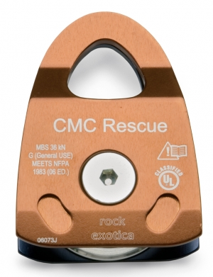
Pulleys
Types of Pulleys
Single Sheave: 2”, 3”, and 4”
Double Sheave: 2”, 4”, Becket
Prusik Minding: 2”, 3”
Extended and squared side plates
NFPA requirements
Light Use: 22kN (4946)
General Use: 36kN (8093)
Advancements
Alloys
High efficiency
Size
Notes:
Description of single and double pulleys
Description and purpose of PMP
Advancements
Use of alloys and high efficiency design have led to very light weight small pulleys with General Use ratings

Slide 63
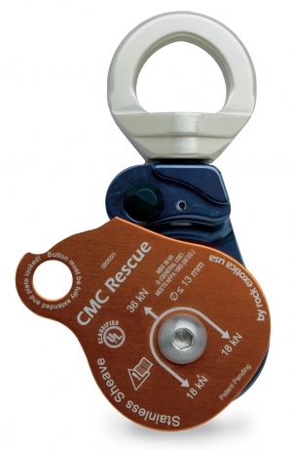
Pulleys
Specialized Pulleys
Integrated Swivels, High Line Carriage, MPD, CSR
Notes:
Integrated Swivel
Rights itself
Possesses side locking side plates so that rope can be rigged and unrigged without removal from carabiner or dependent load
High Line Carriage
Multiple attachment points for highline rigging
Also serves as knot passing pulley
MPD – Mulyi Purpose Device
Self contained lower and haul system with self minding cam
CSR – Confined Space Rescue system
Self minding cam

