Slide 1
Custom REST services and jQuery AJAX
Building your own custom REST services and consuming them with jQuery AJAX

Slide 2
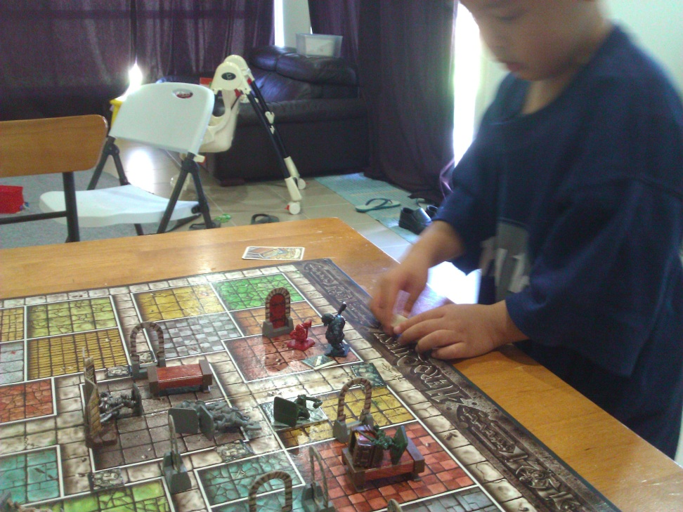
about John Liu
Senior Consultant for SharePoint Gurus Sydney
Blog http://johnliu.net
Community: user groups, SharePoint Conferences and SharePoint Saturday
@johnnliu
Loves .NET - SharePoint 2007, 2010, Silverlight & Windows Phone
Video games, board games, D&D
Notes:
Keith (geek in training), cheating his dice roll while I'm taking this picture because he didn't get enough skulls to hit the ogre.

Slide 3
Contents
Intro
  jQuery
  REST API (out of the box)
Create SOAP service
Create REST service
Highly responsive websites with jQuery AJAX
Create ADO.NET DataService

Slide 4
Intro - jQuery in 1 slide
JavaScript library
Select using CSS rules, then do something with the selected set
Lots of helper functions, utilities
Externally injected so doesn’t interfere with how SharePoint works
$("div.mybox").addClass("yourbox").show();
http://jquery.com/

Slide 5
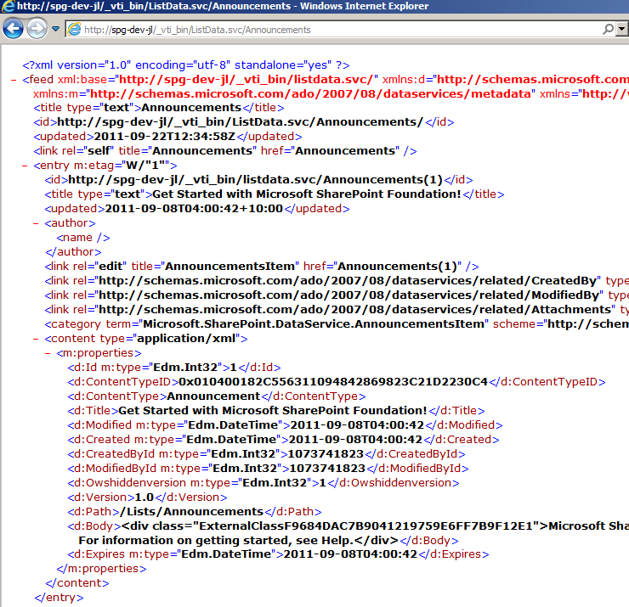
Intro - SharePoint REST API in 1 slide
/_vti_bin/ListData.svc/

Slide 6
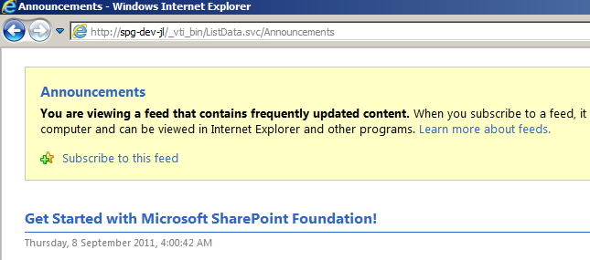
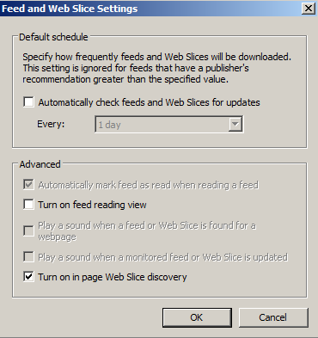
Quick tip with IE
If you see this, IE is trying to be helpful
Uncheck!

Slide 7
What are REST useful for?
Within SharePoint - not much Incorrect - see John's KnockoutJS presentation - REST in 2010 ROCKS.
With other applications - extremely useful
Very simple interface that many 3rd party apps know how to talk
  Phone apps, JavaScript apps
  Reporting apps, integration apps
  SOAP is a lot more complex with creating the right SOAP envelop
  REST is easy as long as you can make a web page request

Slide 8
Question before demo
How many have written web parts for SharePoint
How many have build your own WCF services at some point
  (for SharePoint?)
Notes:
Web API.
Simplying how you can write REST services over HTTP
(new) How many of you have looked at MVC 4
(bonus) What's the key feature of MVC 4?

Slide 9
Write your own SOAP and REST services
Code Demo
Notes:
Write your own SOAP and REST services
Create soap service
Deploy and see the /mex
Issues with binding
Create REST service
Look at the result
What we can do in REST – full SPContext
Create a dumb web part
Smarts in javascript.
See result
See Javascript
Network payload
JavaScript debugging
PUT service
DataService

Slide 10


Building your own WCF services
Useful for InfoPath
SP2013 - new Workflow Action "Call HTTP Web Service"
The problem with WCF:
Error “This collection already contains an address with scheme http”
Configuration necessary in web.config
Use Microsoft.SharePoint.Client.Services.MultipleBaseAddressBasicHttpBindingServiceHostFactory
Notes:
WCF service can only have 1 base address header
Can cheat either in code or in configuration

Slide 11
What you can do in a REST service
SPContext.Current
Check current user's roles and permissions
Make read and write database calls
SPSecurity.RunWithElevatedPrivileges
SPUtility.SendEmail
Perform disk IO
Use Microsoft.SharePoint.Client.Services.MultipleBaseAddressWebServiceHostFactory
Reminder: remember SPDisposeCheck

Slide 12
AJAXify your UI
Define: AJAX
  do it without refreshing the browser. This means a seamless user experience
Grab just the data I need from a quick service call
Find where I want it to go
Form HTML string and append() into the existing DOM structure

Slide 13
AJAX vs. Web Parts
AJAX
ASP.NET Web Parts
Script runs on client
Need to learn jQuery AJAX
Debug in browser
Small payload
Client side DOM manipulation
Best Feature
Responsive fast UI
ASP.NET hosted code
Learn ASP.NET page lifecycle
Debug in server
Larger page size (waiting…)
Connected web parts
Configuring webparts is easier for non-developer

Slide 14
Deploy is simple
Farm Solution
But doesn’t interfere with your site collections or deploy anything into SharePoint
Stuffed up? Delete the service folder and it's gone!
WebParts can be sandbox solutions – so if your service is stable, you only need to deploy/redeploy sandbox webparts to update your UI / script
Your script can be stored in the library, can be modified without redeploy

Slide 15
Debug? Where!?
Debug service on the server
  Holds up App Pool -
Debug webpart on the browser
  Holds up only your own browser
  IE9's dev tools is pretty good tool

Slide 16
Write your own Dataservices
Bonus Demo
Notes:
Write your own SOAP and REST services
Create soap service
Deploy and see the /mex
Issues with binding
Create REST service
Look at the result
What we can do in REST – full SPContext
Create a dumb web part
Smarts in javascript.
See result
See Javascript
Network payload
JavaScript debugging
PUT service
DataService

Slide 17
Future of jQuery, AJAX and REST
jQuery data binding
  Jquery-tmpl
  jQote
KnockoutJS
  MVVM data-binding on client side

Slide 18
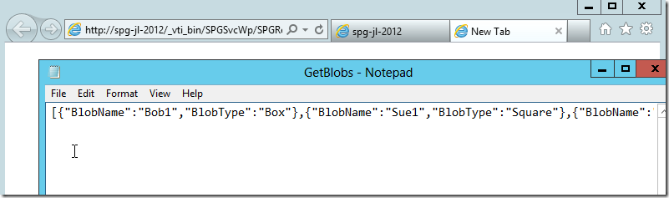
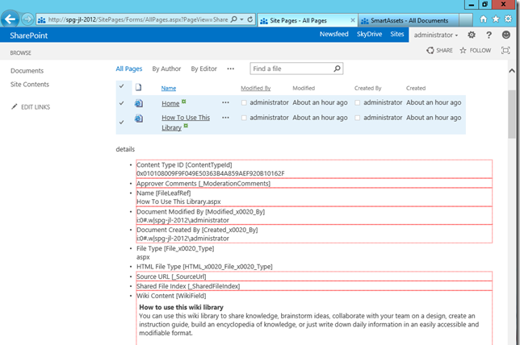
SharePoint 2013

Slide 19
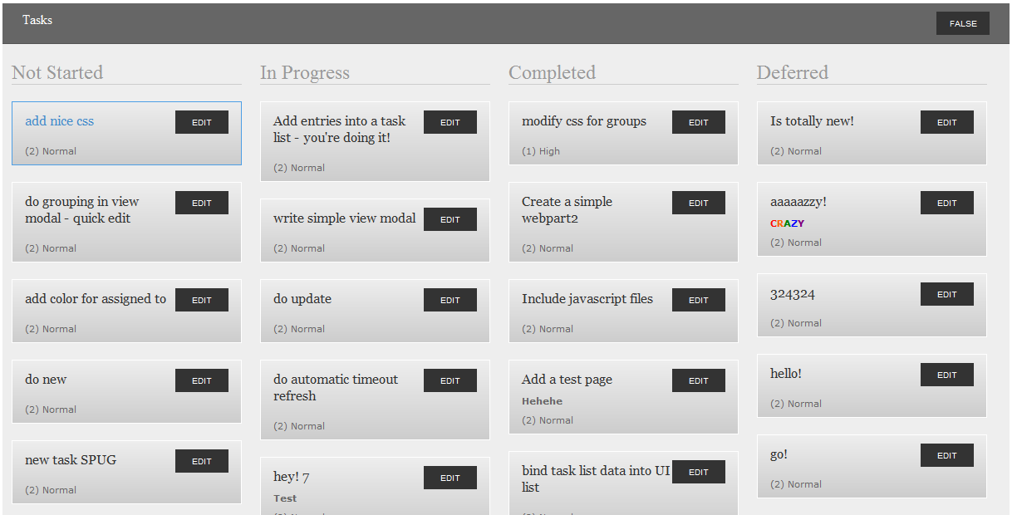

Slide 20
Summary
This is way better than writing webparts :-)
jQuery
REST API (out of the box)
Create SOAP service
Create REST service
Highly responsive websites with jQuery AJAX
Create ADO.NET DataService

Slide 21
Resources
REST and jQuery AJAX
http://blogs.msdn.com/b/sharepointdev/archive/2011/02/22/calling-a-wcf-service-using-jquery-in-sharepoint.aspx
http://www.wictorwilen.se/Post/Calling-a-WCF-Service-using-jQuery-in-SharePoint-the-correct-way.aspx
http://johnliu.net/rest/
Data Service
http://msdn.microsoft.com/en-us/library/dd728279

Slide 22
Help! I'm still on 2007
http://spservices.codeplex.com/
jQuery wrapper around SharePoint 2007 (and 2010) SOAP services
Notably, via JavaScript you can:
  Update item without form
  Start workflow on any item
  Get information from user profile service
  Talk to Search service

Slide 23
John.Liu@SharepointGurus.net
@johnnliu
http://JohnLiu.net

