Slide 1
Planning & Prioritising
calendar (time)
  work commitments, term dates, special events, deadlines
  times away, holidays, date nights, Christmas plans!
  serving commitments, leisure pursuits
    family, friends, church…
budgets (money)
  income, expenditure, savings, investment
    debts, giving/tithing, saving, spending

Slide 2
⁹ I am the gate. If anyone enters by me, he will be saved and will come in and go out and find pasture. ¹⁰ A thief comes only to steal and kill and destroy. I have come so that they may have life and have it in abundance. ¹¹ “I am the good shepherd. The good shepherd lays down his life for the sheep…¹⁴ “I am the good shepherd. I know my own, and my own know me, ¹⁵ just as the Father knows me, and I know the Father. I lay down my life for the sheep. ¹⁶ But I have other sheep that are not from this sheep pen; I must bring them also, and they will listen to my voice. Then there will be one flock, one shepherd.
John 10:9-15 CSB

Slide 3
¹⁴ “I am the good shepherd. I know my own, and my own know me, ¹⁵ just as the Father knows me, and I know the Father. I lay down my life for the sheep. ¹⁶ But I have other sheep that are not from this sheep pen; I must bring them also, and they will listen to my voice. Then there will be one flock, one shepherd.
John 10:9-15 CSB

Slide 4
¹⁶ But I have other sheep that are not from this sheep pen; I must bring them also, and they will listen to my voice. Then there will be one flock, one shepherd.
John 10:9-15 CSB
I have other sheep
I must bring them
There will be one flock

Slide 5


Slide 6


Slide 8
identify
intercede
invest
intentional
invite

Slide 9
identify
Pray first:
Ask God to reveal
who your one ought to be.

Slide 10
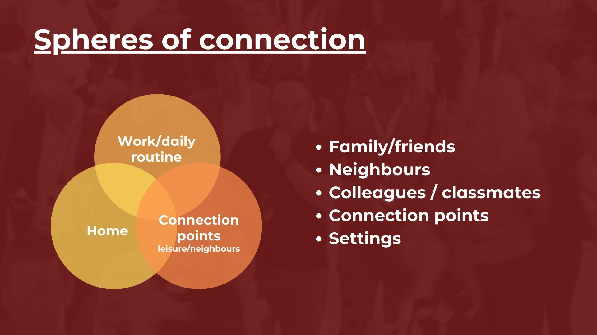
identify

Slide 11
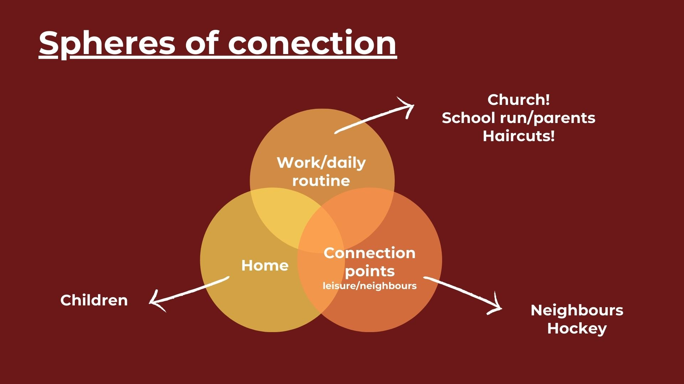
identify

Slide 12


Slide 13
identify
intercede
invest
intentional
invite

Slide 14
⁹ I am the gate. If anyone enters by me, he will be saved and will come in and go out and find pasture. ¹⁰ A thief comes only to steal and kill and destroy. I have come so that they may have life and have it in abundance.
¹⁴ “I am the good shepherd. I know my own, and my own know me, ¹⁵ just as the Father knows me, and I know the Father. I lay down my life for the sheep. ¹⁶ But I have other sheep that are not from this sheep pen; I must bring them also, and they will listen to my voice. Then there will be one flock, one shepherd.
John 10:9-15 CSB

