Slide 1
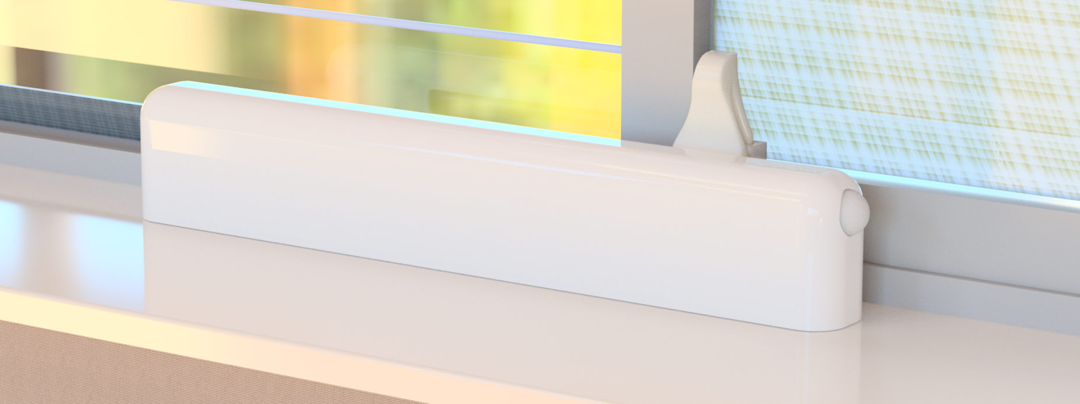
Jesús F. Treviño Daniel E. Treviño
Misael Pérez

Slide 2
Agenda
Team
fenestra overview
What we do & why
Value proposition
fenestra v1.0
Technology details
Business overview
Mission & objective
Competitive overview
Synergies (economic uplift)
Disruptions
Go to market plan
Market size
Beachhead market segment
Kickstarter Campaign
Product development
Key milestones & phases
Test plan
Kickstarter campaign prototypes
Post successful Kickstarter prototypes
Expected CoGS & Pricing (Gross Margin)
Long term product roadmap
Notes:
2

Slide 3
Team
Jesús F. Treviño Founder and CEO Mechanical Engineer, Tecnológico de Monterrey
MBA, Carnegie Mellon University
Directly responsible for production launches in the USA and Mexico for the automotive industry.
Team member for production launches in China for gaming consoles and tablet computers.
Daniel E. Treviño Co-Founder and CTO Software Engineer, Tecnológico de Monterrey
Over 9 years of experience in the embedded software industry working for Qualcomm and Texas Instruments. Have successfully contributed in launching mobile phones to all major U.S. wireless carriers.
Misael Pérez Lead Hardware Engineer
Electronics Engineer, Universidad de Guadalajara
Robotics, Kanazawa Institute of Technology
Over 10 years of experience in design, test and manufacture of consumer electronics ranging from servers and game consoles to wearables.

Slide 4
What we do & why
1. fenestra improves people's health
FACT- The air you breathe inside your home is dirty, in fact, it's 5 to 10 times as dirty as the air outside.
PROBLEM
People would like to open their windows more often to let fresh air in, but are concerned of changing weather, pollen, and/or pollution.
SOLUTION
fenestra understands outdoor weather conditions and automatically opens and closes the windows in your home at precisely the right moments. Fresh air from the outdoors circulates through your home, and flushes out dirty and stuffy air resulting in a healthier indoor environment.
*

Slide 5
What we do & why
2. fenestra saves people money
FACT- People spend 20% of their energy bill cooling their home.
PROBLEM
People would like to open their windows more often to let fresh air in, but are not able to do so because they are not home, awake or even aware when outdoor conditions are just right.
SOLUTION
fenestra automatically opens your windows when outdoor temperature and humidity are ideal. This inflow of cool air from the outdoors helps decreases the use of A/C and can lower your energy bills 10% to 30%.
*

Slide 6
What we do & why
3. fenestra makes life easy
Most people are aware that opening windows in order to let fresh air in is beneficial
PROBLEM
People don’t do it often because it’s inconvenient
SOLUTION
fenestra leverages the latest IoT technology, and transforms the passive home window, into an active and smart component of the home ventilation system.

Slide 7
What we do & why
4. fenestra gives people peace of mind
Most people feel worried about opening their windows and leaving them unsupervised.
PROBLEM
Open windows are considered unsafe.
SOLUTION
fenestra eliminates this worry by using motion sensors which monitor your windows even while open.
At any sign of tampering, fenestra will notify you via your smartphone, will activate numerous alarm actions and immediately close your window.

Slide 8
Value proposition
FOR:
Tech savvy homeowners and parents who value their health, saving money, and sustainability
WHO:
Value the feeling of fresh air but find it inconvenient and risky to open the windows around their home
OUR PRODUCT:
Will revolutionize home ventilation by optimizing the time of day when the windows in a home are open. By tracking real time weather data, air quality, and your desired home temperature, fenestra will seamlessly open your windows at exactly the right time
PROVIDES:
A smart system that will refresh your home, save you energy, and keep your home safe
UNLIKE:
Having to operate and maintain costly air filtration equipment; having to constantly operate your air conditioning; having to open and close your windows manually while looking out for weather changes, and the security of your home.

Slide 9
fenestra v1.0 (MVP)
Device which automates horizontal sliding windows
Two way interaction with your smartphone or tablet via the SmartThings App (iOS & Android)
Battery operated & charged by solar panel
Able to get detailed information on outdoor conditions like weather and air quality by communicating with web API’s
Able to sense indoor temperature, humidity, and react
Self locking, able to sense movement, and react with alarm actions to keep your home safe
Compatible with popular web based services such as IFTTT, Amazon Echo, and Google Home
Simple to install/remove; mounted at the base of the window

Slide 10
Tech Specs
Motor: 6 volt electric motor mechanism with digital encoder.
Sensors: Temperature, humidity, presence, and movement sensors onboard.
Chipset: ATMEL® Microcontroller + Microchip ZigBee® radio module.
Connectivity: Samsung SmartThings®.
Power: High capacity Li-on battery charged by a 6.5 watt solar panel.
Operation: Controlled using any iOS or Android smartphone/tablet via the SmartThings® app.
Control Range (May Vary): 325 feet (100 meters).

Slide 11
Mission & Business objective
Mission
Improve people’s health and help them save energy by automating and keeping safe an integral part of their home.
Business objective
Become the market and technology leader of smart window solutions to both consumers and window OEM’s.
Position fenestra as a brand synonymous with smart window solutions and innovation.

Slide 12
Competitive Overview
 | Technology | Advantages | Disadvantages
Alternatives | Manual Open-Close | No added costs | Not optimal Difficult to execute Safety (un-guarded) May be counterproductive if outdoor weather changes
Substitutes | Indoor air filters | No perceived danger of open windows | Provide no breathable oxygen. Energy consumption (one per room). Noise. Cumbersome. Cost of equipment + replacing filters.
 | Ceiling and floor fans | Immediate relief from feeling heat | Helps heat sensation, but does not cool or replace the air inside homes
Complements | Air quality monitors | Real time monitoring and reporting of indoor air quality | Can’t act on such information. fenestra could act on this information
 | Whole house fans | Very efficient method to use outside cool air to ventilate and cool a home | System is operated using a switch or a timer. Also, needs windows to be open. fenestra could automate windows and bring weather intelligence to the system

Slide 13
Synergies
User interviews and analysis of the competition showed a couple of sectors where fenestra will present synergy opportunities:
Window OEM’s
Current windows are “offline” and Window OEM’s may not want to build in their organizations an IoT/Smart Home team.
fenestra could be the strategic supplier of the hardware and mechanism to automate windows. Also, provide the integration of the window to the SmartThings ecosystem, and other Smart Home platforms.
Indoor air quality (IAQ) monitors
Current IAQ monitors measure and alert the homeowner when IAQ is poor.
fenestra could ACT upon that information and open home windows to improve IAQ.
Whole House Fans (WHF)
Current WHF systems are controlled using a switch or a timer. They depend on cool outdoor air to cool the home. Additionally, the home windows need to be open for the system to operate efficiently.
fenestra could automate windows, bring weather intelligence to the system, and control the fan operation
Home Alarm Systems and Providers
Current alarm systems require all windows to be closed in order to be armed
fenestra could provide a surveillance method for windows, whether the window is closed or open

Slide 14
Disruptions
… the flip side of the coin also exists. In these sectors fenestra can present disruptions:
Indoor air filters and air purifiers
Currently home owners operate air filters/purifiers to clean their indoor air. Most of these work only on individual rooms, are noisy, consume electricity/filters and bring no breathable oxygen into a room.
fenestra not only reduces the need for air filters, it also changes the air and increases the oxygen level inside the home. CO₂ that accumulates indoors does not get filtered out by air filters!
Air Conditioning
Current A/C load needs are calculated using the size of the home and the cooling hours needed.
fenestra will reduce the amount of cooling hours required to make a home comfortable year round. This change will mean smaller A/C units needed at homes in many regions.

Slide 15
Addressable market
30 Million households projected to add Smart Home technology in next 12 months (April, 2016)¹
The amount of households having Smart Home technology will double in size in 2017
56% of households with Smart Home technology plan to add devices to their systems
40% of high income households (>$200K) plan to add Smart Home technology to their homes
Smart Home technology is becoming ever more mainstream. Bed, Bath & Beyond Flyer for Thanksgiving weekend features a cover dedicated to Smart Home Technology.²
1 http://corporate.comcast.com/news-information/news-feed/thirty-million-u-s-households-projected-to-add-smart-home-technology-in-next-12-months
2 http://weekly-ads.us/bed-bath-and-beyond-weekly-ad-11322-715-0
Notes:
15

Slide 16
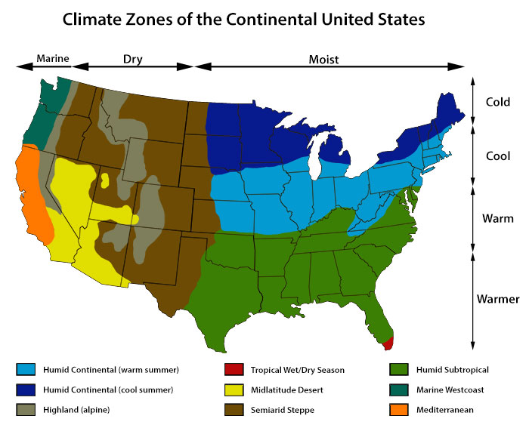
Beachhead market segment (MVS)
Homeowners who:
are concerned about IAQ due to allergies/asthma
like technology and brag about their gadgets
have, or looking to have SmartThings
have, or looking to have a smart thermostat
mainly have horizontal sliding windows in their home
live in target climate zone (highlighted)
are energy conscious / sustainability

Slide 17
Go to market: Kickstarter campaign
Objective
Minimize risk & capital needs by building inventory on pre-orders only
Gather intelligence on the customers response for this technology:
Demographics of project backers
Main concerns, questions, doubts, etc.
Use cases and scenarios
Sales funnel conversion rates
Marketing for fenestra and smart window technology
Finalize development for manufacturing

Slide 18
Product development milestones
 | EPv1 & v2 | EVT | DVT | PVT or 1st Batch | Mass Production
General Objective | Integrate complete package on final design | Plastic tooling w/o finalized cosmetics Try-out brackets from hard tooling / equipment Test plan detail by type Beta units for 3rd party | Final validation test before sellable units Plastic molds final cosmetics Optimizing for CoGS Test plan detail by type Beta units for 3rd party | Full line setup (garage version) Analysis yield, volume, time, rework time... Final QA/QC processes | Sub-Contract Final Assembly & Testing CoGS Optimization
Quantity Prototypes | 1 - 5 | 10 - 15 | 15 - 20 | 500 | +1,000
Notes:
18

Slide 19
Product development test plan
 | EPv1 & v2 | EVT | DVT | PVT or 1st Batch | Mass Production
Mechanicals Assembly | Component packaging Belt mechanism Threaded rod pitches Installation @ Window | Form cosmetics Assembly testing Solar Wiring Harness Installation in different windows Durability testing Full functional testing | Fit & finish cosmetics Final supplier testing and award Assembly time per unit (direct labor) Assembly quality testing | Final implementation engineering changes Full assembly QA/QC | Test components CoGS optimization Full assembly QA/QC
Hardware | Architectural integration testing. Use case scenario validation. | Electrical and thermal verification of analog/digital components. Initial factory testing and programming. | Final electrical design verification, performance and reliability testing. Final factory assembly, programming and test. | Manufacturing stability and process improvements for manufacturing robustness.
Software Firmware | Testing of new hardware/software integration with new PCB. Verify differences in mechanical performance and make changes as needed. | Power consumption optimization development with finalized PCB board. | Monkey and stability testing. Final onboard PCB testing. | Changes derived from QA/QC testing and feedback.
Notes:
19

Slide 20
Product development prototypes
Pre-Kickstarter Campaign
Dev Phase | Timing [Wks.] | Dev Units | Objectives
EPv1 | Current | 1 | Show & Tell
EPv2 | +5 | 4 | Show & Tell – Demo Units Integrated PCB Improved Alarm & Movement Integrated Solar Panel Marketing Campaign

Slide 21
Product development prototypes
Post-Kickstarter Campaign → Production Launch
Dev Phase | Timing [Wks.] | Dev Units | Objectives
EVT | 6 | 10 | Plastic mold tooling w/o finalized cosmetic finish Manufacturing, PCBA, & Mechanism Testing Beta units for ViP 3rd party
DVT | 8 | 15 | Final validation test before sellable units Plastic molds tooling final cosmetic Optimizing for CoGS Beta units for 3rd party
PVT (1st Batch) | 10 | Kickstarter Volume | Full line setup Analysis yield, volume, time, rework time... Final QA/QC processes

Slide 22
Expected CoGS & Pricing
 | EP | EVT | DVT | PVT or 1st Batch | High Volume SWAG
Mechanicals | $260.60 | $65.15 | $65.15 | $60.15 | $54.05
Hardware | $86.24 | $79.61 | $79.61 | $26.29 | $20.34
Total Direct Material | $346.84 | $144.76 | $144.76 | $86.44 | $74.39
Average Selling Price |  |  |  | $175.00 | $165.00
Notes:
22

Slide 23
Long term product roadmap
For fenestra v1.0, we are laser focused: just one just one type of window, on just one Smart Home platform.
Our long term target though, is to have a solution for every type of window and every major platform.
Generation | Description
fenestra v1.0 | Attachment for horizontal sliding windows
fenestra v2.0 | Attachment for vertical sliding windows
fenestra v3.0 | Connectivity on additional platforms (Apple Home Kit – Google Brillo)
fenestra v4.0 | Turn-Key solution for window OEM’s (Pella, Andersen Windows, Milgard…)
Notes:
23

Slide 24
Why fenestra will succeed
smart fenestra is the owner of a patent pending which encompasses the intelligent, safe and efficient operation of a home window
fenestra is the first and only smart window technology which solves indoor air quality problems in a truly eco-friendly way.
fenestra is a clean and easy way to reduce energy use and costs.
Our team has the experience, vision and passion to make fenestra a success.

Slide 25
In Depth Slides

Slide 26
In Depth: Security
User interviews revealed that most people feel worried about opening their windows and leaving them unsupervised.
SmartThings secure wireless communications and back-end
Onboard electronics: loud piezo buzzer + presence (IR Sensor) & movement (Accelerometer) sensors
Homeowner can adjust window opening amount and opt for small opening when away from home
Alarm escalation:
Movement and/or presence triggers audible alarm, closes window, and sends notification
Interference during alarm triggers second alarm, sends emergency notification
Using IFTTT further actions can be taken for second alarm like a direct phone call to homeowner or neighbor
Future development: Integrate with 3rd party security systems and components

Slide 27
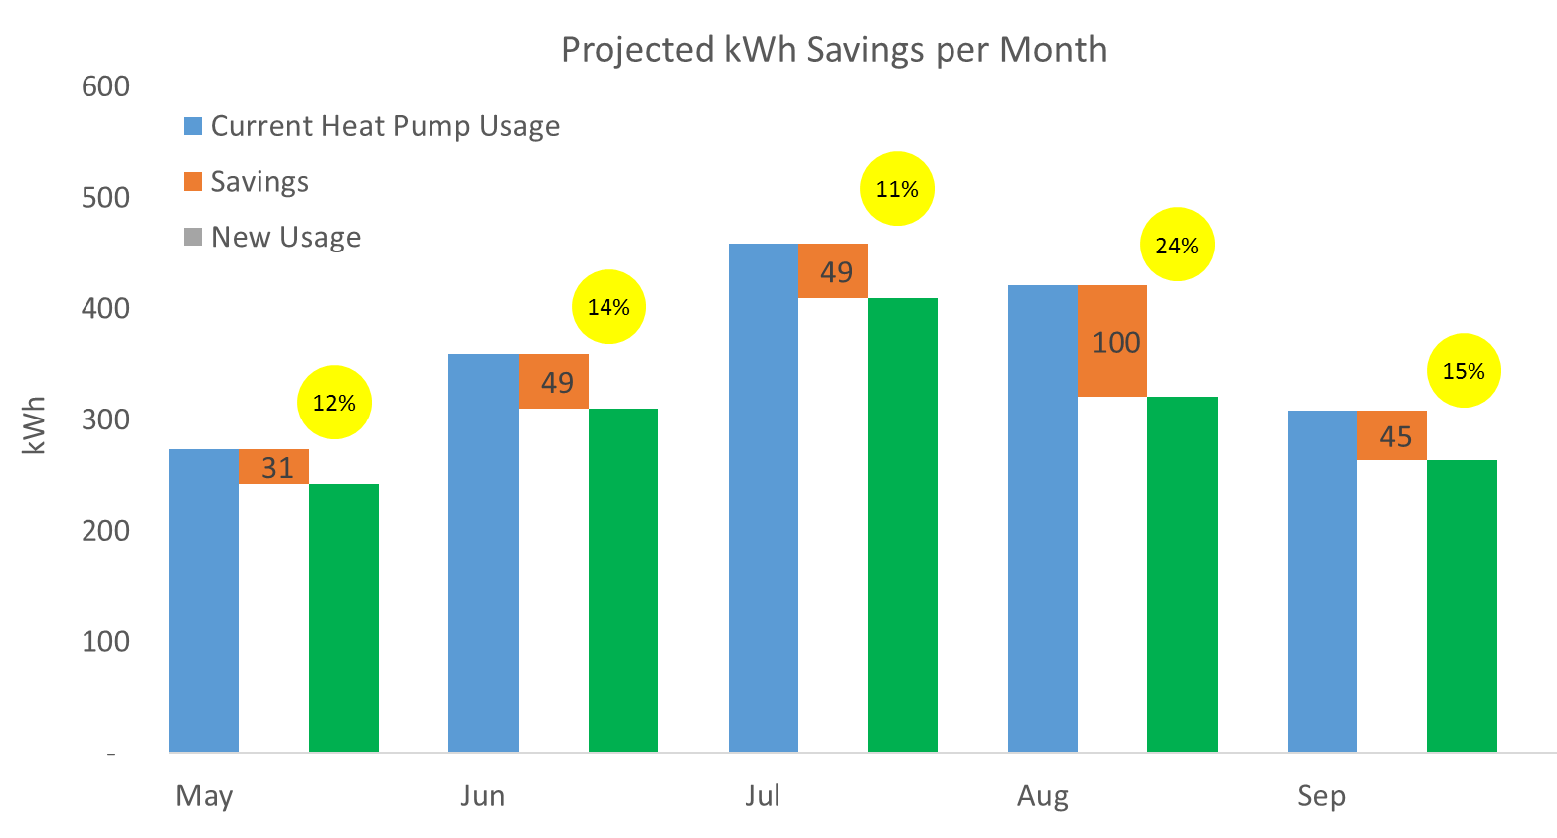
In Depth: A/C energy savings
Analysis of the data from the Net-Zero Energy Residential Test Facility (NZERTF) helped us explore energy saving strategies. Our insights lead us to design an algorithm which operates the home windows based on weather conditions.
The graph shows the amount of energy used for A/C each month, followed by the opportunity our algorithm identified, and finally the projected energy use. The yellow balloons show the percentage savings expected for each month.

Slide 28
In Depth: Safety
User interviews revealed that people feel concerned about their windows moving without notice, while kids and pets are around. Also mentioned were concerns for emergency situations.
Onboard electronics carefully track movement of the window and can detect obstructions. In case of an obstruction, fenestra will reverse its movement to avoid pinching a pet or person and will notify the homeowner.
A quick release mechanism allows the homeowner to open or close the window in case the device has no power or in the event of an emergency.

