Slide 1
Express one quantity as a fraction of another
Grade F/G
Express one quantity as a fraction of another, where the fraction is less than 1 or greater than 1
If you have any questions regarding these resources or come across any errors, please contact
helpful-report@pixl.org.uk

Slide 2
Key Vocabulary
Fraction
Quantity
Units

Slide 3
How to express one quantity as a fraction of another
1) Write 6g as a fraction of 14g.
6
14
Simplify:
3
7

Slide 4
How to express one quantity as a fraction of another
2) Write 5cm as a fraction of a meter.
1 m = 100 cm
5
100
Simplify:
1
20

Slide 5
How to express one quantity as a fraction of another
The number of people visiting a museum reduced from 68 to 42. What fraction did it decrease by?
68
42
Simplify:
34
21
Simplify again by converting to mixed fraction
13
21
1

Slide 6
How to express one quantity as a fraction of another – Now you try …
  Write the first quantity as a fraction of the second
  a) 20 days and 45 days
  b) 30p and £6
  c) 3kg and 200g
  d) 20 minutes and 2 hours
  In a class of 32, 18 pupils are girls. What fraction of the class are boys?
  A car journey took 10 hours to complete. What fraction of the day was spent on the journey?
  The number of trees in a forest increased from 80 to 125 from 2001 to 2016. What fraction had the number of trees increased?

Slide 7
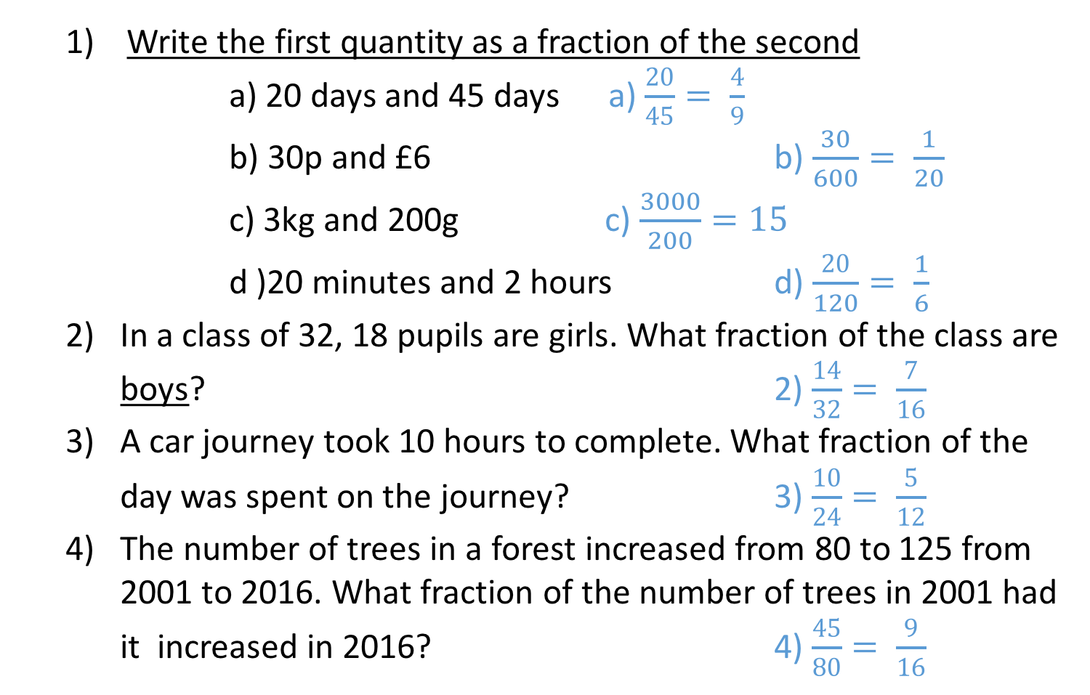
How to express one quantity as a fraction of another – Now you try …
  Write the first quantity as a fraction of the second
  a) 20 days and 45 days a) $\frac{20}{45}= \frac{4}{9}$
  b) 30p and £6 b) $\frac{30}{600}= \frac{1}{20}$
  c) 3kg and 200g c) $\frac{3000}{200}=15$
  d )20 minutes and 2 hours d) $\frac{20}{120}= \frac{1}{6}$
  In a class of 32, 18 pupils are girls. What fraction of the class are boys? 2) $\frac{14}{32}= \frac{7}{16}$
  A car journey took 10 hours to complete. What fraction of the day was spent on the journey? 3) $\frac{10}{24}= \frac{5}{12}$
  The number of trees in a forest increased from 80 to 125 from 2001 to 2016. What fraction of the number of trees in 2001 had it increased in 2016? 4) $\frac{45}{80}= \frac{9}{16}$

Slide 8
Problem Solving and Reasoning
There are 60 pens in a pencil case. Out of these, 32 are blue and 1/4 of the blue pens do not work. What fraction of the pens are blue and do work?
1/4 of the 32 pens = 8 pens are blue and do not work.
32 – 8 = 24 pens are blue and do work.
24
60
Simplify:
2
5

Slide 9
Reason and explain
In which areas of our life would we need this skill?
Prove that 12 as a fraction of 25 is equivalent to 48%.
Ali got 26 marks out of 50 in a maths test. In a science test he scored 11 marks out of 20. In which subject did he achieve a better fraction of marks?

