Slide 1

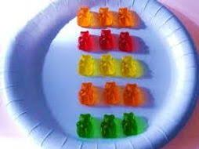
Maths
Understanding and using arrays

Slide 2

An array is an arrangement of objects into rows and columns. It helps us to count them more easily and also helps us to work out multiplication and division problems.
How could we count this array of eggs? What groups can you see?
I can see 5 groups of 2 eggs if I look at each column and I can see 2 groups of 5 when I look along the rows of eggs in the box.

Slide 3






Here are my 5 groups of 2. What calculations does this show me?
It can be written like this!
2 + 2 + 2 + 2 + 2 = 10
Or
5 x 2 = 10

Slide 4







Here are the 2 groups of 5 I can see!
This can be written like this:
5 + 5 = 10
Or
2 x 5 = 10

Slide 5
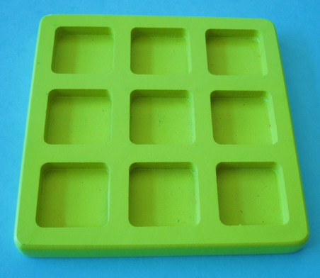

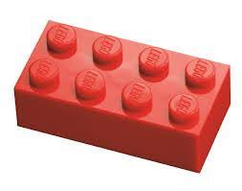

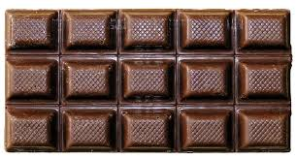
Have a look at these real life arrays and see what groups you can find.

Slide 6
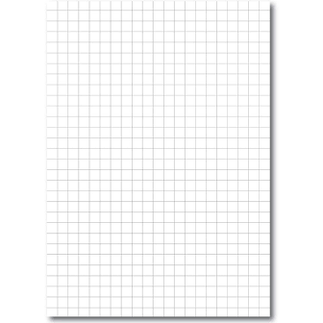
Have a look a this array. What groups can you see? Can you record the repeated addition and multiplication calculations? Remember to draw around the groups to help you see.

Slide 7

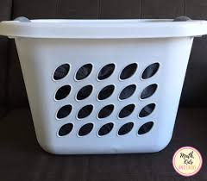
Count in equal groups to find out the total of the array, not in ones!
Your turn!

Slide 8

Your turn!

Slide 9
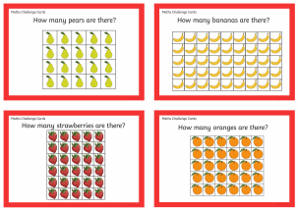
Work through these arrays. Draw the groups you can find and write down the calculations. There should be 2 repeated addition and 2 multiplication calculations for each array

Slide 10
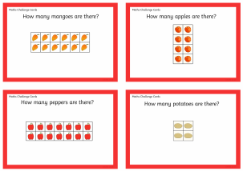
Work through these arrays. Draw the groups you can find and write down the calculations. There should be 2 repeated addition and 2 multiplication calculations for each array

Slide 11
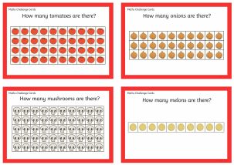
Work through these arrays. Draw the groups you can find and write down the calculations. There should be 2 repeated addition and 2 multiplication calculations for each array

Slide 12

Can you use objects in your house to make your own arrays to match my calculations?
4 x 5 =
3 X 10 =
7 X 2 =
3 X 3 =

