Slide 1
Center for Wooden Boats
2022 State of the Boatshop

Slide 2
2021 - Year in Review
Boats Completed - Cosign Wherries, Whitehall, Midori, Dora, J&H lightning, Kayaks and countless other boats had more hands on them then in years past.
Hours made - Roughly over 2000 hours of signed Volgistics shifts with a fill rate of roughly a 90% fill rate.
Projects Pushed On - NLU seen more and more work and organization, countless sorting of items for 3D scans, auctions, and landmarking progress.

Slide 3
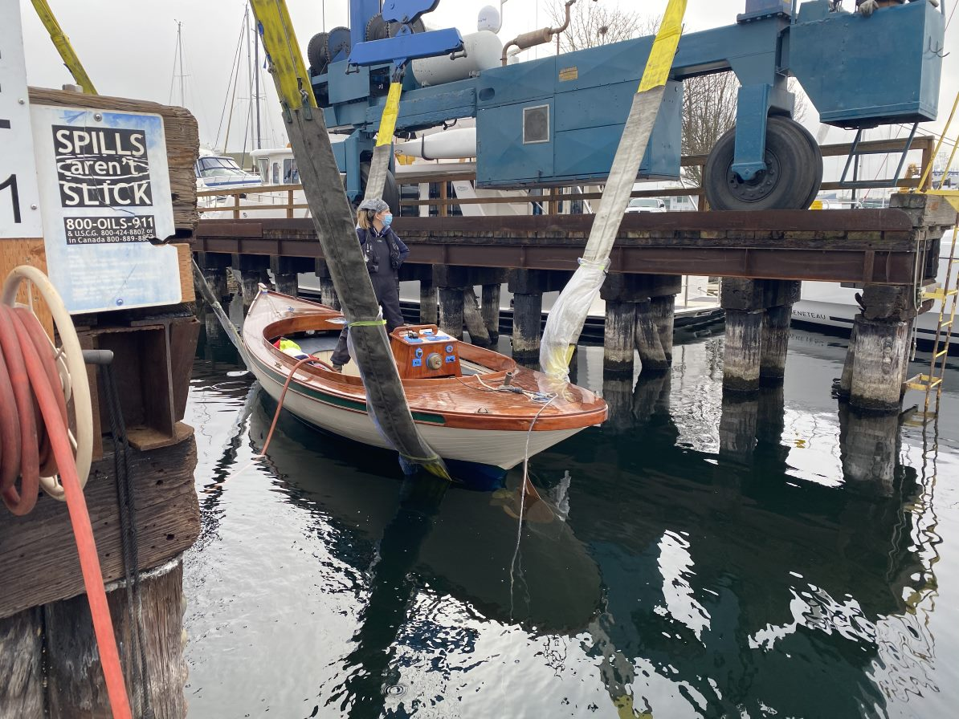
Division of labor in shops
Floating Shop - Mostly paint and minor repairs; projects measured in few days/weeks, traditional vessels. Public/Exhibit space. I-beam Haulouts.
Bill Garden Boathall - Mostly long term restorations and major overhauls; and contemporary boats. Projects measured in months. Class space. Use of ramps and haulouts.
North Lake Union - Long term storage and restoration; Large vessel work on all types of boats. Storage and For Sale staging areas. Indefinite timeframes.

Slide 4
Shop reorganize - Tools
Floating shop has little back stock, lightweight but common tools (full sets of everything still), small sets of paint and chems to match boats in water, and flexibility for when stuff breaks down.
Oarhouse tools set acts an extension of Floating shop with specifics (rig gauges all cotter and riggings pins)
WEC shop space and rooms act as back stock areas, excess storage, etc for SLU based operations.

Slide 5
Shop reorganize - Materials
Follows similar idea to Tools, what we need on the docks, excess on land.
Materials tracking sheets and data:
- Pumps of epoxy and scoops of fillers - Extra wood from stockpiles / non-designated lumber - Grabbing a new gallon of primer/ alcohol for the other shops?
All recorded on sheets near those stations or storage area.
Also for most consumables on a restock bases (not per glove, but per box)

Slide 6
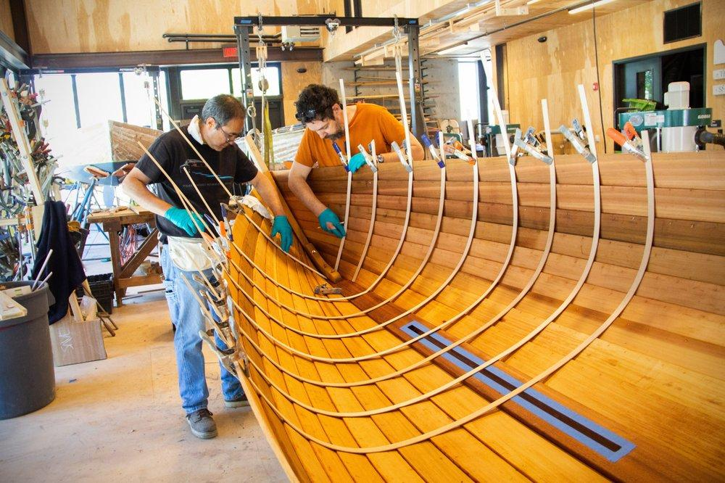
Volunteers in the shop
In coming months, opening the shop up for use of space and tools in exchange for volunteer hours. Another way to use those hours if you don't sail.
That comes with some ability to check off people on tools for both safety and efficiency sakes similar to blue cards.
Expanding classes, and assistant shifts for classes. Great for learning and helping side by side, this allows CWb to do more volume.

Slide 7
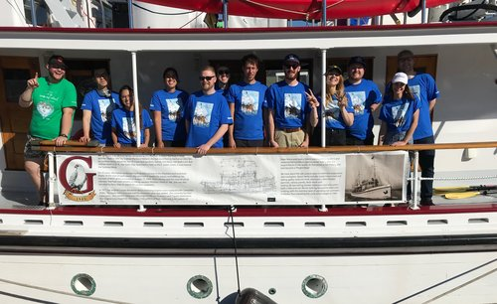
Volunteers on the Docks
New Hull and rig health sheets for identifying boat parts, and problems.
Preventive maintenance and repairs, varnish top offs, and rotating boats in and out of service
Continue and improve best practices for rafting and boat handling to reduce passive damage to boats.

Slide 8
Safety
Updated ear and eye pro as available
Updated and condensed MSDS for all shops, easy to access
Tool lock out for larger tools, especially in event settings, or when applicable.
By keeping stocked supplies, we will be able to do best practices for sanding(dust collection bags), scraping(cleaning up scraps) and any other tasks (end of shift procedures)
Helps keep the shop running smoothly, and for a long time for anyone to enjoy
Increased and more clear signage on procedures for rags, paints, etc.
(resolute fire story)

Slide 9
2022 going forward
3 BJKs at NLU for major restoration and pipeline to get there, with a staying presence for storage and heavier work. Getting these in the water would put us as far ahead as we’ve been in a long time for BJKs
Many Public Sail Boats are in desperate need of work, Katie, Great pelican, and others to be freshened up for the grand return when able.
Mercurys - Hopefully seeing mercury Methabel and others worked on towards late summer for use in heavier winter days.
Adding the capabilities to make our own signage and exhibits boards/running laser engraving ( New Shifts)
Most of all, have fun keeping boats afloat so we can continue sharing this unique place we get to work and be at.

Slide 10
Q & A

