Slide 1
EDGE
A NETWORK FOR MINISTRY DEVELOPMENT
Congregational Assessment Report
Notes:
Good morning everyone

Slide 2
Agenda
Introductions
Overview of The Consultation
Church Has Changed
The Change Curve
Overview
Assessment Report – Lesley
Property Scan – Kris
IMNA - Nancy
Recommendations
Next Steps
Please ask
questions
Notes:
Ad Hoc Property Team
Rev. Helen Prior, Minister
Jennifer Butka, Administrator
Joe Emond, Chair Property
Tom Jefferies, Transition Team member
Don Roberts, Trustee
Joanna Waugh, Chair Finance and Stewardship
Bob Richards - EDGE Missional Consultant
Kris Tavella
Lesley Harrison
I will provide an opening prayer – Helen can I ask you to provide a closing prayer?
Prayer – Oh holy one – we meet today to have a discussion concerning the future of Olivet United Church, a faith community that is now 101 years old. This discussion will go on after today as Olivet United reflects on its history and discerns its future. Later this week they will mourn the death of Jesus the Christ and celebrate his resurrection. Let us all remember that from death, comes life. Death is terrible and birth is difficult. The Olivet community of faith does have a future, but possibly in ways they have yet to dream. They will continue to travel with you. Amen
Feelings?
Has these reports been shared with the congregation?

Slide 3
Church Has Changed
In 1959 four new United Churches each week; in 2000’s one church closes each week
United Church – 2002 to 2012
Membership decline - 26%
Average attendance decline – 38%
Church school decline – 53%
All main stream protestant denominations have declined in Canada since mid-1960’s
You are not alone – it is not your fault
Notes:
You are not alone – it is not just your church that has changed

Slide 4
A Time of Transition - New Questions for a New Day
How do we bring them in?
How do we send them out?
How do we survive?
How do we serve?
What’s our vision and how do we implement it?
What’s God up to and how do we get on board?
What can this church do?
What can we do together?
Notes:
If you ask these questions there is no assurance that you'll find the way to renew, revitalize or redevelop your church. It may happen. But you may just as likely discover that asking these questions takes you down a road to some other alternative that you hadn't even thought of before. What I feel pretty confident about, however, is that asking these new questions will bring us closer to discovering what God is seeking from us in this time. I also believe asking these new questions will help ensure that whatever the future holds for us and our congregations we will be more faithful in the work we are about right now. And that is a pretty wonderous thing!

Slide 5
The Change Curve
DENIAL
2
HEALING
SHOCK
ANGER OR BLAME
7
1
3
BARGAINING
AND SELF-BLAME
Morale, energy and performance
4
6
ACCEPTANCE
5
DEPRESSION AND CONFUSION
Time
Notes:
Based on Elisabeth-Kubler-Ross’s 5 stages of grief –
As a congregation you will go through this – the pace will vary by individual – you as a team will go though it at different rates

Slide 6
Attitude to Change
Attitude to change – (as highlighted in the IMNA Survey)
Because many of the respondents (80%) see experimentation and change as a positive factor in your church’s life, there is a strong basis to continue the conversation about changes necessary to help people understand adaptive and cultural change.
And yet for the majority of the congregation who believe that it is not the time for institutions to fade and new things to emerge, the challenge will be to remain as you are and find ways to be in dialogue with the wider culture.

Slide 7
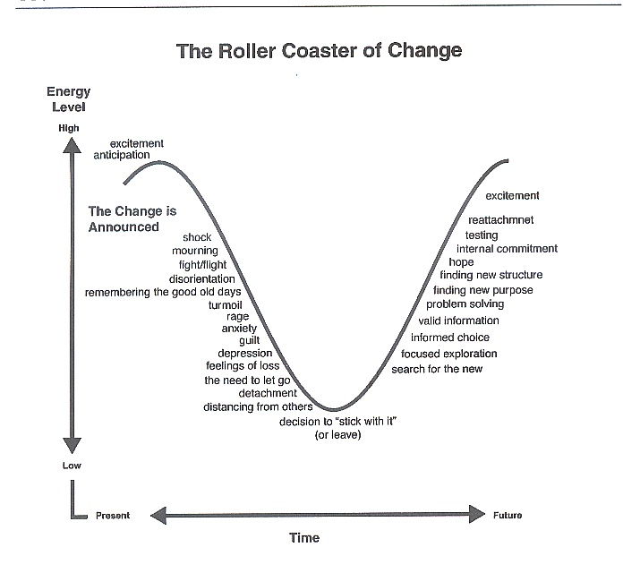
Notes:
Explain rollercoaster ride of change theory
In times of change there is an initial response (positive or negative) that generates energy to carry the body up the slope. But then momentum takes over and there is the reality and fear and shock of uncontrollably heading down the ‘hill’. *This is our time of grief, loss, honouring what was.
After heading down the emotional ride, we reach a point where we ask ourselves whether to stick with it or leave. The right hand side of the graph is another uphill climb – a chance to rebuild, reattach, hope and dream. It represents the future actions.
Some Observations:
*Often when people deal with change, many different emotions surface and it is important to acknowledge and give heed to why and what they can tell us.
*Trying to pull people from one side of the chart to the other is a persuasive strategy and this engenders resistance. Leading Change in the Congregation: Spiritual and Organizational Tools for Leaders, pg. 119. by Gilbert Rendel
*Responding to feelings by speaking reasons more slowly and clearly does not work either.
So we look to creating a place within our ministries for us to share our stories and experiences around change and honour those varied feelings. This is one such tool

Slide 8
Double Loop Theory
Peaking
Long Range Visioning
7) Embodying/
Performing
Hospicing
1)Initiating
(Attentive)
Stewarding
Composting
6) Illuminating (Prototyping)
2) De-framing & Listening to “All My Relations”
5) Connecting (Letting-Come)
3) Networking
(Listening with the Heart & Letting Go)
4 Connecting / (Presencing)

Slide 9
Congregation Assessment Report
The Congregation Assessment Report for St. Paul’s United Church is based on the following information sources:
St. Paul’s UC EDGE Property Scan (November 1, 2016)
St. Paul’s IMNA Survey Results (Follow-up Report Feb. 2017)
St. Paul’s Community Round Table (March 2017)

Slide 10
Missional Analysis
According to the IMNA survey data, half of the respondents acknowledge that you either have a mission (a call of your congregation to engage in God’s work) or are working on setting priorities and defining the mission of the congregation
As you work to further define your missional approach, engaging the congregation in feedback and input will be important as you have a high level of connection, interest and participation in the decision-making and strong opportunity for good communication (as indicated by the 83% of respondents who attend your Annual General Meeting).

Slide 11
Missional Analysis
Ideal Church - (as highlighted in the IMNA survey) :
Currently your congregation places emphasis on creating a space of belonging and teaching people how to act and live (behave) but with less emphasis on believing. This indicates that your emphasis is on creating a culture of hospitality and belonging which invites people to bring their own beliefs and questions.

Slide 12
Missional Analysis
Ideal Church - (as highlighted in the IMNA survey) :
a place which is inviting and welcoming, where people are offered support and compassion on life’s journey.
The input and contribution of people of all ages is valued and the ideas and lives of all are respected (regardless of sexual orientation, race, culture, etc.).
a place that reaches out to others in community but also focuses on the inner growth and development of individual’s spiritual growth.

Slide 13
Missional Analysis
General Priorities – (as identified in the IMNA):
increase the number of children and adults
Increase the faith development of children, youth and adults

Slide 14
Missional Analysis
Leadership/Governance – (as indicated by the IMNA data):
The data indicates that the church is fairly strong in the areas of recruitment and training of leaders
Going forward however a strategy for preventing burnout and the adoption of a suitable structure of governance could become more of a focus as the congregation ages and often more responsibility falls to fewer folks to carry it out.

Slide 15
Missional Analysis
Worship:
The traditional components of worship are emphasized consistently and valued with less interest in using technology and/or having lay leaders participate in worship.
Although music is “accessible” to all age groups, more up-to-date music to engage the youth might be an opportunity for growth.

Slide 16
Missional Analysis
Community involvement –
People’s connection to St. Paul’s United Church is stronger (55%) than their Involvement in church (34). But their involvement in groups beyond the church is double (68%) to that which people shared as their involvement in the church.
This indicates a high level of community involvement as a basis to leverage relationships

Slide 17
Missional Analysis
Community Round Table:
At your Community Round Table, recommendations to collaborate with other churches around wider community causes like poverty, refugee resettlement and food security are areas to which energy could be directed.

Slide 18
Property Development
KEY: High probability of success 76% (further research suggested)
The EDGE Property Scan investigated:
the zoning considerations needed to facilitate a higher density multi-residential development than currently allowed
the marketability of housing in the church neighbourhood
the local housing market demand and prices, and
the relative attractiveness of the church based on size and shape of its property
The report concludes there is a high probability for successful development of the property however more research and due diligence is required before taking concrete steps.

Slide 19
Missional Recommendations
1. Table Talk Conversations
This is a 6-8 week, congregationally led process, initiated as an open invitation to congregational members following worship.
Each week 2-3 questions (pre-prepared by EDGE and reflective of the IMNA information specific to your congregation and your missional possibilities) are put out on each table.
A recorder is elected to be present at each table to ensure the conversation and information is gathered.

Slide 20
Recommendations
2. Vision Day
This event is for the congregation. The Vision Day is designed to help shift the culture and lenses of the congregation by seeding imagination and generating hope and excitement about the new missional opportunities God is inviting us into

Slide 21
Recommendations
4. Consulting Sessions (5x2 hour)
EDGE Consulting Sessions may take place in person, or in many cases will also draw on EDGE web-video conferencing technology to maximize the effective use of consultation time. We are recommending 5x 2hour sessions with your consultant in order to:
Foster the continued development of missional leadership capacity
Continue to explore ways of shifting to a missional, adaptive congregational culture
Continue to work on mission by designing strategies and clarifying implementation
Explore or move forward conversations with partners / partnerships that engage the congregations missional strategies and directions
Consider the EDGE property process in relationship to the congregational mission direction and any partnership conversations

Slide 22
Property Recommendations
Explore Property Development (with Assistance from EDGE)
EDGE recommends the further investigation of this development opportunity and wants to remind you that we will happily assist throughout this process.
Generally, development is undertaken through a non-participatory partnership in which the congregation leases or sells their property to a developer which then takes the risk and responsibility for developing and managing the project.
Clearly, an overall financial strategy is required. Recognizing that our property is our greatest asset we need to explore possible future uses for this asset by utilizing means congruent with our discerned spiritual directions.

Slide 23
Next Steps
Discuss and assess further your Congregational Assessment Report
Consider both the Missional and the Property Recommendations
Engage conversation with your Presbytery/Brian McFadyen regarding further process and grant funding with EDGE: brian@mc2solutions.ca
Contact Lesley (EDGE Consultant/Coach Coordinator) at lharrison@confmnwo.mb.ca

